Slide 1
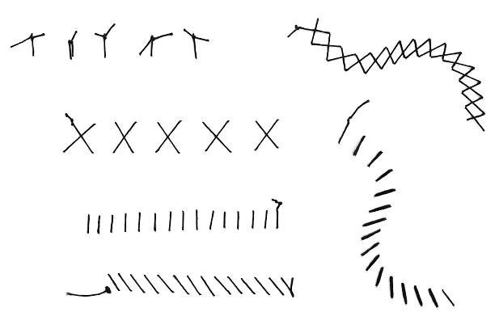
Laceration and
Wound care
101
Dr. Amy Sikes
October 2023

Slide 2
Goals and Objectives
At the end of this presentation, the learner should appreciate the following:
Wound evaluation for suture repair or referral to specialist
Timing for laceration/wound repair
Tools for laceration/wound repair
Wound Care and Follow-up
Goal for laceration repair
Notes:
Please note – appreciation, not proficiency! But everyone will leave with a tools to practice at home and recommendations for further education on suturing.

Slide 3
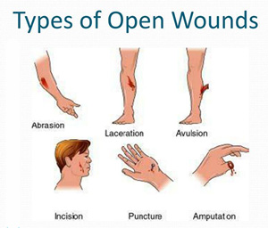
Wound Evaluation
Mechanism and timing of injury
Tetanus immunization status
Foreign body present
Extent of wound
Review allergies
Cosmetic significance
Notes:
Things to ask yourself:
- Was the Injury blunt, abrading, crush, lacerating, tearing?
Tetanus: My rule of thumb – if greater than 2 years, give it. CDC recommendations are 5 yrs. But I have not encountered once patient who presents for a laceration that can tell me when they last received a Tdap.
Foreign body: If concerned – GET AN XRAY … example of retained dog tooth
Extent of wound –depth, length; is there a neurovascular or tendon injury

Slide 4
SHOULD I SEW OR SHOULD THEY GO?
EVALUATION TO TREAT OR REFER
LACERATIONS FOR ER EVALUATION:
Extensive or deep lacerations/puncture wounds/animal bites that involve muscle, tendon or fascia (including hands)
Neurovascular compromise
Fracture, amputation or joint involvement
Severe contamination
Area where there is significant tissue loss
Lip lacerations that cross the vermillion border or facial lacerations to ensure optimal cosmetic outcomes
  Eyelid/orbital lacerations
  Some ear lacerations
Notes:
One thing I do want to point out with regarding to wounds you should be able to care for is YOUR EXPERIENCE AND ABILITY TO MONITOR WOUND – EITHER IN YOUR COMMUNITY OR CLINIC SETTING.

Slide 5
Which wounds should NOT be sutured?
Animal bites – unless on face
Human bites
Lacerations older than 24 hrs (unless on face)
Lacerations overlying infected tissue
Deep puncture wounds

Slide 6
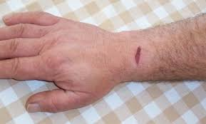
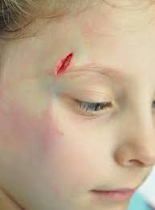
WOUNDS YOU SHOULD BE ABLE TO CARE FOR:
Abrasions/Road Rash
Skin tears
Human/Animal bites
Lacerations on:
  Face
  Trunk
  Extremities
Notes:
I consider wounds that can be cared for in the primary care or urgent care setting to be SIMPLE LACERATIONS - this is a laceration through the skin and subcutaneous tissue only, without injury to underlying structures such as major fascial compartments, nerves, tendons. Remember – If there is injury to underlying structures, this needs to be referred to the ER for a surgical/subspecialty evaluation.
One thing I do want to point out with regarding to wounds you should be able to care for is YOUR EXPERIENCE AND ABILITY TO MONITOR WOUND – EITHER IN YOUR COMMUNITY OR CLINIC SETTING.

Slide 7

What is the goal of laceration repair?
Achieve hemostasis
Avoid infection
Restore function to the involved tissues
Achieve optimal cosmetic results with minimal scarring

Slide 8

Laceration
Repair
Timing
PRIMARY CLOSURE – SUTURE, STAPLES, TISSUE ADHESIVE, ADHESIVE STRIPS
12-18 Hours – caused by clean/sharp objects
Up to 24 Hours – Wounds of head and neck
SECONDARY INTENTION
Presenting after the times above
Contaminated wounds
Deep stab/puncture wounds
Non-cosmetic animal bites
Notes:
One more thing to consider in your initial evaluation is timing of laceration repair from actual injury AND type of healing based upon this.
12-18 hrs: Wounds caused by clean, sharp objects – think of someone cutting vegetables in the kitchen and cut their hand or a laceration caused by tin or glass.
Secondary Intention: open wounds that are left to heal from the base up

Slide 9
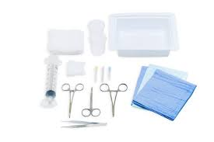
TOOLS OF
THE TRADE
Suture appropriate for location (see handout)
Lidocaine – syringe, 18g needle to draw, 23g needle to infiltrate area
Saline/Flushes
4x4 pads
Needle Drivers
Forceps
Scissors
Notes:
Some clinics have premade suture kits that include most, if not all, of the items in the checklist. If you are working somewhere that doesn't I have provided you a list of items you will need to pull.

Slide 10
Time to Get it Done!
Wound has been evaluated
Pain medication given
Tdap given (if indicated)
Digital, local or regional anesthetic
Wound/laceration irrigated
Wound explored
It's SUTURE TIME … what do I do?

Slide 11
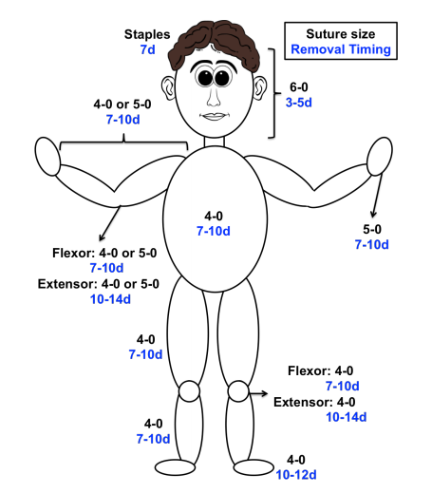
Suture size?

Slide 12
Technique | Recommendations
Simple Interrupted | Tissue approximation; can be used for most wounds
Simple Running | LONG lacerations; all sutures lost if one is accidentally cut
Horizontal Mattress Suture | Everting wound edges; can cause necrosis/scarring
Vertical Mattress Suture | Most effective for everting wound edges; can cause necrosis/scarring
Half-buried Mattress Suture | Triangular wound edges – FLAP repair
Staples | Fast; Unclean wounds; Avoid in cosmetic concern areas
Adhesive Strips | Fast, no anesthesia required; approximate simple/small lacerations – low tensile areas with no bleeding
Tissue Adhesive | Fast, no anesthesia required; approximate small/ simple lacerations – low tensile areas with no bleeding
Notes:
How do you choose which closure technique is best?
Tissue adhesives can be applied more quickly, require no anesthesia, and eliminate the need for follow-up because they slough off spontaneously within five to 10 days. They form a protective barrier to promote wound healing and may have antimicrobial effects.18 Although tissue adhesives have a higher direct cost per unit than sutures, they are more cost-effective because of quick application and no follow-up.19 Tissue adhesives' low tensile strength makes them inappropriate for high-tension areas, such as over joints, unless the area is immobilized. They may be ideal for simple lacerations under a cast or splint.

Slide 13
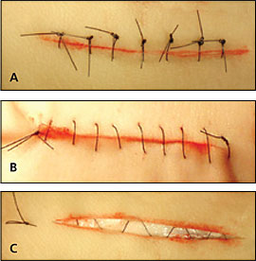
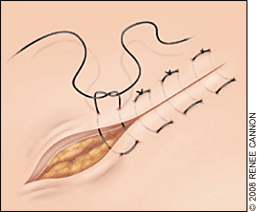
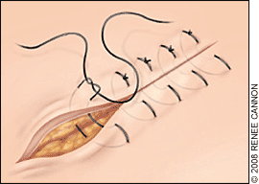
Types of Basic Suture
Notes:
Most wounds can be closed effectively with nonabsorbable, single interrupted sutures.
A running (“baseball”) suture is used for long, low-tension wounds, whereas a subcuticular running suture is ideal for closing small lacerations in low skin-tension areas where cosmesis is important, such as on the face.
The horizontal mattress technique may be the best option for closing gaping or high-tension wounds or wounds on fragile skin because it spreads the tension along the wound edge. The vertical mattress technique is best for everting wound edges in areas that tend to invert, such as the posterior neck or concave skin surfaces

Slide 14
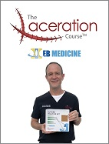
How do I know what to do?
PRACTICE
PRACTICE
PRACTICE
Notes:
https://www.youtube.com/watch?v=ld14-8Tq6a0
https://www.youtube.com/watch?v=NnKdmjX5pWU
https://lacerationrepair.com/techniques/
The Laceration Course – is a good one. I took it last year through EB Medicine. Cost is around $300 – well worth it – PLUS CME!

Slide 15
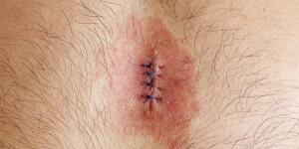
FOLLOW-UP
Antibiotics
Laceration/Suture care
When to return for suture removal
Discharge instructions
  Warning signs
    Redness
    Pus
    Fever
    Increased pain
Notes:
1. Redness
2. Pus
3. Fever
4. Increased pain

Slide 16

Skin tears – how do you treat these
Bandaging and ointments
Where is the best place to start in a laceration repair?
Use of a stapler
Notes:
Skin tears: Most can be tacked down with a one or two sutures; apply a petrolatum gauze and bandage. These need to be evaluated every 3-4 days.
Bandage: I usually have nursing staff apply triple antibiotic ointment and a non-stick bandage over sutures. You can counsel your patient as these are being applied on what to do at home.

Slide 17


THANK YOU!

Slide 18
References
Wound center treatment: Foot doctor Edison, NJ 08837 and South Amboy, NJ 08879. Wound Center Treatment | Foot Doctor Edison, NJ 08837 and South Amboy, NJ 08879. (n.d.). https://www.favorfootandwound.com/specialties/wound-center
Laceration repair and sutures – a cheat sheet guide. ALiEM Cards. (n.d.). https://aliemcards.com/cards/laceration-repair-suture-material/
Nice threads: a guide to suture choice in the ED - CanadiEM. (2015, February 5). CanadiEM. https://canadiem.org/nice-threads-guide-suture-choice-ed/
Forsch, R. T. (2017, May 15). Laceration Repair: A Practical approach. AAFP. https://www.aafp.org/pubs/afp/issues/2017/0515/p628.html
Forsch, R. T. (2008, October 15). Essentials of skin laceration repair. AAFP. https://www.aafp.org/pubs/afp/issues/2008/1015/p945.html#follow-up-care-and-billing

