Slide 1


Utilizing the Social Vulnerability Index to Analyze Statewide Health Disparities in Cholecystectomies
Habib Abla, MS; Reagan A. Collins, BA; Chathurika S. Dhanasekara, MBBS, PhD; Kripa Shrestha, MBBS, MPH, MS; Sharmila Dissanaike, MD
1ST ANNUAL
WEST TEXAS HEALTH DISPARITIES
RESEARCH SYMPOSIUM

Slide 2
1ST ANNUAL
WEST TEXAS HEALTH DISPARITIES
RESEARCH SYMPOSIUM
DISCLOSURES
We have no conflicts of interest to declare

Slide 3



1ST ANNUAL
WEST TEXAS HEALTH DISPARITIES
RESEARCH SYMPOSIUM
INTRODUCTION
  White adult patients are more likely to undergo surgery than black adult patients¹
  Black patients have higher operative mortality risks across numerous procedures²
  Patients with a lower socioeconomic status are at risk for increased operative mortality³

Slide 4
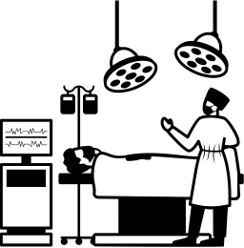


1ST ANNUAL
WEST TEXAS HEALTH DISPARITIES
RESEARCH SYMPOSIUM
INTRODUCTION
In 2010, emergency general surgery (EGS) accounted for 7.1% of all hospitalizations⁴
Cholecystectomies are one of the most common EGS procedures with 1.2 million done annually
In cholecystectomies, non-white patients had significantly longer lengths of stay and increased total hospital charges compared to white patients⁵

Slide 5
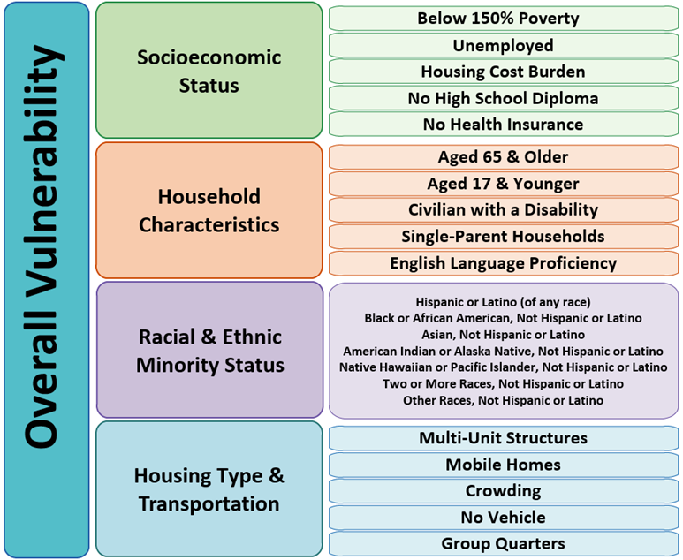
1ST ANNUAL
WEST TEXAS HEALTH DISPARITIES
RESEARCH SYMPOSIUM
SOCIAL VULNERABILITY INDEX
The Social Vulnerability Index (SVI) was originally used by the CDC to prepare for and respond to natural disasters, disease outbreaks, or chemical spills
It is readily accessible, updated every two years, available at a relatively discrete geographic level, and subdivided into multiple categories

Slide 6
1ST ANNUAL
WEST TEXAS HEALTH DISPARITIES
RESEARCH SYMPOSIUM
METHODS
Combined Texas Hospital Inpatient Discharge Public Use Data File and Texas Outpatient Surgical and Radiological Procedure Data Public Use Data File from 2016-2019
Stratified patients into SVI quartiles:
  Lowest quartile as low vulnerability
  Middle two as average vulnerability
  Highest as high vulnerability
Statistical analysis included the Wilcoxon rank sum, t-test, and χ²
Relative risk of undergoing surgery was calculated with subgroup sensitivity analysis

Slide 7



1ST ANNUAL
WEST TEXAS HEALTH DISPARITIES
RESEARCH SYMPOSIUM
RESULTS
Higher proportions of White patients received cholecystectomies
Non-Hispanic patients received cholecystectomy at higher proportions
Individuals with private insurance were more likely to undergo a cholecystectomy
Urban residents underwent surgery in higher proportions

Slide 8



1ST ANNUAL
WEST TEXAS HEALTH DISPARITIES
RESEARCH SYMPOSIUM
RESULTS
Low vulnerability SVI groups were 21% more likely to undergo cholecystectomy (RR: 1.21, 95%CI 1.18-1.24)
High vulnerability SVI groups were 9% less likely to undergo cholecystectomy (RR: 0.91, 95%CI 0.88-0.93)
Differences between average and high vulnerability groups diminished in an emergency setting

Slide 9
1ST ANNUAL
WEST TEXAS HEALTH DISPARITIES
RESEARCH SYMPOSIUM
CONCLUSIONS
Patients with higher SVI were less likely to receive an elective cholecystectomy
These differences diminished in an emergency setting
SVI is a more sensitive method of identifying social determinants impacting health than age, sex, ethnicity, and insurance status, alone

Slide 10
1ST ANNUAL
WEST TEXAS HEALTH DISPARITIES
RESEARCH SYMPOSIUM
REFERENCES
Best MJ, McFarland EG, Thakkar SC, Srikumaran U. Racial disparities in the use of surgical procedures in the us. JAMA Surg. 2021;156(3):274-281.
Lucas FL, Stukel TA, Morris AM, Siewers AE, Birkmeyer JD. Race and surgical mortality in the United States. Ann Surg. 2006;243(2):281-286.
Bennett KM, Scarborough JE, Pappas TN, Kepler TB. Patient socioeconomic status is an independent predictor of operative mortality. Ann Surg. 2010;252(3):552-557; discussion 557-558.
Gale SC, Shafi S, Dombrovskiy VY, Arumugam D, Crystal JS. The public health burden of emergency general surgery in the United States: A 10-year analysis of the Nationwide Inpatient Sample--2001 to 2010. J Trauma Acute Care Surg. 2014;77(2):202-208
Gahagan JV, Hanna MH, Whealon MD, et al. Racial disparities in access and outcomes of cholecystectomy in the united states. Am Surg. 2016;82(10):921-925.

