Slide 1



Structure & Execution of the Rural Student Health Sciences Mentorship Program (RSHSMP)
Asher K. George, MPH
1ST ANNUAL
WEST TEXAS HEALTH DISPARITIES
RESEARCH SYMPOSIUM

Slide 2
1ST ANNUAL
WEST TEXAS HEALTH DISPARITIES
RESEARCH SYMPOSIUM
DISCLOSURES
Nothing to Disclose

Slide 3
1ST ANNUAL
WEST TEXAS HEALTH DISPARITIES
RESEARCH SYMPOSIUM
Purpose of RSHSMP
Mission Statement: To build fruitful mentoring relationships between medical students and rural high school students interested in medicine and improving health outcomes in their local communities
Vision Statement: To empower rural students to see their potential as future physicians in their hometowns

Slide 4
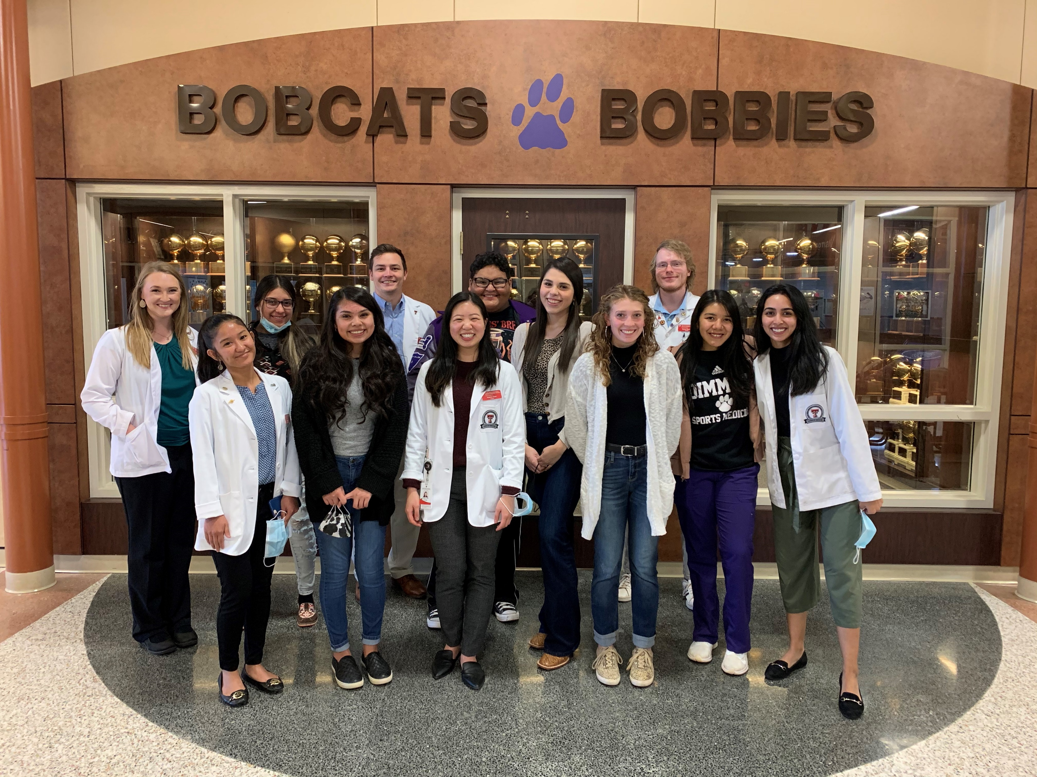
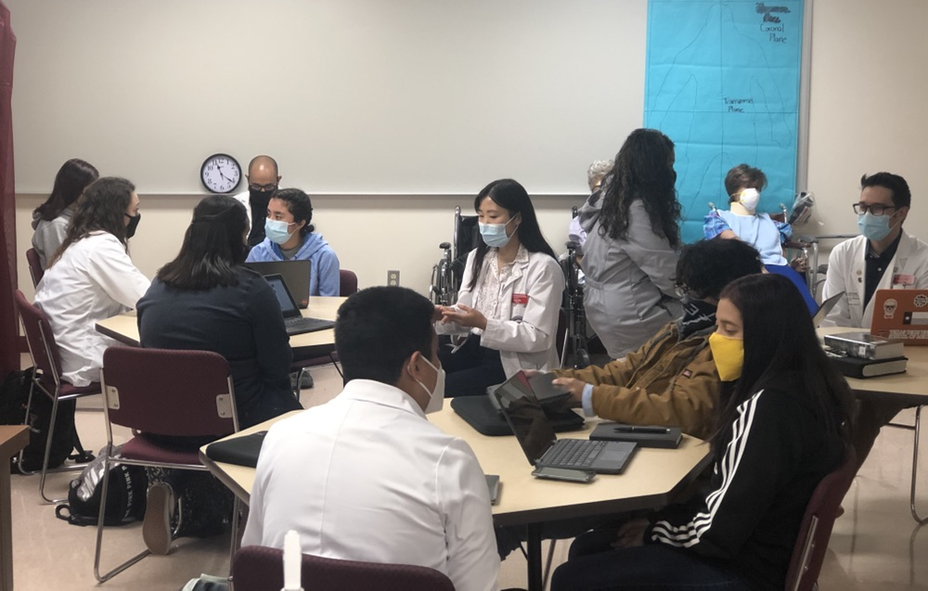
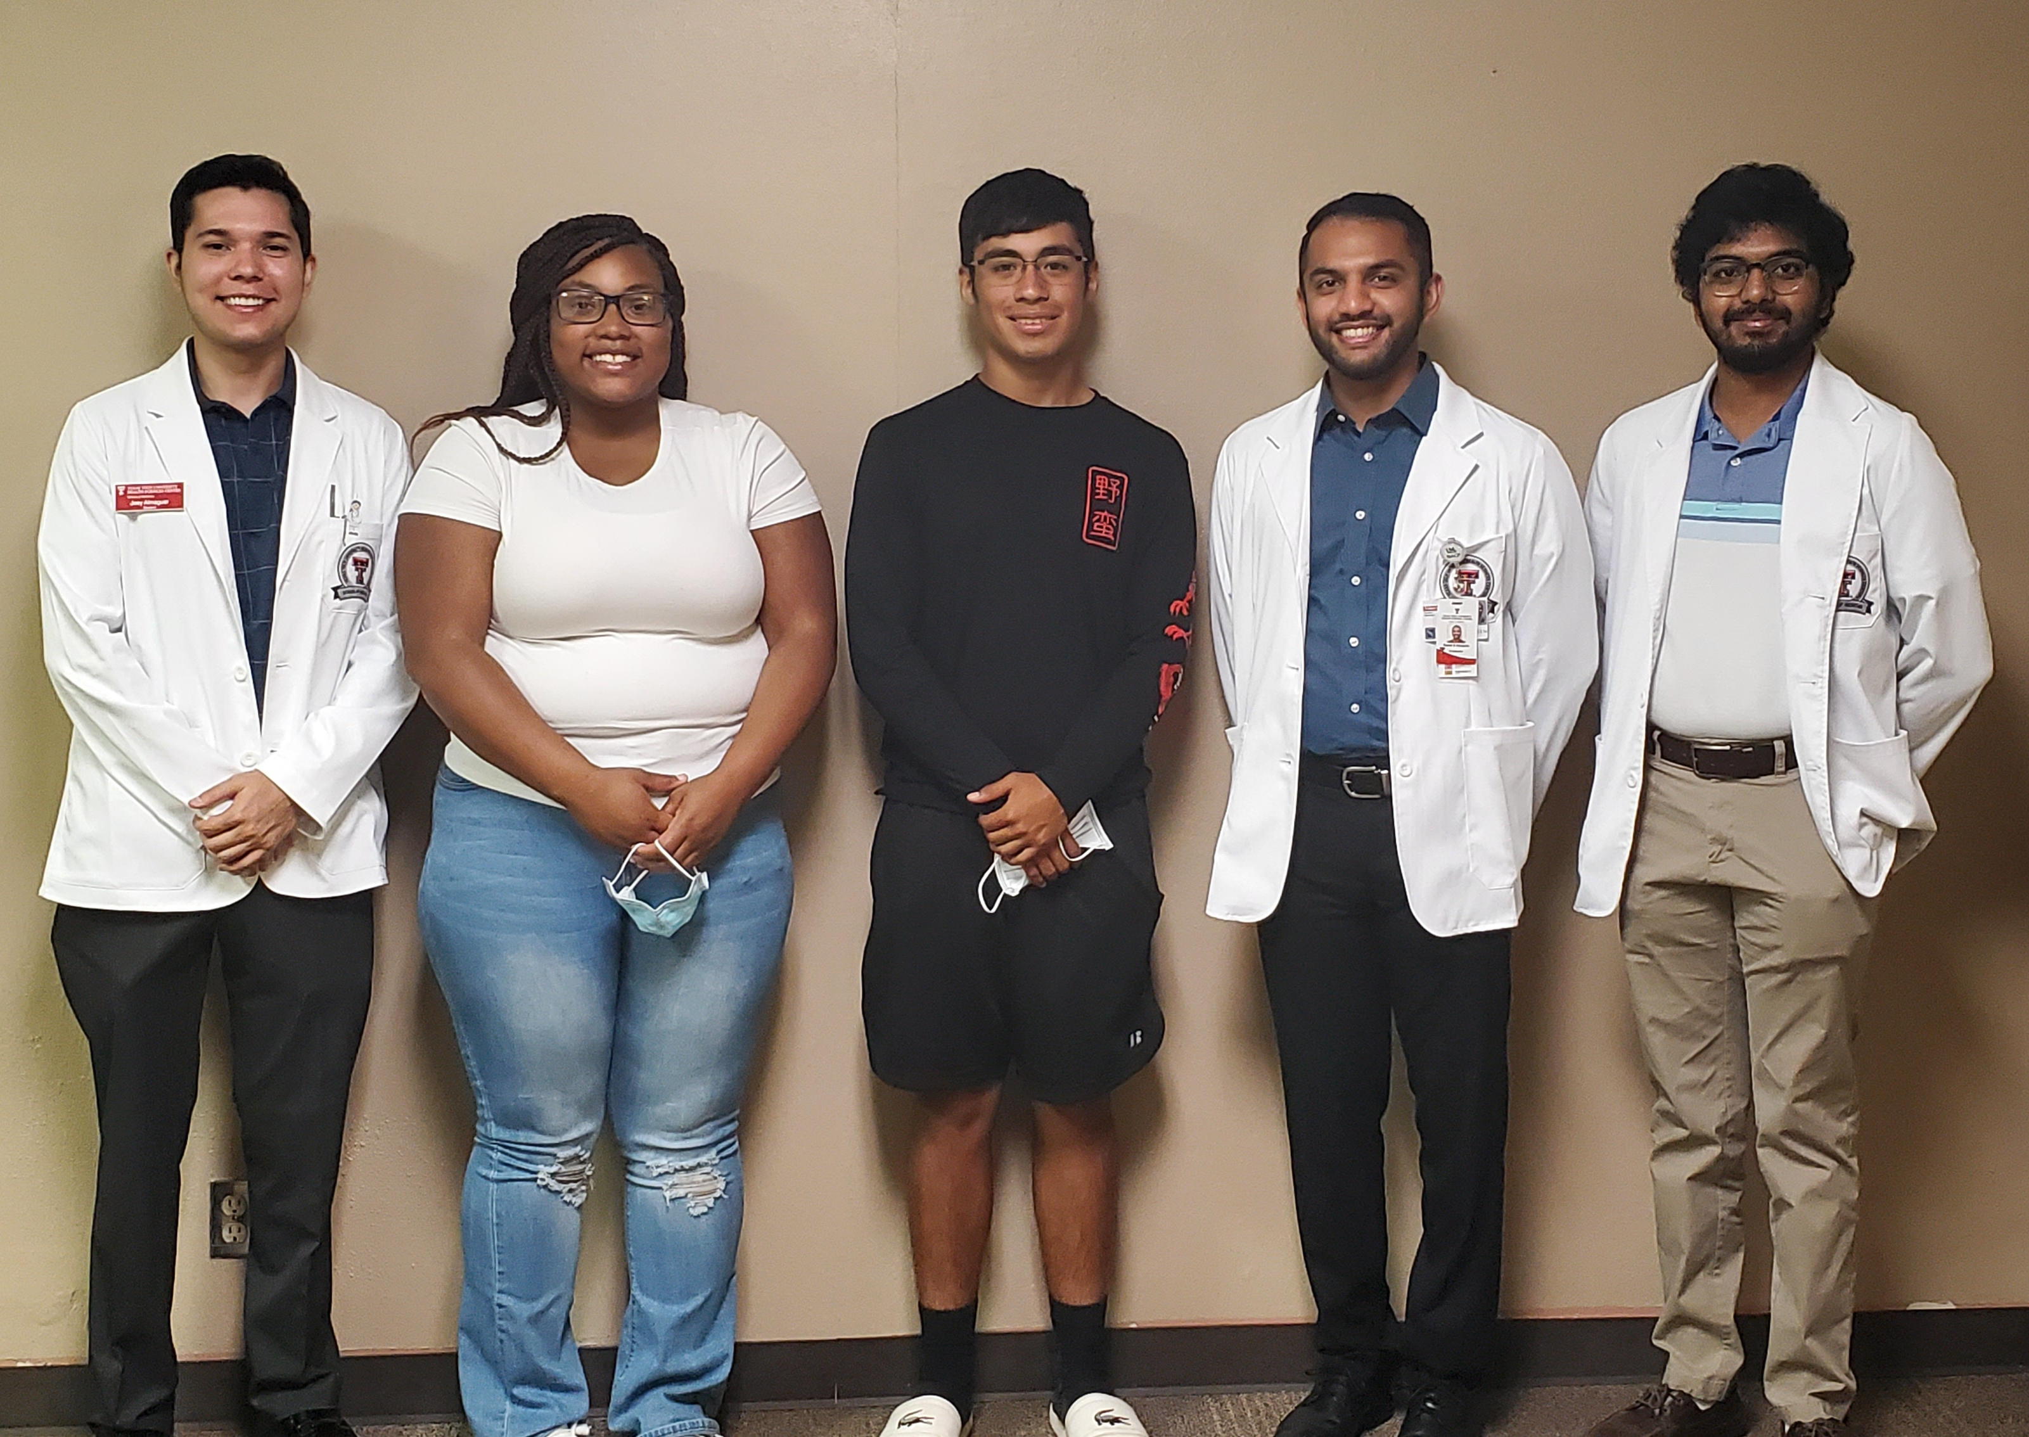
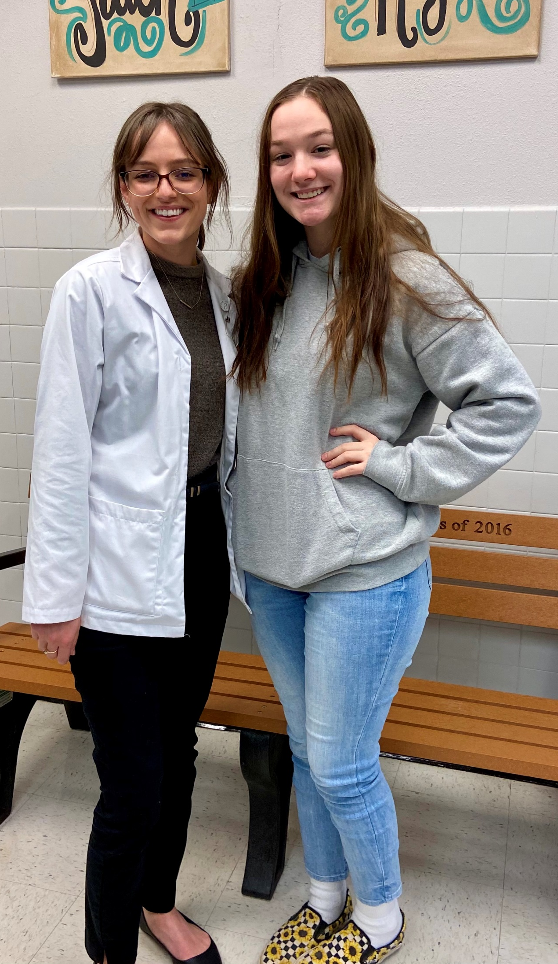
1ST ANNUAL
WEST TEXAS HEALTH DISPARITIES
RESEARCH SYMPOSIUM
History of RSHSMP
Program founded in 2020
    First cohort of medical student mentors & rural high school mentees
    30 mentor-mentee partnerships among 8 rural high schools in West Texas from 2020-21 and 2021-22

Slide 5
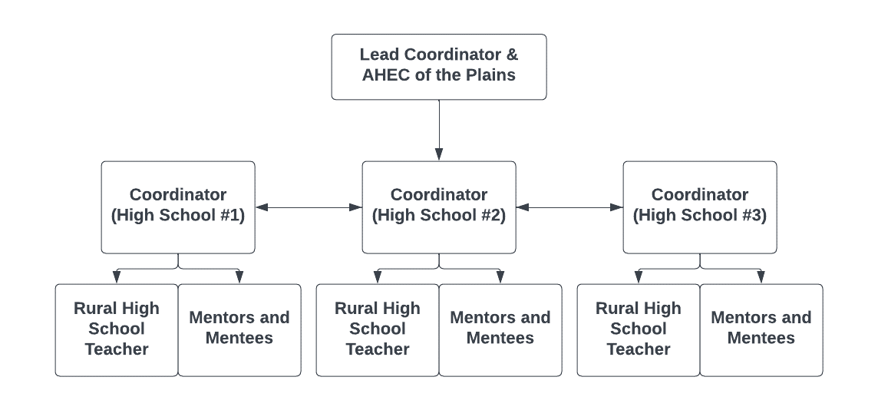
1ST ANNUAL
WEST TEXAS HEALTH DISPARITIES
RESEARCH SYMPOSIUM
Current Structure of RSHSMP
Monthly in-person or zoom meetings between partnerships
    October to February
Monthly discussion topics
  Interest in healthcare, applying
  to college, applying to medical school, financial assistance,
  Day-in-the-Life, and hands-on experiences

Slide 6
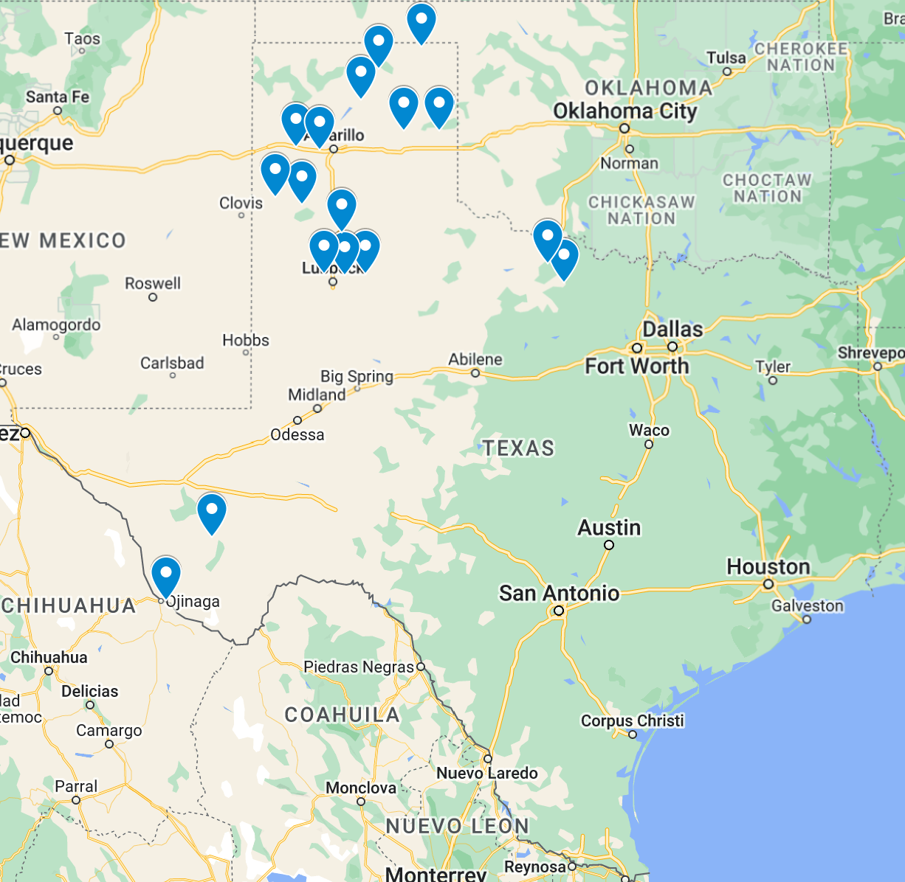
1ST ANNUAL
WEST TEXAS HEALTH DISPARITIES
RESEARCH SYMPOSIUM
Current State of RSHSMP
40 TTUHSC medical students and 57 rural high schoolers
    17 high schools represented in 2022-23
Mentors receive mileage reimbursements if meeting mentee(s) in-person

Slide 7
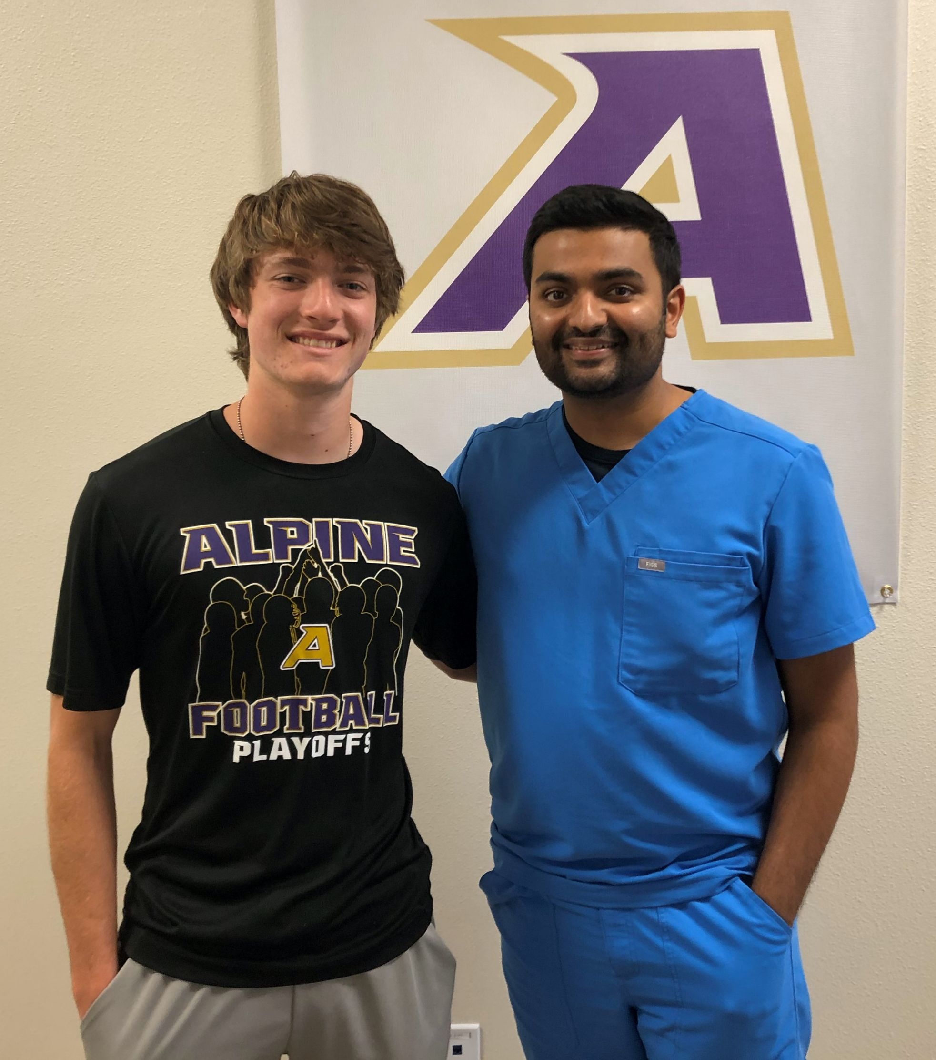
1ST ANNUAL
WEST TEXAS HEALTH DISPARITIES
RESEARCH SYMPOSIUM
Outcomes and Future Directions
Evaluate effectiveness and responsiveness of high schools/mentees to the program
Re-establish online portal to track pre/post-program surveys
Conduct further research on student responsiveness to program
Expand program to include other health sciences professions

Slide 8
Thank You!
1ST ANNUAL
WEST TEXAS HEALTH DISPARITIES
RESEARCH SYMPOSIUM

