Slide 1


Retrospective Study of Psychiatric Hospitalizations in a West Texas Mental Health Treatment Facility during the COVID-19 Pandemic
Presented by: Ashley Selman
Article by: Jimin Kim, BS1 ; Nikita Rao, BS2 ; Alex Collins, MBA2 ; Tochi Eboh, BS2 ; Julie Chugh, BS2 ; Shyam Sheladia, BS2 ; and Tarek H. Naguib, MD, MBA3
1ST ANNUAL
WEST TEXAS HEALTH DISPARITIES
RESEARCH SYMPOSIUM

Slide 2
1ST ANNUAL
WEST TEXAS HEALTH DISPARITIES
RESEARCH SYMPOSIUM
DISCLOSURES
The authors disclose that they have no conflicts of interest or outside party influence.

Slide 3
1ST ANNUAL
WEST TEXAS HEALTH DISPARITIES
RESEARCH SYMPOSIUM
Overview
Purpose: To characterize and compare inpatient admissions in West Texas before and during the initial months of the COVID-19 pandemic.
Methods:
  Study Type: Retrospective study of 1392 inpatient psychiatry admissions
  Time periods examined:
    Period A (pre-pandemic): 03-13-2019 to 07-03-2019
    Period B (pandemic): 03-13-2020 to 07-03-2020
  Demographic Inclusion criteria:
    Age: 18-65 years
    Disorder categories: psychotic, bipolar, depressive, anxiety, obsessive-compulsive
    Medications: SSRIs, SNRIs, mood stabilizers, and anti-psychotics
    Substance use: alcohol, nicotine, recreational drugs
  Exclusion criteria: use of prescription pain medications and anesthetics
Limitations:
  Not generalizable to the broader population
  EHR documentation gaps
  Unknown variables surrounding the interpretation of of substance and medication-related diagnoses

Slide 4
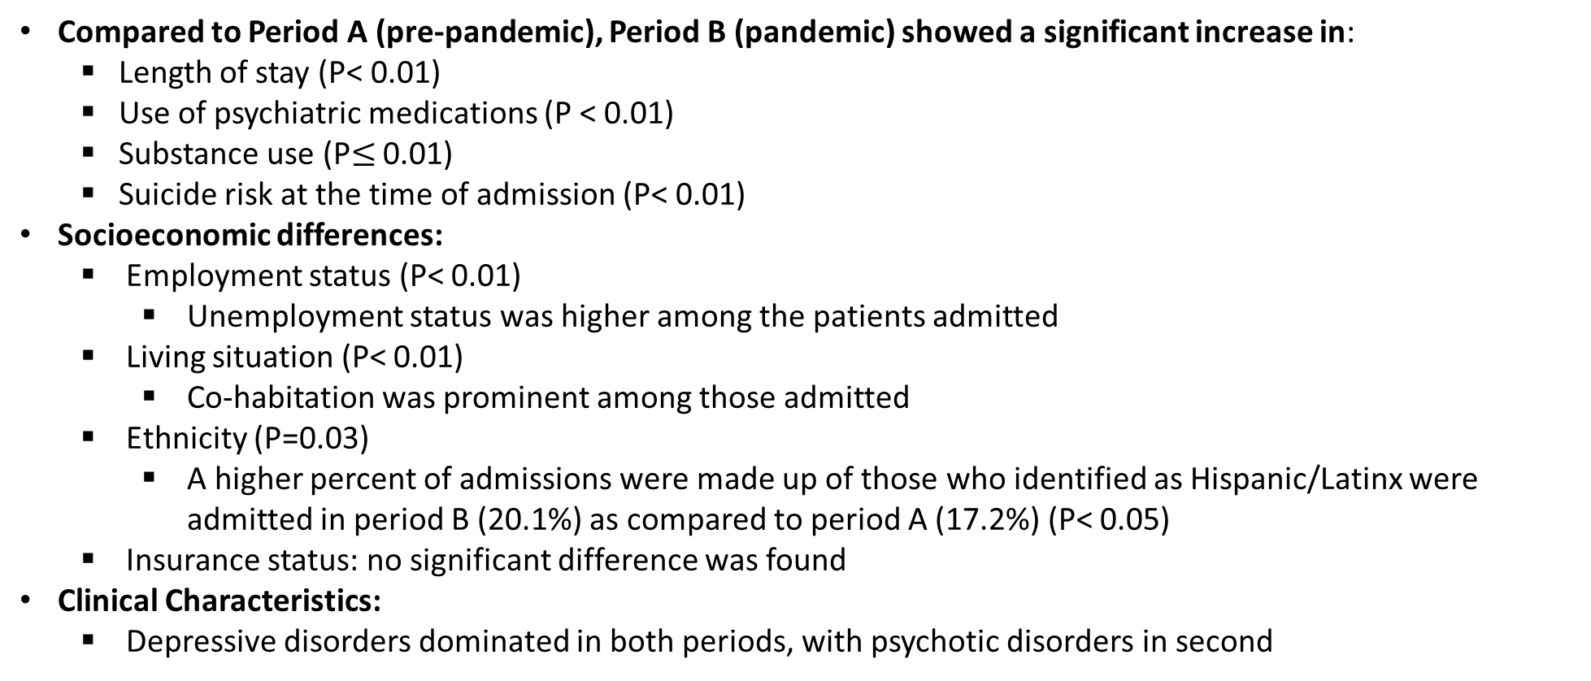
1ST ANNUAL
WEST TEXAS HEALTH DISPARITIES
RESEARCH SYMPOSIUM
Results
Compared to Period A (pre-pandemic), Period B (pandemic) showed a significant increase in:
  Length of stay (P< 0.01)
  Use of psychiatric medications (P < 0.01)
  Substance use (P$≤$ 0.01)
  Suicide risk at the time of admission (P< 0.01)
Socioeconomic differences:
  Employment status (P< 0.01)
    Unemployment status was higher among the patients admitted
  Living situation (P< 0.01)
    Co-habitation was prominent among those admitted
  Ethnicity (P=0.03)
    A higher percent of admissions were made up of those who identified as Hispanic/Latinx were admitted in period B (20.1%) as compared to period A (17.2%) (P< 0.05)
  Insurance status: no significant difference was found
Clinical Characteristics:
  Depressive disorders dominated in both periods, with psychotic disorders in second

Slide 5
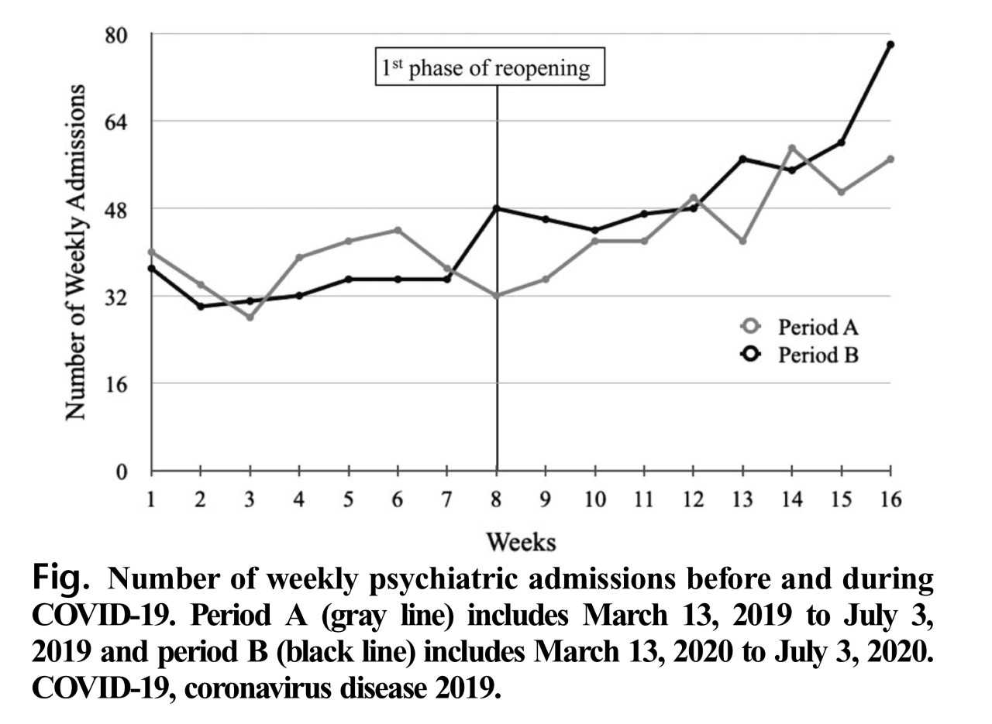
1ST ANNUAL
WEST TEXAS HEALTH DISPARITIES
RESEARCH SYMPOSIUM
Results

Slide 6
Questions?
1ST ANNUAL
WEST TEXAS HEALTH DISPARITIES
RESEARCH SYMPOSIUM

