Slide 1


Disparate Impact of Healthcare Access Restrictions due to COVID-19 Pandemic on Breast Cancer Diagnosis and Treatment
Elliotte Cannon
Elliotte Cannon, Devi Nair, Rakhshanda Layeequr Rahman, Karla Daniele, Brooke Jensen, Chathurika S Dhanasekara; Texas Tech University Health Sciences Center School of Medicine, Lubbock, TX; Texas Tech University Health Sciences Center Breast Center of Excellence, Lubbock, TX; Texas Tech University Health Sciences Center Department of Surgery, Lubbock, TX; Virginia Tech Carilion, Roanoke, VA
1ST ANNUAL
WEST TEXAS HEALTH DISPARITIES
RESEARCH SYMPOSIUM

Slide 2
1ST ANNUAL
WEST TEXAS HEALTH DISPARITIES
RESEARCH SYMPOSIUM
DISCLOSURES:
Nothing to disclose.

Slide 3
1ST ANNUAL
WEST TEXAS HEALTH DISPARITIES
RESEARCH SYMPOSIUM
INTRODUCTION
The COVID-19 pandemic altered healthcare access avenues for patients worldwide. In May 2020, 79% of cancer patients in the US in active treatment experienced some delay in their healthcare due to COVID-19 related restrictions.

Slide 4
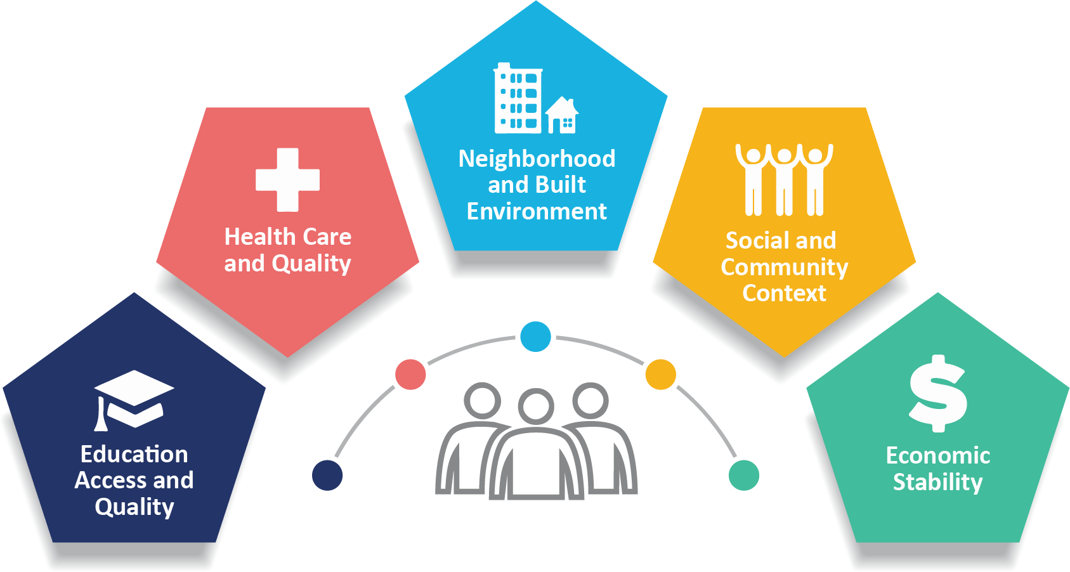
1ST ANNUAL
WEST TEXAS HEALTH DISPARITIES
RESEARCH SYMPOSIUM
INTRODUCTION
Our institution, designated a “Hispanic Serving Institute (HSI)”, is ideally suited to study the impact of the COVID-19 pandemic on this population.
Hispanic patients are disproportionately affected by their social determinants of health, putting them at higher risk of being affected during pandemic.

Slide 5
1ST ANNUAL
WEST TEXAS HEALTH DISPARITIES
RESEARCH SYMPOSIUM
METHODOLOGY
1.
The institutional breast cancer database was queried for patients managed between January 1, 2018 and April 18, 2022.
Socio-demographic variables, screening, and treatment initiation dates were analyzed.
2.
Patients were then stratified into groups based on diagnosis date:
Pre-Pandemic: | January 1, 2018 - February 28 2020
Pandemic: | March 1, 2020 - June 30, 2021
Post Pandemic: | July 1, 2021- April 18, 2022
3.
Interaction models were created to evaluate the association between ethnicity and distance from treatment center on the time lapses between 1) mammogram to biopsy and 2) biopsy to first treatment

Slide 6
1ST ANNUAL
WEST TEXAS HEALTH DISPARITIES
RESEARCH SYMPOSIUM
RESULTS
Median (IQR) number of days between biopsy and first treatment was similar across all groups
[Group 1 = 39.5 (102.5) days; Group 2 = 50 (121) days; Group 3 = 57 (54) days - p = 0.338].

Slide 7
1ST ANNUAL
WEST TEXAS HEALTH DISPARITIES
RESEARCH SYMPOSIUM
RESULTS
Patients who lived > 50 miles away from the treatment facility experienced longer time lapses between biopsy date and first treatment compared to those living ≤ 50 miles away
(β = 40.60, SE (standard error) = 20.87,
p = 0.052).
Model showing the interaction between distance from Cancer Center and period on the time lapse between biopsy and first treatment.
Independent Variable | Estimate | SE | t value | p-value
(Intercept) | 79.277 | 5.560 | 14.257 | <0.001
COVID | -2.660 | 9.599 | -0.277 | 0.782
Post COVID | -6.008 | 12.289 | -0.489 | 0.625
Distance from Cancer Center (>50 miles) | 6.655 | 13.148 | 0.506 | 0.613
COVID x Distance from Cancer Center (>50 miles) | 40.599 | 20.870 | 1.945 | 0.052
Post COVID x Distance from Cancer Center (>50 miles) | -10.479 | 31.415 | -0.334 | 0.739

Slide 8
1ST ANNUAL
WEST TEXAS HEALTH DISPARITIES
RESEARCH SYMPOSIUM
RESULTS
Of the 488 patients during the study period, 163 (33%) patients were Hispanic.
There was a significantly higher proportion of non-insured patients in the Hispanic group compared to the non-Hispanic group
[Hispanic group = 12 (7.4%) patients; Non-Hispanic group = 8 (2.5%) patients - p = 0.020].

Slide 9
1ST ANNUAL
WEST TEXAS HEALTH DISPARITIES
RESEARCH SYMPOSIUM
RESULTS
Compared to Non-Hispanics, Hispanics in Group 2 experienced a shorter time lapse between mammogram and biopsy
(β = -17.34, SE = 5.46, p = 0.002).
However, they experienced a longer time lapse between biopsy and first treatment
(β = 43.57, SE = 18.25, p = 0.017).
Model showing the interaction between ethnicity and period on the time lapse between mammogram and biopsy.
Independent Variable | Estimate | SE | t value | p-value
(Intercept) | 14.108 | 1.837 | 7.681 | <0.001
COVID | 5.206 | 3.032 | 1.717 | 0.087
Post COVID | 5.119 | 4.107 | 1.246 | 0.213
Ethnicity (Hispanic) | 5.918 | 3.329 | 1.777 | 0.076
COVID x Ethnicity (Hispanic) | -17.340 | 5.460 | -3.176 | 0.002
Post COVID x Ethnicity (Hispanic) | -10.979 | 6.409 | -1.713 | 0.087
Model showing the interaction between ethnicity and period on the time lapse between biopsy and first treatment.
Independent Variable | Estimate | SE | t value | p-value
(Intercept) | 78.929 | 6.082 | 12.978 | <0.001
COVID | -6.588 | 10.260 | -0.642 | 0.521
Post COVID | -6.868 | 15.009 | -0.458 | 0.648
Ethnicity (Hispanic) | 4.853 | 10.800 | 0.449 | 0.653
COVID x Ethnicity (Hispanic) | 43.568 | 18.245 | 2.388 | 0.017
Post COVID x Ethnicity (Hispanic) | -3.450 | 22.953 | -0.150 | 0.881

Slide 10
1ST ANNUAL
WEST TEXAS HEALTH DISPARITIES
RESEARCH SYMPOSIUM
DISCUSSION
Pandemic related delays in breast cancer treatment were observed mainly in Hispanic patients and those living >50 miles from the treatment center.
Hispanics in the Pandemic Group experienced shorter time lapses between mammography and biopsy, however they were found to experience longer time lapses between biopsy and first treatment.
Notes:
What might explain the delays for those living more than 50 miles away?
Bordering states such as New Mexico had stricter pandemic guidelines than the state of Texas did, such as requiring a 14 day quarantine period after returning from out of state travel. These strict guidelines may have resulted in patient related delays in appointment scheduling due to the fear of missing work for 2 full weeks.
What kind of mitigation efforts were responsible for shorter time lapses btwn mammo and biopsy?
These grant funded efforts included extended clinic hours, proactively scheduled appointments and reminder phone calls to the patients, and early detection education in the community via webinars, flyers, and socially distant health fairs.
Potential reasons for longer time lapses between biopsy and treatment?
There was a higher proportion of non-insured patients in the Hispanic group compared to the non-Hispanic group, which could explain the delays in getting the non-insured patients treated in a timely manner.

Slide 11

1ST ANNUAL
WEST TEXAS HEALTH DISPARITIES
RESEARCH SYMPOSIUM
FUTURE DIRECTIONS
1)
Conduct longitudinal studies to track the long-term impact of delayed breast cancer diagnosis and treatment on patient outcomes.
2)
Collaborate with other institutions to conduct multi-center studies to further validate the findings of this study and identify evidence-based interventions to reduce healthcare access disparities for Hispanic patients.
3)
Identify potential barriers faced by under insured patients in accessing timely treatment, and propose interventions such as financial assistance programs to mitigate these disparities.
Notes:
Potential barriers faced by the under insured?
Could be financial constraints, transportation issues, lack of understanding their options, or healthcare system-related factors

Slide 12
1ST ANNUAL
WEST TEXAS HEALTH DISPARITIES
RESEARCH SYMPOSIUM
Questions?
Thank you for your time!
Notes:
What might explain the delays for those living more than 50 miles away?
Bordering states such as New Mexico had stricter pandemic guidelines than the state of Texas did, such as requiring a 14 day quarantine period after returning from out of state travel. These strict guidelines may have resulted in patient related delays in appointment scheduling due to the fear of missing work for 2 full weeks.
What kind of mitigation efforts were responsible for shorter time lapses btwn mammo and biopsy?
These grant funded efforts included extended clinic hours, proactively scheduled appointments and reminder phone calls to the patients, and early detection education in the community via webinars, flyers, and socially distant health fairs.
Potential reasons for longer time lapses between biopsy and treatment?
There was a higher proportion of non-insured patients in the Hispanic group compared to the non-Hispanic group, which could explain the delays in getting the non-insured patients treated in a timely manner.

