Slide 1


IMPACT OF RACE ON UTILIZATION OF RIB PLATING:
A CROSS-SECTIONAL NATIONAL COHORT ANALYSIS
Esere Nesiama MBA; Neeraj Dayama MD, PhD, MBA; Kripa Shrestha MBBS, MPH, MS; Samudani Dhanasekara MD, MS, PhD; Sharmila Dissanaike MD, FACS
1ST ANNUAL
WEST TEXAS HEALTH DISPARITIES
RESEARCH SYMPOSIUM

Slide 2

1ST ANNUAL
WEST TEXAS HEALTH DISPARITIES
RESEARCH SYMPOSIUM
DISCLOSURES
No disclosures for this project

Slide 3


Rib Fracture Management
1ST ANNUAL
WEST TEXAS HEALTH DISPARITIES
RESEARCH SYMPOSIUM
Traditional management: external splinting, pain control, and incentive spirometry
New management: Surgical stabilization of Rib Fractures (SSRF) for flail chest and multiple displaced fractures

Slide 4

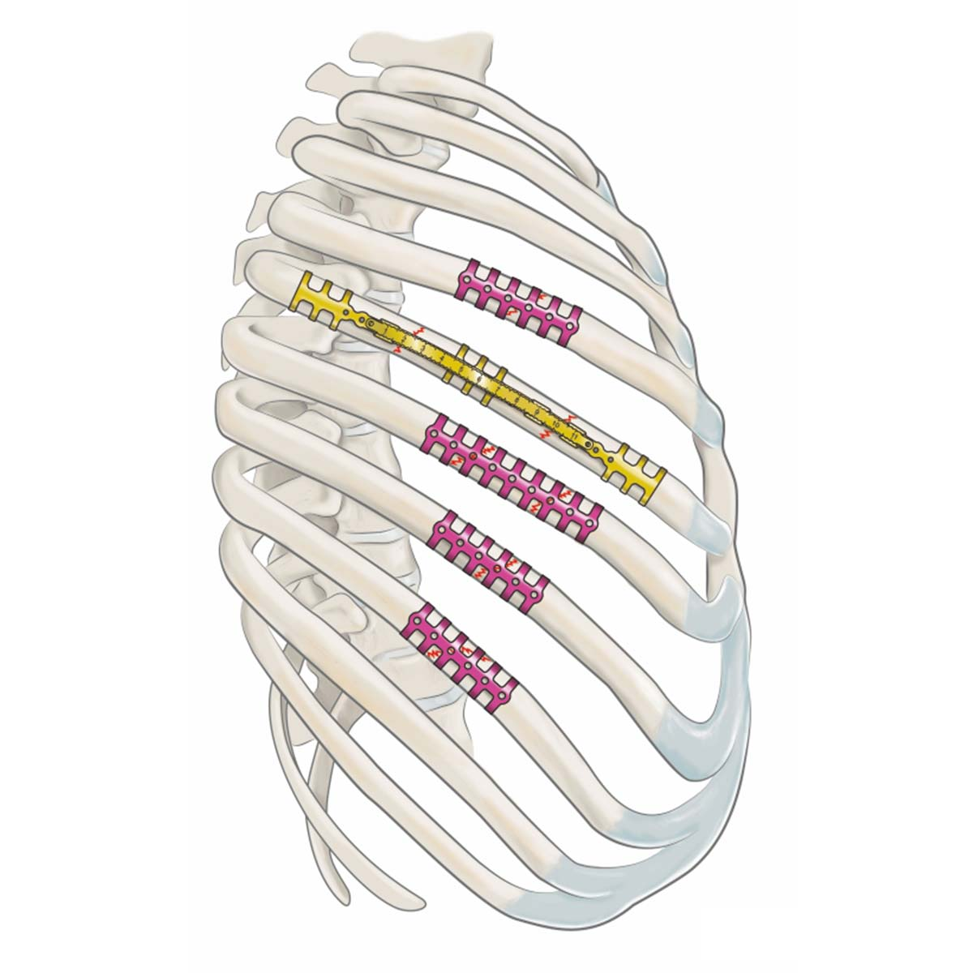
Rib Plating Systems
1ST ANNUAL
WEST TEXAS HEALTH DISPARITIES
RESEARCH SYMPOSIUM
Pre-threaded holes with self-tapping screws
Wrap around clips

Slide 5

SSRF Benefits
1ST ANNUAL
WEST TEXAS HEALTH DISPARITIES
RESEARCH SYMPOSIUM
Reduced mortality
Decreased length of Intensive Care Unit (ICU) stay
Decreased complications
Parra et al., Sarani et al.

Slide 6




Healthcare Disparities
1ST ANNUAL
WEST TEXAS HEALTH DISPARITIES
RESEARCH SYMPOSIUM
Non-White race: decreased likelihood of SSRF
High output SSRF centers: highest chance of SSRF
Higher evidence-based practice adherence: younger age, white race, higher injury severity score (ISS)
Underinsurance: associated with higher mortality
Greene et al., Weygandt et al., Para et al., Tignanelli et al., Salazar et al.

Slide 7

Goal
1ST ANNUAL
WEST TEXAS HEALTH DISPARITIES
RESEARCH SYMPOSIUM
  Identification of healthcare disparities in SSRF between White and Black patients.

Slide 8
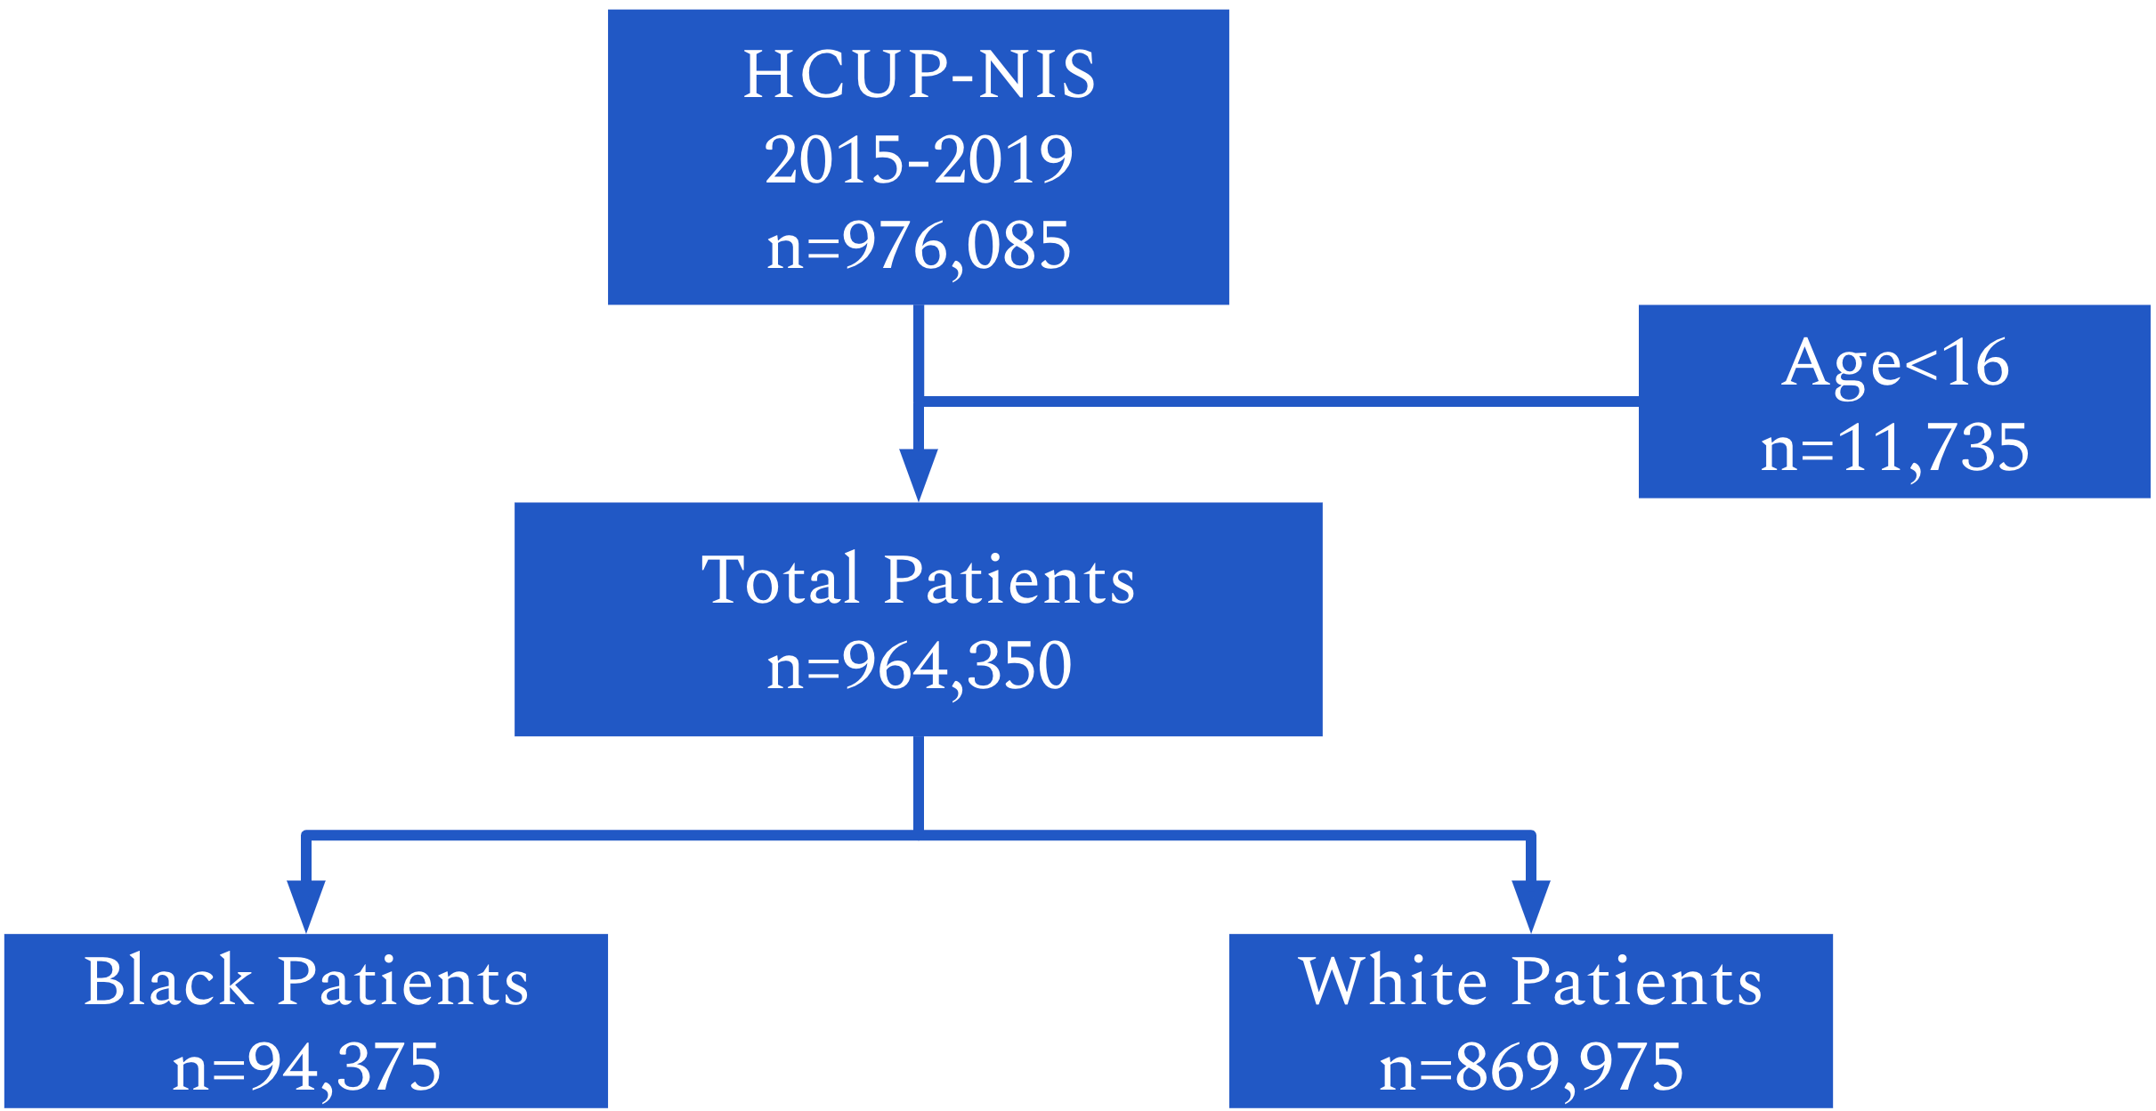


Methods
1ST ANNUAL
WEST TEXAS HEALTH DISPARITIES
RESEARCH SYMPOSIUM

Slide 9


Variables Analyzed
1ST ANNUAL
WEST TEXAS HEALTH DISPARITIES
RESEARCH SYMPOSIUM
Race, sex, age, type of rib fracture, injury severity score, hospital location, hospital size, income quartile of patient’s ZIP code, insurance status.
Multiple logistic regression model
Odds Ratios
95% confidence interval

Slide 10


Results
1ST ANNUAL
WEST TEXAS HEALTH DISPARITIES
RESEARCH SYMPOSIUM
Characteristic | Odds Ratio [95% Confidence Interval] | P-value
Black | 0.62 [0.54-0.72] | <.0001
Female | 0.70 [0.65-0.76] | <.0001
Age (years)
16-39 | Reference
40-65 | 0.65 [0.59-0.71] | <.0001
>65 | 0.39 [0.34-0.45] | <.0001

Slide 11

Injury Type
1ST ANNUAL
WEST TEXAS HEALTH DISPARITIES
RESEARCH SYMPOSIUM
Characteristic | Odds Ratio [95% Confidence Interval] | P-value
Type of Injury
Single fracture | 0.06 [0.05-0.07] | <.0001
Multiple fractures | 0.14 [0.11-0.17] | <.0001
Flail chest | 3.10 [2.52-3.80] | <.0001
Injury Severity Score
<16 | Reference
16-75 | 0.95 [0.85-1.06] | 0.3459

Slide 12





Insurance
1ST ANNUAL
WEST TEXAS HEALTH DISPARITIES
RESEARCH SYMPOSIUM
Characteristic | Odds Ratio [95% Confidence Interval] | P-value
Insurance
Private Insurance | 0.55 [0.50-0.61] | <.0001
Uninsured | 0.44 [0.37-0.52] | <.0001
Medicaid | 0.38 [0.34-0.44] | <.0001
Medicare | 0.32 [0.28-0.36] | <.0001

Slide 13

Income
1ST ANNUAL
WEST TEXAS HEALTH DISPARITIES
RESEARCH SYMPOSIUM
Characteristic | Odds Ratio [95% Confidence Interval] | P-value
Income Quartile Zip Code
≤25% | Reference
25-50% | 0.71 [0.64-0.78] | <.0001
50-75% | 0.65 [0.59-0.72] | <.0001
≥75% | 0.68 [0.60-0.78] | <.0001
{

Slide 14



Region and Hospital Size
1ST ANNUAL
WEST TEXAS HEALTH DISPARITIES
RESEARCH SYMPOSIUM
Characteristic | Odds Ratio [95% Confidence Interval] | P-value
Hospital Setting
Urban | Reference
Rural | 0.28 [0.21-0.38] | <.0001
Region
Northeast | Reference
Midwest | 0.82 [0.71-0.95] | 0.0089
South | 0.69 [0.61-0.80] | <.0001
West | 0.85 [0.71-1.01] | 0.0695
Hospital Size
Small | Reference
Medium | 0.80 [0.69-0.94] | 0.0078
Large | 0.85 [0.77-0.95] | 0.0044

Slide 15
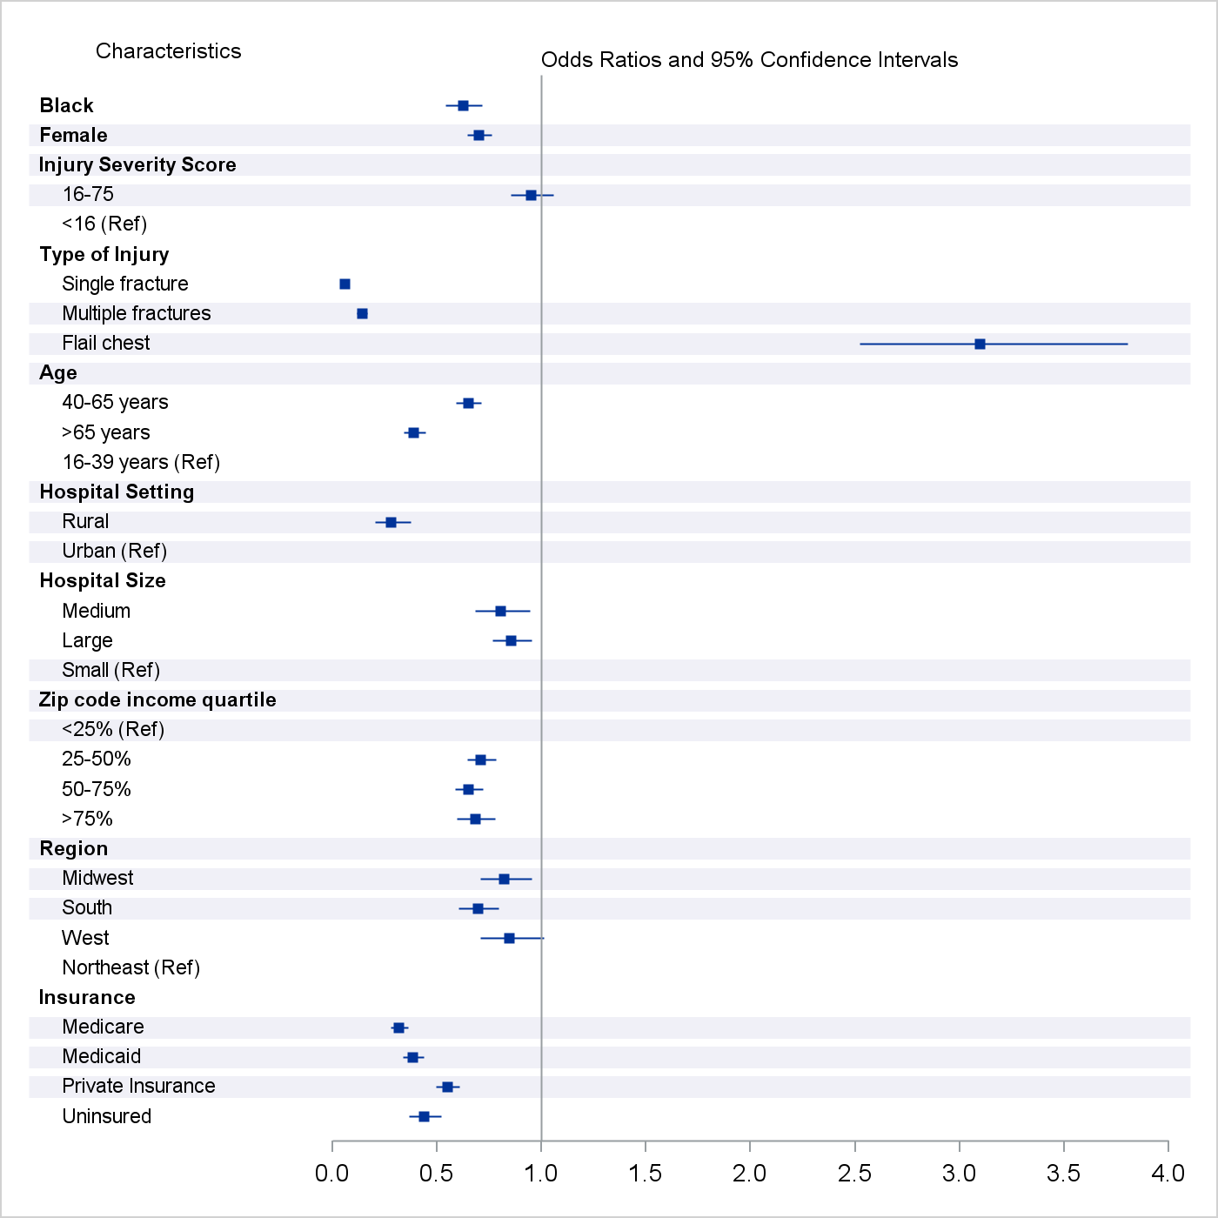
1ST ANNUAL
WEST TEXAS HEALTH DISPARITIES
RESEARCH SYMPOSIUM

Slide 16
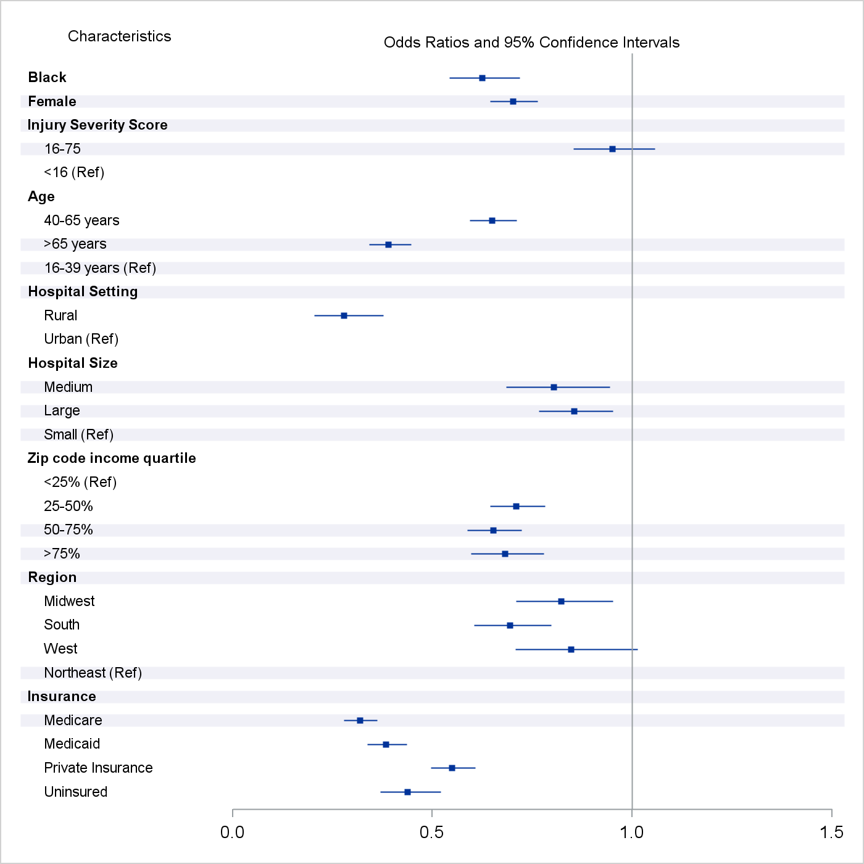
1ST ANNUAL
WEST TEXAS HEALTH DISPARITIES
RESEARCH SYMPOSIUM

Slide 17

Conclusion
1ST ANNUAL
WEST TEXAS HEALTH DISPARITIES
RESEARCH SYMPOSIUM
Black patients were less likely to receive SSRF than white patients
Flail chest injuries were more likely to receive SSRF
Patients with private insurance were most likely to receive SSRF
Large hospitals were less likely to conduct SSRF than small hospitals

Slide 18

1ST ANNUAL
WEST TEXAS HEALTH DISPARITIES
RESEARCH SYMPOSIUM

Slide 19
Characteristic | Odds Ratio | P-value | 95% Confidence Interval
Black | 0.624 | <.0001 | 0.543 | 0.718
Female | 0.702 | <.0001 | 0.645 | 0.763
Injury Severity Score
<16 | Ref
16-75 | 0.95 | 0.3459 | 0.853 | 1.057
Type of Injury
Single Fracture | 0.058 | <.0001 | 0.047 | 0.071
Multiple Fracture | 0.141 | <.0001 | 0.117 | 0.169
Flail Chest | 3.097 | <.0001 | 2.521 | 3.804
Age (years)
16-39 | Ref
40-65 | 0.649 | <.0001 | 0.593 | 0.711
>65 | 0.39 | <.0001 | 0.341 | 0.446
Hospital Type
Urban | Ref
Rural | 0.278 | <.0001 | 0.205 | 0.377
Hospital Size
Small
Medium | 0.804 | 0.0078 | 0.685 | 0.944
Large | 0.854 | 0.0044 | 0.766 | 0.952
Income Quartile
Zip code income quartile, <25% | Ref
Zip code income quartile, 25-50% | 0.71 | <.0001 | 0.644 | 0.782
Zip code income quartile, 50-75% | 0.652 | <.0001 | 0.588 | 0.723
Zip code income quartile, ≥74% | 0.682 | <.0001 | 0.597 | 0.778
Hospital Location
Northeast | Ref
Midwest | 0.822 | 0.0089 | 0.71 | 0.952
South | 0.694 | <.0001 | 0.605 | 0.797
West | 0.847 | 0.0695 | 0.707 | 1.013
Insurance
Medicare | 0.318 | <.0001 | 0.279 | 0.362
Medicaid | 0.383 | <.0001 | 0.337 | 0.436
Private | 0.549 | <.0001 | 0.496 | 0.608
Uninsured | 0.438 | <.0001 | 0.369 | 0.521
Notes:
EXTRA SLIDES FOR QUESTIONS IF NEEDED

Slide 20
BED SIZE CATEGORIES (Beginning in 1998)
Location and Teaching Status | Hospital Bedsize
 | Small | Medium | Large
NORTHEAST REGION
Rural | 1-49 | 50-99 | 100+
Urban, nonteaching | 1-124 | 125-199 | 200+
Urban, teaching | 1-249 | 250-424 | 425+
MIDWEST REGION
Rural | 1-29 | 30-49 | 50+
Urban, nonteaching | 1-74 | 75-174 | 175+
Urban, teaching | 1-249 | 250-374 | 375+
SOUTHERN REGION
Rural | 1-39 | 40-74 | 75+
Urban, nonteaching | 1-99 | 100-199 | 200+
Urban, teaching | 1-249 | 250-449 | 450+
WESTERN REGION
Rural | 1-24 | 25-44 | 45+
Urban, nonteaching | 1-99 | 100-174 | 175+
Urban, teaching | 1-199 | 200-324 | 325+
Notes:
EXTRA SLIDES FOR QUESTIONS IF NEEDED

