Slide 1


Sexual Violence in West Texas:
An Assessment of the Texas Department of Public Safety Incident Reporting Data
Grace McCrea, BSA
1ST ANNUAL
WEST TEXAS HEALTH DISPARITIES
RESEARCH SYMPOSIUM

Slide 2
DISCLOSURES
None
1ST ANNUAL
WEST TEXAS HEALTH DISPARITIES
RESEARCH SYMPOSIUM

Slide 3
1ST ANNUAL
WEST TEXAS HEALTH DISPARITIES
RESEARCH SYMPOSIUM
BACKGROUND
Sexual violence is a significant public health issue affecting rural communities throughout West Texas.
The effects of sexual violence and abuse are complicated in rural settings due to limited access to resources and geographic isolation.
There are unique barriers that victims of sexual violence face in rural areas, including transportation and absence of resource centers².

Slide 4
1ST ANNUAL
WEST TEXAS HEALTH DISPARITIES
RESEARCH SYMPOSIUM
PURPOSE
To assess if sexual violence incidence rates are comparable between urban and rural communities in West Texas.
To emphasize the importance of educating and training leaders in rural communities so they are enabled to both identify and respond to the common signs of sexual violence.

Slide 5
1ST ANNUAL
WEST TEXAS HEALTH DISPARITIES
RESEARCH SYMPOSIUM
METHODS
Utilizing the Texas Department of Public Safety Crime Report, data was extracted for 32 West Texas cities to assess the incident rates of sex offenses from 2017-2021¹.
The 31 cities were divided into five groups based on population size, including <5,000, 5,000-10,000, 10,000-20,000, 20,000-300,000, and >300,000, then the average incident rate was calculated for each division.

Slide 6
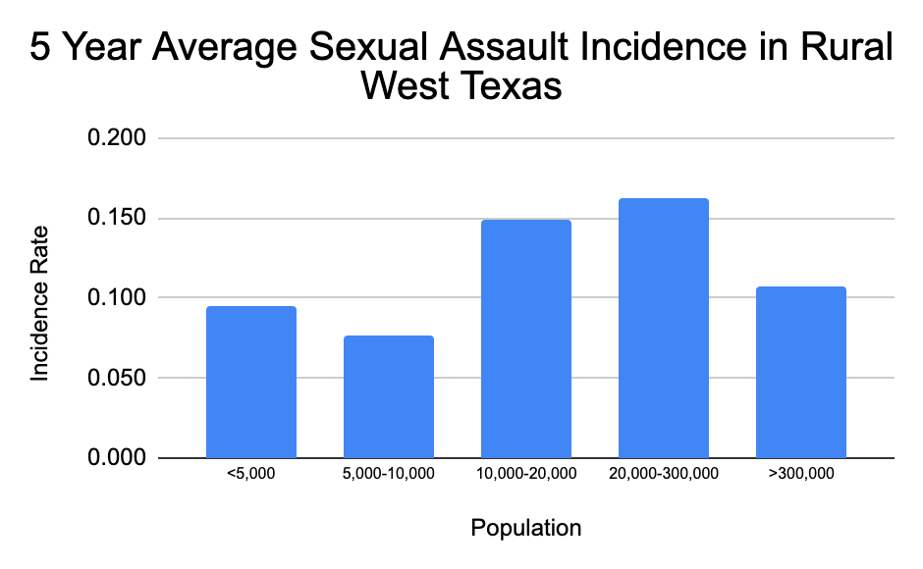
1ST ANNUAL
WEST TEXAS HEALTH DISPARITIES
RESEARCH SYMPOSIUM
RESULTS

Slide 7
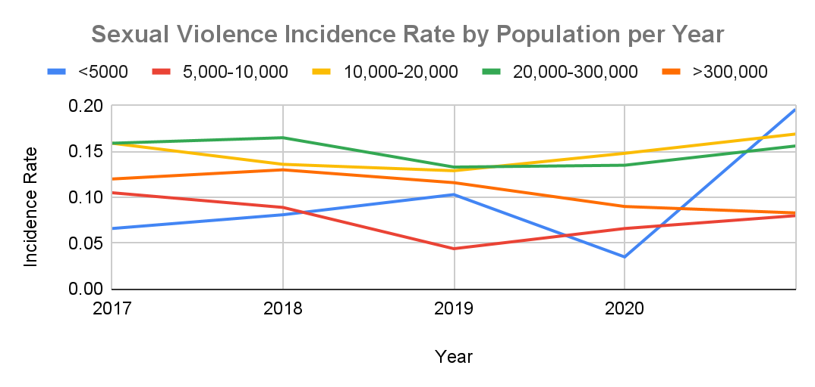
1ST ANNUAL
WEST TEXAS HEALTH DISPARITIES
RESEARCH SYMPOSIUM
RESULTS

Slide 8

1ST ANNUAL
WEST TEXAS HEALTH DISPARITIES
RESEARCH SYMPOSIUM
DISCUSSION
Sexual violence persists as a serious public health issue in West Texas that affects the health, opportunities, and wellbeing of West Texas communities.
Voice of Hope is an organization that serves individuals impacted by sexual violence in Lubbock and surrounding communities.
Prospective intervention strategies should include partnerships between Voice of Hope and rural community leaders in order to ameliorate both the training and utilization of resources available to West Texas communities.

Slide 9
1ST ANNUAL
WEST TEXAS HEALTH DISPARITIES
RESEARCH SYMPOSIUM
ACKNOWLEDGEMENTS
Sarah Neal Horne¹, Sean Daly¹, Jyntre Millsap¹, Grant Tekell¹, Andrew Wagner¹, Christopher Piel M.D., FACEP^{1,2}
  ¹ Texas Tech University Health Sciences Center - School of Medicine
  ² Texas Tech University Health Sciences Center – Department of Emergency Medicine
Voice of Hope

Slide 10
1ST ANNUAL
WEST TEXAS HEALTH DISPARITIES
RESEARCH SYMPOSIUM
REFERENCES
¹ Crime in Texas. Crime in Texas | Department of Public Safety. (n.d.). Retrieved from https://www.dps.texas.gov/section/crime-records/crime-texas
² Lewis, S. (2003, September). Sexual Assault in Rural Communities. Harrisburg, PA: VAWnet, a project of the National Resource Center on Domestic Violence/Pennsylvania Coalition Against Domestic Violence. Retrieved 01/21/ 2023, from: http://www.vawnet.org

