Slide 1


Resident/Fellow Confidence In Treating Chronic Kidney Disease
Meron Tesfaye, Yaw Adu, Erin Adams, Elwin Rutayomba, Felix Morales, MD
1ST ANNUAL
WEST TEXAS HEALTH DISPARITIES
RESEARCH SYMPOSIUM

Slide 2
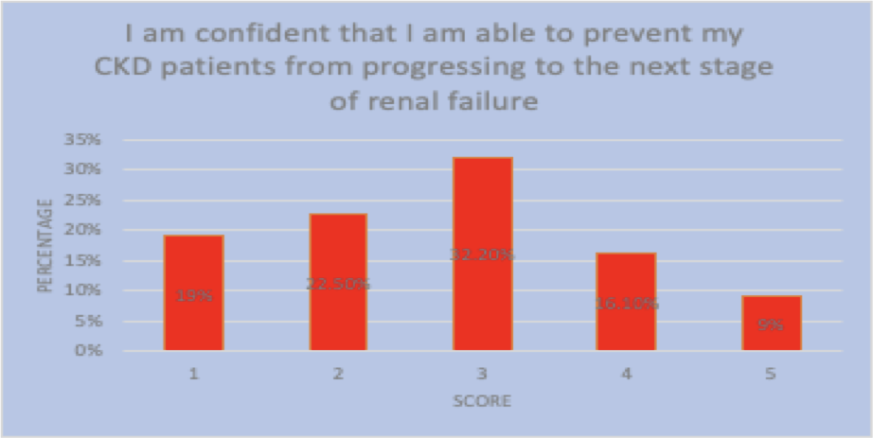
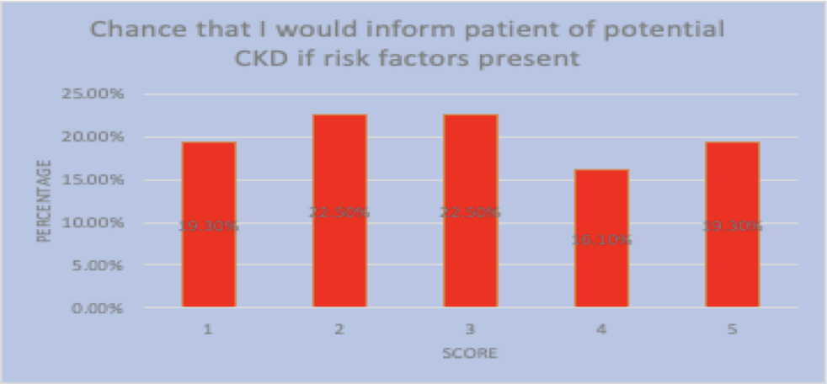
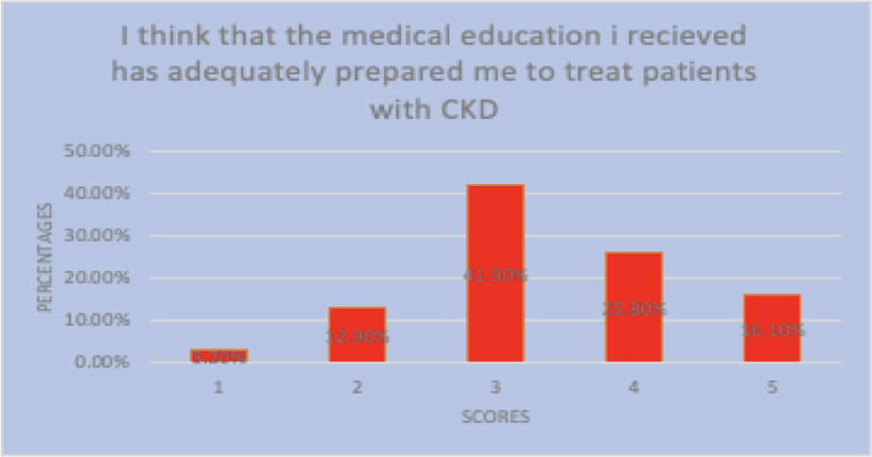
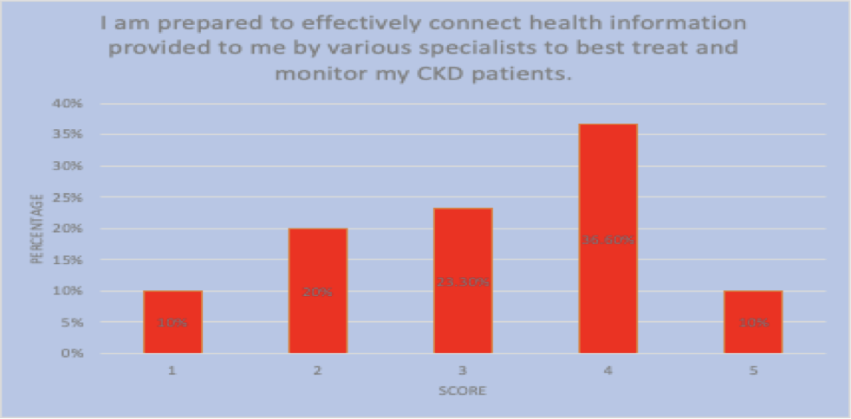
1ST ANNUAL
WEST TEXAS HEALTH DISPARITIES
RESEARCH SYMPOSIUM
Study Question and Background
According to the CDC, 37 million Americans are suffering from chronic kidney disease (CKD). In 2019, treating Medicare beneficiaries with CKD cost a total of $124.5 billion, a staggering 55% increase since 2013. The physical and financial burden of CKD is substantial for both the patient and the US economy. Costs can be decreased by mitigating the advancement of CKD in susceptible patients, which can be achieved by ensuring that medical professionals are adequately educated and trained. Our study focuses on the capability and confidence that Texas Tech University Health Sciences Center (TTUHSC) healthcare professionals possess in treating at-risk and current CKD patients and how we can use this data to better meet the needs of such patients.
Study Population
The study population includes both residents and fellows in various subspecialties who currently practice within the TTUHSC system. Each resident/fellow completed an anonymous Omnibus survey with a variety of questions pertaining to their levels of CKD knowledge. The survey, which included 10 questions, received a total of 31 responses.
Data Collection Methods
This project used the TTUHSC School of Medicine Omnibus Survey, an anonymous online survey instrument sent to all TTUHSC residential campuses and surveyed both residents and fellows.
Conclusions
As the American healthcare system shifts towards value-based care, improving prophylaxis and CKD treatment is crucial. Around 55% of participants felt their medical education was inadequate for diagnosing and treating CKD, leading to over 70% of residents and fellows lacking confidence in screening patients. However, a majority of respondents (more than 50%) said they would inform patients of their CKD risk if they could identify potential risk factors. This highlights the need for extensive education and training on identification and treatment methods, leading to better patient outcomes, lower healthcare costs, and more competent medical professionals.
Results
Survey results found that respondents lacked awareness for the treatment of CKD, which runs parallel with the observation that respondents do not feel completely confident with preventing the progression of CKD. When asked if the medical education the residents received had adequately prepared them to treat patients with CKD, about 58% disagreed. When asked if the residents felt confident in preventing CKD patients from progressing to the next stage of renal failure, around 74% disagreed. Further, when asked if the residents feel prepared to effectively connect health information provided to them by various specialists to best treat and monitor CKD patients, more than 50% disagreed. However, when asked if they would inform the patient of potential CKD if they were able to identify risk factors, more than 60% agreed.
Next Steps
Supply clinics and private practices with informational pamphlets discussing chronic kidney disease to distribute to patients.
Discuss placing more emphasis on chronic kidney disease in the medical school curriculum with deans of academic affairs.
Speaking to residency program directors about incorporating diagnosis and preventative measures into medical education core curriculum.

