Slide 1



Analyzing and Addressing Telemedicine Barriers Among the Lubbock Medicaid Population
Joey Almaguer, MS, Zoe Davis, Meredith Hopson, Tim Fox, and Ariel Santos, MD
1ST ANNUAL
WEST TEXAS HEALTH DISPARITIES
RESEARCH SYMPOSIUM

Slide 2
Disclosure
1ST ANNUAL
WEST TEXAS HEALTH DISPARITIES
RESEARCH SYMPOSIUM
Nothing to disclose
Notes:
These numbers reflect reimbursed telemedicine providers
Increase highly driven by COVID

Slide 3
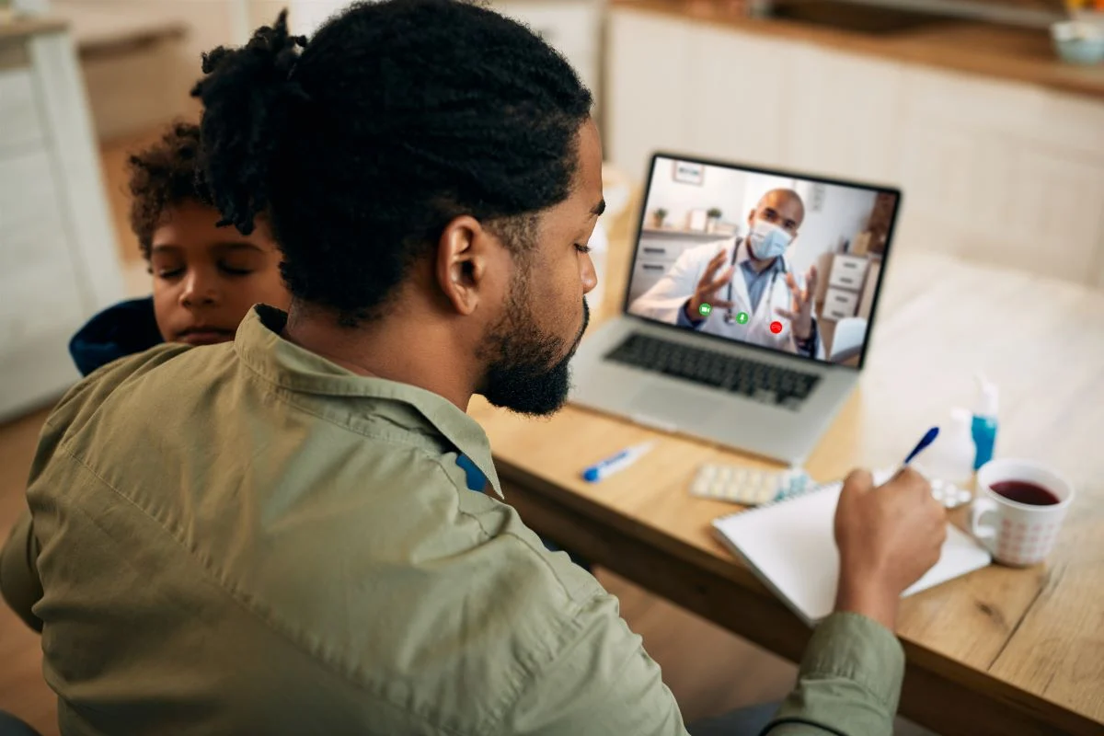
Telemedicine
1ST ANNUAL
WEST TEXAS HEALTH DISPARITIES
RESEARCH SYMPOSIUM
Teleservices
  Telemedicine (MD/DO/NP/PA)
  Telehealth (psychologist, social workers)
  Telemonitoring (vitals)
Benefits:
  Convenient
  Cost-effective
  Improved access to health care
  Continuity of care
  Empowers patients
  Increased efficiency
  Safe
  Secure
2019 – 2021: number of teleservices ↑ 500%
Notes:
These numbers reflect reimbursed telemedicine providers
Increase highly driven by COVID

Slide 4
Medicaid Statistics
1ST ANNUAL
WEST TEXAS HEALTH DISPARITIES
RESEARCH SYMPOSIUM
Texas Medicaid telemedicine:
3.7 million telemedicine services were delivered to Texas Medicaid patients in 2021
Texas Medicaid telemedicine providers: 455 (2019) → 7,505 (2021)
  Texas House Bill 4 passed unanimously in 06/2021
Total amount paid to providers: $115 million (2020) → $214 million (2021)
Most popular diagnoses:
  Behavioral health (304,674)
  Respiratory disease (211,770)
  Abnormal laboratory/clinical findings (206,761)
County type | Telemedicine providers (2020) | Telemedicine providers (2021)
Urban | 5,871 | 5,320
Suburban | 1,609 | 1,525
Rural | 845 | 764
County type | Telemedicine clients (2020) | Telemedicine clients (2021)
Urban | 557,187 | 733,470
Suburban | 131,640 | 161,586
Rural | 87,910 | 109,961
Notes:
These numbers reflect reimbursed telemedicine providers
Increase highly driven by COVID
In-person visits resuming after COVID

Slide 5
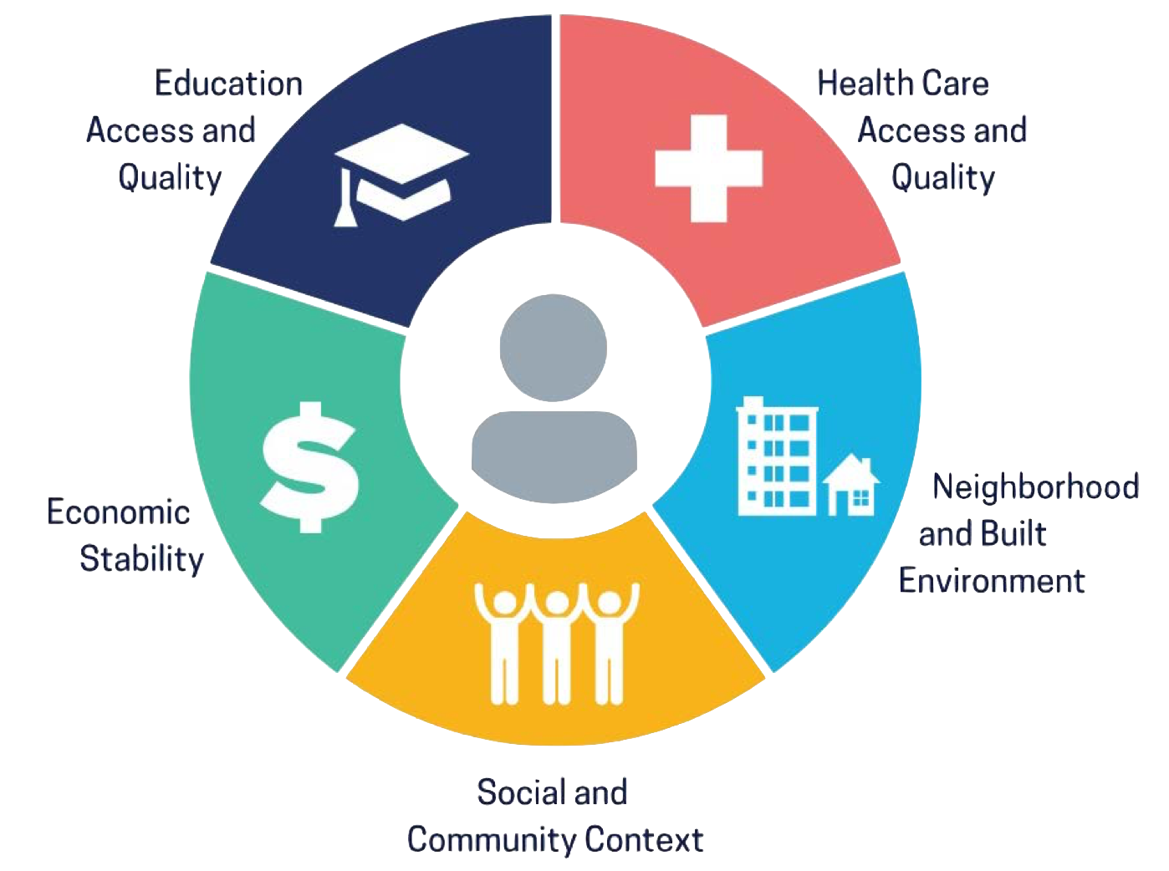
Project Goals
1ST ANNUAL
WEST TEXAS HEALTH DISPARITIES
RESEARCH SYMPOSIUM
Are there barriers to telemedicine access and usage among Lubbock Medicaid patients that can be addressed?
Potential barriers:
  Access to reliable internet
  Zoom capable devices
  Technological fluency
  Need for in-person exams, labs, and imaging
  Personal provider doesn’t offer the service
  Understand functions of telemedicine
Demographic: Medicaid patients (2020 – 2022)
Retrospective chart review
IRB approval
15-item Qualtrics questionnaire (n = )
  English and Spanish
Notes:
URI became the most frequent diagnosis in 2021

Slide 6

Results
1ST ANNUAL
WEST TEXAS HEALTH DISPARITIES
RESEARCH SYMPOSIUM
Respondents = 50
69% report earning < $15,000 annually
94% have heard of telemedicine
  57% have never participated in a telemedicine visit
  43% did not know telemedicine was an option or available to them
  75% are open to using telemedicine
76% are semi-proficient with technology
  5% report difficulty using technology
  76% use their cell phone during telemedicine visits
  Wi-Fi/cellular service was widely accessed
47% listed COVID-19 as reason for telemedicine visit
Top 3 reasons to consider telemedicine
  Avoid waiting room
  Save transportation costs
  Avoid parking
Top 3 reasons they did telemedicine
  Prescription refill
  F/U lab work
  Minor illness care
Zoom capable devices
Technological fluency
Physical exams/labs/imaging
Access to reliable internet
Provider doesn’t offer service
Understand telemedicine uses
Notes:
URI became the most frequent diagnosis in 2021

Slide 7
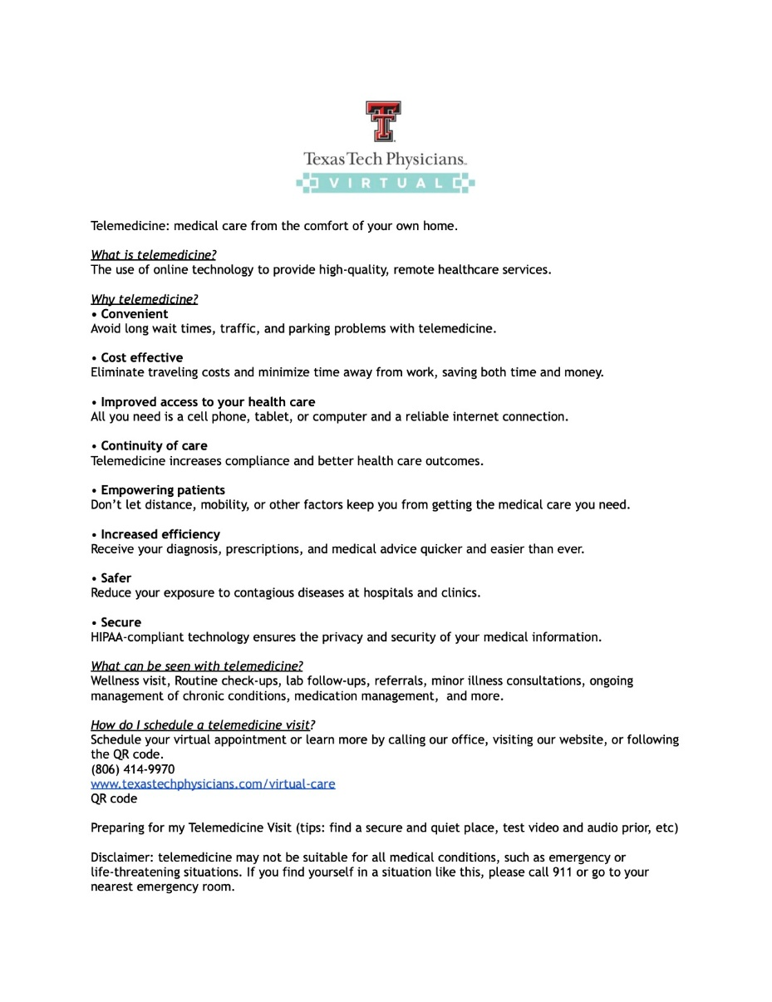
Intervention
1ST ANNUAL
WEST TEXAS HEALTH DISPARITIES
RESEARCH SYMPOSIUM
Flyer: spread awareness on telemedicine functions
  Benefits
  What telemedicine can be used for
  How to schedule a telemedicine visit
Digital copy sent via email
Physical copy available to patients in-person
Future directions:
  Medicaid telemedicine providers decreased 2020 → 2021
  More likely to utilize telemedicine if their provider offers it
  Give resources to providers that could incentivize them to offer telemedicine services
    Specialists
Notes:
URI became the most frequent diagnosis in 2021

Slide 8

References
1ST ANNUAL
WEST TEXAS HEALTH DISPARITIES
RESEARCH SYMPOSIUM
• Healthy People 2030, Social Determinants of Health. https://health.gov/healthypeople/objectives-and-data/social-determinants-health
• COVID-19 And The Rise Of Telehealth. (n.d.). Reeve Foundation. https://www.christopherreeve.org/blog/daily-dose/covid-19-and-the-rise-of-telehealth
• Texas Health and Human Services, Telemedicine, Telehealth and Home Telemonitoring in Texas Medicaid FY 2022 (2022). 77th Legislative Session - 2001 Legislative Reports. Retrieved from https://www.hhs.texas.gov/sites/default/files/documents/sb-789-telemedicine-telehealth-hts-medicaid-dec-2022.pdf
Notes:
URI became the most frequent diagnosis in 2021

