Slide 1


Assessing the Impact of Drug Take-Back Programs in West Texas
Sarah Neal Horne MPH, MPA, MSI
Cheyanna Petty PIII
1ST ANNUAL
WEST TEXAS HEALTH DISPARITIES
RESEARCH SYMPOSIUM

Slide 2
Disclosures
1ST ANNUAL
WEST TEXAS HEALTH DISPARITIES
RESEARCH SYMPOSIUM
None.

Slide 3
Learning Objectives
1ST ANNUAL
WEST TEXAS HEALTH DISPARITIES
RESEARCH SYMPOSIUM
Describe how the current drug overdose epidemic exists as a prevalent public health issue in West Texas.
Explore how limited opportunities for safe disposal of unneeded medications have created a health disparity in West Texas.
Highlight the importance of the Medication Cleanout events as a strategic approach to addressing this health disparity in West Texas.

Slide 4
1ST ANNUAL
WEST TEXAS HEALTH DISPARITIES
RESEARCH SYMPOSIUM
Background
Poisonings remain the leading cause of preventable injury-related death nationwide¹.
Due to the rural and diffuse disposition of many West Texas communities, limited opportunities exist for this population to have access to safe disposal of unneeded medications.
The Medication Cleanout events currently hosted in Lubbock County, Potter County, and Taylor County demonstrate a commitment to West Texans’ safety and health by prioritizing the safe disposal of unneeded medications as a measure of preventing medication misuse and abuse.

Slide 5
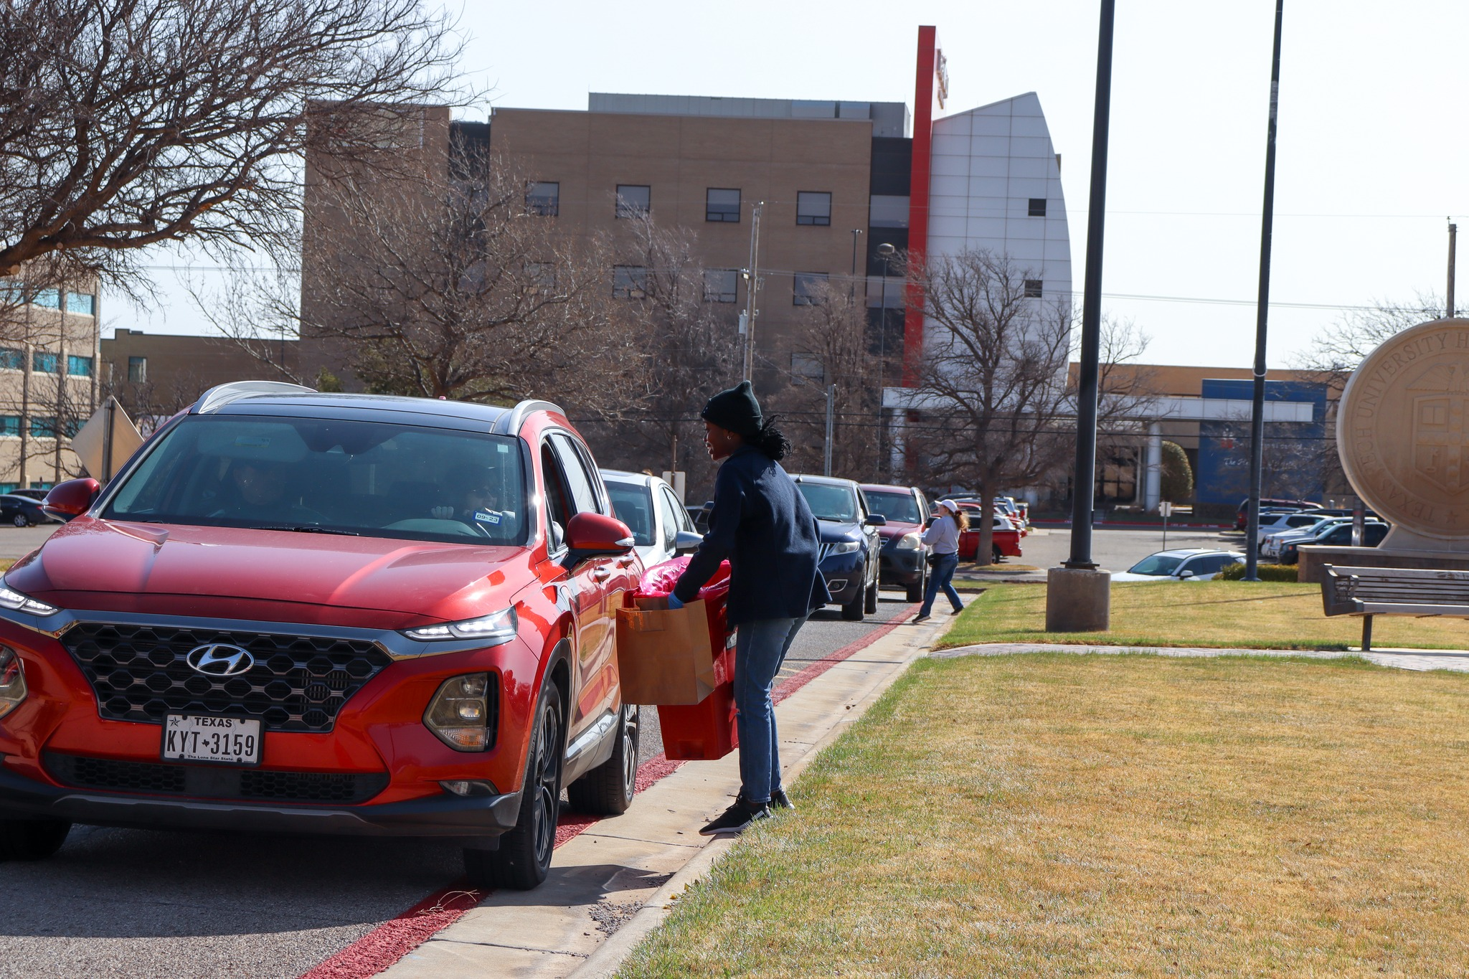
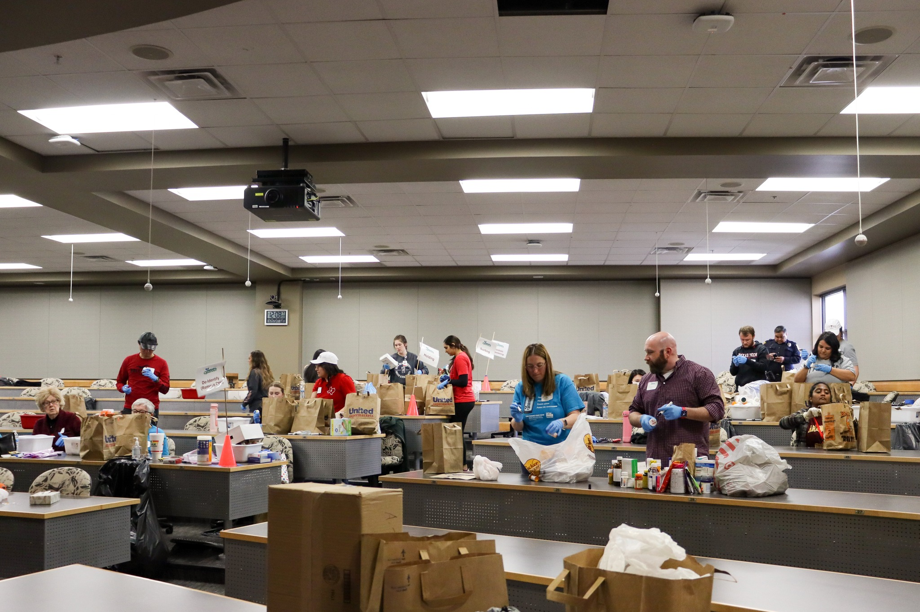
Medication Cleanout
1ST ANNUAL
WEST TEXAS HEALTH DISPARITIES
RESEARCH SYMPOSIUM
From 2009 to 2022, 80 Medication Cleanouts safely disposed of more than 75,000 pounds of unwanted medication and sharps.

Slide 6
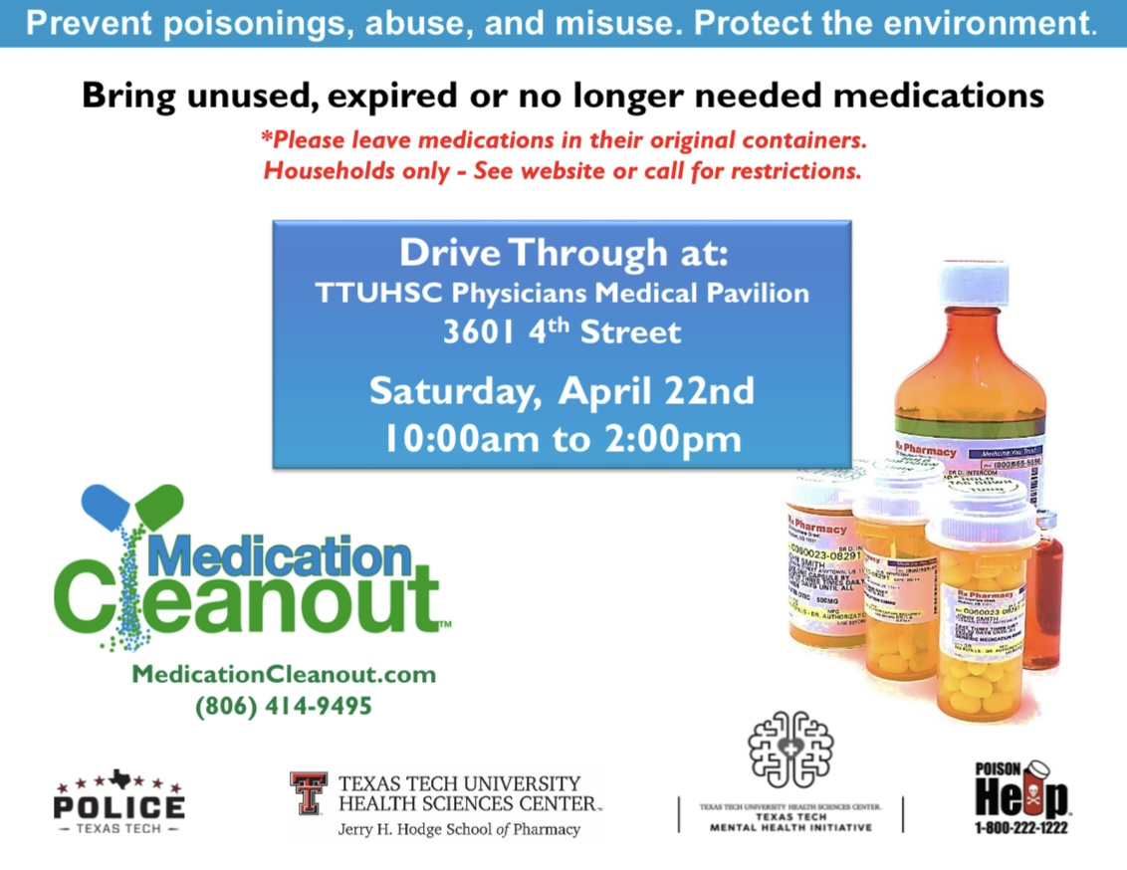
Promotion
1ST ANNUAL
WEST TEXAS HEALTH DISPARITIES
RESEARCH SYMPOSIUM

Slide 7
Hypothesis
1ST ANNUAL
WEST TEXAS HEALTH DISPARITIES
RESEARCH SYMPOSIUM
The Medication Cleanout Events in Lubbock County, Potter County, and Taylor County have seen a continuous increase in collection from 2009 to 2021 and demonstrate a significant avenue for the proper disposal of unused, expired, or unwanted medications and sharps for West Texas communities.

Slide 8
Background Data
1ST ANNUAL
WEST TEXAS HEALTH DISPARITIES
RESEARCH SYMPOSIUM
Utilizing Texas Health Data reported by the Texas Department of State Health Services, data regarding opioid related poison center calls was extracted for Lubbock County, Potter County, and Taylor County from 2009-2021².

Slide 9
Data
1ST ANNUAL
WEST TEXAS HEALTH DISPARITIES
RESEARCH SYMPOSIUM
Data was obtained from the director of the Medication Cleanout events for all three event locations (Lubbock County, Potter County, and Taylor County) in order to evaluate trends in collection during these take-back events from 2009 to 2021³.

Slide 10
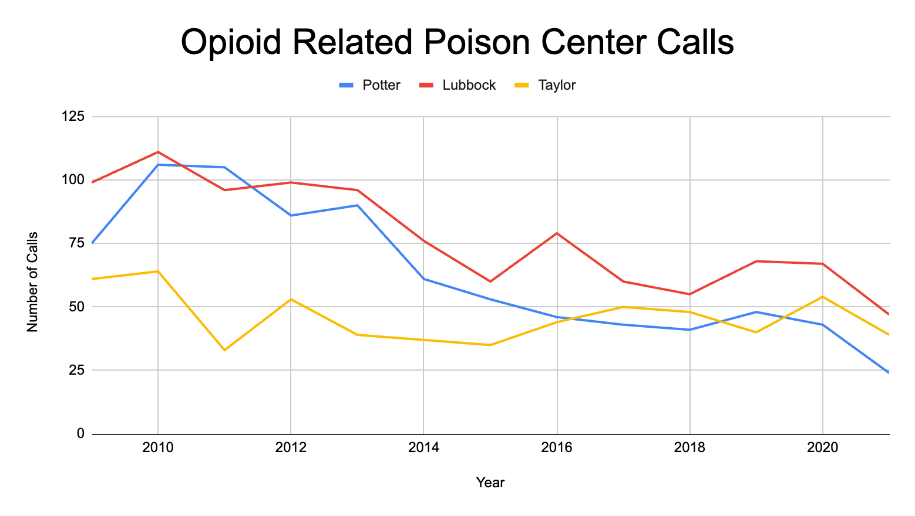
Data
1ST ANNUAL
WEST TEXAS HEALTH DISPARITIES
RESEARCH SYMPOSIUM

Slide 11
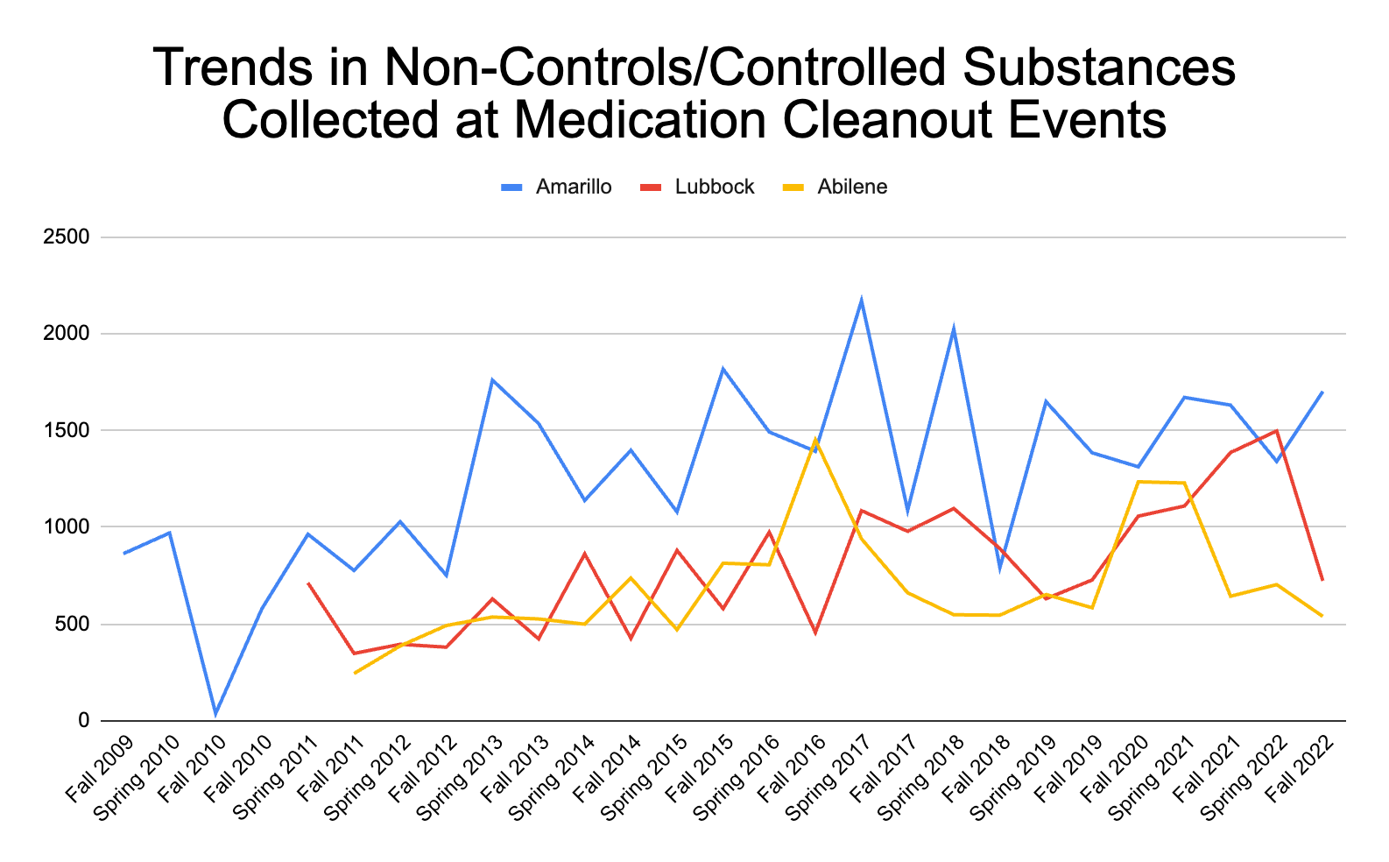
Data
1ST ANNUAL
WEST TEXAS HEALTH DISPARITIES
RESEARCH SYMPOSIUM

Slide 12
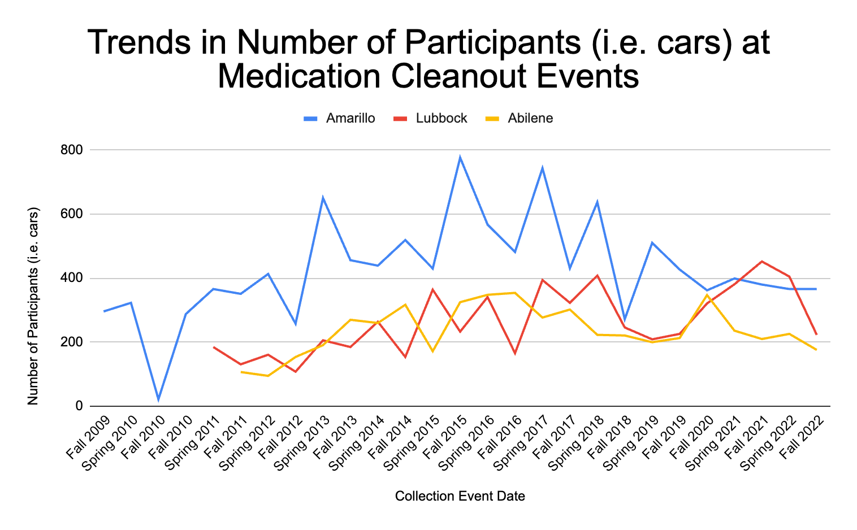
Data
1ST ANNUAL
WEST TEXAS HEALTH DISPARITIES
RESEARCH SYMPOSIUM

Slide 13
Conclusions
1ST ANNUAL
WEST TEXAS HEALTH DISPARITIES
RESEARCH SYMPOSIUM
The Medication Cleanout events play a significant role in addressing health disparities related to drug misuse in West Texas by providing a safe and environmentally friendly way for people to properly dispose of expired, unwanted or unnecessary medications.
It is evident that medication misuse remains a prevalent public health issue. Therefore, this intervention should continue to be prioritized as a means of addressing these health disparities in West Texas.

Slide 14
Future Studies
1ST ANNUAL
WEST TEXAS HEALTH DISPARITIES
RESEARCH SYMPOSIUM
Future studies should compare data from Lubbock County, Potter County, and Taylor County to neighboring counties to assess the impact that the collection events have on these West Texas counties.
At future events, participants’ residences should be logged to provide the opportunity for future studies to evaluate the coverage of each collection event.

Slide 15
Acknowledgements
1ST ANNUAL
WEST TEXAS HEALTH DISPARITIES
RESEARCH SYMPOSIUM
Dr. Jeanie Shawhart Pharm.D.
  TTUHSC School of Pharmacy
  Director-Medication Cleanout
Ronica Farrar
Texas Panhandle Poison Center

Slide 16
1ST ANNUAL
WEST TEXAS HEALTH DISPARITIES
RESEARCH SYMPOSIUM
Thank you!
Questions?

