Slide 1


Identification of Key Healthcare Disparities in West Texas Based on Age, Sex, Language, and Socioeconomic Status
Mythili Bulusu
1ST ANNUAL
WEST TEXAS HEALTH DISPARITIES
RESEARCH SYMPOSIUM
Notes:
For at least the past eight years, the child abuse rate in the Lubbock area has been about twice the rate of child abuse in Texas, making Lubbock the city with the highest rate of child abuse in Texas. According to The Children’s Advocacy Center of the South Plain, about 3 cases of child abuse or neglect occur every day in Lubbock County.
Child Abuse: Mythili Bulusu, Staney Thomas, Radha Patel, Gabriella Garcia, Deepashika Senaratne, Zainab Jafri, Joshua Willms
Joshua Willms Mythili Bulusu Brittany Love Emily Brumfield Radha Patel Matilyn Wang Natalie Yaeger Adeyemi Adeniran Samantha Brown Radha Patel Staney Thomas Gabriella Garcia Zainab Malik Deepashika Senaratne Nicholas Bergfeld

Slide 2
1ST ANNUAL
WEST TEXAS HEALTH DISPARITIES
RESEARCH SYMPOSIUM
DISCLOSURES
The authors declare that the research was conducted in the absence of any commercial or financial relationships that could be construed as a potential conflict of interest.

Slide 3

Overview
1ST ANNUAL
WEST TEXAS HEALTH DISPARITIES
RESEARCH SYMPOSIUM
Healthcare Disparities:
Substance Use Disorders
Cardiovascular Disease
Child Abuse
Notes:
These projects were conducted in partnership with The Lubbock Compact and Researchers for Change.

Slide 4
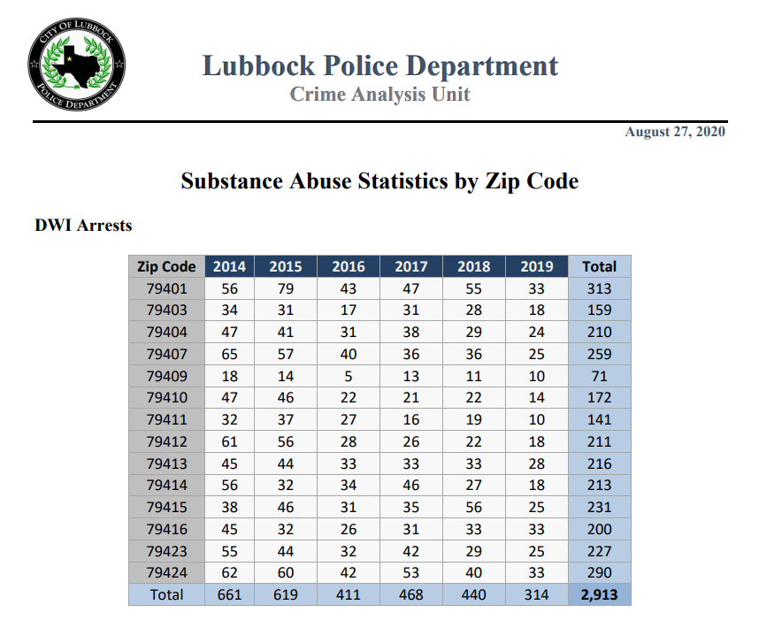
1ST ANNUAL
WEST TEXAS HEALTH DISPARITIES
RESEARCH SYMPOSIUM
Substance Use Disorders
Marijuana Possession Arrests
Narcotics Possession Arrests
Narcotics Distribution Arrests
Heroin Possession Arrests
Drug-Related Cases
Notes:
People in Lubbock tend to assume that if someone truly needs help, they can get it
This is NOT the case, depending on who you are and where you live

Slide 5
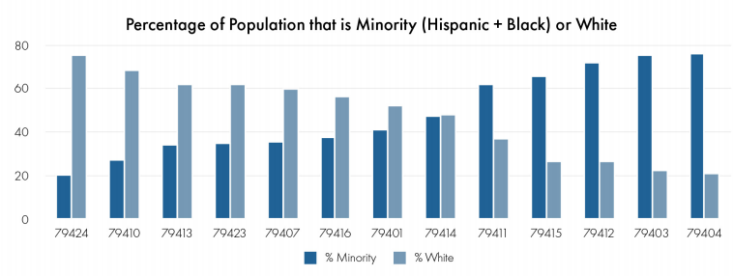
1ST ANNUAL
WEST TEXAS HEALTH DISPARITIES
RESEARCH SYMPOSIUM
Lubbock Zip Codes in Order of Increasing Minority Status

Slide 6
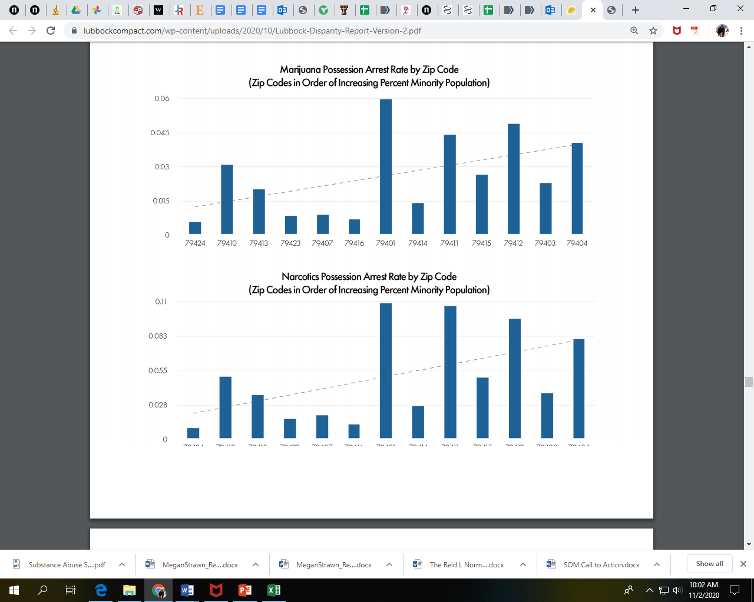
1ST ANNUAL
WEST TEXAS HEALTH DISPARITIES
RESEARCH SYMPOSIUM

Slide 7
1ST ANNUAL
WEST TEXAS HEALTH DISPARITIES
RESEARCH SYMPOSIUM

Slide 8
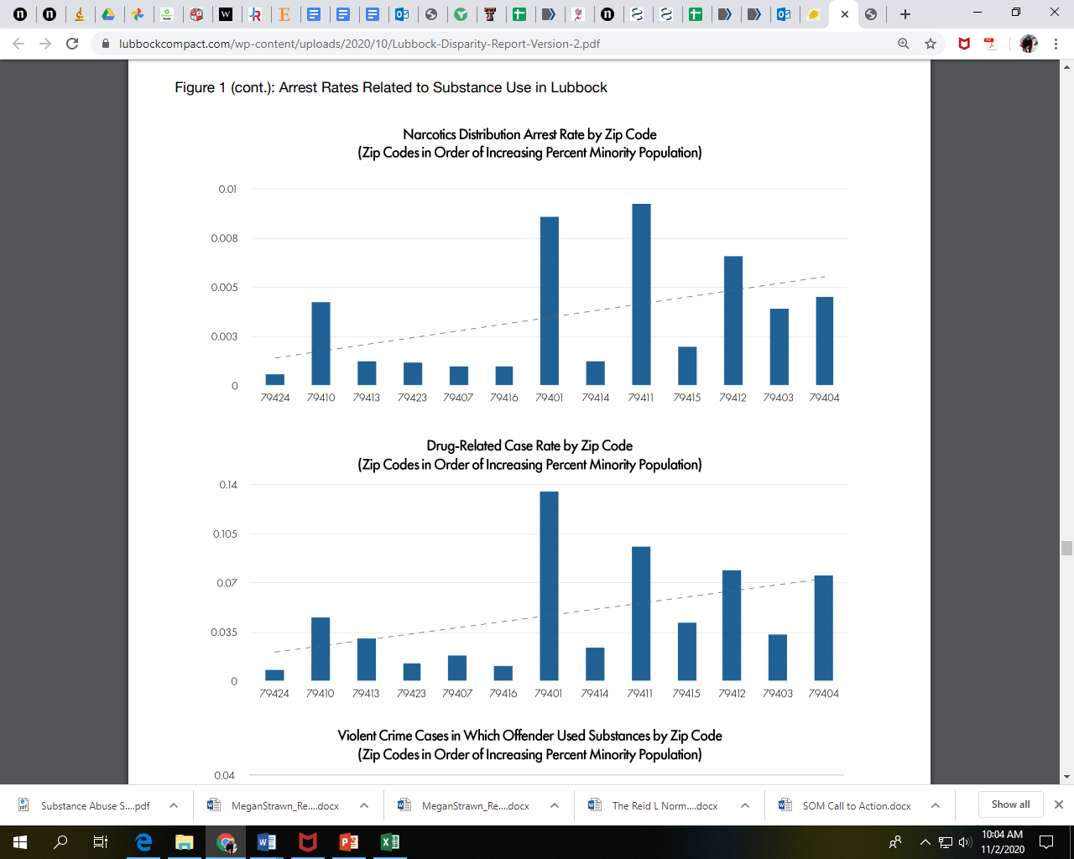
1ST ANNUAL
WEST TEXAS HEALTH DISPARITIES
RESEARCH SYMPOSIUM

Slide 9
1ST ANNUAL
WEST TEXAS HEALTH DISPARITIES
RESEARCH SYMPOSIUM

Slide 10
1ST ANNUAL
WEST TEXAS HEALTH DISPARITIES
RESEARCH SYMPOSIUM
Arrest rates were consistently the lowest in the lowest % minority zip codes
Arrest rates were consistently the highest in the highest % minority zip codes

Slide 11
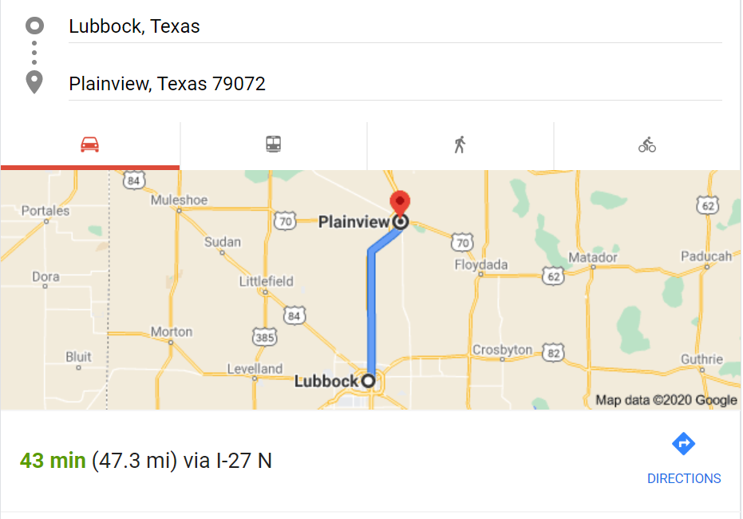
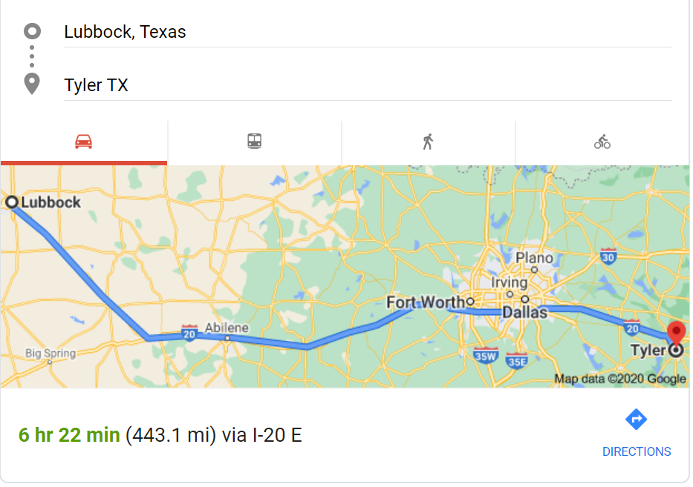
1ST ANNUAL
WEST TEXAS HEALTH DISPARITIES
RESEARCH SYMPOSIUM
Driving time to reach a treatment center for adolescents (13-18 years old)
Boys = 1 hour
Girls = 7 hours

Slide 12
1ST ANNUAL
WEST TEXAS HEALTH DISPARITIES
RESEARCH SYMPOSIUM
Cardiovascular Disease
402 out of every 100,000 people between the ages of 35 and over die from Heart Disease in TX compared to 317 out of 100,000 nationwide [1 ]
Many contributing factors:
  Lower socioeconomic status
  High healthcare expenses
  Less diversity and less access to doctors in rural areas
  Institutionalized racial and gender biases

Slide 13
1ST ANNUAL
WEST TEXAS HEALTH DISPARITIES
RESEARCH SYMPOSIUM
Socioeconomic Disparities
Correlation of Healthcare Affordability with Heart Disease [2]
  Patients without insurance are the most challenged when it comes to paying for healthcare needs
Correlation of Food Availability with Heart Disease [3]
  19% of people living within the Community Health Needs Assessment area are living in complete poverty
Correlation of Doctor Availability with Heart Disease [4]
  77% of rural counties were reported as Primary Care Health Professional Shortage Areas, outlining the lack of doctors in these areas and the subsequent lack of necessary medical care.

Slide 14
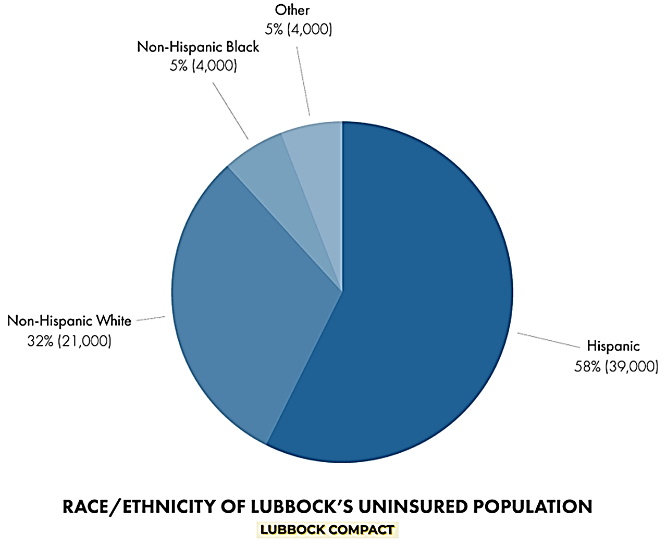
58% of the uninsured in Lubbock are Hispanic
Hispanics account for 36% of Lubbock’s total population

Slide 15
1ST ANNUAL
WEST TEXAS HEALTH DISPARITIES
RESEARCH SYMPOSIUM
Racial Disparities
Gender Disparities
Asians, Latinos, and African Americans are predisposed to illnesses such as diabetes and hypertension so more likely to get cardiovascular disease [5]
Less access to hospitals and less diversity in the healthcare system [6]
Need to transform thinking of healthcare professionals to create equality in the healthcare system
Dismissal of women’s heart-related concerns because of differences in presentation/symptomatology [7]
Women at higher risk of diabetes, hypertension, hypercholesterolemia, and obesity, which increases risk for cardiovascular disease [reference]
Women are less likely to be prescribed aspirins, stanins, and other blood pressure medications due to difference in symptoms [8]

Slide 16
1ST ANNUAL
WEST TEXAS HEALTH DISPARITIES
RESEARCH SYMPOSIUM
Conclusions
Healthcare disparities in West Texas are multifactorial, involving the complex interplay between individual characteristics and disease processes.
Socioeconomic status had the broadest impact, increasing risk for developing many disorders while simultaneously reducing access to care.
Age, sex, and language also played an important role.
Further studies are needed to document healthcare disparities based on age, sex, language, and socioeconomic status in West Texas.

Slide 17

1ST ANNUAL
WEST TEXAS HEALTH DISPARITIES
RESEARCH SYMPOSIUM
Contributors:
Mythili Bulusu
Brittany Love
Emily Brumfield
Radha Patel
Matilyn Wang
Natalie Yaeger
Adeyemi Adeniran
Tochi Eboh
Samantha Brown
Radha Patel
Staney Thomas
Gabriella Garcia
Zainab Malik
Deepashika Senaratne
Al Kankam
Nicholas Bergfeld
Joshua Willms
Editors, Graphic design
Mohammad Karkoutly
Adrian Reyna
Adam Muslow
Gloria Matheson
Jonah Remigio Zachary Brandner
Sydney Keim

Slide 18
Questions?
1ST ANNUAL
WEST TEXAS HEALTH DISPARITIES
RESEARCH SYMPOSIUM
Notes:
Medicine is often considered a homogenous field that serves a diverse population. The most recent report of physician demographics subdivided by race was realized by the Texas Health Professions Resource Center in 2015. In 2015, the racial composition of Texas’ physician population was approximately 63% White, 8% Hispanic, 5% African-American, and 24% Asian and other groups.295 Texas’ population, however, starkly contrasted this with a racial composition of 42% White, 40% Hispanic, 11% African American, and 6% Asian and other groups that same year.296 Racial and ethnic minorities are disproportionately absent from medicine and this has proven to be detrimental to quality of care for many patients. Numerous reports have documented the significant differences in health status and health care quality amongst racial minorities and these health care disparities translate into tangible health outcomes. When disparities lead to misdiagnoses and poor management of conditions, it thwarts efforts to improve the nation’s health and translates into higher costs for the health care system.297 Physician diversity leads to improved access to health for underserved patients. Racial minorities are 295 “Trends, Distribution, and Demographics: Direct Patient Care Physicians.” 296 Ibid. 297 Institute of Medicine (US) Committee on Understanding and Eliminating Racial and Ethnic Disparities in Health Care, Unequal Treatment. 97 generally more satisfied with their care and report receiving higher quality of care, when treated by a health professional from their own ethnic and racial background.298 Diversity begins in educational environments. Interacting with individuals from a variety of ethnic and cultural backgrounds during training has proven to prepare health care professionals to better serve diverse populations (Whitla 2003).299

Slide 19
References
Texas Department of State Health Services. “CDC Heart Disease and Stroke Map.” Texas Department of State Health Services. Accessed June 12, 2021. https://www.dshs.texas.gov/heart/MapWidget.aspx.
Shurmur, Scott “Interview with Dr. Scott Shurmur at TTUHSC by Radha Patel” Interviewed by Radha Patel. March 2, 2021.
UMC Health Systems. “Community Health Needs Assessment 2019.” https://www.umchealthsystem.com/docs/default-source/default-document-library/umc-chna---2019-final.pdf?sfvrsn=5d15361_2
Thomas, S. R., Holmes, G. M., & Pink, G. H. (2016). To what extent do community characteristics explain differences in closure among financially distressed rural hospitals?. Journal of health care for the poor and underserved, 27(4), 194-203.
Nair, Nandini “Interview with Dr. Nandini Nair at TTUHSC by Adeyemi Adeniran” Interviewed by Adeyemi Adeniran. April 14, 2021.
James, C. V., Moonesinghe, R., Wilson-Frederick, S. M., Hall, J. E., Penman-Aguilar, A., & Bouye, K. (2018). Racial/Ethnic Health Disparities Among Rural Adults—United States, 2012–2015: MMWR Surveillance Summaries / November 17, 2017 / 66(23);1–9. Journal of Health Care for the Poor and Underserved, 29(1), 19–34. https://doi.org/10.1353/hpu.2018.0003
Maas, A.H.E.M., and Y.E.A. Appelman. “Gender Differences in Coronary Heart Disease”.
Netherlands Heart Journal 18, no. 12 (2010): 598–603. doi:10.1007/s12471-010-0841-y.
Gaggin, Hanna, and Andrew Oseran. “Gender Differences in Cardiovascular Disease: Women Are Less Likely to Be Prescribed Certain Heart Medications.” Harvard Health, July 16, 2020. https://www.health.harvard.edu/blog/gender-differences-in-cardiovascular-disease-women-are-less-likely-to-be-prescribed-certain-heart-medications-2020071620553
1ST ANNUAL
WEST TEXAS HEALTH DISPARITIES
RESEARCH SYMPOSIUM
Notes:
Medicine is often considered a homogenous field that serves a diverse population. The most recent report of physician demographics subdivided by race was realized by the Texas Health Professions Resource Center in 2015. In 2015, the racial composition of Texas’ physician population was approximately 63% White, 8% Hispanic, 5% African-American, and 24% Asian and other groups.295 Texas’ population, however, starkly contrasted this with a racial composition of 42% White, 40% Hispanic, 11% African American, and 6% Asian and other groups that same year.296 Racial and ethnic minorities are disproportionately absent from medicine and this has proven to be detrimental to quality of care for many patients. Numerous reports have documented the significant differences in health status and health care quality amongst racial minorities and these health care disparities translate into tangible health outcomes. When disparities lead to misdiagnoses and poor management of conditions, it thwarts efforts to improve the nation’s health and translates into higher costs for the health care system.297 Physician diversity leads to improved access to health for underserved patients. Racial minorities are 295 “Trends, Distribution, and Demographics: Direct Patient Care Physicians.” 296 Ibid. 297 Institute of Medicine (US) Committee on Understanding and Eliminating Racial and Ethnic Disparities in Health Care, Unequal Treatment. 97 generally more satisfied with their care and report receiving higher quality of care, when treated by a health professional from their own ethnic and racial background.298 Diversity begins in educational environments. Interacting with individuals from a variety of ethnic and cultural backgrounds during training has proven to prepare health care professionals to better serve diverse populations (Whitla 2003).299

Slide 20
Supplemental Slides

Slide 21
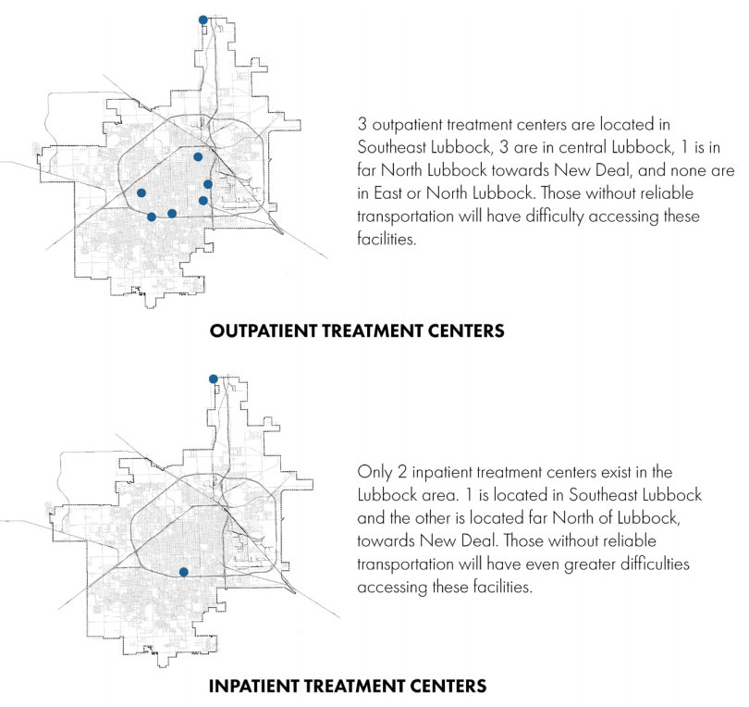
Additional Topics
Binge/Heavy drinking rates by race/income/age/sex
Socioeconomic status
Transportation
Religion
Language
Ethnic representation of providers
Expert perspectives
Personal accounts
Gaps in knowledge

Slide 22
  Managed Care – Suddenly closed in 2019
  The only accessible, state-supported, inpatient substance use disorder treatment center in the Lubbock area.
  Provided 53 inpatient beds and 120 outpatient slots.
  Treated both male and female patients, but only provided transitional living for female patients.
  These treatment resources were an asset to the community as they provided affordable or free treatment to a population that is often without the financial capital to seek treatment
  *The Lubbock Health Department plans to fill the gap to cover patients who lost treatment access, but these projects are only in the beginning phases

