Slide 1

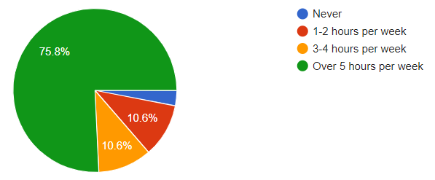
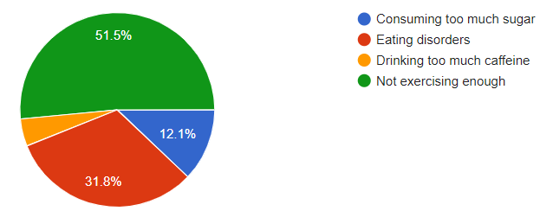
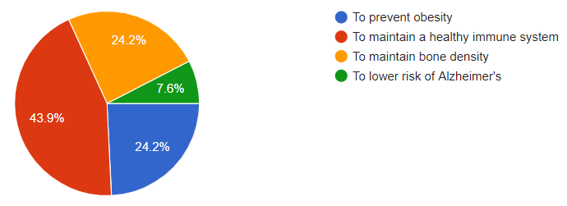
Awareness of the Female Athlete Triad in Middle and Highschool Students
Karishma Desai, Bernardo Galvan, Katherine Holder, Kwame Opoku, Abbie Raef
Faculty Facilitator: Dr. Mimi A Zumwalt, MD
Patients, Physicians & Populations 1 (P3-1) • Spring 2020
Abstract & Background
The Female Athlete Triad is a combination of disordered eating, menstrual irregularity, and low bone mass resulting in lifelong consequences for physically active females. The triad is caused by a caloric imbalance and is associated with significant medical morbidity. Awareness of the triad’s symptoms could help young athletes and coaches identify the syndrome. Prompt identification and treatment are essential to prevent adverse health complications in young athletes. The goal of this study is to assess awareness and knowledge of the female athlete triad among middle and high school athletes who attend a small private school in Lubbock, Texas.
Study Population
Due to the fact that the female athletic triad is most prevalent among young females, especially those who engage in sports or vigorous exercise, middle and high school students from a local private school in Lubbock, TX were chosen to participate in a survey asking them of their familiarity with the condition and its effects. The ages of the respondents ranged from 11 to 18 years of age. Both male and female students from this private school responded to this survey.
Data Collection Method
Quantitative data was collected from the students at All Saints Episcopal School (middle school and high school) using a Google Form questionnaire with ten multiple-choice questions. The form was sent to the principals of the schools and was distributed by them.
Results
A total of 69 responses were collected. Three were excluded since the respondents submitted incomplete questionnaires. In our survey, we chose to accept male respondents to gauge the age groups, as a whole, of their knowledge on the female athletic triad and its consequences. Males were excluded from one question asking if they have started their periods and if so, how often. We used a total of 66 responses. With gender distribution 32 female (48.5%) and 34 male (51.5%). Our age distribution consisted of 11-12, 2 responses (3%); 13-14, 7 responses (10.6%); 15-16, 35 responses (53%); 17-18, 22 responses (33.3%). Regarding how many hours per week students engaged in sport related exercise, there was a predominant selection for over 5 hours per week with 50 responses (75.8%). Followed by an even split between 3-4 and 1-2 hours per week with 7 responses each (10.6% respectively). Two respondents (3%) indicated they had never participated in such activity. In identifying which sport our participants were involved in, we offered 11 different answer choices and allowed for multiple sports to be selected by students. Football 12 (18.2%), Soccer 0 (0%), Dance 5 (7.6%), Golf 7 (10.6%), Cheerleading 9 (13.6%), Track and Field 37 (56.1%), Swimming 2 (3%), Tennis 21 (31.8%), Basketball 31 (47%), Volleyball 14 (21.2%), None 6 (9.1%). Familiarity with the term “female athletic triad” was recorded with a scale of 0-5: zero indicating no familiarity, and 5 indicating very high familiarity. For this question, 56 (84.8%) selected 0, 8 (12.1%) selected 1, and 2 (3%) selected 2. Familiarity ranges 3-5 collectively received no responses. The same questioning method was used for the term “sports-related amenorrhea,” except a 1-5 scale was utilized. Fifty six (84.8%) selected 1, 5 (7.6%) selected 2, 2 (3%) selected 3, 2 (3%) selected 4, and 1 (1.5%) selected 5. Those that indicated they were female were asked how often they experience their period if they have undergone menarche: Once a month 27 (84.4%), Once every 2-3 months (9.4%), and 2 respondents indicated they had not started their period. The last three questions were placed on the survey to test more detailed knowledge of the female athletic triad. Beginning with a question asking students to identify a risk factor: 34 responses (51.5%) indicated Not exercising enough, 21 responses (31.8%) indicated Eating disorders, 8 responses (12.1%) indicated Consuming too much sugar, and 3 responses (4.5%) indicated Drinking too much caffeine. The next question asked about a symptom: 43 responses (65.2%) indicated Irregular period, 11 responses (16.7%) indicated Headache, 9 responses (13.6%) indicated Blurred Vision, and 3 responses (4.5%) indicated Uncontrolled allergies. The final question asked about a long-term health benefit with avoidance of sports related amenorrhea: 29 responses (43.9%) indicated To maintain a healthy immune system, 16 responses (24.2%) indicated To maintain bone density, 16 responses (24.2%) indicated To prevent obesity, and 5 responses (7.6%) indicated To lower risk of Alzheimer's.
Results imply a very athletic population with little knowledge of what the Female Athletic Triad consists of and consequences of sports related amenorrhea. Consequences of these clinical conditions may not be completely reversible, so prevention, early diagnosis, and intervention are critical.
Discussion
From the results of the survey, it is observed that most students claimed to be unfamiliar with the concept of the female athletic triad, and the majority of students claimed unfamiliarity with the term “amenorrhea.” Additionally, it is noted that while a large majority of students indicated that they exercised over 5 hours a week, female students at the observed schools do not seem to be experiencing amenorrhea related to exercise or participation in sports.
This study shows that there is a need for educating middle and high school students on the female athletic triad. While our survey results concluded that students do not seem to be experiencing effects of the athletic triad or amenorrhea from physical exercise, our results also showed that both male and female students were unfamiliar with the term “amenorrhea” and not educated on the topic of the female athletic triad. This was proved further by the results of the three content-related questions included in the survey, which tested knowledge about the female athletic triad. The need for education on this topic is significant, because intervention and education are the first steps to eliminating possible consequences that may arise from the female athletic triad.
Our study was limited by the population size of the group surveyed, so in future studies, it may be helpful to survey a larger group of students. Additionally, our surveying technique could be improved to better quantify results, as it is noted that we asked the students to rank their familiarity of the term “female athletic triad” on a scale of 0-5, but we asked the students to rank familiarity of the term “amenorrhea” on a scale of 1-5. Overall however, our study was successful in identifying an educational need for middle and high school students.
Case Next Steps
Create an educational PowerPoint to teach the students about the female athletic triad
Make posters to be hung up and distributed throughout the two schools
Re-quiz the students to test their new knowledge of the female athletic triad
Fig 1. Student hours per week spent exercising in sport related activities
Fig 2. Student responses at a possible cause of sports related amenorrhea
References
Brown, K. N., Wengreen, H. J., & Beals, K. A. (2014). Knowledge of the Female Athlete Triad, and Prevalence of Triad Risk Factors among Female High School Athletes and their Coaches. Journal of Pediatric and Adolescent Gynecology, 27(5), 278–282. doi: 10.1016/j.jpag.2013.11.014
Female athlete triad. Retrieved from https://www.acog.org/en/Clinical/Clinical Guidance/Committee Opinion/Articles/2017/06/Female Athlete Triad
Loveless, MD, M., & Hewitt, MD, G. (2017). Committee Opinion No. 702 Summary. Obstetrics & Gynecology, 129(6), 1151–1152. doi: 10.1097/aog.0000000000002109
Fig 3. Student responses at a possible health benefit of avoiding amenorrhea

