Slide 1
Contact lenses: Past, Present and Future
Matthew Mahek, OD
TTUHSC Department of Ophthalmology and Visual Sciences

Slide 2
Financial disclosures

Slide 3
Objectives
Described a variety of uses for contact lenses
Discuss the complications associated with contact lenses
Discuss the present and future advances in contact lenses

Slide 4
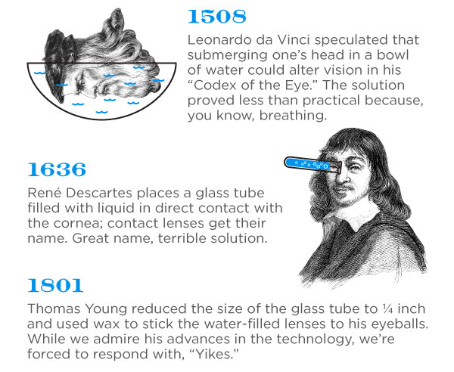

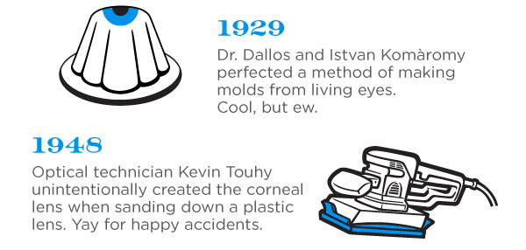
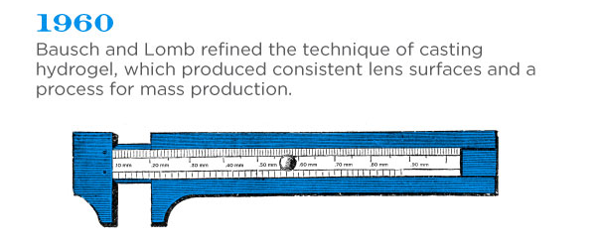
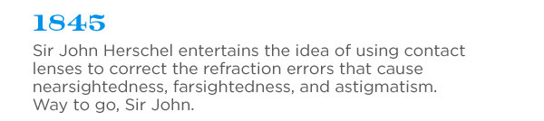
HISTORY OF CONTACT LENSES

Slide 5
HISTORY OF CONTACT LENSES
1979 — The introduction of rigid gas permeable contact lenses
1981 — The introduction of soft extended wear contact
1982 — The launch of soft bifocal contacts
1986 — The introduction of extended wear GP contact lenses
1987 — The launch of disposable contact lenses
1995 — The introduction of daily disposable contact lenses
1999 — The introduction of silicon hydrogel contact lenses
2002 — Silicone hydrogel contact lenses first marketed in U.S.
2010 — Custom-manufactured silicone hydrogel in U.S.

Slide 6
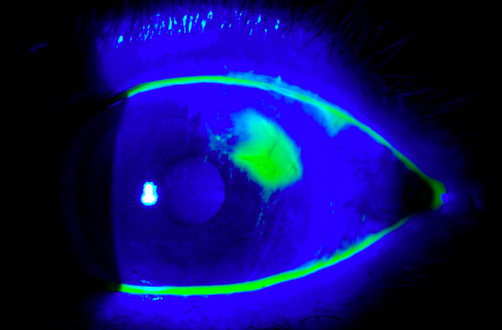
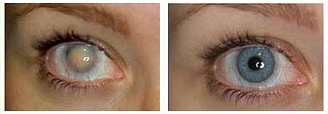
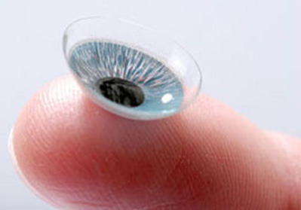
Uses for Contact lenses
Refractive Error
  Especially helpful for high refractive errors
  Anisometropia
Bandage Contact Lens
  Abrasions
  Recurrent Corneal Erosion
  Dry eye
Irregular Corneas
  Keratoconus
  Post-surgical
  Corneal Scarring
Ocular Surface Disease
Costmetic

Slide 7
Important properties of lens materials
Dk
  Measurement of how much oxygen passes thru a lens
  Oxygen transmissibility
  Varies on lens thickness
Water Content
  Higher H₂O = higher Dk

Slide 8
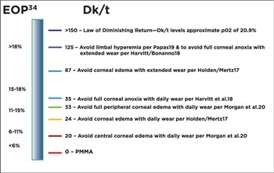
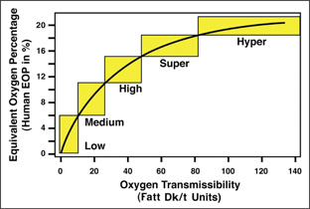
Lens materials
Dk – measurement of how much oxygen passes through a contact lens

Slide 9
DK FOR COMMONLY PRESCRIBED LENSES
Lens | Dk | Water Content
Dailies AquaComfort Plus | 26 | 69%
1-Day Acuvue Moist | 28 | 58%
Acuvue 2 | 28 | 58%
Proclear | 34 | 62%
Acuvue Oasys | 103 | 38%
Acuvue Vita | 103 | 41%
Air Optix Aqua | 110 | 33%
PureVision | 112 | 36%
Ultra | 114 | 46%
Biofinity | 128 | 48%
Dailies Total 1 | 140 | 33% core; >80% surface
Night and Day | 140 | 24%

Slide 10
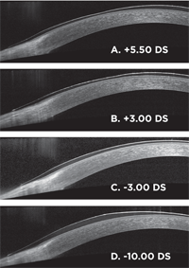
LENS THICKNESS
High minus = thicker edge
High plus = thicker center
Dk/T
  T = Lens Thickness
  Higher thickness = less oxygen transmission

Slide 11
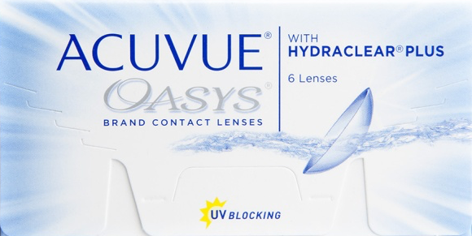
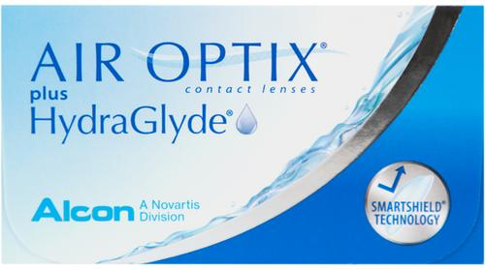
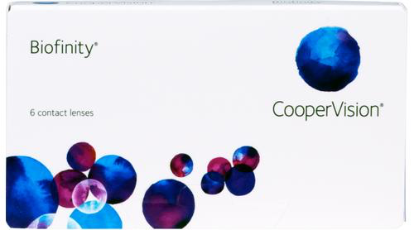
Silicone hydrogels
Silicone Hydrogel
  Advantages
    High Dk
    Less hypoxia
    Extended Wear
    Comfort?
  Disadvantages
    Less wettability
    Higher modulus
    Cost
    GPC

Slide 12
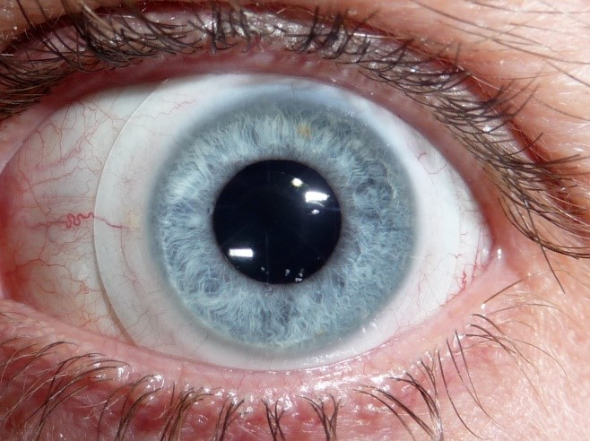
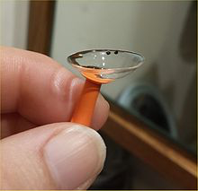
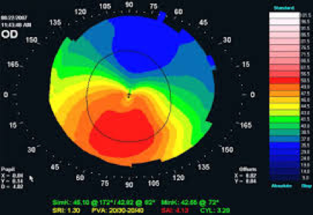
Scleral lenses
Benefits
  Better comfort
  More stability
  Visual acuity
  Advanced irregularity
Fitting
  Central clearance
  Limbal fit
  Edge
Wear and care

Slide 13
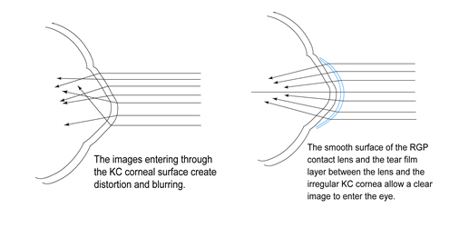
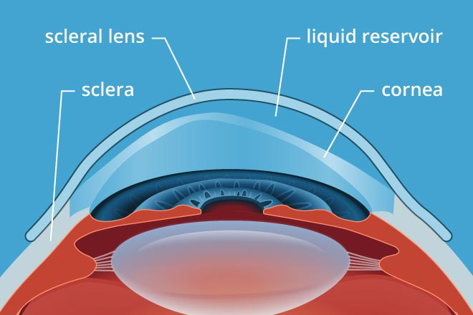
Why RGP and scleral Lenses?
The scleral lens allows a reservoir of tears to form between the irregular cornea and the scleral lens
This provides a more regular refractive surface and better vision

Slide 14
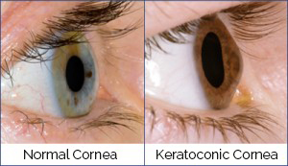
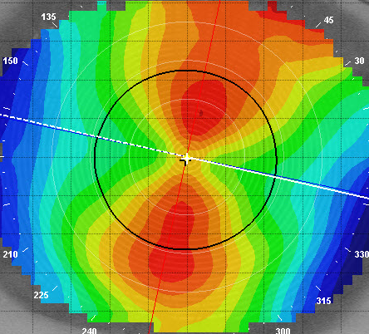
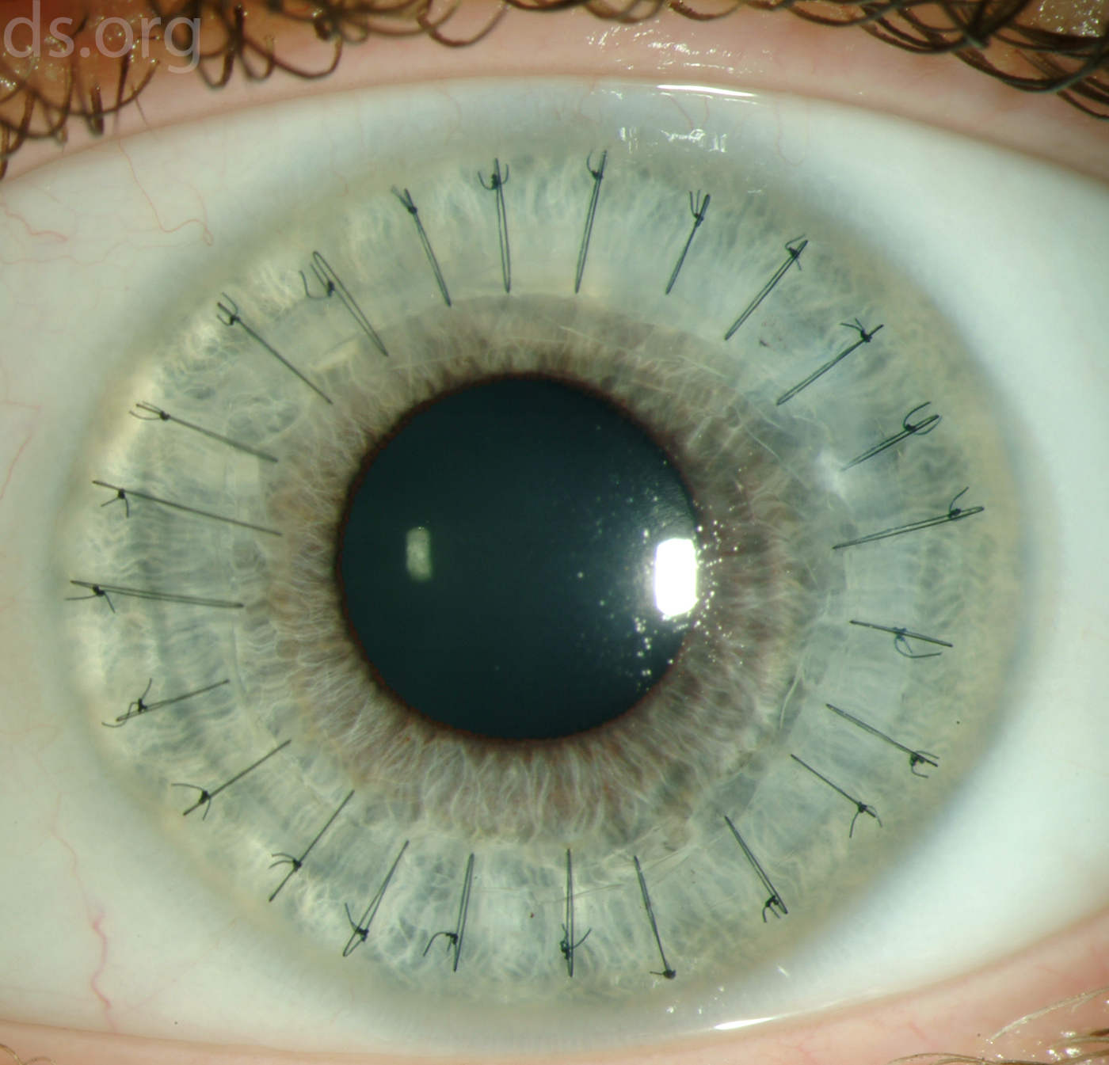
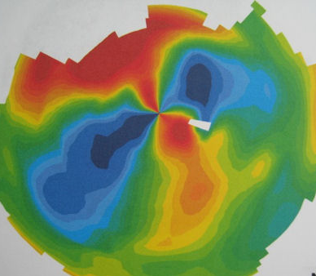
Comparing corneas
Normal Cornea
Bow-tie pattern
Superior = Inferior
Keratoconus
Inferior steepening
Superior ≠ Inferior
Corneal Transplant
Varying irregularity

Slide 15
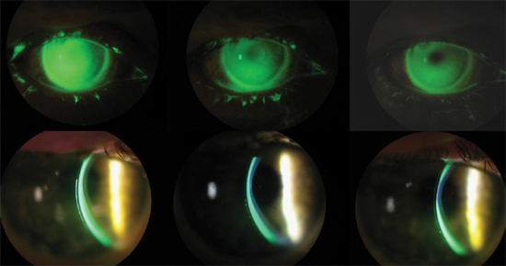
Scleral lens fitting

Slide 16
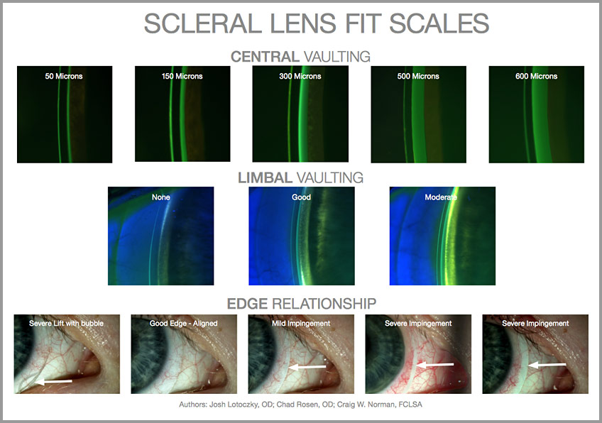
Scleral lens fitting

Slide 17
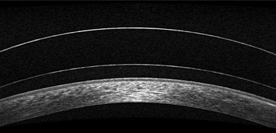
Scleral lens fitting
Scleral Lens
Tear Reservoir
Cornea

Slide 18
Contact lens complications
GPC
CLARE
Contact Lens induced infiltrate
Bacterial keratitis
Acanthomoeba

Slide 19
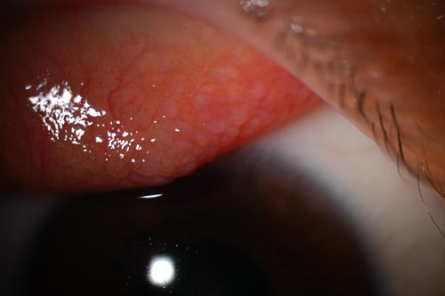
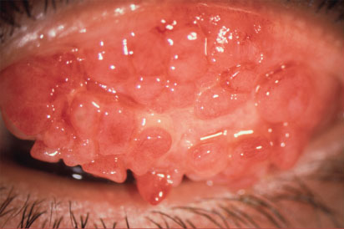
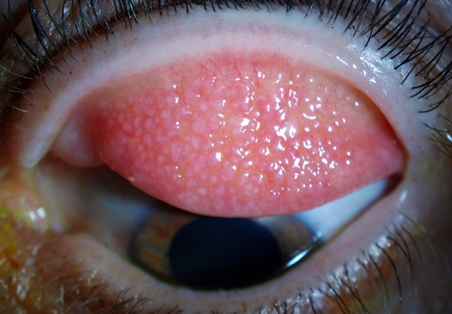
Giant papillary conjunctivitis
Allergic conjunctivitis caused by mechanical irritation
More common in SiHy lenses
Symptoms
  Irritation both with and without contact lens present
  Excessive lens movement
Treatment
  Mild – anti allergy drops
  Severe – Steroid
Prevention
  H₂O₂ Solution
  Daily allergy drop
  Daily disposable lenses

Slide 20
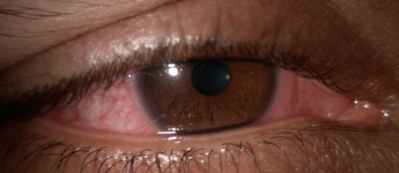
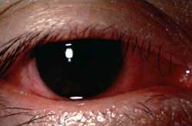
Contact lens acute red eye – CLARE
Inflammatory reaction (not infectious!)
Symptoms
  Pain
  Redness
  Watering
  Photophobia
Treatment
  Antibiotic and steroid combo
  D/C contact lens wear
Prevention
  Improve compliance
  Higher D/k lens

Slide 21
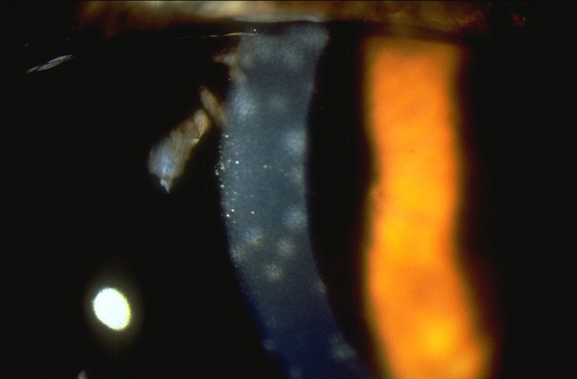
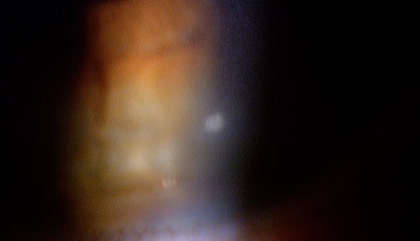
Corneal infiltrate
Hypoxia, hypersensitivity
Inflammatory (not infectious!)
Symptoms
  Pain
  Redness
  Watering
  Photophobia
Treatment
  Antibiotic and steroid combo
  D/C contact lens wear
Prevention
  Improve compliance
  Higher D/k lens

Slide 22
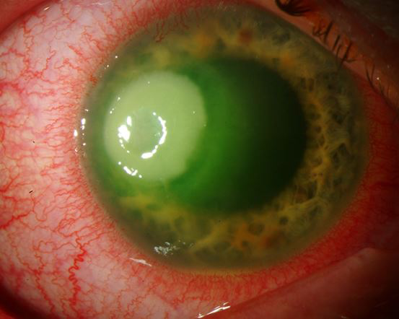
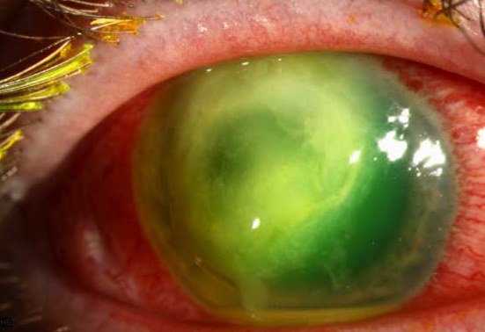
Bacterial keratitis
Cause
  Pseudomonas aeruginosa
  S. aureus, S. epidermidis, S. pneumoniae
  Moraxella
Treatment
  Culture
  Aggressive antibiotics
    Fluoroquinolone
    Fortified
Prognosis
  depends on extent and location of infection

Slide 23
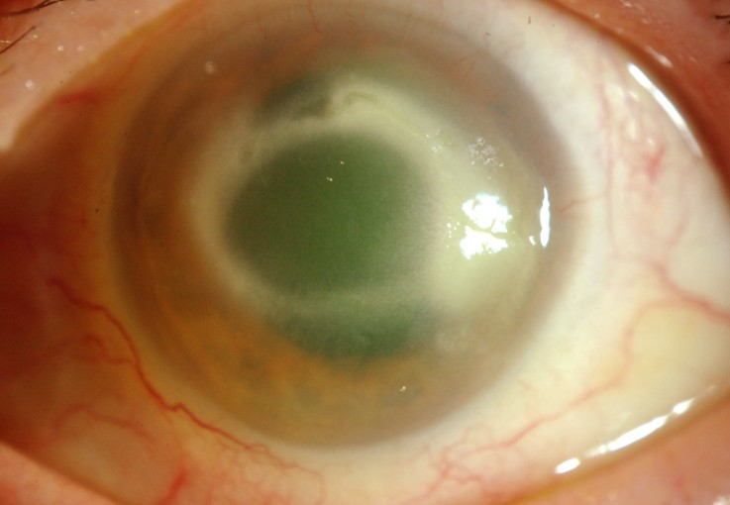

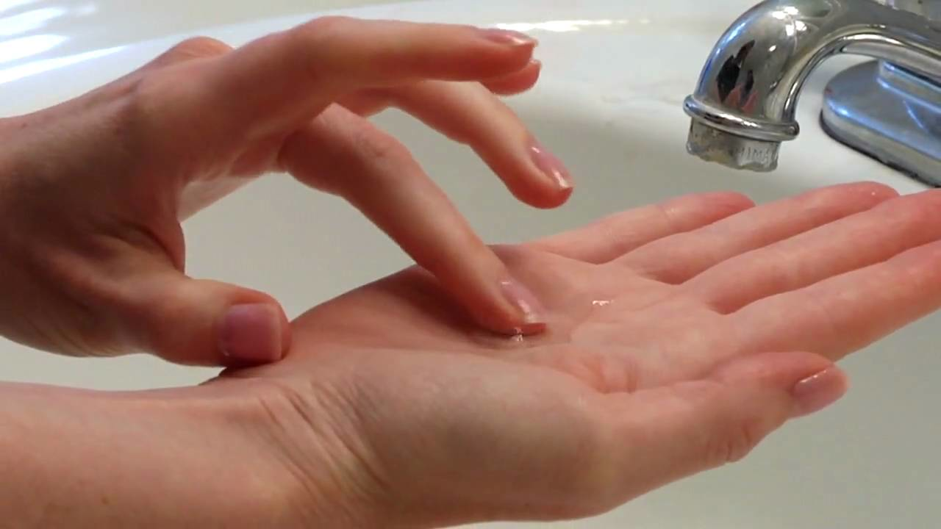
Acanthomoeba Keratitis
Cause
  Acanthamoeba
Treatment
  Topical antiamoebics
  Topical antibiotics
  Prevention!
Prognosis
  Ranges from complete recovery to corneal transplant

Slide 24
Current and future advancements
Extending Range of SiHy Lenses
Transitions
Selenium infused lenses
Medication Delivery
Glucose monitoring

