Slide 1
Managing Stress
The importance of self care and how it affects your mental health
Kristie Collins, LPC, LMFT
Associate Director for the Counseling Center @TTUHSC
Program of Assistance for Students
Notes:
Question: What is self care and how does it impact your mental health?

Slide 2


What is Self care and how does it affect your mental health?
Mental health is the successful performance of mental function.
The term self-care describes the actions that an individual might take in order to reach optimal physical and mental health. Self-care can also refer to activities that an individual engages in to relax or attain emotional well-being, such as meditating, journaling, or visiting a counselor.
Intentionality
Notes:
Question: What is self care and how does it impact your mental health?
It is important to note that self-care for most of us involves INTENTIONALITY

Slide 3
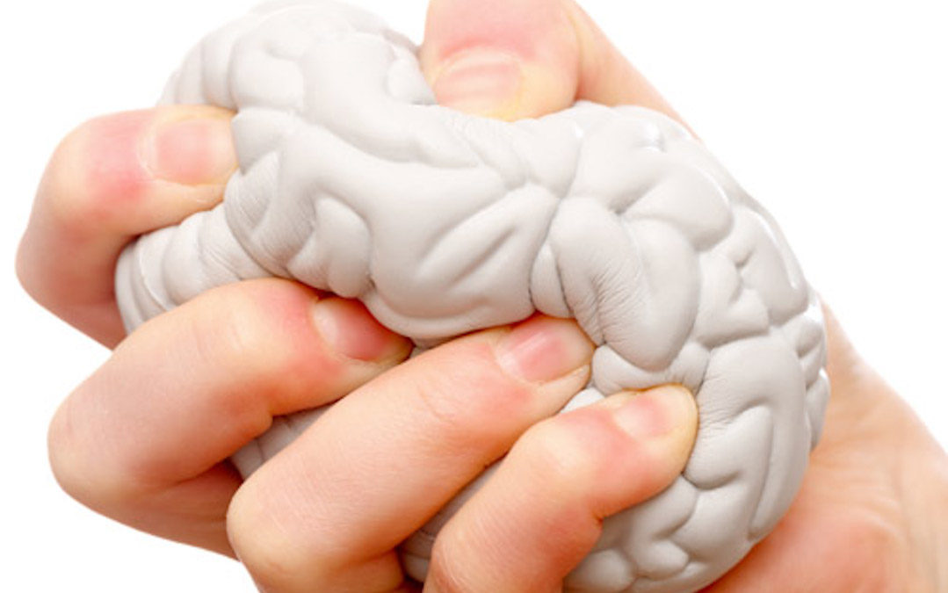
Unmanaged
Stress
Unmanaged
Anxiety
Depression
Learn to manage your stress!
It’s not simple or easy but
it is possible.
Notes:
Lets take a look at the relationship between stress, anxiety, and depression.
–Dr. Curt Thompson, a neuro-psychiatrist says depression becomes a symptom the anxiety I can not manage.
Example: me preparing to run a marathon

Slide 4
Anxiety is a physiological response
Performance
Beneficial
Resource
Blessing
Harmful
Liability
Curse
Anxiety
Notes:
Anxiety affects our body.

Slide 5
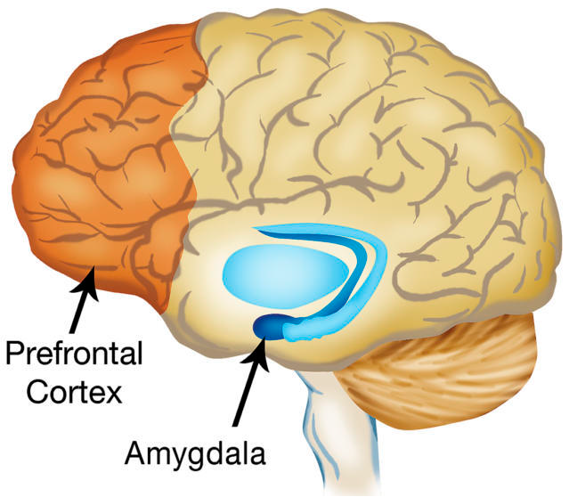
Anxiety is a physical response
Prefrontal Cortex: part of “higher” functioning, meaning it is used to:
Define
Create
Respond
Plan
Reason
Judge
Amygdala: involved in processing emotions, and fear-learning. It links areas of the prefrontal cortex to the brainstem systems.
Smoke detector
Fight/Flight or Freeze response
Notes:
Understanding our brain and how it works helps us to understand anxiety.
When faced with a threatening situation, our thalamus, which receives incoming stimuli, sends signals to both the amygdala and the cortex.
If the amygdala senses danger, it makes a split second decision and begins the fight-or-flight response before the cortex has time to overrule it.
This cascade of events triggers the release of adrenaline (epinephrine), which leads to increased heart rate, blood pressure, and breathing. You may experience a racing heart, shaking, sweating, and nausea as this happens.
In this way, the amygdala triggers a sudden and intense unconscious emotional response that shuts off the cortex, making it hard for you to think clearly about the situation. As your brain triggers the release of stress hormones such as cortisol, you find it increasingly hard to problem solve and concentrate. This whole process takes a toll, and you may not recover to your original level of functioning for several hours.

Slide 6
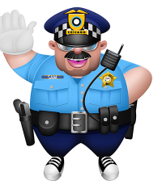
Amygdala acts as our smoke alarm
Search
SAM
Alert
Mobilize
Notes:
Analogy: smoke detector in the home I grew up in going off every time my mother cooked
The term "amygdala hijack" was coined by psychologist Daniel Goleman in his 1995 book, Emotional Intelligence: Why It Can Matter More Than IQ. Goleman used the term to recognize that although we have evolved as humans, we retain an ancient structure in our brain that is designed to respond swiftly to a threat. While at one time this was designed to protect us, it can interfere with our functioning in the modern world where threats are often more subtle in nature.

Slide 8
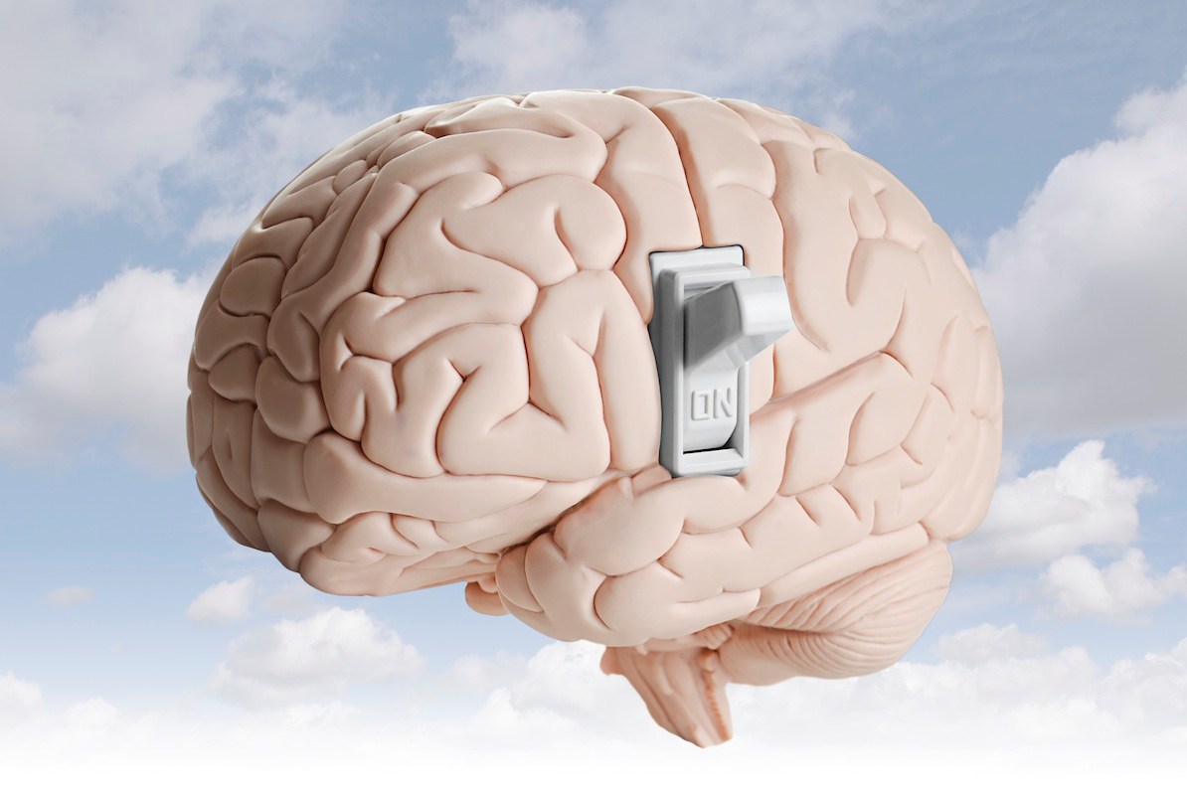
You can learn to manage your stress
Whether you were born with a brain that tends to create anxiety or acquired your anxiety problems as a result of life experiences, you can cope with anxiety. We have proof
through science that a positive
environment can turn off bad genes.
-Rewire Your Anxious Brain by Pittman and Karle

Slide 9
You can learn to manage anxiety
We have to take personal responsibility for the way we think, speak, and act. We need to stop being victims of our biology, of what happens to us and start being victors. -Dr. Caroline Leaf

Slide 10
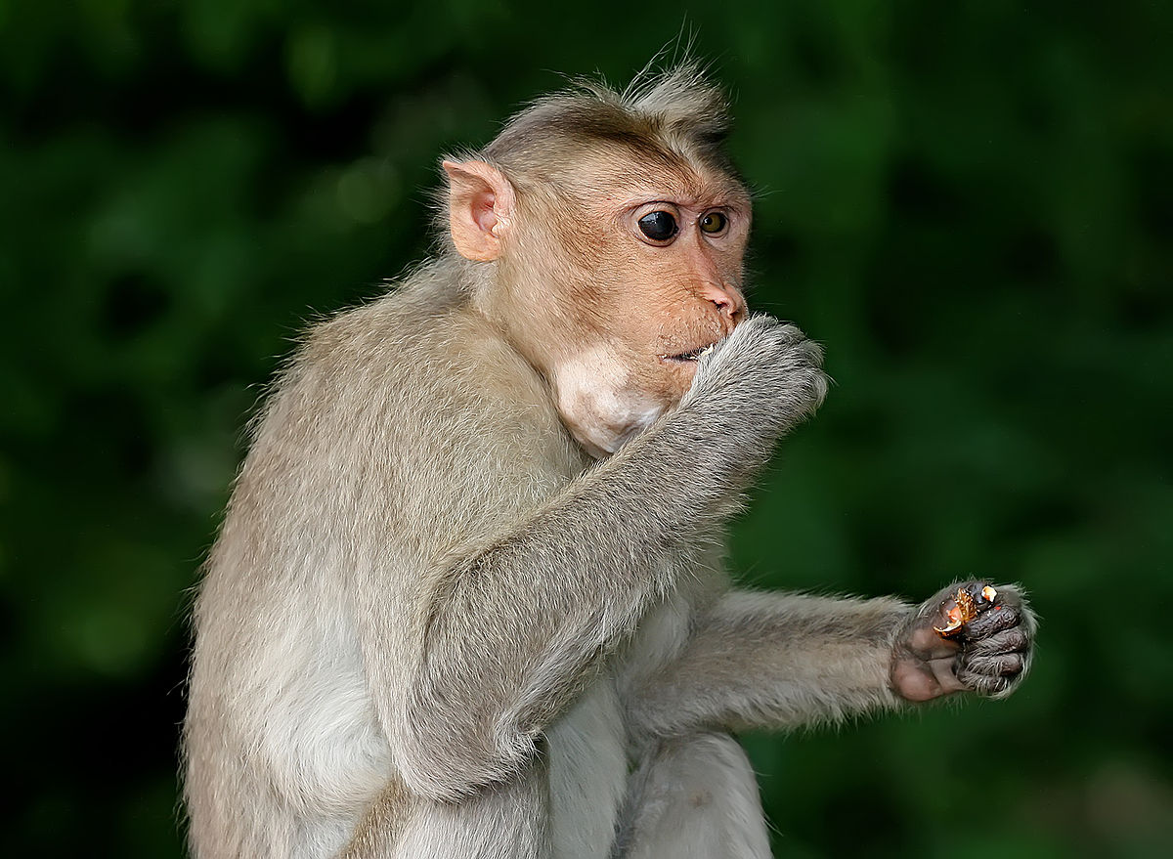
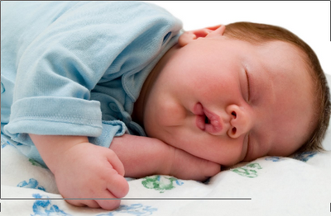


SELF-TALK
SELF-CARE
  Eating
  Sleeping
  Exercising
  Mindfulness

Slide 11
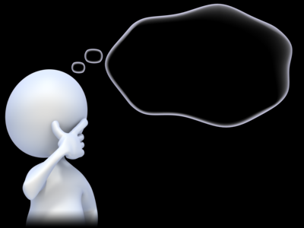
Self talk
The inner dialogue we have going in our head every waking moment
  Helps form our identity
  Determines our values
  Causes feelings such as
    Anxiety
    Depression
Positive
Negative
Neutral
Interesting Fact:
You do not question your own self talk!
What you tell yourself becomes your reality!

Slide 12

Conscious vs. subconscious Mind
Conscious Mind - 5 to 7 thoughts every second
Subconscious Mind – 2 million bits of info every second
Problem: Much of our negative thinking happens in the subconscious mind while we are unaware

Slide 13
Anxiety-Igniting Thought | Coping Thoughts
It's no use trying. Things will never work out for me. | I'm going to try, because then there's at least a chance that I'll accomplish something.
Something's going to go wrong. I can feel it. | I don't know what's going to happen. These kinds of feelings have been wrong before.
I need to focus on this thought, doubt, or concern. | Cortex, you've spent too much time on this and need to move on.
I must be competent and excel at everything I do. | No one is perfect, I'm human and expect I'll make mistakes at times.
Everyone should like me. | No one is liked by everyone, so I'll encounter people who don't like me.

Slide 14



Mindfulness
Definition of mindfulness: maintaining a moment-by-moment awareness of our thoughts, feelings, bodily sensations, and surrounding environment.
Resources:
Moodfit
Notes:
Anxiety is caused by the past and all the things we can’t change and the future and all the things we can not predict or control.
Mindfulness is being in the here and now which is much less stressful.

Slide 15
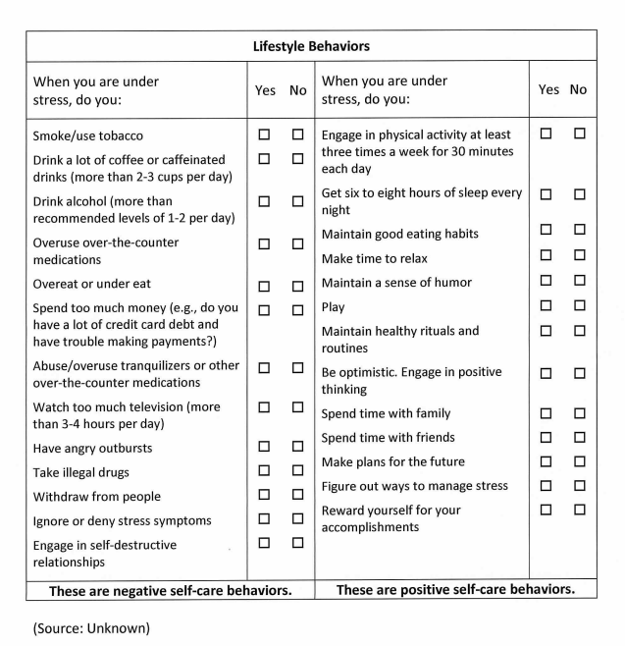
Self-Care Survey
https://PollEv.com/surveys/MKLWwE4a4N0MNjkQnAQjj/web

Slide 16
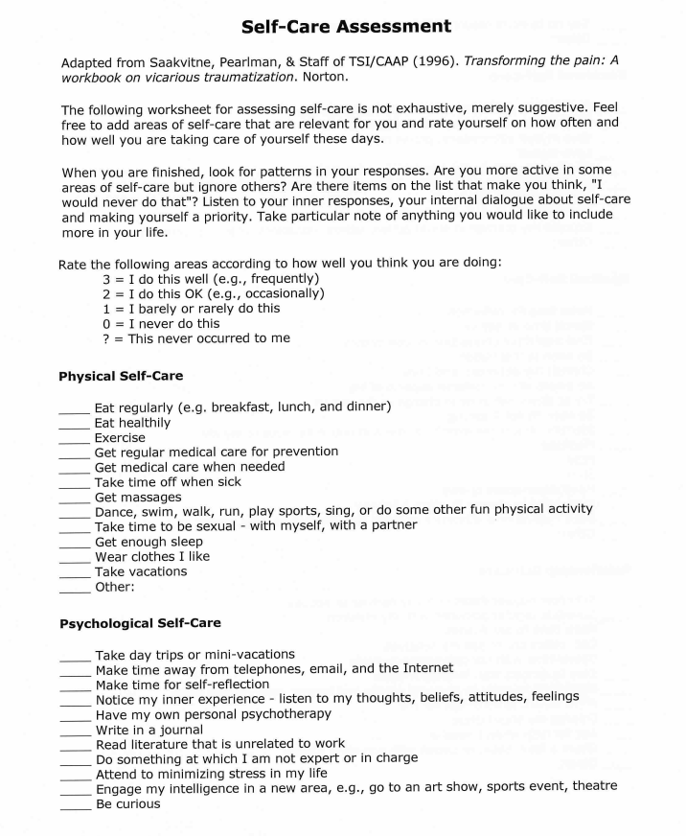
3 = I do this well or frequently
2 = I do this OK or occasionally
1 = I barely or rarely do this
0 = I never do this
? = This never occurred to me

Slide 17
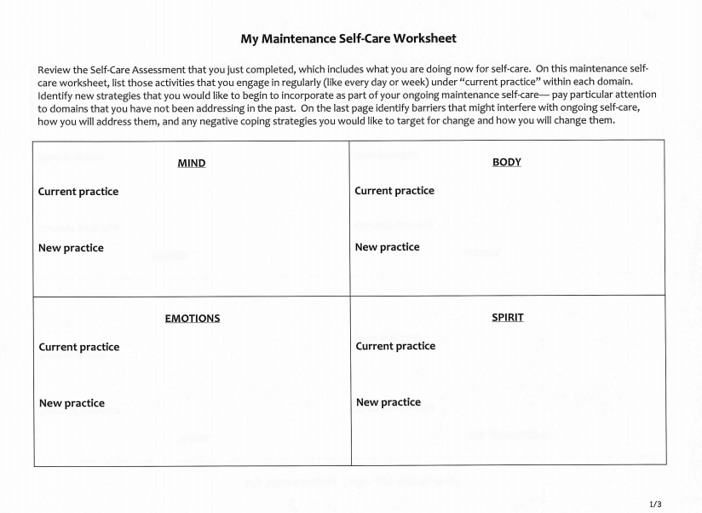
I don’t currently have a practice
10 minutes of mindfulness daily using the headspace app

Slide 18
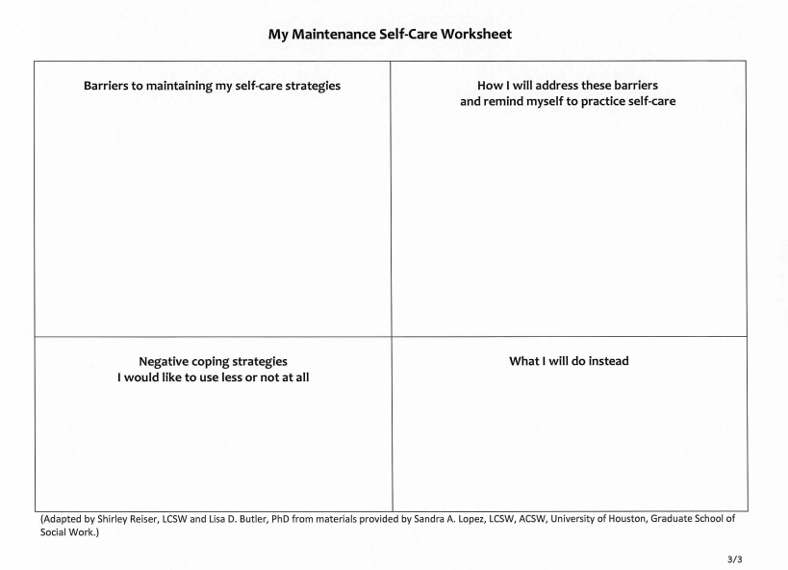
Finding a quiet space, making time
Use part of my lunch hour and go out to my car so I will not be disturbed
Eating when I feel stressed
Try to use mindfulness before I stress eat

Slide 19
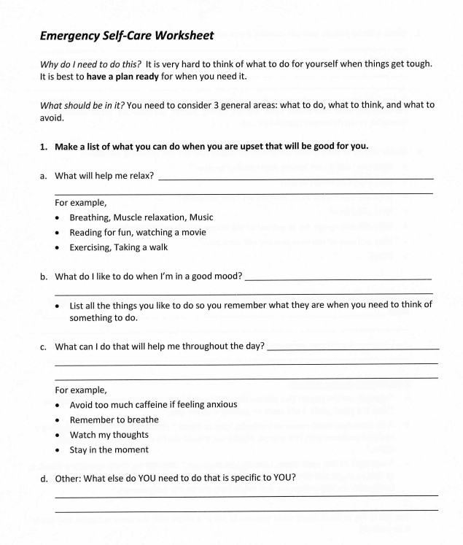


Write this out on an index card or put it in your phone and keep it with you.

Slide 20

Resources
Program of Assistance for Students at TTUHSC
  1-800-327-0328
  1-806-743-1327
  ttuhsc.edu/counseling (for resources and a list of PAS providers)
  Telehealth counseling offered to students not near an on-site PAS provider
Therapy Assistance On-line (TAO)
  thepath.taoconnect.org
  Log in for self-help using TTUHSC email

