Slide 1

Career Services Center Employer Training

Slide 2
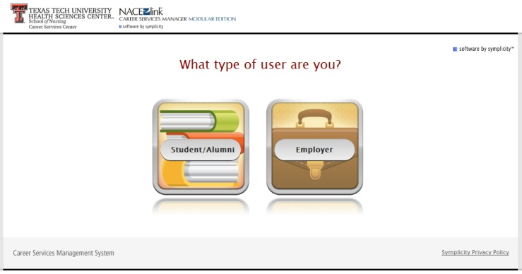
This is the main login page. The link can be found at www.ttuhsc.edu/son/career
Employers click here

Slide 3
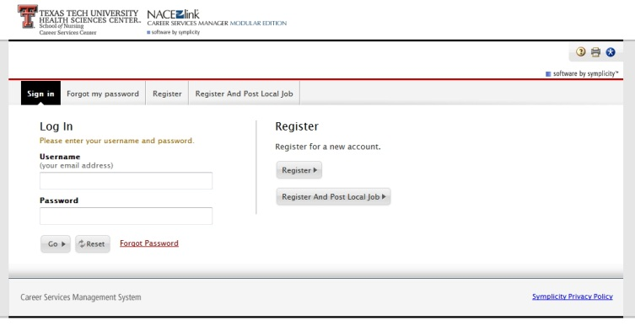

If you are not registered please click on Register
If you already have a Username and Password Log In here
Employers have two choices when logging into the system. If you already have a Username and Password you can log right in. If you do not have them you will need to register.

Slide 4
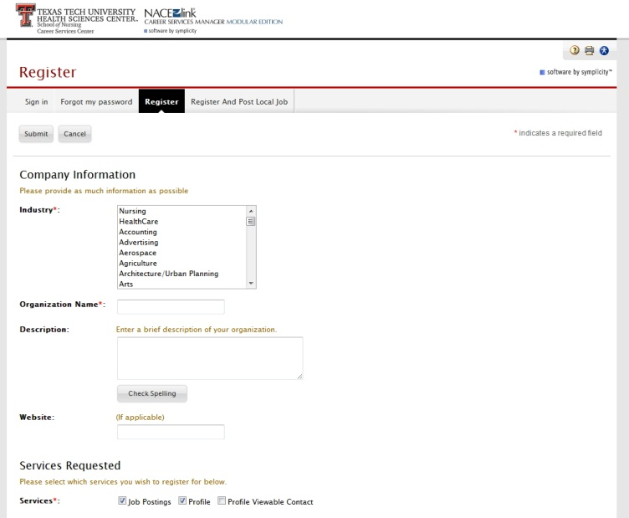

When you click on the “Register” button you will be taken to the “Company Information” page.
Please complete all fields. The fields marked with a red asterisk * are required fields. Click the submit button before moving on.
When you reach the “Contact Information” section, enter the email and phone number that you would like students to use to contact you. Also enter the business address not your personal address.

Slide 5
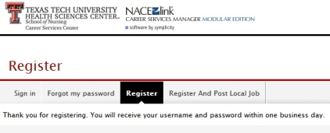
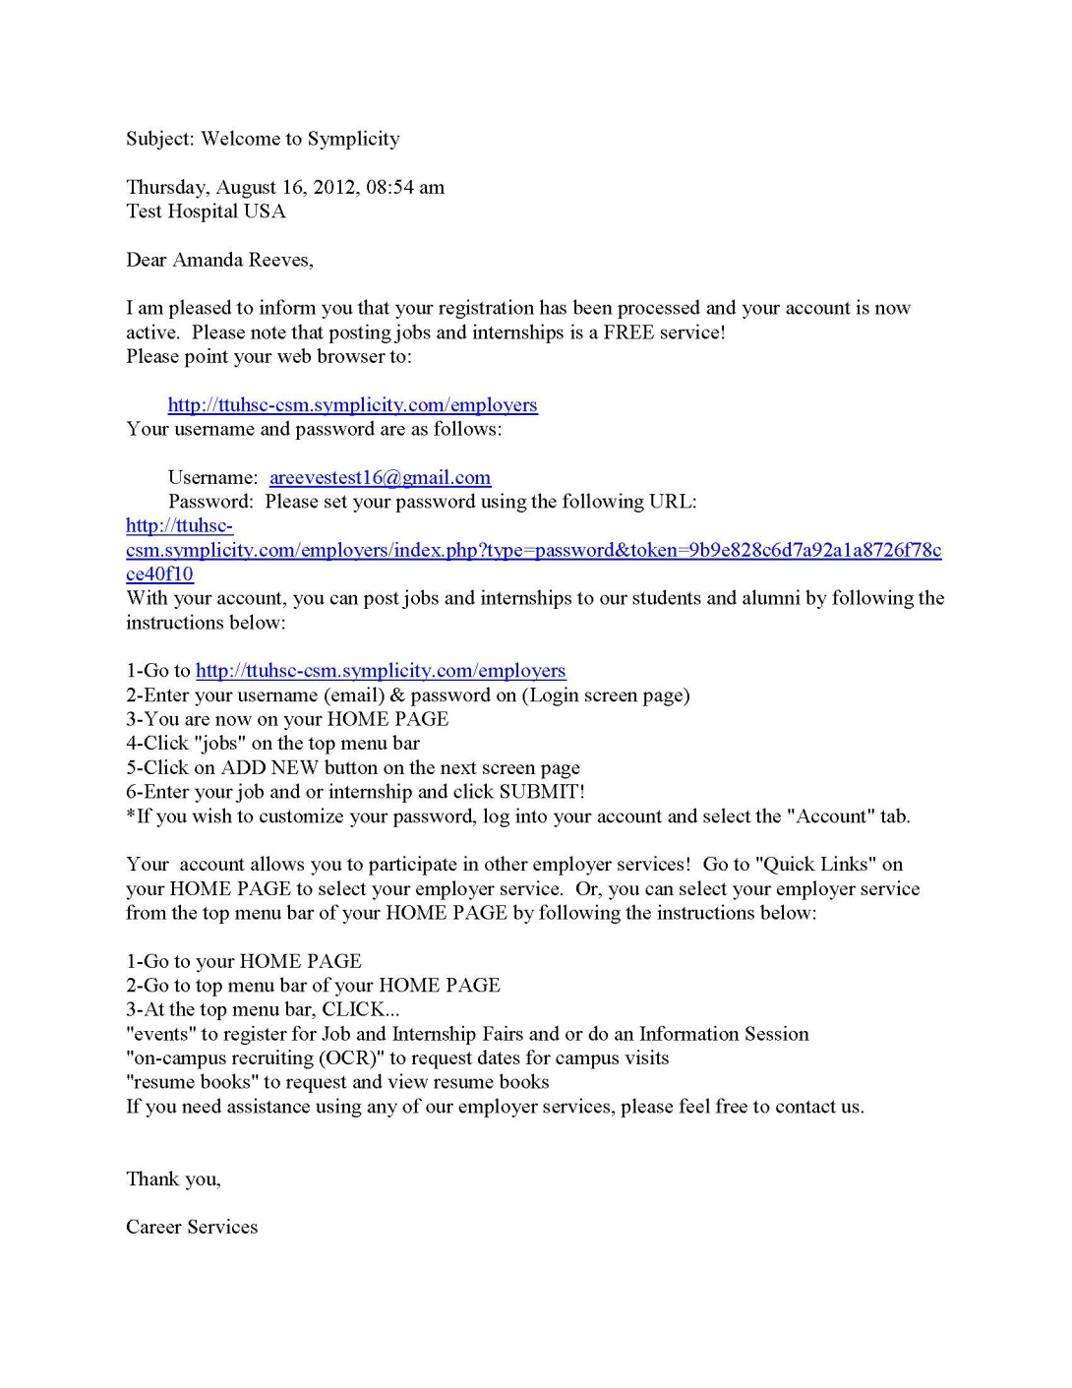
Once you have completed registration you should see a page like the one above.
Upon approval of your registration (within one to two working days) the SON Career Services Center staff will send you a “Welcome” letter to your email address.

Slide 6
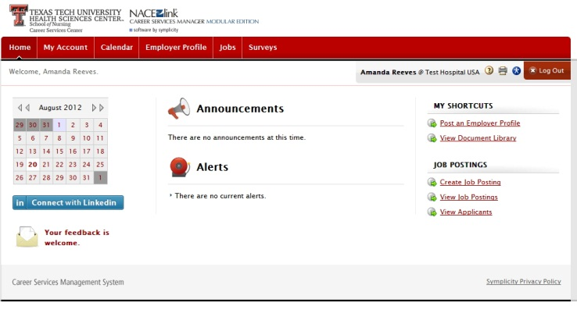
Access the system using the URL on the “Welcome” letter. Access the “My Account” section to make sure all of your information is correct.

Slide 7
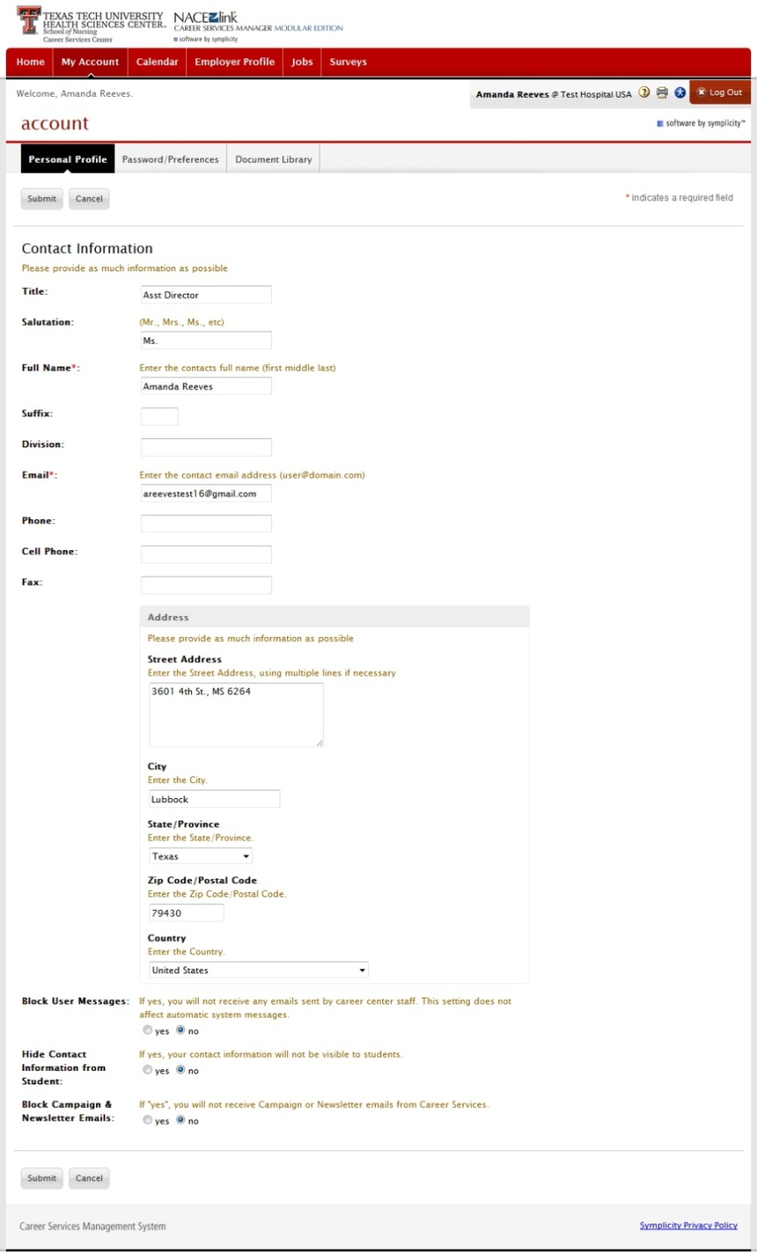
The “Personal Profile” tab allows you to update all personal information.
You will also be able to hide your contact information from students if you so desire.

Slide 8
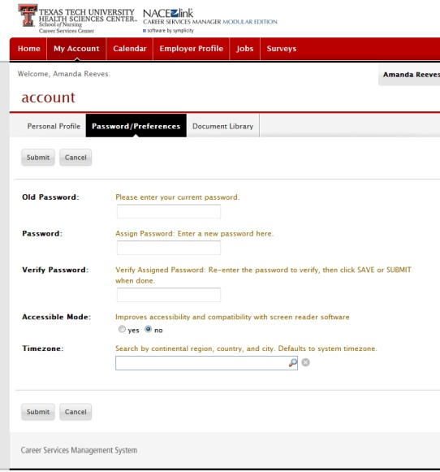
You will also have the option to change your password if needed from your “My Account” section.

Slide 9
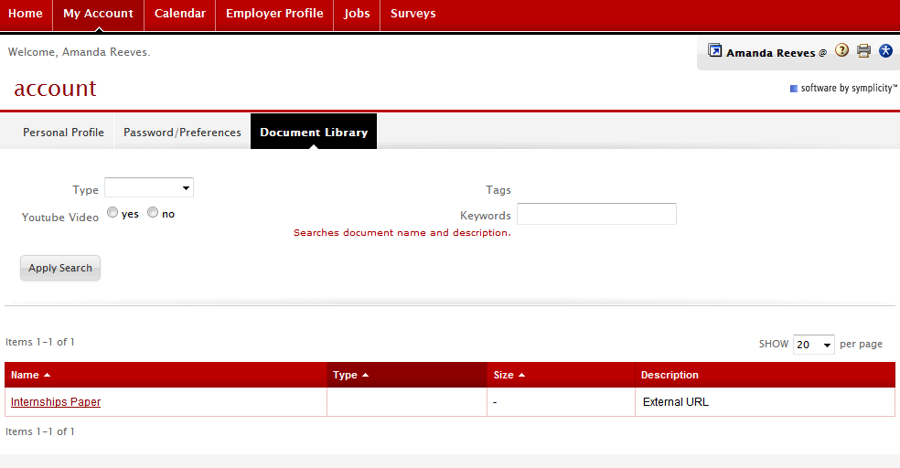
Contacts will have access to a personal “Document Library” where you will be able to store links to videos or information about your company. This will allow you to have the information on the system at all times and you will not have to search for it on your personal computer. All documents are secure and may only be viewed by the contact who stored them.

Slide 10

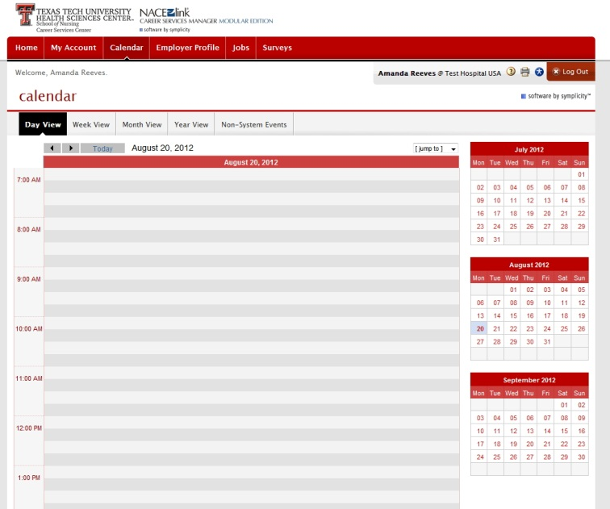
The “Calendar” section displays all system events that relate to you the Contact.
The TTUHSC School of Nursing Career Services Center will add events to your calendar to keep you informed of career fairs or workshops that your company may want to participate in. It does not mean that you are required to attend.

Slide 11
Click on the “Employer Profile” section which contains information about your Organization and is viewable by Students.

Slide 12
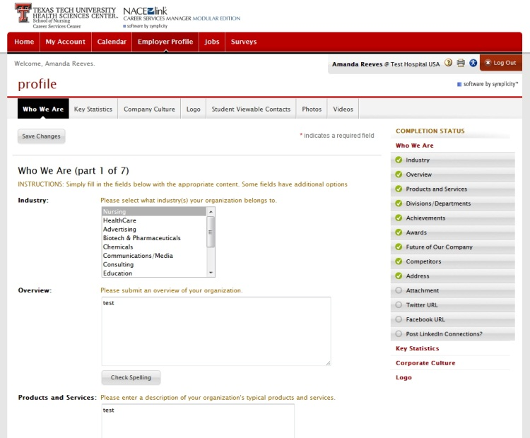

“Who We Are” is the first tab under the “Employer Profile” section and displays the basic information about the organization.
Fill out all of the fields that you deem necessary. Fields left empty will not be visible to the students
Be sure to click on “Save Changes” before going to the next tab. A green check will appear on the right sidebar when the field has been saved.

Slide 13
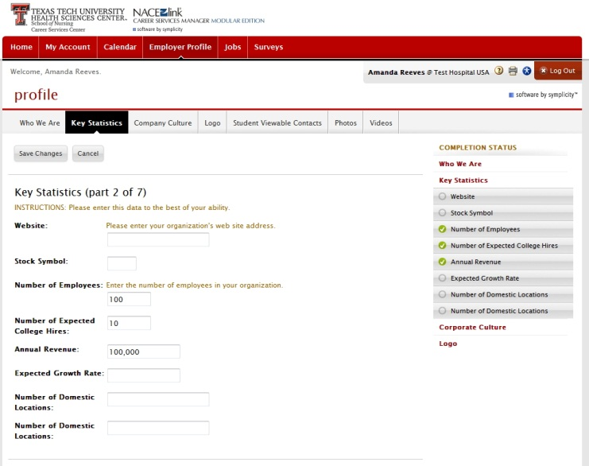
“Key Statistics” tab displays items such as the organizations website, the number of employees, and the number of expected hires.
Fill out all of the fields that you deem necessary. Fields left empty will not be visible to the students
Be sure and click on “Save Changes” before going on to the next tab. A green check will appear on the right sidebar when the field has been saved.

Slide 14
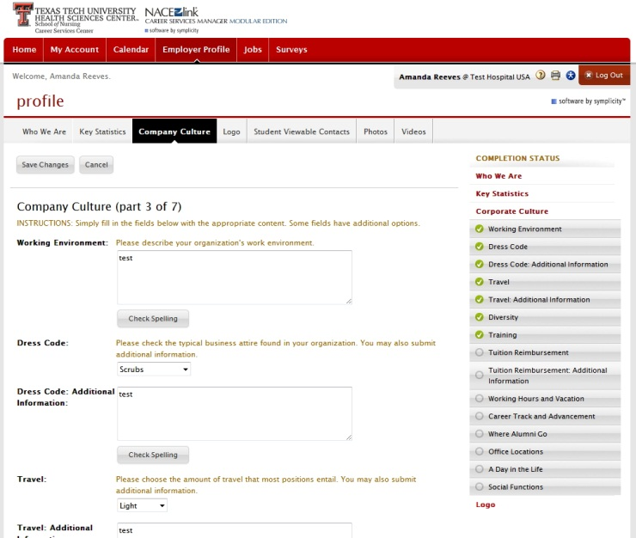
The “Company Culture” tab displays information about the working environment, dress code, training and other related information.
Fill out all of the fields that you deem necessary. Fields left empty will not be visible to the students
Be sure and click on “Save Changes” before going on to the next tab. A green check will appear on the right sidebar when the field has been saved.

Slide 15
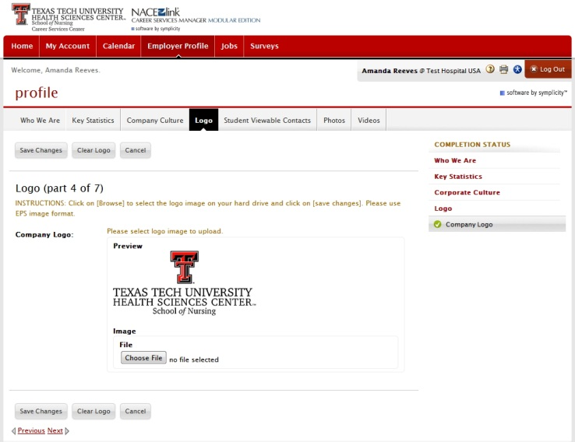
You may upload your organization’s logo using the “Logo” tab. All files are supported but it is suggested to use an EPS format if possible.

Slide 16
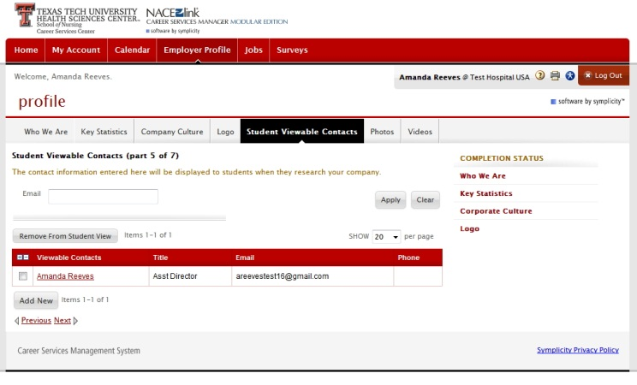
The “Student Viewable Contacts” tab allows you to determine which contacts’ information are visible to the students. You can remove a contact from student view by checking the box beside their name(s) and then clicking on “Remove from Student View”.

Slide 17
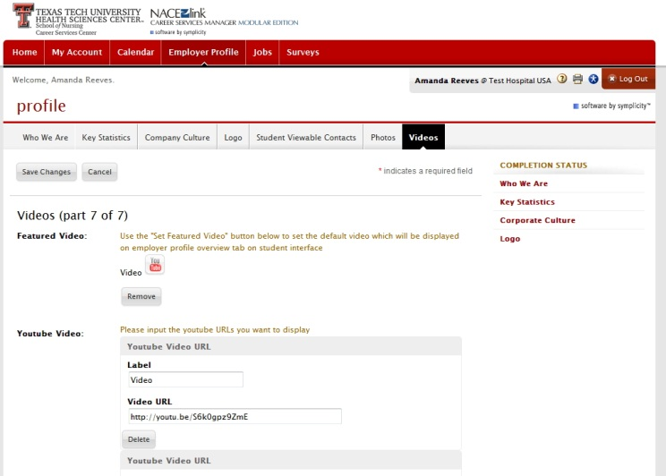
The “Video” & “Photo" tabs allows you to add Video and Photos from the organization’s YouTube and Flicker accounts.

Slide 18
Once registered and set up the contact can start posting jobs. You can do this one of two ways. Click on the “Jobs” section at the top.
Or click on the “Job Posting” shortcut to the right on the Home Page.

Slide 19
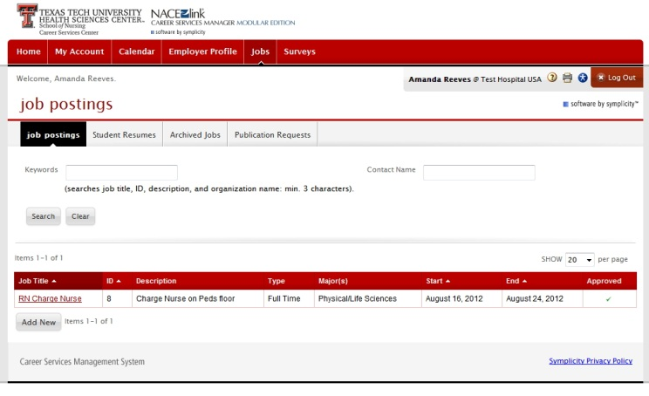
When clicking on the “Jobs” section you will be sent to the “Job Posting” page where you can review jobs that you have already posted.
You will also be able to Add a new Job Posting by clicking on the “Add New” button.

Slide 20
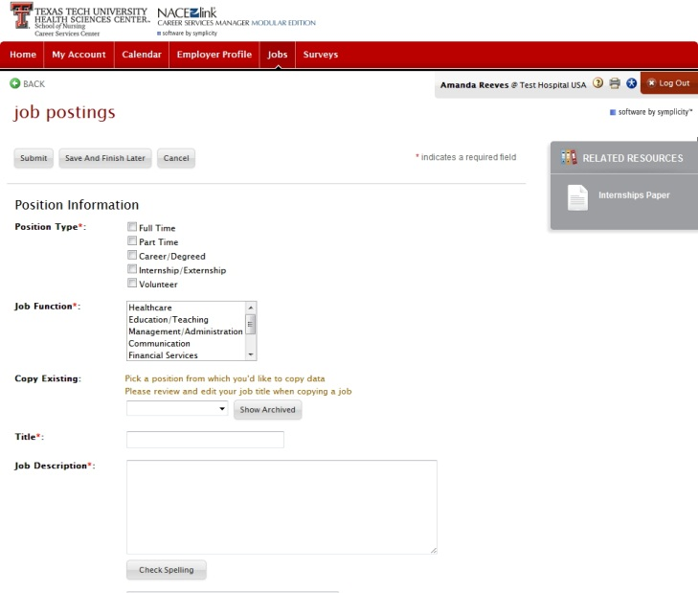

After clicking “Add New” you will see the screen to the left. Complete all fields. The fields marked with a red asterisk * are required fields, click submit before moving on.
You can also click on the “Save and Finish Later” button if needed and post the job at another time.

Slide 21
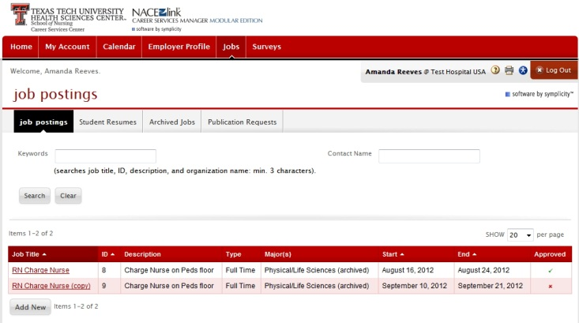
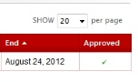
Once you select the “Submit” button the Career Services Center Manager will be notified of the new position requiring approval. Upon approval a green check will be seen in the Approved column of the list and students will be able to see the new posting.

Slide 22
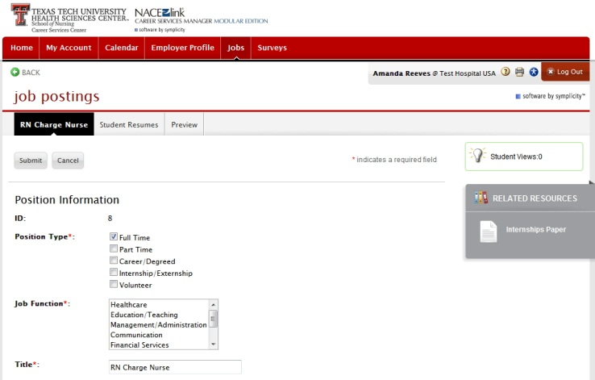

You will be able to see how many times a job posting has been viewed. A sidebar in the upper right hand corner titled “Student Views” will display the count.

Slide 23
Five days after a job posting date ends it will be placed in your “Archived Jobs”. When a job is placed in archive it is no longer viewable by students. If the job is also deleted or cancelled it will be placed in the archive as well.

Slide 24
This is your overview of the SONCareerLink Software. If you have any questions or comments feel free to contact us by clicking on the “Your Feedback is Welcome” link on the lower left hand corner of the Home Page.

Slide 25

This is your basic overview of the TTUHSC School of Nursing Career Services Software. If at anytime you run into any trouble or have any questions or comments please do contact us by clicking on the Your Feedback is Welcome button in the lower left corner.

