Slide 1
Career Services Center
Ignorance is NOT Bliss
Christy Meriwether
Donna Balko
Jennifer Gray

Slide 2
Jobs by the Numbers*
 | May 2018 | December 2018
UT Southwestern | 2 | 1
Parkland | 1 | 2
Cook Children’s | 1 | 0
Children’s Health | 2 | 0
Baylor – North (DFW) | 7 | 6
Memorial Hermann (Houston) | 0 | 3
Medical City | 5 | 5
*Only takes in account students who completed a survey (about 50%)

Slide 3
Navigating Hospital Websites
  www.bswhealth.com
  www.childrens.com
  www.cookchildrens.org
Notes:
According to the nationwide survey, conducted online by Harris Poll on behalf of CareerBuilder from November 16 to December 6, 2016 among more than 2,600 hiring and human resource managers, it doesn’t take long for a hiring manager to make a decision. Around half of employers (51 percent) know within the first five minutes of an interview if a candidate is a good fit for a position — on par with last year (50 percent).
“The best solution to minimize pre-interview anxiety is solid preparation,” said Rosemary Haefner, chief human resources officer for CareerBuilder. “If you don’t read about the company and research your role thoroughly, you could magnify your fear of interviewing poorly and lose the opportunity.”

Slide 4

Student Resources
  www.ttuhsc.edu/nursing/career
Library of Resources:
Cover Letter Plannning Guide
Resume Action Verbs
Interview Questions
Questions for YOU to ask the Interviewer
How to Document Clinical Experiences
Workshop Presentations
Resume Building Presentation
Notes:
According to the nationwide survey, conducted online by Harris Poll on behalf of CareerBuilder from November 16 to December 6, 2016 among more than 2,600 hiring and human resource managers, it doesn’t take long for a hiring manager to make a decision. Around half of employers (51 percent) know within the first five minutes of an interview if a candidate is a good fit for a position — on par with last year (50 percent).
“The best solution to minimize pre-interview anxiety is solid preparation,” said Rosemary Haefner, chief human resources officer for CareerBuilder. “If you don’t read about the company and research your role thoroughly, you could magnify your fear of interviewing poorly and lose the opportunity.”

Slide 5
Clinical Experience Example
    Relevant Clinical Experience
    Pediatrics, University Medical Center, Summer 2019
    96 hours of clinical experience expected in Pediatrics during Summer of 2019
    Labor and Delivery, TTUHSC Simulation Center, Fall 2018
    Counseled a young mother with gestational diabetes on proper nutrition choices
    Monitored fetal heart rates throughout labor and delivery, and reported abnormal findings to charge nurse, while emotionally supporting the patient
    Pediatrics, TTUHSC Simulation Center, Fall 2018
    Diverted a young patient through age-appropriate play during IM injection
    Educated parents on the use of a hand held nebulizer and provided reassurance
    Telemetry, University Medical Center and Covenant Health, Summer 2018
    Provided evidence-based practice care for a patient after total hip replacement including Foley catheter care, IV dressing changes, and administering medications

Slide 6
Cover Letter
  First paragraph – Introduction
  Introduction with information about the job you are applying to
  Second paragraph – Body
  Why are you interested in the position?
  Why their hospital?
  Why did you go into nursing? What sets you apart?
  Be specific
  Final Paragraph – Closing
  Indicate you hope to meet with them
  Make reference to your contact information
  Thank them
Refer to the “Cover Letter” PDF on website in the Library of Resources

Slide 7
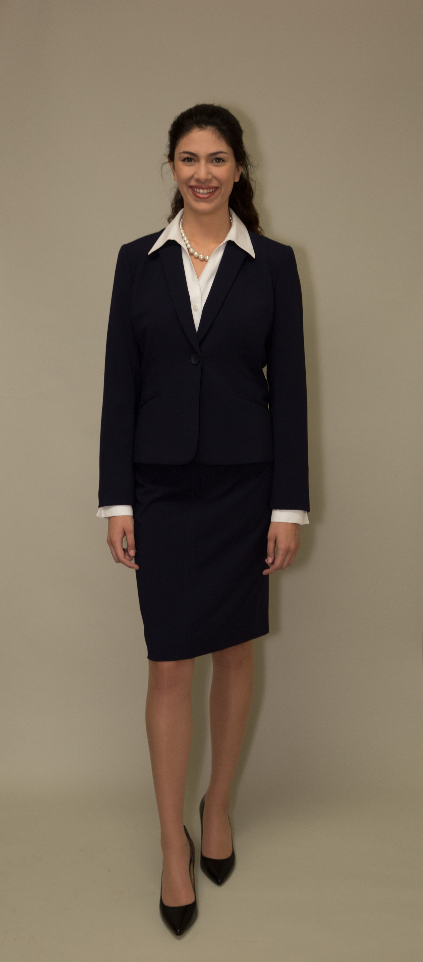
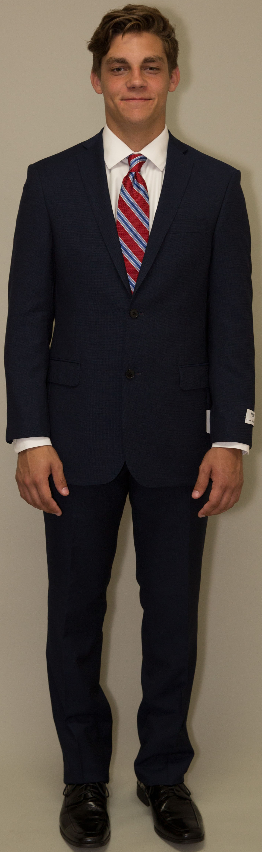
The Interview Suit

Slide 8
You could botch the interview without saying a WORD!
7% Words we speak
38% Tone of voice
55% Non Verbal
Notes:
According to the nationwide survey, conducted online by Harris Poll on behalf of CareerBuilder from November 16 to December 6, 2016 among more than 2,600 hiring and human resource managers, it doesn’t take long for a hiring manager to make a decision. Around half of employers (51 percent) know within the first five minutes of an interview if a candidate is a good fit for a position — on par with last year (50 percent).
“The best solution to minimize pre-interview anxiety is solid preparation,” said Rosemary Haefner, chief human resources officer for CareerBuilder. “If you don’t read about the company and research your role thoroughly, you could magnify your fear of interviewing poorly and lose the opportunity.”

Slide 9
10 Most Common Interviewee Mistakes
Failing to make eye contact: 67%
Failing to smile: 39%
Playing with something on the table: 33%
Crossing their arms over their chests: 32%
Having bad posture: 31%
Fidgeting too much in their seats: 30%
Playing with their hair or touching their faces: 28%
Having a weak handshake: 22%
Using too many hand gestures: 13%
Having a handshake that was too strong: 9%
Notes:
According to the nationwide survey, conducted online by Harris Poll on behalf of CareerBuilder from November 16 to December 6, 2016 among more than 2,600 hiring and human resource managers, it doesn’t take long for a hiring manager to make a decision. Around half of employers (51 percent) know within the first five minutes of an interview if a candidate is a good fit for a position — on par with last year (50 percent).
“The best solution to minimize pre-interview anxiety is solid preparation,” said Rosemary Haefner, chief human resources officer for CareerBuilder. “If you don’t read about the company and research your role thoroughly, you could magnify your fear of interviewing poorly and lose the opportunity.”

Slide 10
Easiest Ways to Ruin a Job Interview
Candidate is caught lying about something: 66 percent
Candidate answers a cellphone or text during the interview: 64 percent
Candidate appears arrogant or entitled: 59 percent
Candidate dresses inappropriately: 49 percent
Candidate appears to have a lack of accountability: 48 percent
Notes:
According to the nationwide survey, conducted online by Harris Poll on behalf of CareerBuilder from November 16 to December 6, 2016 among more than 2,600 hiring and human resource managers, it doesn’t take long for a hiring manager to make a decision. Around half of employers (51 percent) know within the first five minutes of an interview if a candidate is a good fit for a position — on par with last year (50 percent).
“The best solution to minimize pre-interview anxiety is solid preparation,” said Rosemary Haefner, chief human resources officer for CareerBuilder. “If you don’t read about the company and research your role thoroughly, you could magnify your fear of interviewing poorly and lose the opportunity.”

Slide 11
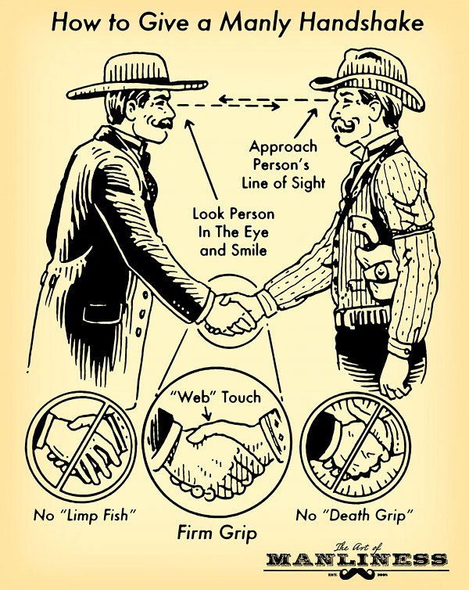

Slide 12



Slide 13
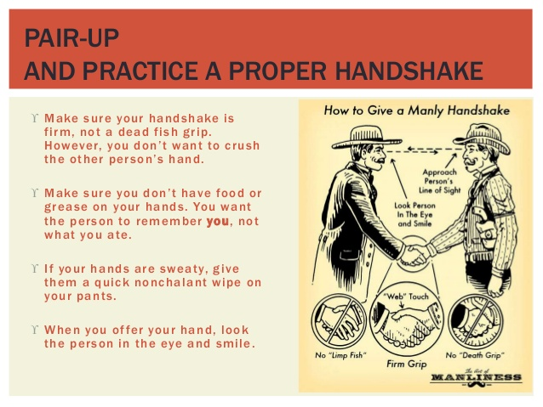
Notes:
According to the nationwide survey, conducted online by Harris Poll on behalf of CareerBuilder from November 16 to December 6, 2016 among more than 2,600 hiring and human resource managers, it doesn’t take long for a hiring manager to make a decision. Around half of employers (51 percent) know within the first five minutes of an interview if a candidate is a good fit for a position — on par with last year (50 percent).
“The best solution to minimize pre-interview anxiety is solid preparation,” said Rosemary Haefner, chief human resources officer for CareerBuilder. “If you don’t read about the company and research your role thoroughly, you could magnify your fear of interviewing poorly and lose the opportunity.”

Slide 14

Eye Contact
  Upward roll signals frustration or exasperation
  Rubbing eyes signals boredom or disbelief
  Staring back blankly signals distance
Notes:
According to the nationwide survey, conducted online by Harris Poll on behalf of CareerBuilder from November 16 to December 6, 2016 among more than 2,600 hiring and human resource managers, it doesn’t take long for a hiring manager to make a decision. Around half of employers (51 percent) know within the first five minutes of an interview if a candidate is a good fit for a position — on par with last year (50 percent).
“The best solution to minimize pre-interview anxiety is solid preparation,” said Rosemary Haefner, chief human resources officer for CareerBuilder. “If you don’t read about the company and research your role thoroughly, you could magnify your fear of interviewing poorly and lose the opportunity.”

Slide 15
Practice Interviewing
  Big Interview
  Mock Interviews with Career Center Staff
Notes:
According to the nationwide survey, conducted online by Harris Poll on behalf of CareerBuilder from November 16 to December 6, 2016 among more than 2,600 hiring and human resource managers, it doesn’t take long for a hiring manager to make a decision. Around half of employers (51 percent) know within the first five minutes of an interview if a candidate is a good fit for a position — on par with last year (50 percent).
“The best solution to minimize pre-interview anxiety is solid preparation,” said Rosemary Haefner, chief human resources officer for CareerBuilder. “If you don’t read about the company and research your role thoroughly, you could magnify your fear of interviewing poorly and lose the opportunity.”

Slide 16
Show Interest
  Learn about the organization
  Ask Questions www.ttuhsc.edu/nursing/career
  Ask: When should I expect to hear from you?
Notes:
According to the nationwide survey, conducted online by Harris Poll on behalf of CareerBuilder from November 16 to December 6, 2016 among more than 2,600 hiring and human resource managers, it doesn’t take long for a hiring manager to make a decision. Around half of employers (51 percent) know within the first five minutes of an interview if a candidate is a good fit for a position — on par with last year (50 percent).
“The best solution to minimize pre-interview anxiety is solid preparation,” said Rosemary Haefner, chief human resources officer for CareerBuilder. “If you don’t read about the company and research your role thoroughly, you could magnify your fear of interviewing poorly and lose the opportunity.”

Slide 17

Thank you note
Ms. Rhonda Recruiter,
Thank you so much for meeting with me today. It was such a pleasure to learn more about the position at Hendrick Medical Center, and I’m very excited about the opportunity to join your unit.
I look forward to hearing from you about the next steps in the hiring process, and please do not hesitate to contact me if I can provide additional information.
Best regards,
Greta Graduate

