Slide 1
The NIH Biosketch
November 2019

Slide 2
Why?
Allows applicants to:
describe the magnitude and significance of their scientific contributions (including publications)
provide detailed information about their research experience in the context of the proposed project
Forms, instructions, and samples available at:
https://grants.nih.gov/grants/forms/biosketch.htm
Notes:
Since the biosketch is required for all types of grant programs,
today we want to make sure you understand the sections of the biosketch and how important it is to customize this for your applications.
In particular, you will want to emphasize the significance of the investigator’s scientific contributions and provide details about their research experience and career in general.
This is the only place in the application to make this case and for the investigator to talk about themselves.

Slide 3
Who?
All senior/key personnel and other significant contributors (OSCs) must include biographical sketches (biosketches).
Notes:
Grant applications must include biosketches for all key personnel and other significant contributors
Remember that the investigator and many of your key personnel also need to register in commons, postdocs and students, and so make sure that is handled well in advance.
Other significant contributors are those that are zero-person months or ‘as needed’, and they do not expect to provide measurable effort towards the project

Slide 4
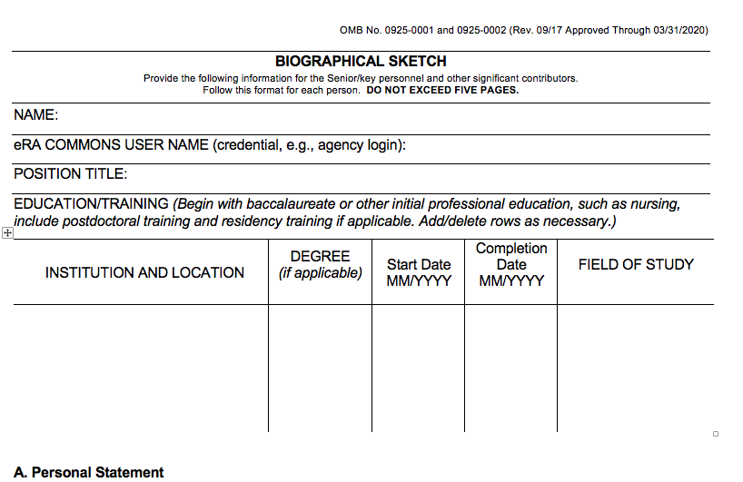
NIH Biosketch Form
Be sure to include eRA Commons ID
Forms, instructions, and samples available at:
https://grants.nih.gov/grants/forms/biosketch.htm
Notes:
You can find the biosketch template forms on the NIH website at the link below, and I can provide the updated slides for you after the talk.
This is the current form, but If you use SciENcv to prepare your bio sketch, you will always be using the latest version of the template.
The first thing you need to know is that there is a five-page limit.
How you use the pages for the multiple sections is up to you, but you should review and compare with your colleagues
At the top of the form are where you put your name, title and commons information, along with your educational and any medical residency positions, all of which are pretty self-explanatory.
Remember that the investigator and many of your key personnel also need to register in commons, postdocs and students, and so make sure that is handled well in advance.

Slide 5
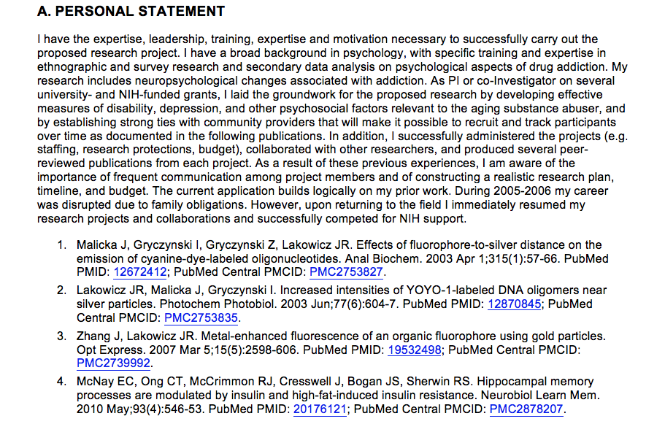
NIH Biosketch, Section A
Explain factors affecting productivity (e.g. family care responsibilities)
Highlight your experience and qualifications for this project
Your qualifications for your role on the project
Notes:
Next up is the Personal Statement section, where you make your case why you are well-suited to your role on the project.
You might include key aspects of training or past experience, technical expertise, significant collaborations, and past performance
This is also an opportunity to explain anything else you’d like the reviewers to know about your career and research directions.
For instance, this is where you can describe how you are proposing work in a new direction, or significant training or mentorships relationships, or any personal or family situations such as parental leave, child care, elder care, or medical conditions
Finally, you can provide information on up to 4 publications or research products, and this is not limited to publications—it could be key software, videos, research methods or models, or a variety of other interim products. I have a slide later that specifically mentions the policies regarding these interim products.

Slide 6
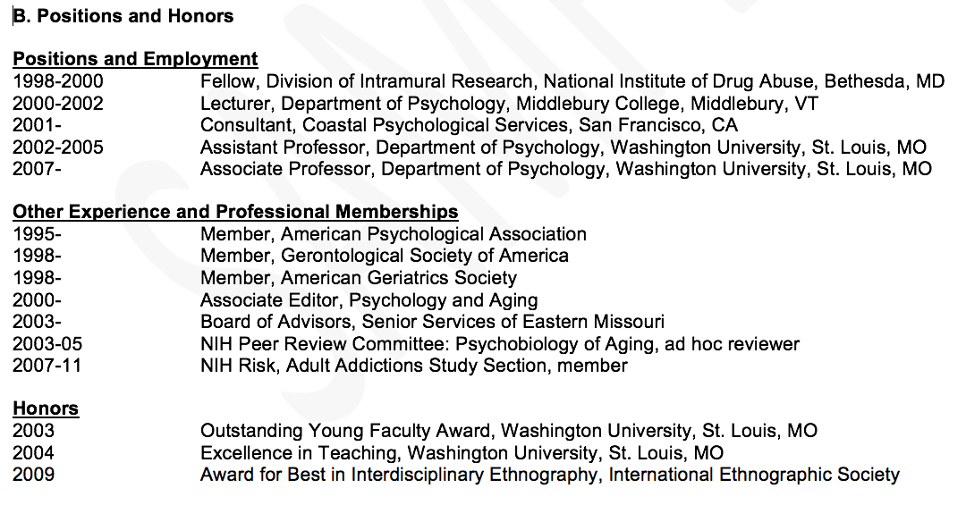
NIH Biosketch, Section B
Add new positions with an expected start date
Your relevant positions and honors
Notes:
Section B for positions and honors is fairly self-explanatory, where you can list your current and past positions that are relevant to the proposal.
If you are moving to a new organization, you can note the expected start date.
You may also wish to include any board certifications or clinical licensures that are relevant.

Slide 7
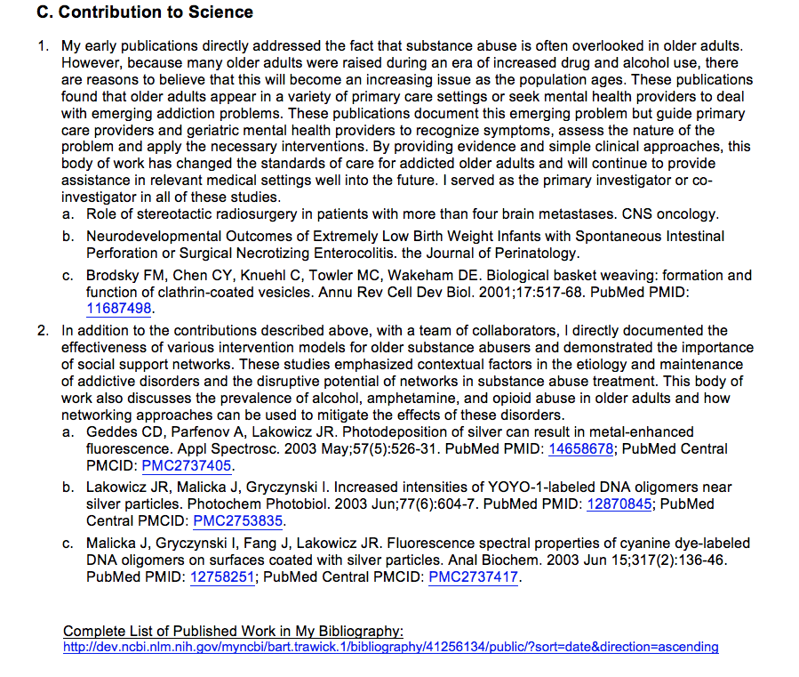
NIH Biosketch, Section C
Make this personal!
URL must be to a Federal Government website
Your general scientific contributions and achievements
Notes:
In the Contributions section, applicants may list up to 5 significant contributions, each around a half page in length, and each with up to 4 publications. You note the historical background, the central finding, how that affected your field or the application to health or technology, and most importantly, your role in the work.
Make this personal!
For junior investigators, it’s expected that they will have fewer contributions, but they can cite conference proceedings such as meeting abstracts, posters or other presentations, (in-progress products can be mentioned, but not cited), and the citations do not have be authored by the investigator , but do have to be relevant to your contributions.
You can also submit a hyperlink to an on-line bibliography but it must be hosted on federal (.gov) website.

Slide 8
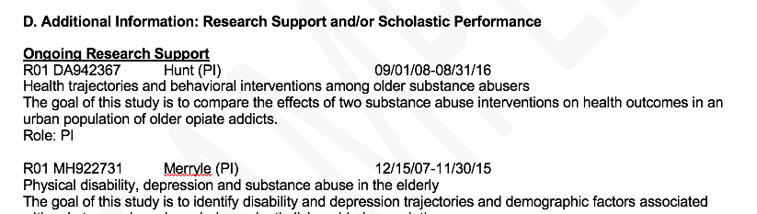
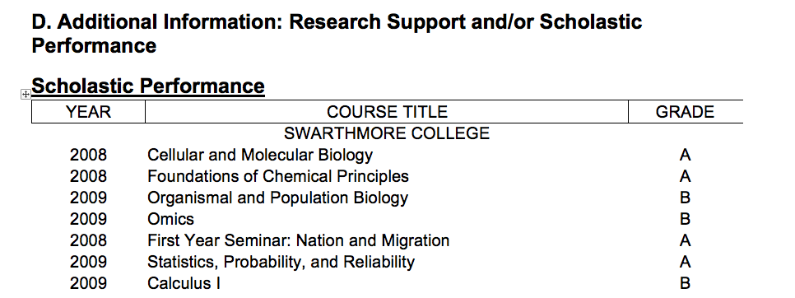
NIH Biosketch, Section D
Non-Fellowship Application
Fellowship Application
Your Research Support and/or Scholastic Performance
Notes:
Additional Information: Research Support and/or Scholastic Performance
This section should be straightforward to complete. You can list any of your ongoing or completed research support, focusing on the goal of the research and your role. The description is likely something you can pull right from the abstract.
Fellowship applicants list their courses and grades, and are not expected to list research support, but they can if they have some, which may be important for post-doctoral applicants.

Slide 9
Biosketch Summary
General advice
Make it personal
Only opportunity to tell the reviewers about you, your career, and expertise
Seek advice and examples from peers and senior colleagues about what a biosketch looks like
Help the reviewers!
Demonstrate that you are the most qualified investigator to do the work
Reviewers instructed that publication track record for early career investigators will not match more senior investigators
Favor clarity over detail and jargon
Provide a URL to publications via a federal (.gov) website
Questions about the biosketch?
Notes:
In closing, this is your one opportunity for the investigator to show they are the best, most appropriate person to lead the study, and the only place to share important information about your career, and any personal or family responsibilities that have caused a gap
In crafting this, make sure you look at the online examples and get examples from your colleagues.
Help the reviewers make a case for you in the study section. Reviewers are instructed to take your career stage into account, but make sure to make that case yourself.
Be concise and clear, and don’t overstuff the section. Try to use shorter sentences, bullets and shorter paragraphs
If you want to share your full bibliography you can do so on a .gov website.

