Slide 1


Slide 2
Vivarium Expansion

Slide 3
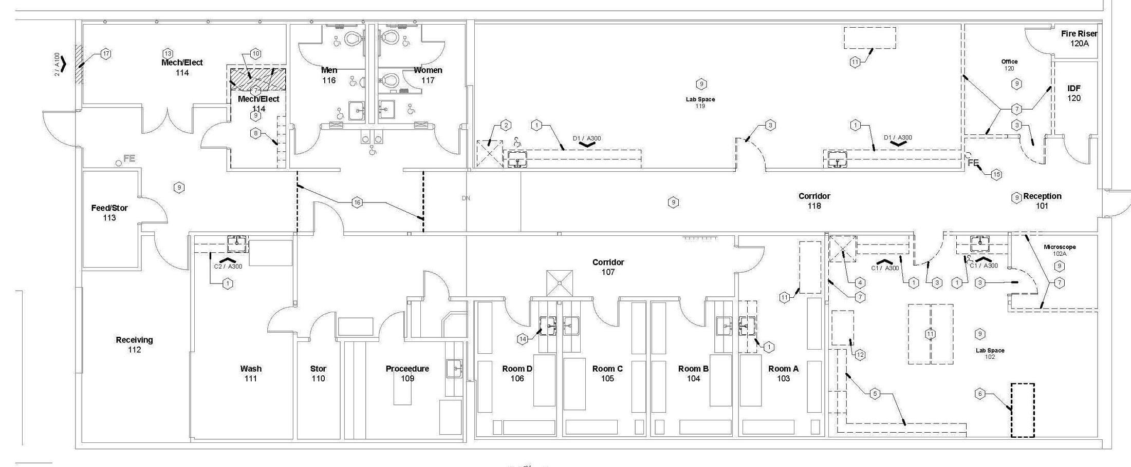
Current Vivarium

Slide 4
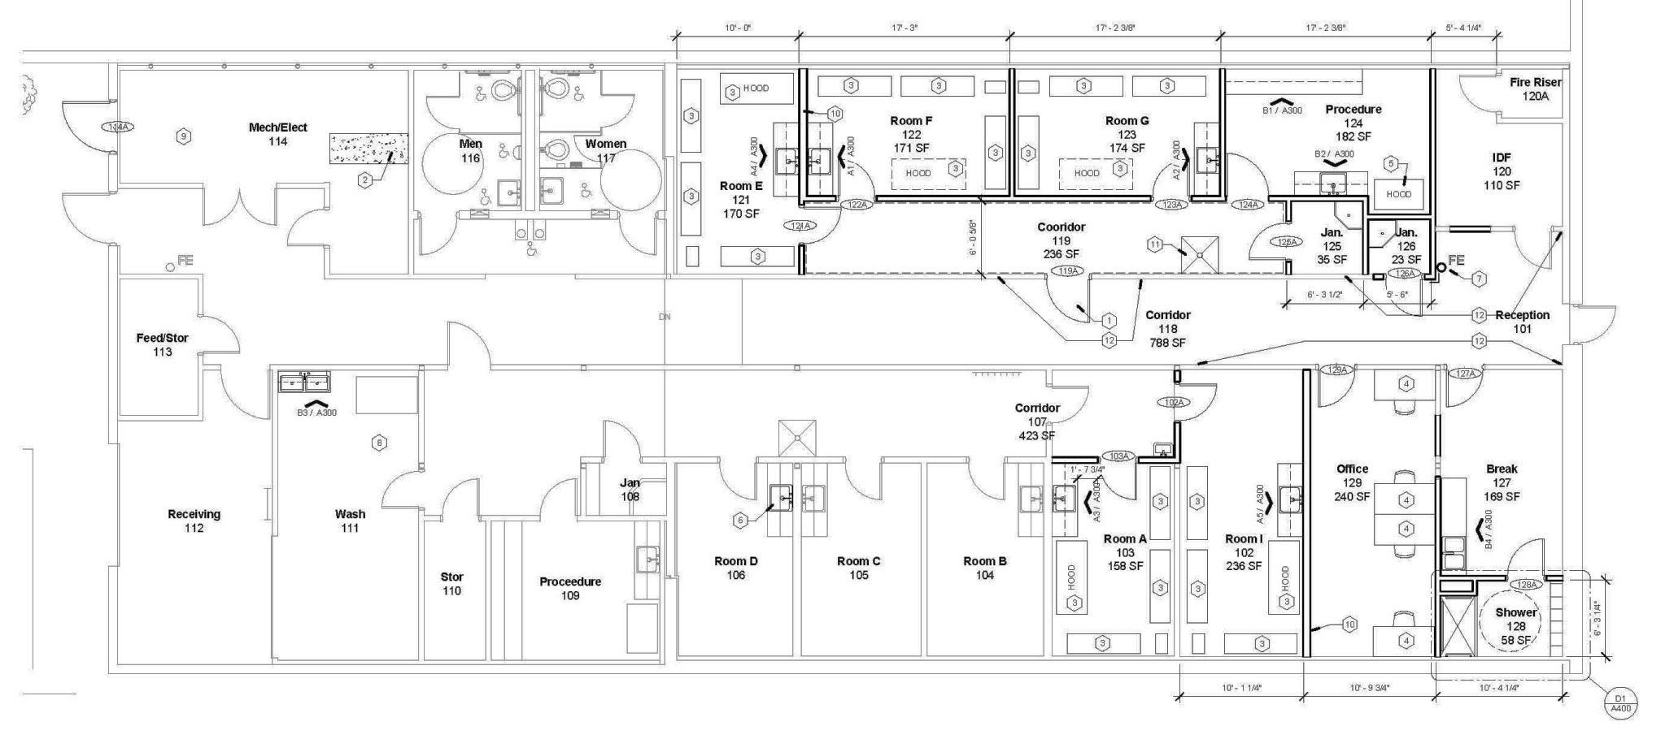
Planned Expansion

