Slide 1

Running An Effective Meeting
Presenters:
Dr. Chephra McKee, Pharm.D.
Dwaine Fombuh, Pharm.D. Candidate, Class of 2015

Slide 2
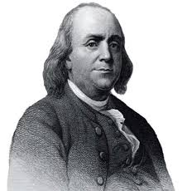
“We must all hang together or, most assuredly, we shall hang separately.”
- Benjamin Franklin
http://4.bp.blogspot.com/_Aau9mMFNWPY/TC5VbEeHt3I/AAAAAAAAA90/yEaRG7oGLpA/s1600/ben.jpg

Slide 3
A not-so effective meeting…
https://www.youtube.com/watch?v=xQW1fEwYZVA

Slide 4
Ways to run an effective meeting
Feel free to add your own personal twist to any of these ideas!

Slide 5

Organize Meeting Logistics
Meeting location/space
Date and time
Advance notice
  Agenda
  RSVP list
Technical support
  Polycom™
  Projector/computer
http://any-eventuality.com/wp-content/uploads/2011/08/checklist-000008772494Small.jpg
Notes:
Meeting location/space
Reserve a room with all the tools you think you will need.
Date and time
Don’t overlap with other organizations unless absolutely necessary.
Advance notice
Agenda sent in advance
RSVP list for food/space
Technical support
Polycom™
Projector/computer

Slide 6
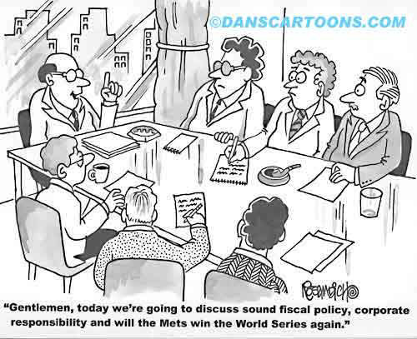
Make Objectives Clear
What do I need to accomplish?
  Change in officers
  Input from others
  Event proposals and updates
http://danscartoons.com/tag/executive/

Slide 7
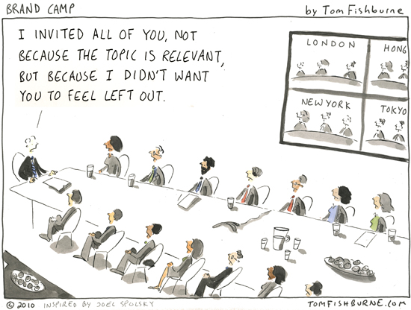
Consider Who’s Invited
Invite good sources of information
Try to keep everything relevant
http://imgarcade.com/1/effective-meetings-cartoon/

Slide 8
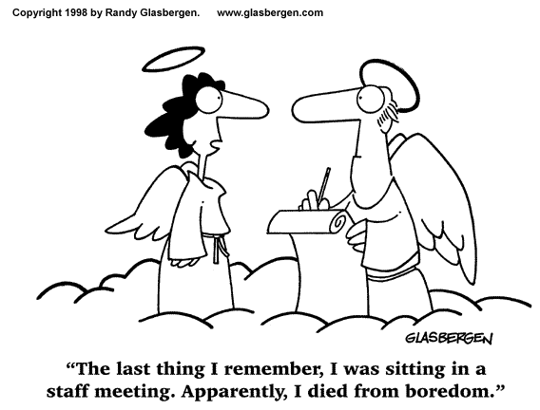
Start On Time, End On Time
People value their time!
Try to stick to no longer than 60 minutes
http://agilevietnam.files.wordpress.com/2012/12/effective_meeting_3.gif?w=454&h=345

Slide 9
Open With Concerns Or Ideas
Set aside time for an open forum
  Issues may be further investigated
  Issues may be tabled until next meeting

Slide 10
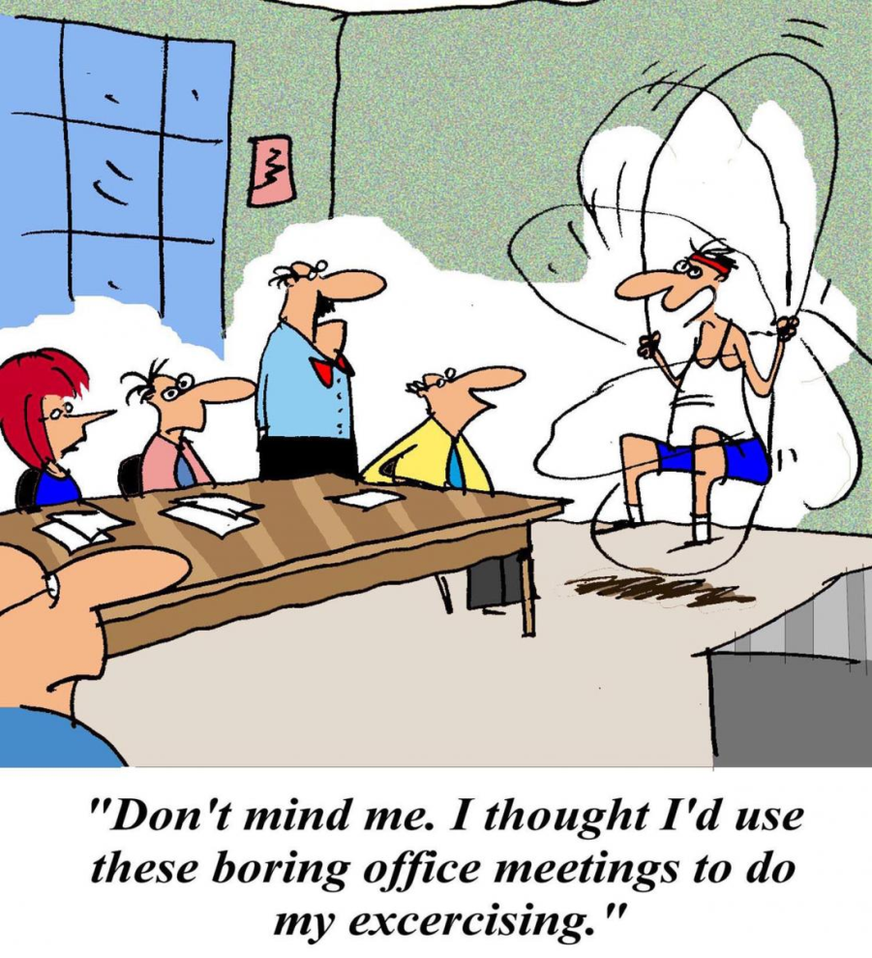
Stay On Task
Agendas include things to be covered
  Allot time for each item
Don’t be afraid to table topics
http://www.noln.net/sites/default/files/images/meeting%20cartoon%20shutterstock_98942855.jpg

Slide 11
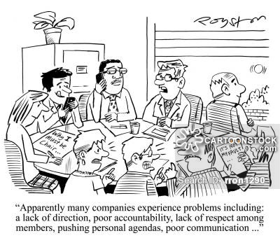
Keep Everyone Involved
Do not allow a monopoly on time!
Keep all members engaged!
http://www.cartoonstock.com/directory/b/bad_management.asp

Slide 12
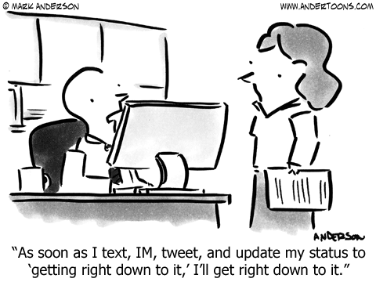
Ban Technology
Difficult to implement
  Access to online documents
Internet can lead to distractions!
http://scs-connect.com/revenue-distraction-humor/
Notes:
Reference for picture: http://scs-connect.com/revenue-distraction-humor/

Slide 13
Follow up
Email a highlighted memo
  Send to those absent
Include goals and assignments
  Leads to production between meetings

Slide 14
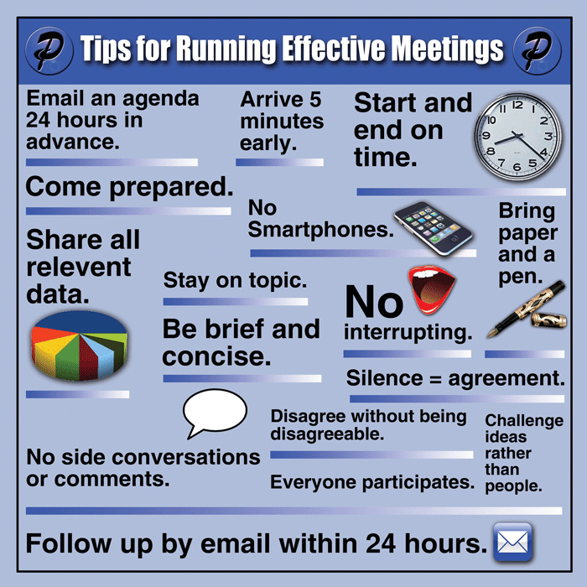
Summary
Organize logistics
Set clear meeting objectives
Invite pertinent guest
Start and end on time
Open forum
Stay on task
Keep everyone engaged
No technology
Follow-up
http://paceimpact.com/wp-content/uploads/2014/07/tips-for-effective-meetings.gif

Slide 15
References
Hartman N. Seven Steps to Running the Most Effective Meeting. Forbes. February 5th, 2014. Available at http://www.forbes.com/sites/forbesleadershipforum/2014/02/05/seven-steps-to-running-the-most-effective-meeting-possible/
Pigeon Y, Khan O. Leadership Lesson: Tools for Effective Team Meetings – How I learned to Stop Worrying and Love my Team. Association of American Medical Colleges. Available at: https://www.aamc.org/members/gfa/faculty_vitae/148582/team_meetings.html

Slide 16
Running An Effective Meeting
Presenters:
Dr. Chephra McKee, Pharm.D.
Dwaine Fombuh, Pharm.D. Candidate, Class of 2015

