Slide 1
P3 Spring Registration
Dr. Charles Seifert presents:
Registration Opens November 10 @ 5 a.m. and ends on January 3 @ 5 p.m.

Slide 2
Student Responsibility
At all times it is the student’s responsibility to enroll in the required courses to meet graduation requirements.
The student may change their schedule at any time prior to the first day of the semester. Once the semester begins, any changes must be submitted to Student Services who will then authorize the Registrar to make the changes in the schedule.

Slide 3
Continued
Errors in registration include registering in the wrong section (including wrong campus), wrong course, enrolling in the wrong rotation, and not enrolling in a course.
Please always print out your schedule upon completion of registration from the Concise Student Schedule to document you have registered in all required courses for the semester.

Slide 4
Select Your Classes for Enrollment
If a course has a prerequisite, you must have already had the course in order to enroll.
Some courses have a requirement that you must be at the correct classification in order to register for the course. In this example you must be a P3 student to register for Phar 4270.

Slide 5
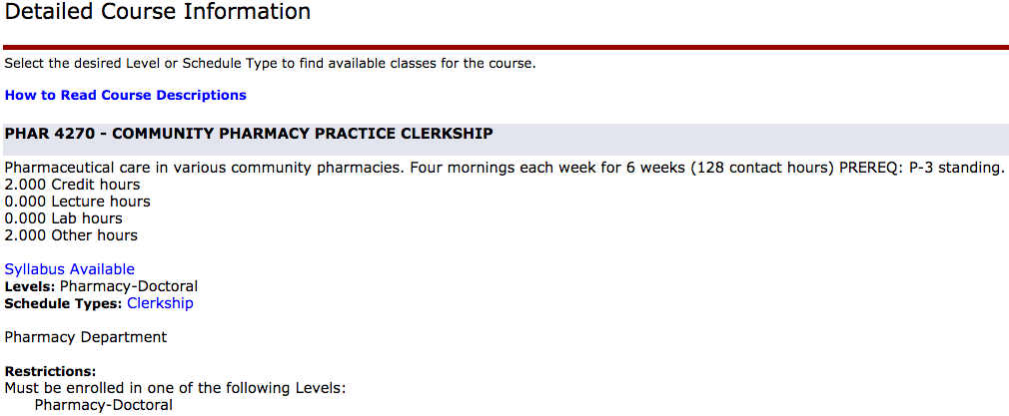
Detailed Class Information to View Prerequisites, Co-requisites, etc.

Slide 6
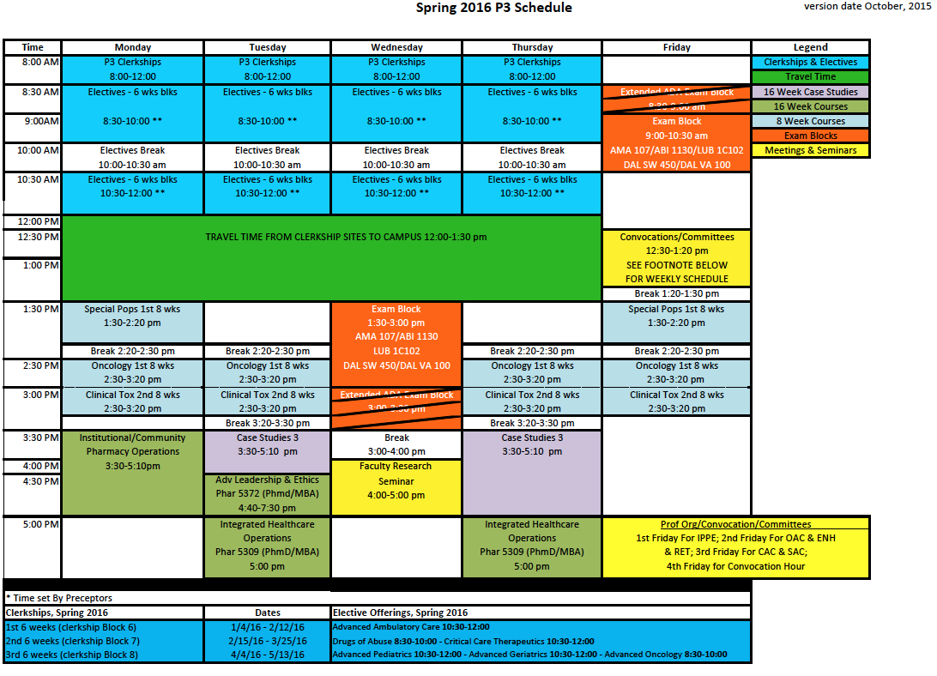
P3 Courses for Enrollment

Slide 7
Significant Schedule Changes
PHAR 4236 Community/Institutional Pharmacy will be held on Monday from 3:30pm-5:10pm
For Block 8 Electives:
  PHAR 4218 Advanced Oncology will be held from 8:30am – 10am.
  (In Dallas-it will be held at both VA and SW)
  PHAR 4202 Advanced Pediatrics is from 10:30am-12pm.
    (In Dallas-it will only be held at the VA)
  PHAR 4215 Advanced Geriatrics is from 10:30am – 12pm.
    (In Dallas-it will only be held at SW)

Slide 8
Spring 2015 Class Schedule
Use the Registration Worksheet of the Spring 2016 Class Schedule (that will be emailed to you) which has a list of the courses and CRN’s you need to enroll in if you are on track.
Enroll in course sections for one site only unless multiple sites have been assigned for rotations by the Experiential Office. Each course has a listing of the campus for that section.
For Dallas Students – if you are taking one of the single campus offerings – please choose a corresponding campus for Case Studies III.

Slide 9
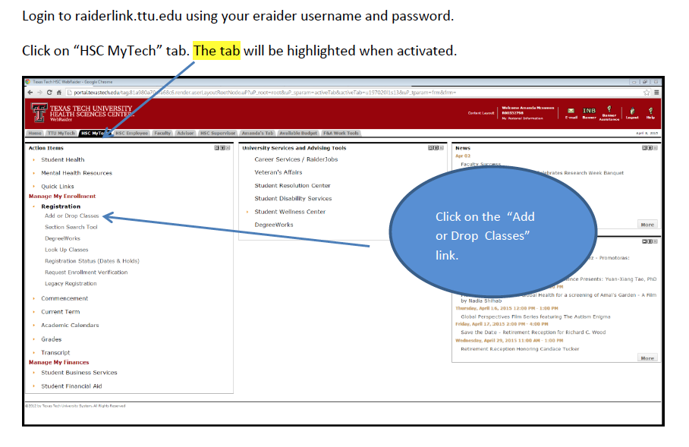
Registration from WebRaider Portal

Slide 10
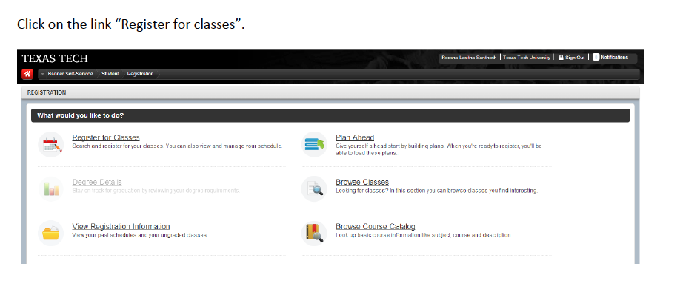

Slide 11
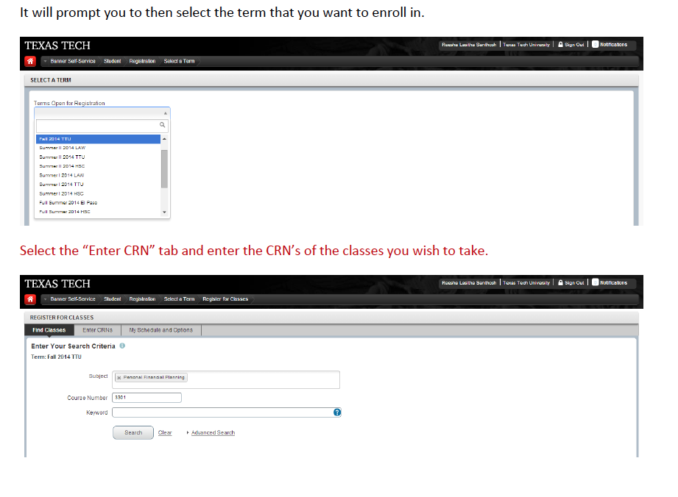

Slide 12
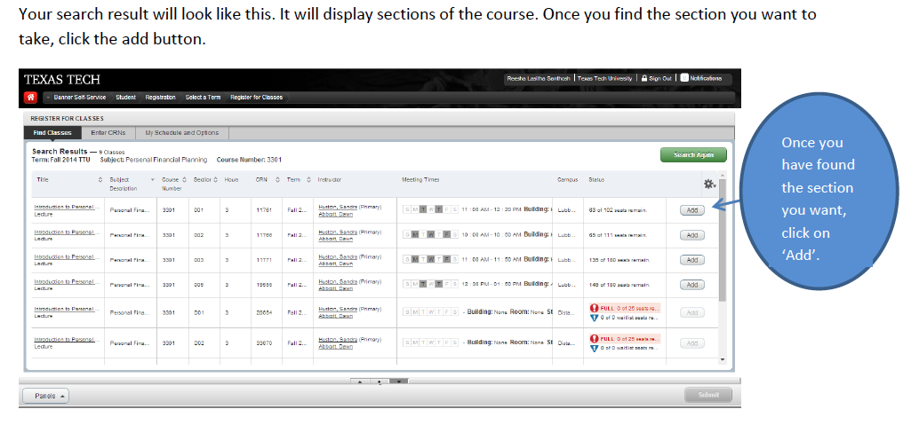

Slide 13
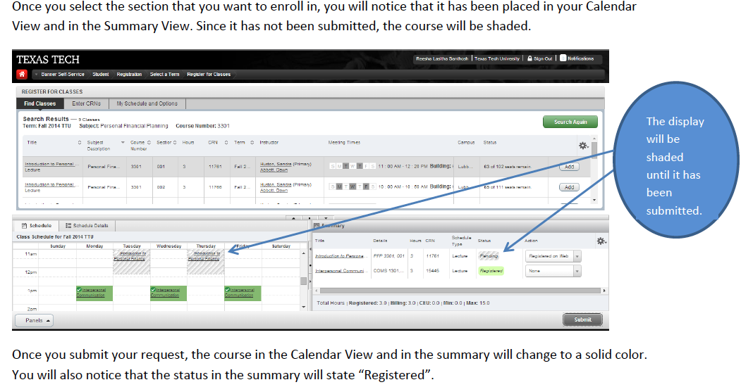

Slide 14
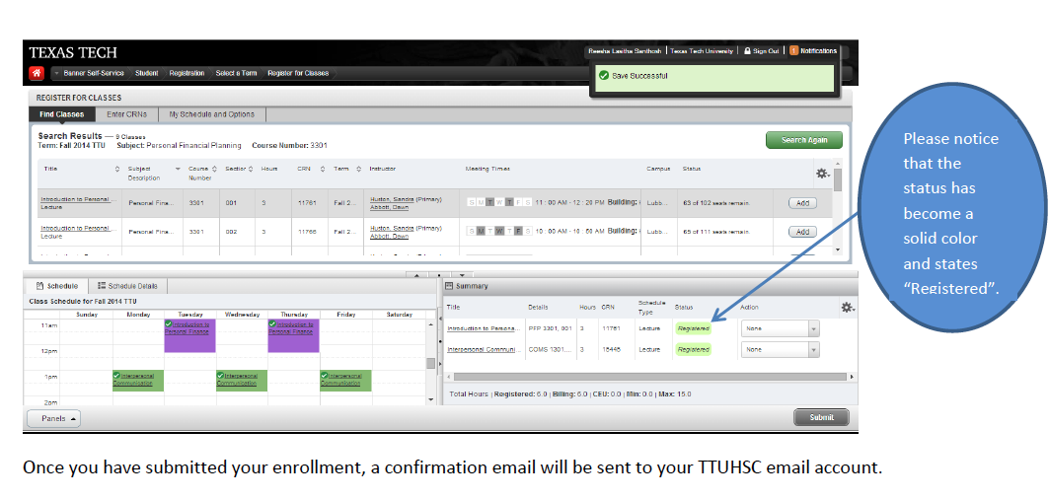

Slide 15
Electives
Electives are taught face-to-face and must be taken during non-rotation periods. Do not select a rotation as the same time you have a rotation.
Electives are set to run in six-week blocks to coincide with rotations.
Two electives are scheduled in each six-week block.

Slide 16
Electives Continued
You must have a total of three electives during your P3 year. If you have two rotations in the fall, then you will select only one elective in the fall. If you have only one rotation in the spring, then you will select two electives in the spring. You must have a total of three electives during your entire P3 year (add fall electives to your spring electives – 2 electives taken in fall requires that you take only 1 elective in the spring).

Slide 17
Electives are subject to change
There are several reasons there can be changes made to an elective offering.
  Faculty resign position. No other faculty available to teach the course.
  Faculty have teaching conflicts with electives
  Enrollment fails to meet the minimum enrollment of 10 students.

Slide 18
Special Project Elective
Special Project Electives - independent study for a student with the aid of faculty mentor.
Student who enjoys working independently can be researched-based or clinical.
Contract for Completion.
Contact Student Services for paperwork.

Slide 19
Rotation Course Numbers
You will not enroll in all rotations in a term.
Enroll only in assigned rotations for a term with dates of January 4 -May 13
These are the rotation course numbers for P3 rotations:
  Phar 4270 Community
  Phar 4274 Institutional Pharmacy Practice
  Phar 4275 Ambulatory Clinical Skills
  Phar 4276 Inpatient Clinical Skills

Slide 20
Errors in Enrollment for Rotations
Please keep in mind that you must enroll through the WebPortal for all assigned rotations.
The Experiential Office sets your rotations in E*Value. E*Value is not the official registration site. This site only notifies you of rotations for which you must register.
If you do not register through the WebPortal for your rotations, you can fall one year behind.

Slide 21
E*Value and Rotations
To view your Experiential Program rotation course numbers for registration, go to your profile page in E*Value.
To Access E*Value:
  Go to the School of Pharmacy webpage: www.ttuhsc.edu/sop
  Click on E*Value Access in the left-hand menu.
    Login Name & Password have been previously sent to you by the Experiential Program office.
    If you do not know your login information, or have trouble logging in, please contact the Experiential Program staff member on your campus.

Slide 22
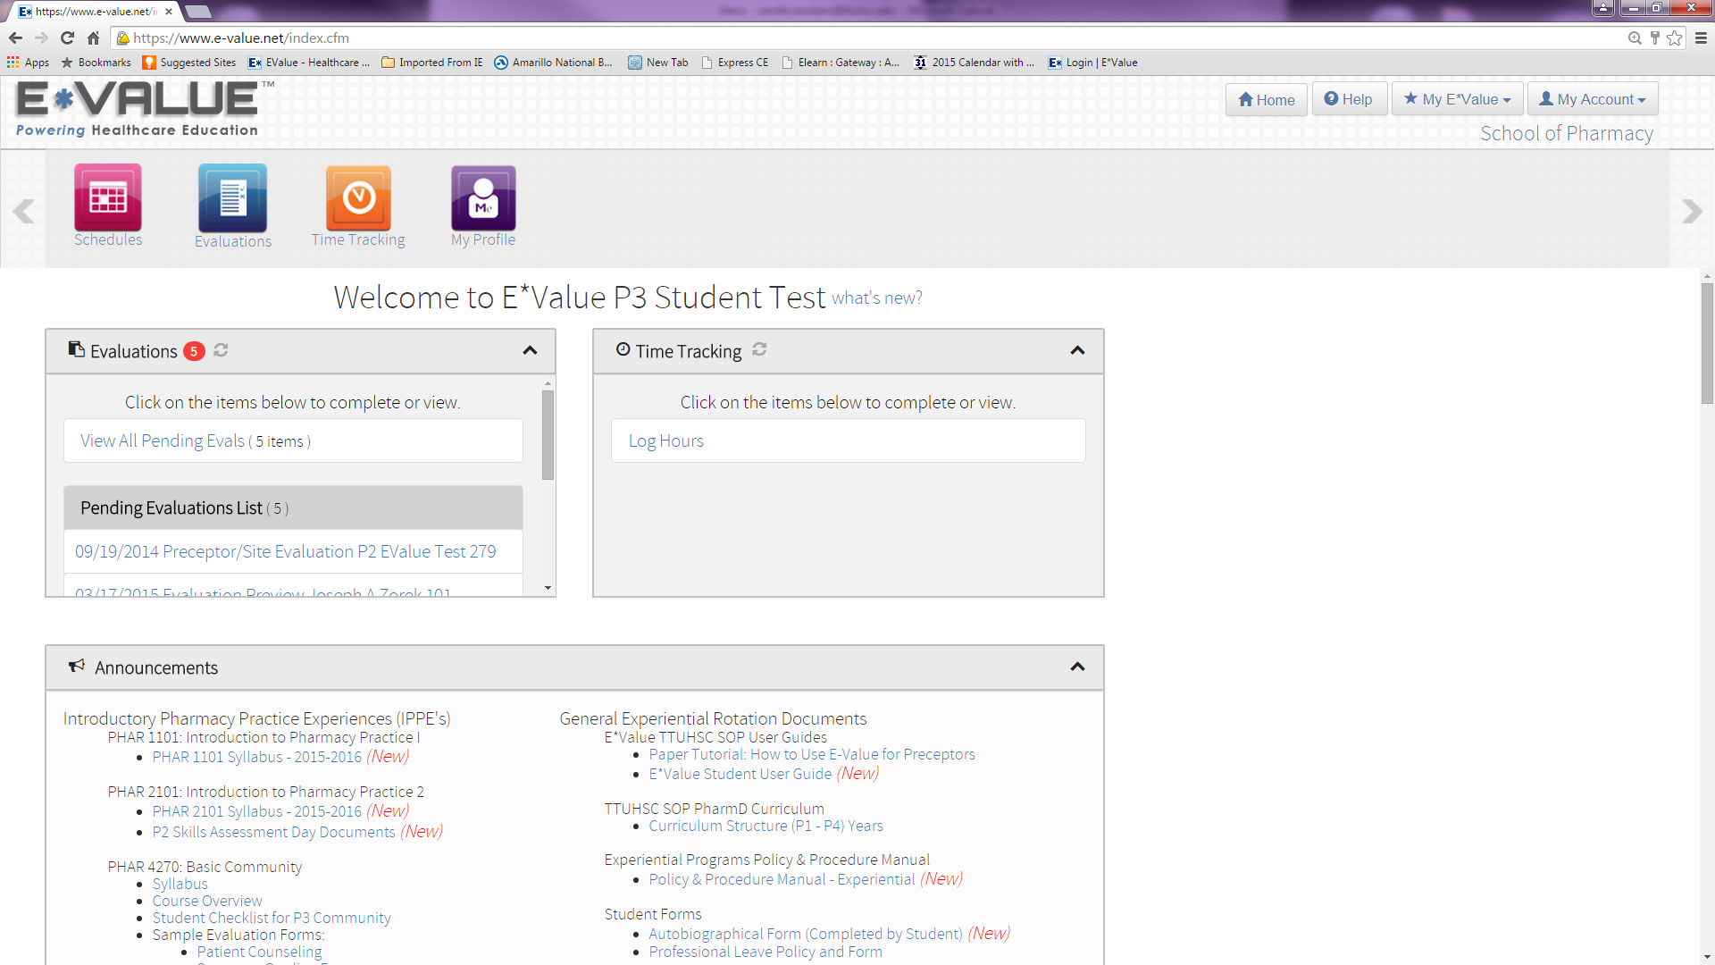
E*Value – Finding Assigned Rotations

Slide 23
E*Value Continued
Click on the “Schedules” tile and then the “Reports” menu item.
You can now choose “Rosters” from the Schedules box.
You will run a Roster Schedule Report to get your spring rotation schedule. Remember you are only to enroll in rotations assigned for the specific term of registration.
Select “01/04/2016” as the Start Date, and “05/13/2016” as the End Date. You should not have to change any of the other filter options.
Click the Next button to see your schedule.

Slide 24
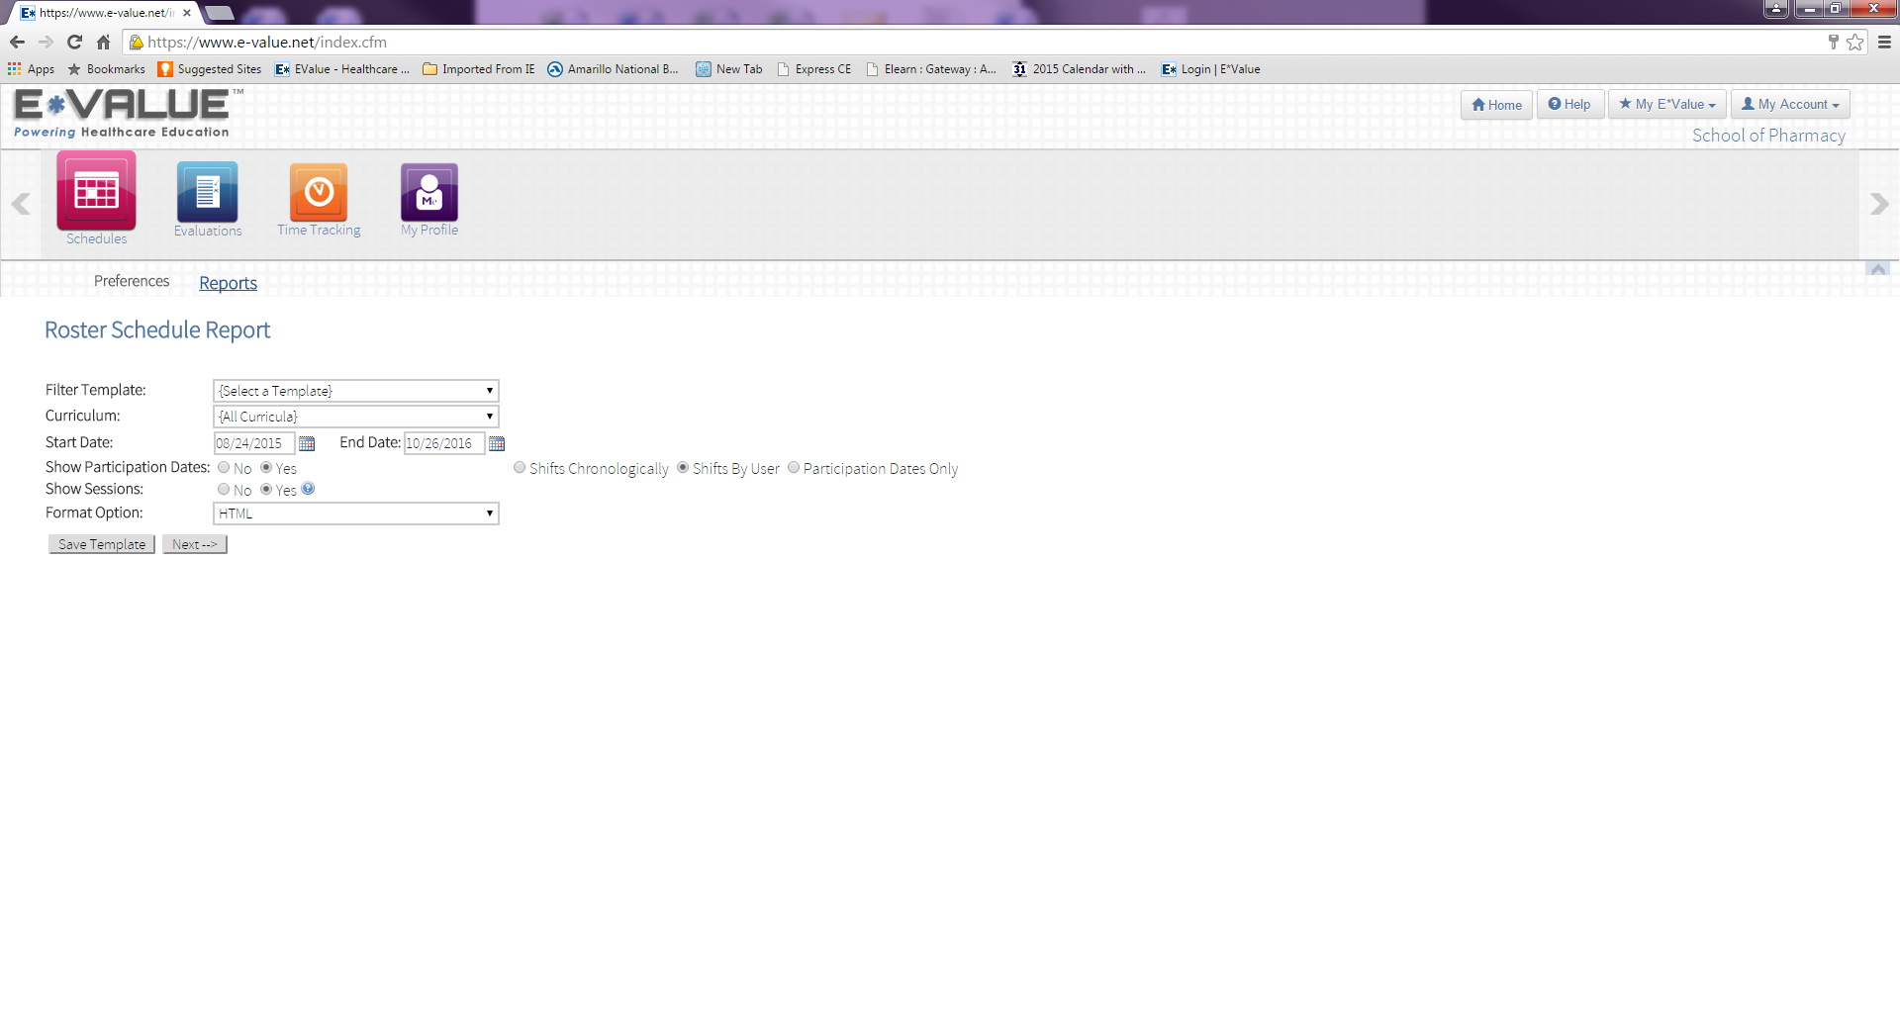
E*Value Roster Schedule Report Example:

Slide 25
E*Value Continued
The rotation course number for registration is listed in the Course/Rotation name. The example given is the P3 Intermediate Community-Basic rotation. You can see the course number (PHAR 4270) precedes the course name.
Section numbers should be listed as part of the Preceptor’s name (101, 103 etc…) on the report.
If a preceptor’s name does not include a section number, please contact your Experiential Program Coordinator.

Slide 26
E*Value Continued
Section numbers for Rotations:
  Amarillo Faculty: 101
  Amarillo Adjunct: 103
  Abilene Faculty: 201
  Abilene Adjunct: 202
  Dallas Faculty: 301
  Dallas Adjunct: 303
  Lubbock Faculty: 401
  Lubbock Adjunct: 403

Slide 27
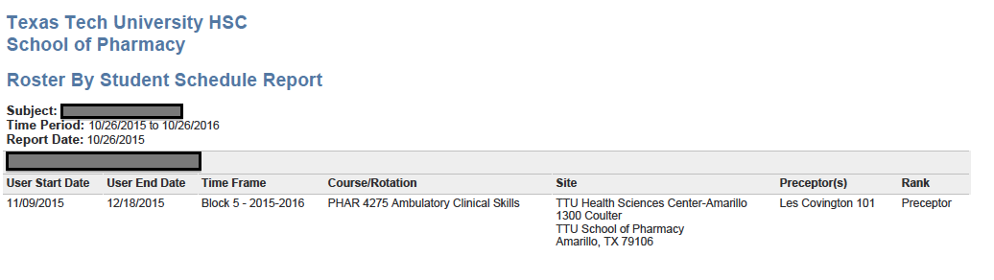
E*Value List of Rotations Example:

Slide 28
Important Information
If at any time your rotations change within E*Value, you must change your registration in WebRaider before the semester begins.
You must check E*Value at least two weeks prior to the start of any semester to be sure that your rotations have not changed.

Slide 29
Important Information Cont.
If the change occurs during the semester, then notify Student Services in Amarillo immediately. We have to authorize the change to your schedule.
Failure to make a change in your schedule can result in serious consequences

Slide 30
DegreeWorks and Concise Student Schedule
Use these two tools together to be sure you have registered for all classes needed to graduate.
You can go to DegreeWorks after you have registered to have an overall picture that shows you have registered for all the courses needed toward graduation.

Slide 31
Additional Tools for Registration include DegreeWorks
Use the DegreeWorks from the WebRaider Portal. https://degreeworks.texastech.edu/
In the Student ID window enter your R#
Green Checks indicate completed courses
Blue are in Progress
Red X’s indicate outstanding coursework

Slide 32
DegreeWorks continued
You will need to enroll in courses offered that will complete the enrollment in that area.
These are the courses you must complete to graduate.
Each section should be completed from the previous semester or show enrolled
Some courses have moved from fall to spring so look for these sections as “Not met” to find needed enrollment.

Slide 33
Continued
P3 students will have a variety of views in the degree audit. If you had summer rotations or you took all electives in the fall, your requirements will vary to complete the P-3 year.
You will need to enroll in courses and rotations offered that will complete the enrollment in that area. You must enroll through the WebRaider Portal for rotations assigned by the Experiential Office scheduled in January 4, 2016 to May 13, 2016.
Each section should be completed from the previous semester or show enrolled.

Slide 34
Other helpful websites
Use the Academic/Events Calendar to find a list of important activities as well as the holidays and special events. http://www.ttuhsc.edu/sop/academicinfo/docspring_2016_Final_Exam_Schedule_revB.pdf
Use the Final Exam Schedule to find the dates for final exams and the time for the final exams. http://www.ttuhsc.edu/sop/academicinfo/docs/Spring_2016_Final_Exam_Schedule_revB.pdf
Use the Course Syllabi to find the Spring 2016 syllabi. http://www.ttuhsc.edu/sop/faculty/selfgov/curricularaffairs/spring2016_syllabi.aspx

Slide 35
Check List
Are all your courses on the same campus?
Did you print your Concise Student Schedule for verification that you enrolled in all courses.
Did you check your enrollment against DegreeWorks?
All students must enroll for Phar 1001 Annual Assessment.
Number of courses will vary for the P3 student based on previous enrollments.
Success!

Slide 36
P3 Registration Dates
Opens November 10th at 5am.
Ends January 3rd at 5pm.

