Slide 1
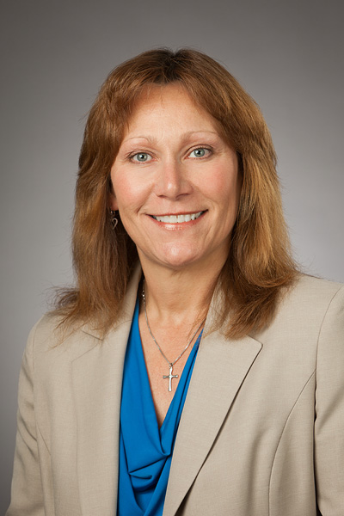
The nuts and bolts of the CRI and the IRB
Catherine Lovett, MSN, RN
Managing Director

Slide 2
Overview
The mission and services provided by the Clinical Research Institute (CRI)
Basic elements of protocol design
Key areas of protocol review by the CRI and the Institutional Review Board (IRB)
Required documents to submit to IRB with initial review
Elements necessary for IRB approval of a project
TTUHSC institutional research training/requirements

Slide 3
CRI Mission
To help you conduct original, investigator-initiated research

Slide 4
Organizational Chart

Slide 5
Services
The CRI can assist with the following:
Study design: Based on statistical considerations from the very beginning
IRB submissions: No study with humans can be done without IRB approval. The CRI has the personnel to prepare all necessary IRB submissions
Study conduct for in-patient and out-patient projects: From recruiting subjects, scheduling appointments, performing procedures like blood draws, BMD tests, EKGs, etc., to collecting data and assisting with reports and manuscript preparation
Data analysis: By statisticians

Slide 6
How it works…………
Think of a research project you would like to conduct
↓
Do your literature search
↓
Download the Protocol Template from the CRI website
and write your draft protocol
↓
Download the CRI Work Order from the CRI website
↓
Submit the signed Work Order and draft protocol to the CRI
↓
The CRI will help you finalize your protocol

Slide 7
How it works…………
The CRI will prepare and submit ALL IRB paperwork
(make sure ALL your training, and iRIS accounts are up to date!)
↓
Once IRB approval is obtained, your research nurse will organize/coordinate the study for you. This includes: subject recruitment, staff education, data collection, IRB paperwork, patient visits and follow-up, study closure, etc.
↓
The PI needs to:
Identify & help recruit study subjects
See the study subjects at each visit per the protocol
Be available for questions and signatures
↓
Study completed---CRI will work with you to get it published!
**ALL AT NO COST TO YOU!**

Slide 8
CRI Review
CRI Directors/Statistician/Monitor will review the draft documents you submit to help you finalize your protocol
Why?
Because we want:
  Your project to be the best it can be
  Your project to be successful
  You to have no problems getting IRB approval
  You to be able to publish your project
Because of our experience with the IRB we know:
  What they want
  What they look for
  How they want things worded
  What wording raises their blood pressure
Because CRI resources will be used we must ensure they are used appropriately and in the most efficient manner

Slide 9
Protocol Review Process
Is it clear in the background that you did a literature review?
  Statements supported by references?
  Do you present both sides of a question and suggest why you think one is correct?
  Is there support for the methods you want to use?
    Are surveys/instruments validated? (especially for constructs like depression, communication, happiness, etc.)
    Are devices scientifically supported for accuracy/safety?
Is the protocol focused?
  Investigators perspective: even the smallest research takes a lot of time
  Patients perspective: avoid involving “innocent” people in poorly designed research

Slide 10
Review Process
What are the hypotheses?
  What is being measured, manipulated?
  Are all variables clearly identified as independent or dependent?
  Are the hypotheses specific and testable?
Will the design lead you to reach your goal?
  Is the design appropriate for the level of evidence they want to reach?
Outcome measures
  Are they defined
  Are the units/scales (mm, cl, kg, years, 1-7, nominal) defined?

Slide 11
Review Process
Sample size justification/power analysis/pilot project?
  CRI can do this for you if you provide:
    How many patients you will expect to recruit
    Expected attrition rate
    What effect size will you be able to detect?
Statistical analysis
  CRI can provide this wording, but will review what is written if it is written

Slide 12
Review Process
Is the project viable?
  Is it feasible to recruit patients, get data, perform analyses and write a report in a reasonable time; before someone else does the study & publishes it?
  Is there reasonable expectation that it will be accepted for publication?
  Are all documents provided for IRB submission?
    Data sheet, surveys, advertisements, diaries, etc.
    Are these documents worded, formatted correctly?
IS THERE ENOUGH INFORMATION FOR SOMEONE
TO REPRODUCE YOUR PROJECT?

Slide 13
Review Process
  We “track changes” in MS Word so you can easily see our comments and suggestions
  We e-mail document(s) back…….
  We are available to discuss any questions you may have
    Monthly visits to Odessa
    Phone/Lync
  This review typically only takes a couple of days
CRI
Investigator
CRI
Investigator
CRI
IRB

Slide 14
IRB-Who is it?
  NOT the Clinical Research Institute!!
IRB stands for the Institutional Review Board for the Protection of Human Subjects
Federal Law defines its role, composition and manner of functioning
Members of an IRB are volunteers appointed by the Institution but who operate independently

Slide 15
IRB-What does it do?
Primary purpose is to protect the rights and welfare of all human research participants by:
    Confirming study validity
    Evaluating safety for minimizing risk to subjects
Also wants to help:
Improve quality of research
Educate researchers
Protect researchers
Protect institutions

Slide 16
IRB-What does it do?
An IRB reviews every protocol and has the authority to:
  Approve the study
  Require modifications for approval
  Disapprove the study
  Stop any research project even if previously approved

Slide 17
IRB-Submission
Required documents:
Protocol
  Aims and objectives, supporting background, outcomes (data recording sheet), design, methods, subjects (number, inclusion-exclusion criteria & recruitment), risks and benefits, confidentiality, statistical analysis, investigator qualifications and potential significance of the study
CRF (Case Report Form)/Data Sheet
For recording data and defining what will be measured
Informed consent form (consent for adults, assent for minors)
Surveys and questionnaires (paper & electronic )
Advertisements for subject recruitment

Slide 18
IRB-Types of Review
Exempt projects: Studies done without any subject identifiers
  Retrospective chart reviews, anonymous surveys
Expedited review: Minimal risk studies that can be evaluated by two members of the IRB Board.
  Retrospective chart reviews with identifiers collected
  Face to face interviews where the signed consent form would be only identifying link
Full Board review: Proposed research that is greater than minimal risk
  Uses vulnerable populations, has any unapproved drugs or devices, deception of subjects, surveys with sensitive questions or any other project that doesn’t quite meet the definition for expedited review.
  TTUHSC IRB meets monthly, 4th Wednesday of the month.

Slide 19
IRB-Criteria for approval
Study is scientifically valid
Risks to subjects are minimized and reasonable in relation to anticipated benefits
Selection of subjects is equitable & appropriate demographically
  Participation must be voluntary with the right to withdraw
Safeguards are included for vulnerable populations (students…..)
Informed consent is sought and documented from each subject
Privacy and confidentiality of subjects is protected

Slide 20
Process
The project was approved by IRB
The researchers run the study
The CRI coordinates the study
Send ~10% finished data for preliminary analysis
No
Is data OK? Fix it!
No
Yes
Proceed with data collection
until database is locked
Researchers and biostatisticians meet to discuss specifics
Data analysis
Report writing/Manuscript Prep

Slide 21
Summary
USE US! (Please, or lose us)
E-mail: clinicalresearch@ttuhsc.edu
Offices
Odessa: 2C-44 Lubbock: BA-101, MS 8183
    (432) 703-5390 (806)743-4222
Contact Numbers:
L. O. Lutherer, MD, PhD Alan Peiris, MD, PhD
(806) 743-2532 (806) 743-3554
Tom Tenner, PhD Cathy Lovett, RN, MSN
(806) 743-3010 (806) 743-4433
Website: http://www.ttuhsc.edu/clinicalresearch/
        CRI Work Order
        Protocol template
        Useful links, i.e. FDA, IRB

Slide 22

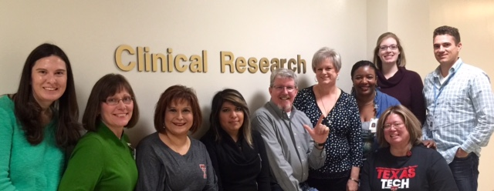
Lubbock CRI Staff
Phone: (806) 743-4222 Office: BA-101

Slide 23
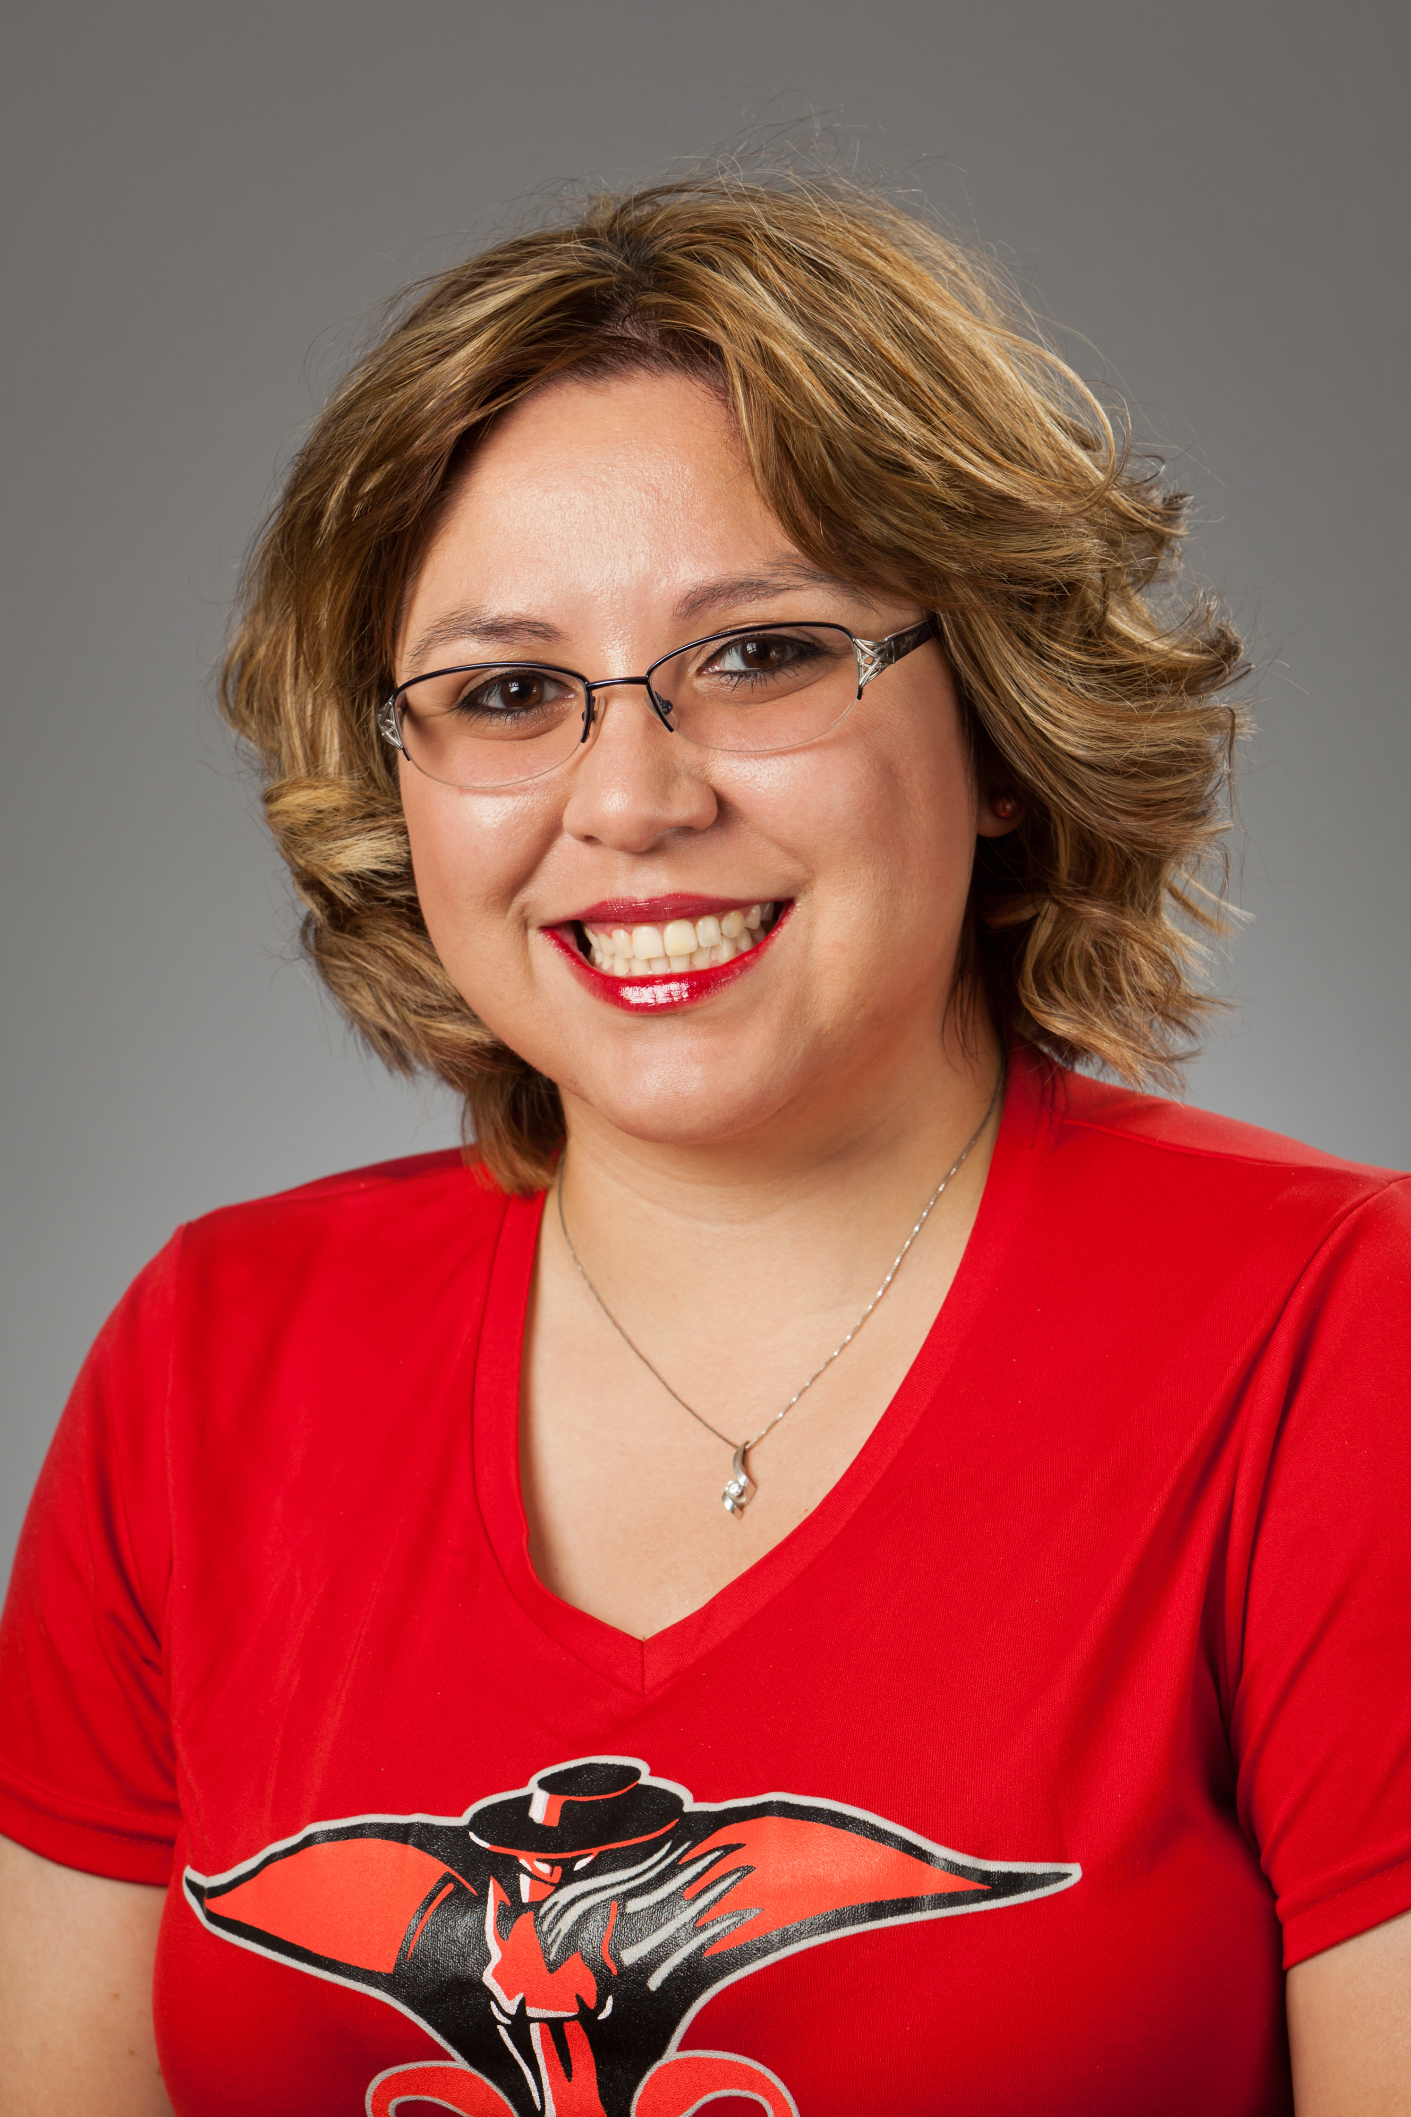
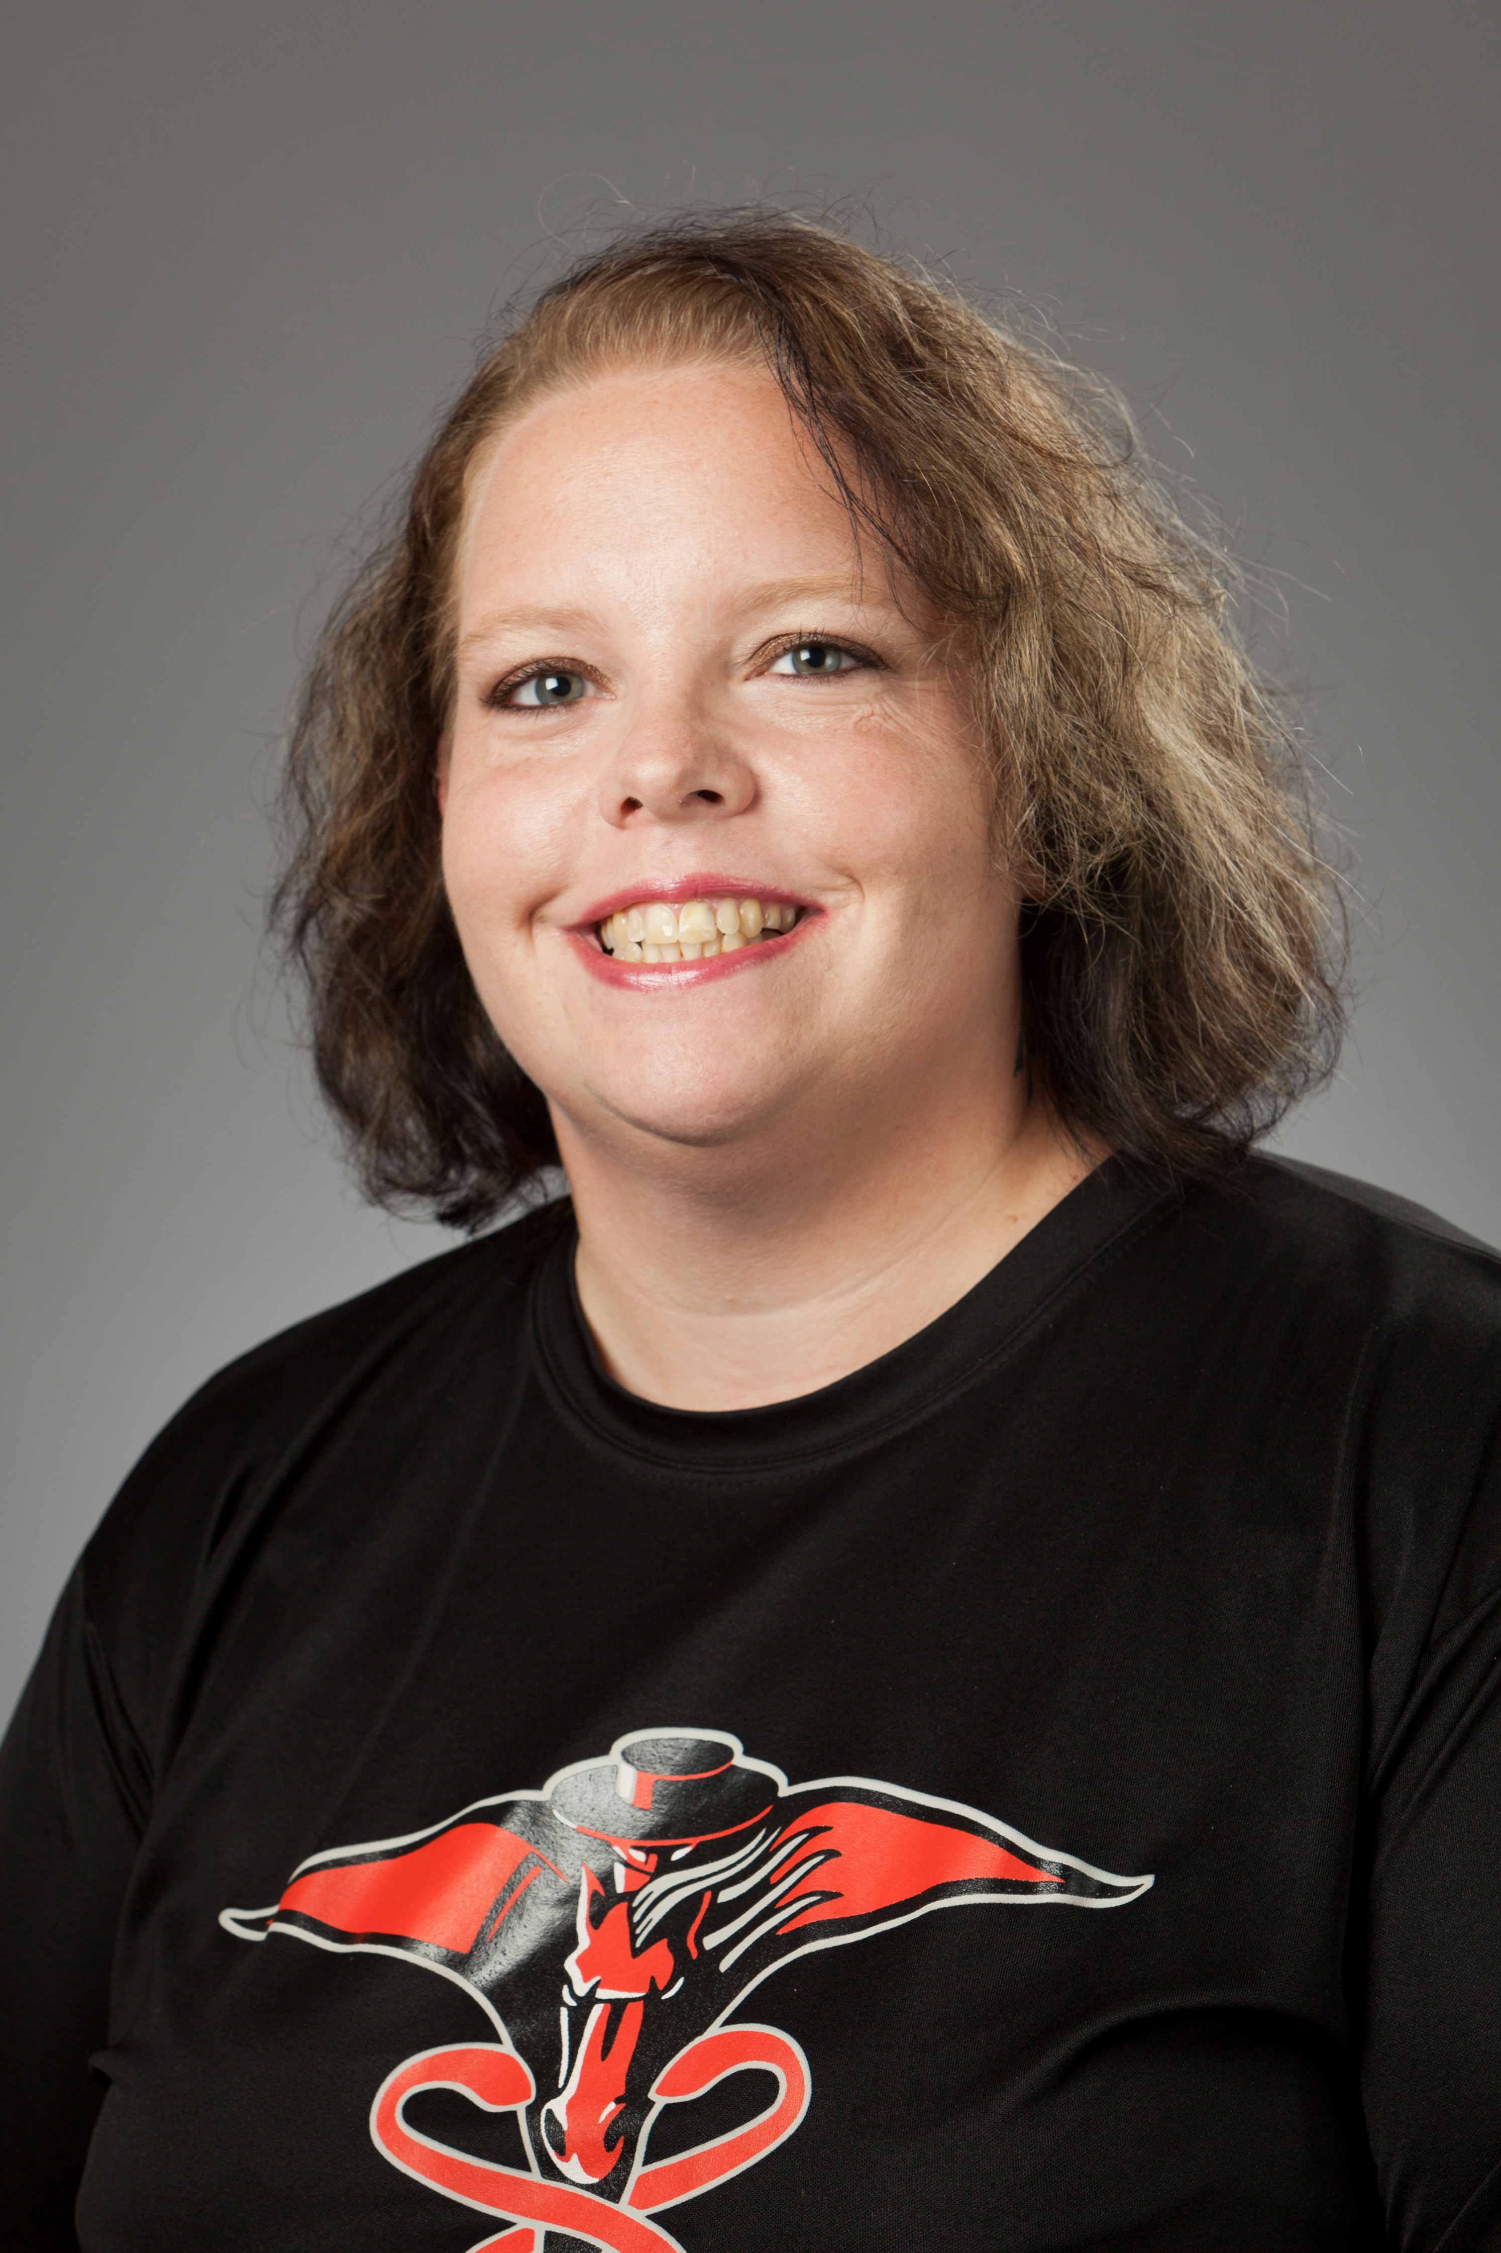
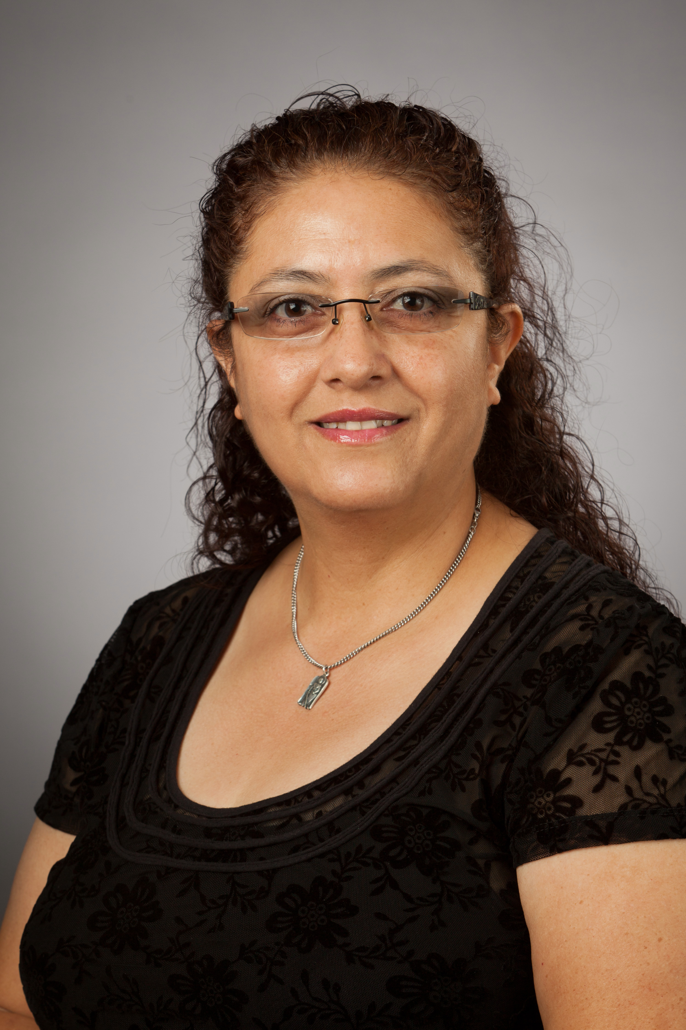
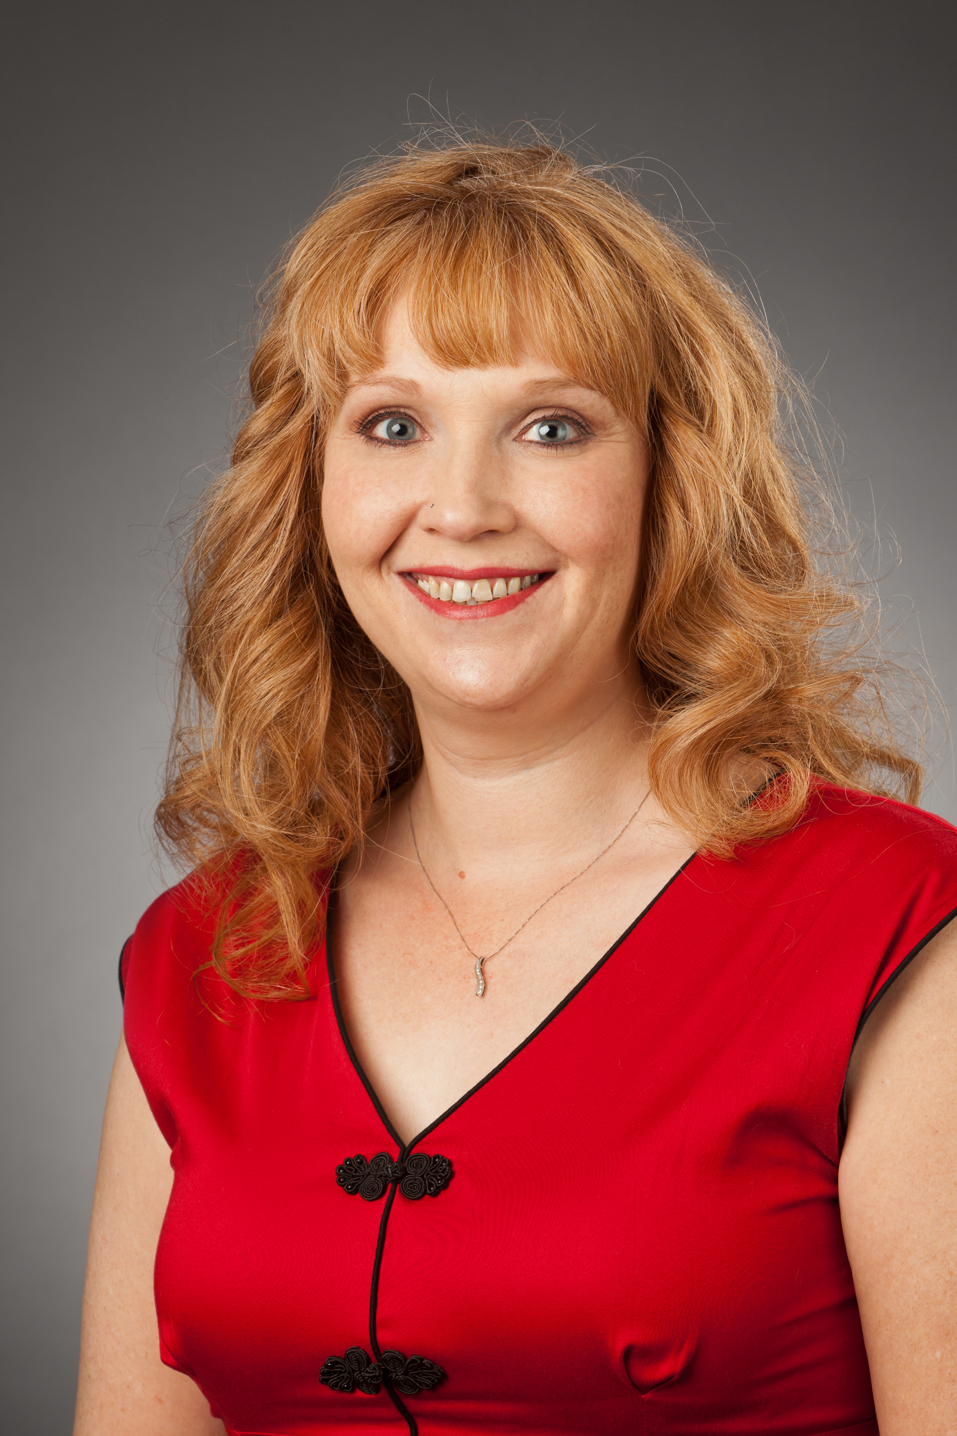
Odessa CRI Staff
Jennifer Hinojosa, RN Certified CRC
Ailena Mulkey, RN Certified CRC
Eva Santiago, LVN
Certified CRC
Cari White, RN, CRC
Phone: (432) 703-5390 Office: 2C-44

Slide 24
(P.S.) Training- #1
Citi Training- (Some faculty completed this training before orientation, if you have, please change the primary email address to a TTUHSC email address once you are provided with one)
This course will introduce you to the research world and get you familiar with the regulations governing clinical research. (must be renewed every 3 years)
  If you have not done so please complete the required courses at www.citiprogram.org.
  Please remember to use your TTUHSC email to register, and a personal as a backup.
  Click on the words “Register here” and follow the instructions to register. Be sure to affiliate with Texas Tech University Health Sciences Center and not with Texas Tech University.

Slide 25
Training- #2
Conflict of Interest and Commitment (COIC Training)
- You will need to complete the COIC training which can be found on your Webraider page on the right hand side. As you complete the training be sure to indicated that you are involved in research.
- If you do not have an eraider ID or are not a TTUHSC staff or student please contact Virginia Smith in the TTUHSC Research Integrity Office about completion of this requirement 806-743-2991 or Virginia.smith@ttuhsc.edu
- For more information: https://www.ttuhsc.edu/research/financialdisclosure.aspx
The training and disclosure modules may be accessed through “Required Courses” on ACME, through the “Training Resources” tab on WebRaider or by clicking http://www.ttuhsc.edu/IT/ACME/roles/authenticated/courses.aspx then click next or https://tthsclubbock.co1.qualtrics.com/jfe/form/SV_0v4zMgpJvoXEjXv. When completing the disclosure portion of the module, be sure to indicate that you ARE involved in research.

Slide 26
Last item!
iRIS– this is the electronic system we use to communicate with the IRB
Request an iRIS account- All individuals who will be working on the study MUST have iRIS access prior to being added to a study. If they are not in iRIS, they need to request an iRIS account by clicking on the 'Request New Account' button located on the iRIS login screen.
Here is the link- https://www.sobmrimedris.ttuhsc.edu:8867/Login.jsp?logout=Yes&s=1436196019129
FOR SPECIFIC QUESTIONS ABOUT ANY OF THIS TRAINING OR YOUR iRIS ACCOUNT, THE CONTACT IS
VIRGINIA SMITH AT 806-743-2991
Virginia.smith@ttuhsc.edu

