Slide 1
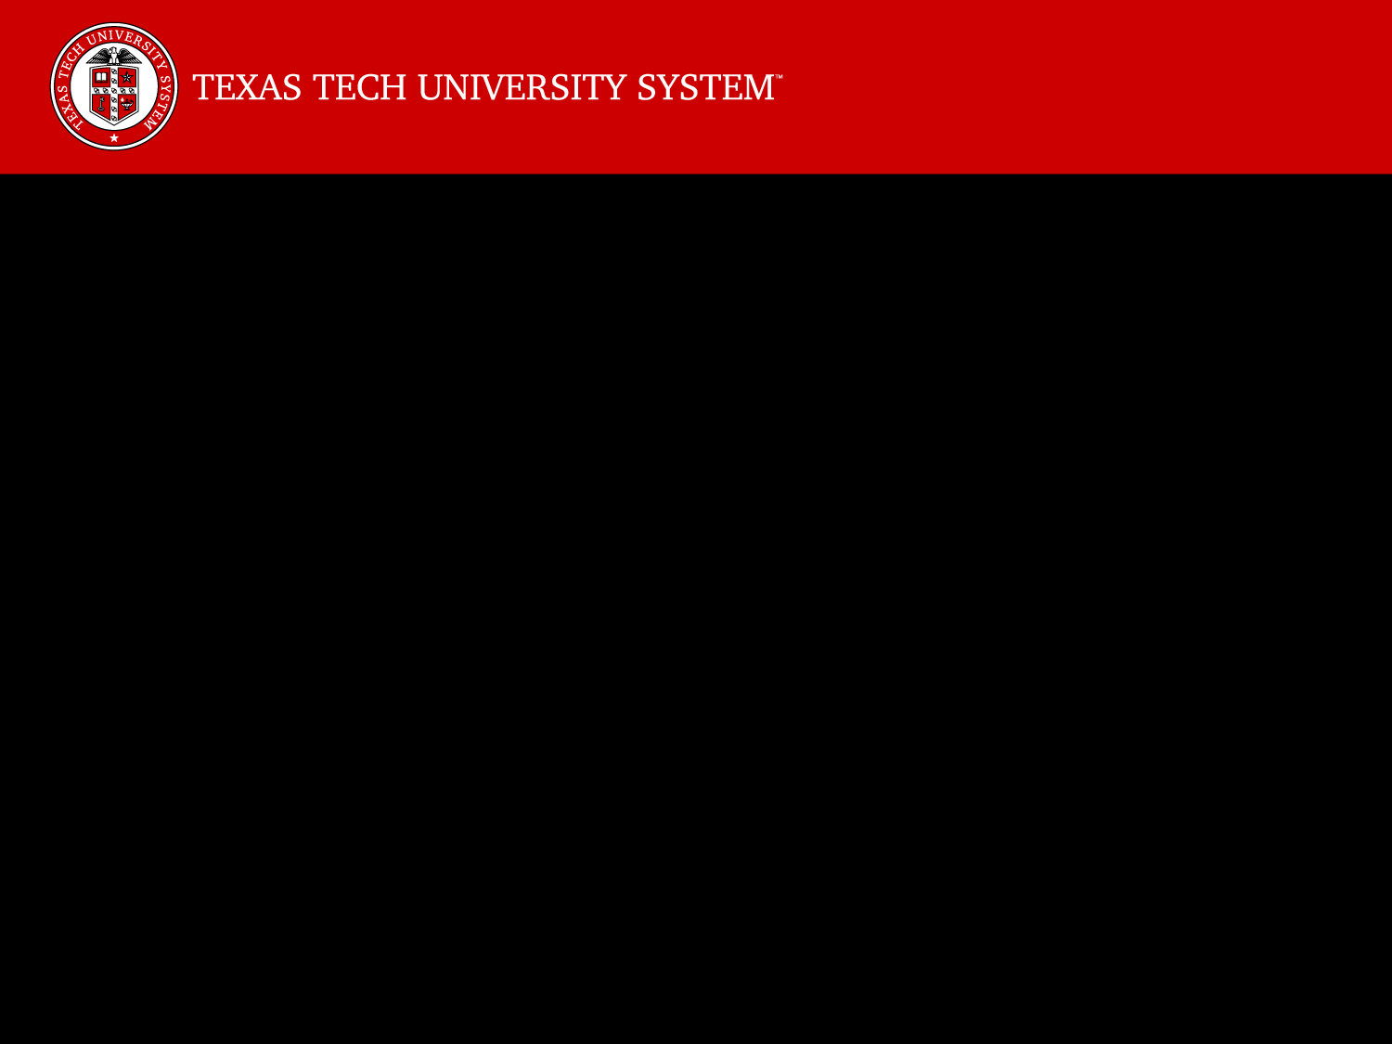



How to Obtain Federal Funds for Research
That Is Commercializable:
The SBIR/STTR Program
Sponsored By:
TTUHSC Office of the Vice President for Research
TTU Office of the Vice President for Research
Office of Research Commercialization
February 19, 2016

Slide 2
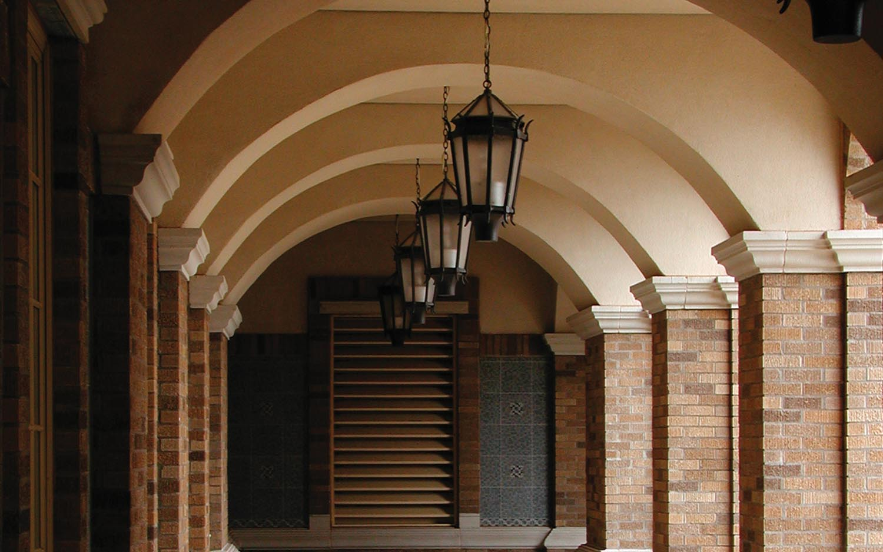

How to Obtain Federal Funds for Research
That Is Commercializable:
The SBIR/STTR Program
Hosted By:
Dr. P. Michael Conn, Ph.D.
Senior Vice President for Research
Texas Tech University Health Sciences Center
Dr. Robert V. Duncan, Ph.D.
Senior Vice President for Research
Texas Tech University

Slide 3

Panel
Eli Velasquez, JD Managing Director, Venture Development
Susan M. Back, PhD, MBA, Director, SBIR/STTR Resource Center
PJ Pronger, MPA, Associate Managing Director
Regional Business Development Partnership, TTU
Regional Small Business Development Center
Lisa McDonald, MSTC, Director, Texas Tech Accelerator
Weston Waldo, President, yearONE, LLC

Slide 4
The SBIR/STTR Program
Q & A
Please Send Follow-Up Questions and
Suggestions for Further Programs to:
Susan.Back@ttu.edu

Slide 5
SBIR/STTR
STRATEGIES FOR SUBMITTING A WINNING APPLICATION
Thank You!
For Further Information, Contact: Susan.Back@ttu.edu 806.834.4789

