Slide 1


Slide 2

The CH Foundation and Laura W. Bush Institute for Women’s Health
2021 Funding Cycle
Smiley Garcia, Senior Director Governmental/Foundation Relations
Office of the President
October 6, 2020

Slide 3

Goals and Mission
We work with TTUHSC leadership, SVPR and deans to identify research priorities and program initiatives
Augment TTUHSC research priorities and targeted projects with the TTU System office to prospect additional corporate investment and foundation funding opportunities
Partner with the VP Research Office in the development of strategic plan utilizing foundation based funding as a strategic bridge to Federal and State funding opportunities
Partner with VP Research Office and Academic Deans to determine a sustainable funding plan for prioritized research initiatives

Slide 4

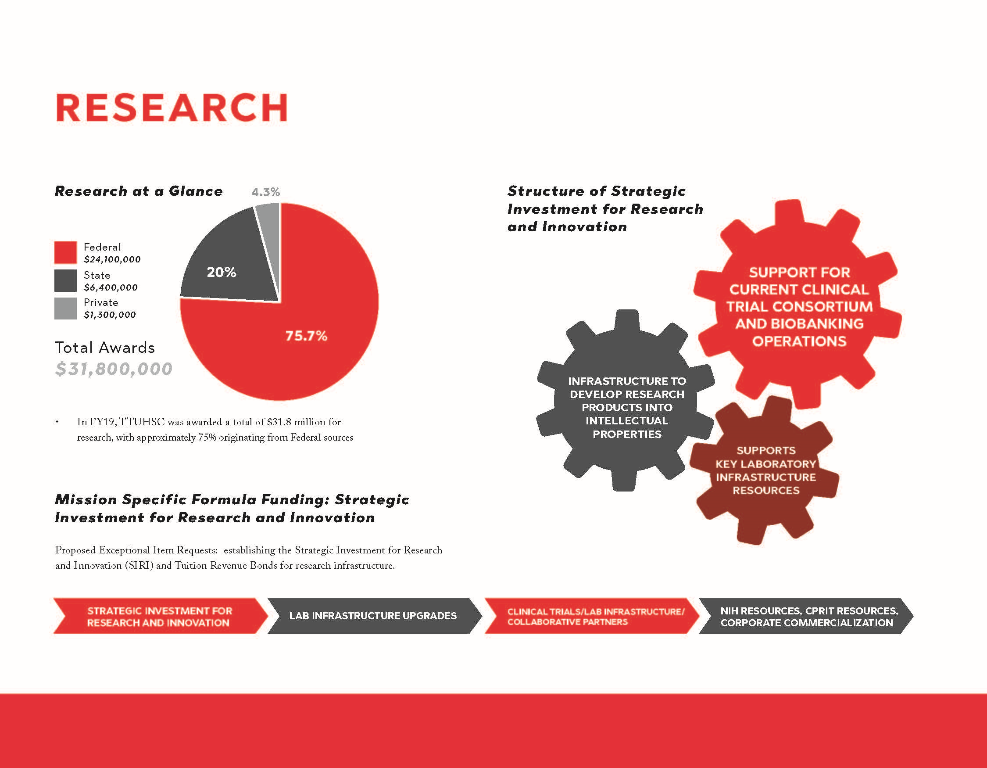

Slide 5
The CH Foundation Overview
  Major partner in funding TTU and TTUHSC projects. Successfully funded initiatives include: research, education programs and community development
  Fund projects in Lubbock area
  For research, they are looking at projects are collaborative, innovative and have significant community impact
  Over a four year period, funded approximately $1.7 million in TTUHSC specific projects

Slide 6
The CH Foundation: By the numbers
  The Foundation has funded $2.4 million specifically for research
  $11.7 million in Federal funding awarded from the Foundation’s initial investment
  For every one dollar of Foundation investment, $9.47 Federal funds were awarded
  42% of foundation awards have resulted in Federal funding for research
  The average CH award for research: $64,268; The average CH related Federal award: $560,546

Slide 7

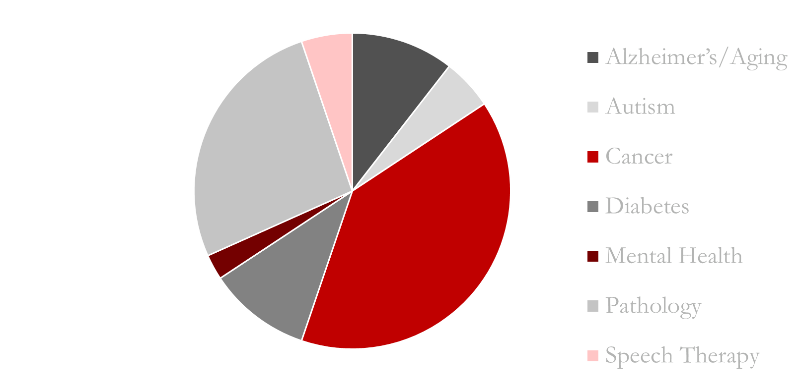
  Alzheimer’s/Aging: 10.5 %
  Autism: 5.2%
  Cancer: 39.5%
  Diabetes: 10.5%
  Mental Health: 2.6%
  Pathology: 26.5%
  Speech Therapy: 5.2%
The CH Foundation: Research Award Distribution

Slide 8
RFP
October 2020
Final Proposals
March 26, 2021 CHF
Awardees Announced
July 2021 CHF
$ Grant Awards
December 31, 2021 CHF
Grant Reports Due
December 1, 2022
CH: Finalists Announced
January 2021
CH Preliminary Proposals
November 13, 2020
CH: HSC Internal Review Committee
Nov 16-Dec 17, 2020
Final Proposals
March 5, 2021 CHF
Internal Reviews
Mar 9-March 26, 2021

Slide 9
The CH Foundation: General Guidance
  What the foundation will NOT Fund
  Salaries and Fringe Benefits. Proposals can include student stipends and tuition waivers
  Unrestricted Funds and International Travel
  Funds for “special events”- especially fundraising
  Projects or scholarships based solely on race, ethnicity or religion

Slide 10
The CH Foundation: General Guidance
  Proposals should reflect the Foundation’s goals and funding priorities
  This year they have stated the importance of community impact, innovation and collaboration
  Research project has a strategic link to a future Federal NIH/NSF/DOD proposal
  Projects should reflect how funding impacts a particular stage of research and illustrate the “way ahead” toward the research goals
  Preliminary and final proposals to be written in lay terms since the decision makers are non-scientists. Meet the Foundation’s intent without compromising the science

Slide 11
The CH Foundation: Preliminary Proposals
  Preliminary proposals include:
  Cover page with project title and amount requested (template provided)
  One to two-page project description- be concise
  Budget (template provided)
  Give special consideration to:
  Name of project: not too detailed or technical
  Emphasize the collaboration, innovation and community impact in your proposal
  Budget: be concise, it cannot change if you are approved for final

Slide 12
The CH Foundation: Final Proposals
  Finalists announced in January 2021
  Cover page with title and amount requested
  Content and length: Template provided, format set by the Foundation. Written in lay language, detailing use of funds and impact
  Budget: No changes from pre-proposal
  Bios of PIs and key collaborators
  Documentation of collaboration and letters of support

Slide 13
The CH Foundation: Key Dates and Action Items
  Pre-proposals due November 13, 2020
  Finalists announced early January 2021
  Final Proposals due March 5, 2021
  Sent to the Foundation March 26, 2021
  Annual/Final Reports
  All funds must be spent in the calendar year for which it was awarded (Dec. 31st)
  Grant reports are due December 1st of the year they are funded
  Grant reports are submitted to the foundation through ER/IA office
  Extension requests to the foundation are not an option

Slide 14
Laura W. Bush Institute for Women’s Health
  In September the LWBIWH became the newest member of our External Relations Team
  The LWBIWH is dedicated to improving the lives of women and girls in Texas and across the nation by advancing multidisciplinary science in women’s health
  As part of their mission with scientific investigation, the Institute does offer funding for translational, clinical and population-based research that aligns with the mission of the Institute with emphasis on sex and gender based medicine
  The Institute’s focus of their grant program is to provide “seed funding” for novel research unique to women’s health that highlights critical issues for women and a focus on the treatment of medical conditions that lead to more personalized medical care

Slide 15
LWBIWH: Types of Funding
  Seed Grants up to $25,000
  Projects should have a clear goal that could result in potential extramural research funding or contributes to innovations in sex and gender education
  Suitable projects include clinical or health services studies as well as those that use animal, theoretical or laboratory models
  Small Grant Funding ($5,000-$10,000)
  Provides funding, research support and other resources to assist clinical faculty (may include students) with career interests in women’s health and differences biological sex differences and continuity in research focus
  Suitable projects include patient-oriented research as well as epidemiological, behavioral health studies, pilot data, survey studies, educational program development

Slide 16
LWBIWH Grant Funding at a Glance
  Since the grant program’s inception in 2008
  The Institute has awarded $3,135,281 in grants
  167 research projects
  58 scholarly works
  5 PhD dissertations
  5 NIH grants

Slide 17
LWBWH: Grant Process and Eligibility
  Researchers will utilize the existing grant application process within their school
  Each school will review the applications and direct those that match the criteria designated by the Laura W. Bush Institute directly to the Institute
  The Institute will review proposals that have been submitted by each school and is evaluated based on: a) quality of the science and b) alignment with the Institute’s mission
  Eligibility
  All faculty at the TTUHSC schools are encouraged to apply for funding
  Grant recipients must be a member of the Laura W. Bush Institute for Women’s Health
  Members are accepted after providing a CV and personal statement to the Institute

Slide 18
Laura W. Bush Institute for Women’s Health
  Resources for more information or questions:
  Angela Knapp Eggers, Grant Administrator
  angela.knapp@ttuhsc.edu or (806) 414-9941
  Connie Tyne, Executive Director
  connie.tyne@ttuhsc.edu or (214) 358-9057

