Slide 1


Slide 2

The CH Foundation 2022 Funding Cycle
Smiley Garcia, Senior Director Governmental Relations
Office of the President
October 5, 2021

Slide 3

Goals and Mission
We work with TTUHSC leadership, SVPR and deans to identify research priorities and program initiatives in alignment with TTUHSCs strategic plan: innovation, collaboration and telehealth
Augment TTUHSC research priorities and targeted projects with the TTU System office to prospect additional private based foundation and Federal funding opportunities
Partner with the Senior VP Research Office in the development of operations plan utilizing foundation based funding as a strategic bridge to Federal and State funding opportunities
Partner with Senior VP Research Office and Academic Deans to determine a sustainable funding plan for prioritized research initiatives

Slide 4
Innovation and Collaboration in Research
  In the 87th Legislative Session earlier this year, the Legislature passed a mission specific formula for research
  Allocated $3.2 million as base funding and then would allocate match funding for all Federal and private research awards such as the CH Foundation
  This was Dr. Rice-Spearman’s top legislative priority this past Legislative Session, focusing on translational research that will be applied to chronic disease and health disparities in our area
  Opportunities such as the CH Foundation would enhance this investment by the Legislature and foster Dr. Rice-Spearman’s vision in transforming healthcare through innovation and collaboration

Slide 5
The CH Foundation Overview
  Major partner in funding TTU and TTUHSC projects. Successfully funded initiatives include: research, education programs and community development
  Fund projects in Lubbock area
  For research, they are looking at projects that mirror TTUHSCs strategic plan, particularly projects that are collaborative, innovative and have significant community impact
  Over a four year period, funded approximately $2.3 million in TTUHSC specific projects
  This past cycle, the Foundation funded 7 projects for a total of $465,000

Slide 6
The CH Foundation: By the numbers
  The Foundation has funded $3.1 million specifically for research
  $11.7 million in Federal funding awarded from the Foundation’s initial investment
  For every one dollar of Foundation investment, $9.47 Federal funds were awarded
  45% of foundation awards have resulted in Federal funding for research
  The average CH award for research: $64,268; The average CH related Federal award: $560,546

Slide 7

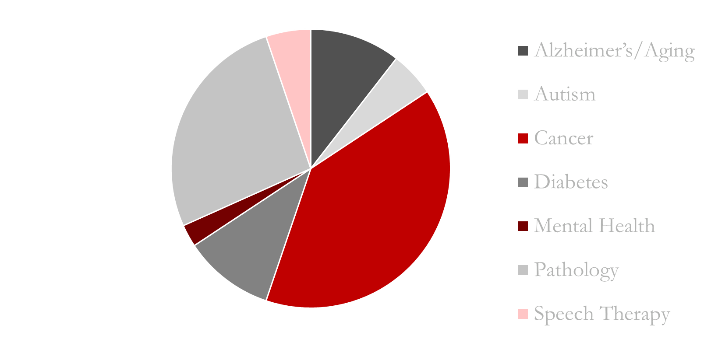
  Alzheimer’s/Aging: 10.5 %
  Autism: 5.2%
  Cancer: 39.5%
  Diabetes: 10.5%
  Mental Health: 2.6%
  Pathology: 26.5%
  Speech Therapy: 5.2%
The CH Foundation: Research Award Distribution

Slide 8
RFP
October 5, 2021
Final Proposals
March 29, 2022 CHF
Awardees Announced
July 2022 CHF
$ Grant Awards
January 1, 2023 CHF
Grant Reports Due
December 1, 2023
CH: Finalists Announced
January 2022
CH Preliminary Proposals
November 12, 2021
CH: HSC Internal Review Committee
Nov 15-Dec 17, 2021
Final Proposals
March 4, 2022 CHF
Internal Reviews
Mar 7-March 25, 2022

Slide 9
The CH Foundation: General Guidance
  What the foundation will NOT Fund
  Salaries and Fringe Benefits. Proposals can include student stipends and tuition waivers
  Unrestricted Funds and International Travel
  Funds for “special events”- especially fundraising
  Projects or scholarships based solely on race, ethnicity or religion

Slide 10
The CH Foundation: General Guidance
  Proposals should reflect the Foundation’s goals and funding priorities
  The Foundation has stressed the importance of community impact, innovation/ collaboration and alignment with TTUHSCs strategic goals
  Research project has a strategic link to a future Federal NIH/NSF/DOD proposal
  Projects should reflect how funding impacts a particular stage of research and illustrate the “way ahead” toward the research goals
  Preliminary and final proposals to be written in lay terms since the decision makers are non-scientists. Meet the Foundation’s intent without compromising the science

Slide 11
The CH Foundation: Preliminary Proposals
  Preliminary proposals include:
  Cover page with project title and amount requested (template provided)
  One to two-page project description- be concise
  Budget (template provided)
  Does not have to be entered in Cayuse
  Give special consideration to:
  Name of project: not too detailed or technical
  Emphasize the collaboration, innovation and community impact in your proposal
  Budget: be concise, it cannot change if you are approved as a finalist

Slide 12
The CH Foundation: Final Proposals
  Finalists announced in January 2022
  Cover page with title and amount requested
  Content and length: Template provided, format set by the Foundation. Written in lay language, detailing use of funds and impact
  Budget: No changes from pre-proposal
  Bios of PIs and key collaborators
  Documentation of collaboration and letters of support
  Must have OSP approval via Cayuse

Slide 13
The CH Foundation: Key Dates and Action Items
  Pre-proposals due November 12, 2021
  Finalists announced early January 2022
  Final Proposals due March 4, 2022
  Sent to the Foundation March 28, 2022
  Foundation Announces Awards June 2022
  Annual/Final Reports
  All funds must be spent in the calendar year for which it was awarded (Dec. 31st)
  Grant reports are due December 1st of the year they are funded
  Grant reports are submitted to the foundation through ER/IA office
  Extension requests to the foundation are not an option

