Slide 1
eCHECKUP TO GO Mandatory Course
Newly admitted students will be assigned the eCHECKUP TO GO Course in their Webraider Portal Webraider.ttuhsc.edu
What is the eCHECKUP TO GO Course?
eCHECKUP TO GO is an Alcohol Awareness Course that is required to complete.
*Note: Your School May Require That You Complete This Course As Part Of Your Orientation Packet Before Being Allowed To Register. All TTUHSC Students are required to complete this within one month from the first day of class. The system will update the completed course and then it will disappear from the portal within one week of completion.
*This course are completely confidential. NO ONE will see your results but you.

Slide 2
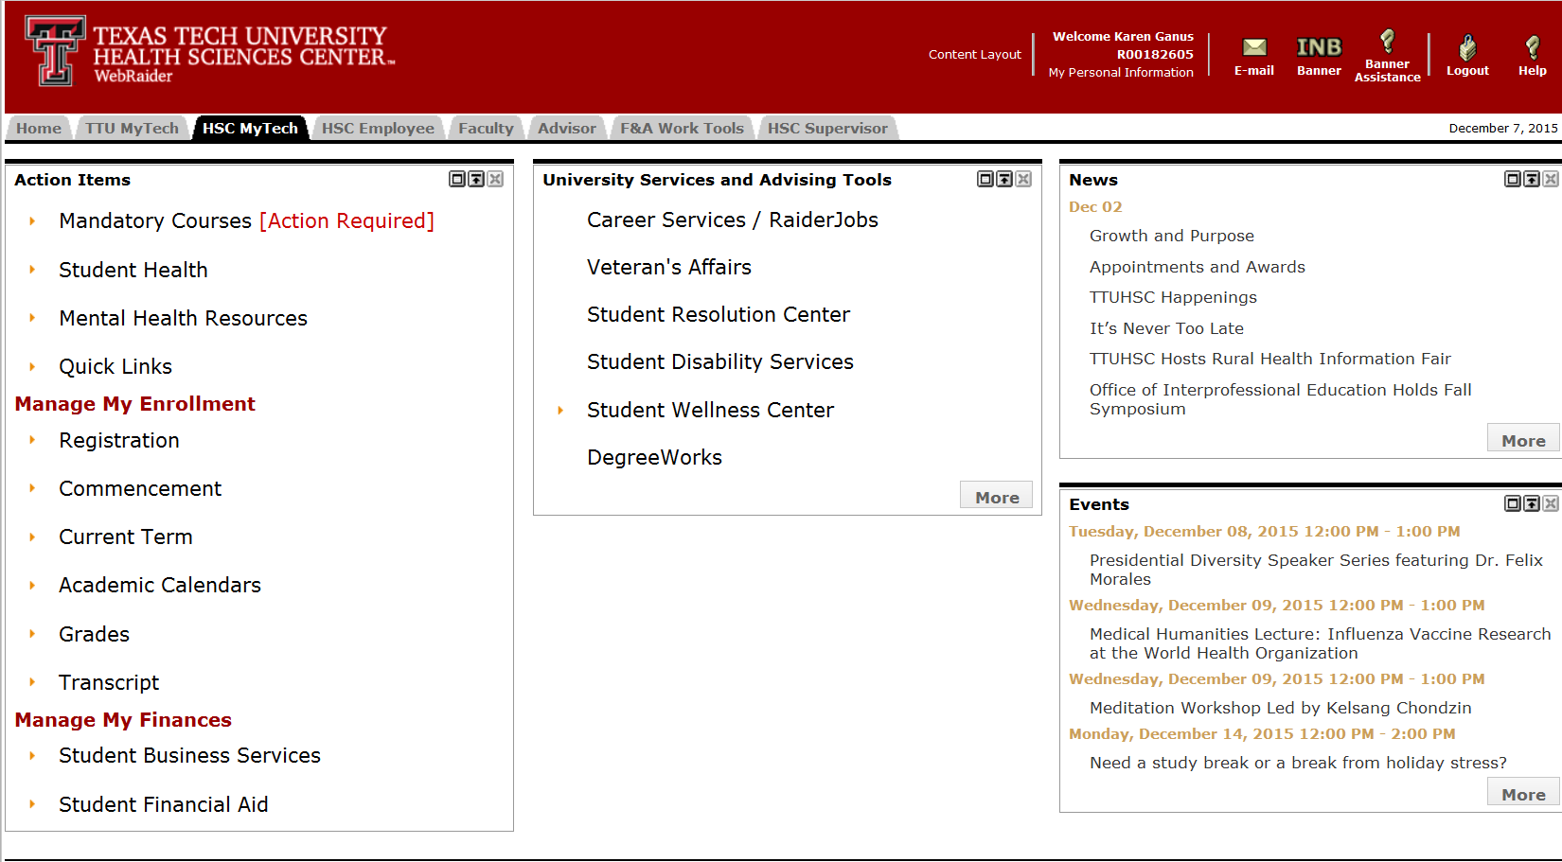
To eCHECKUP TO GO: Use Firefox or Chrome Log into Webraider Portal Click on HSC MyTech Tab

Slide 3
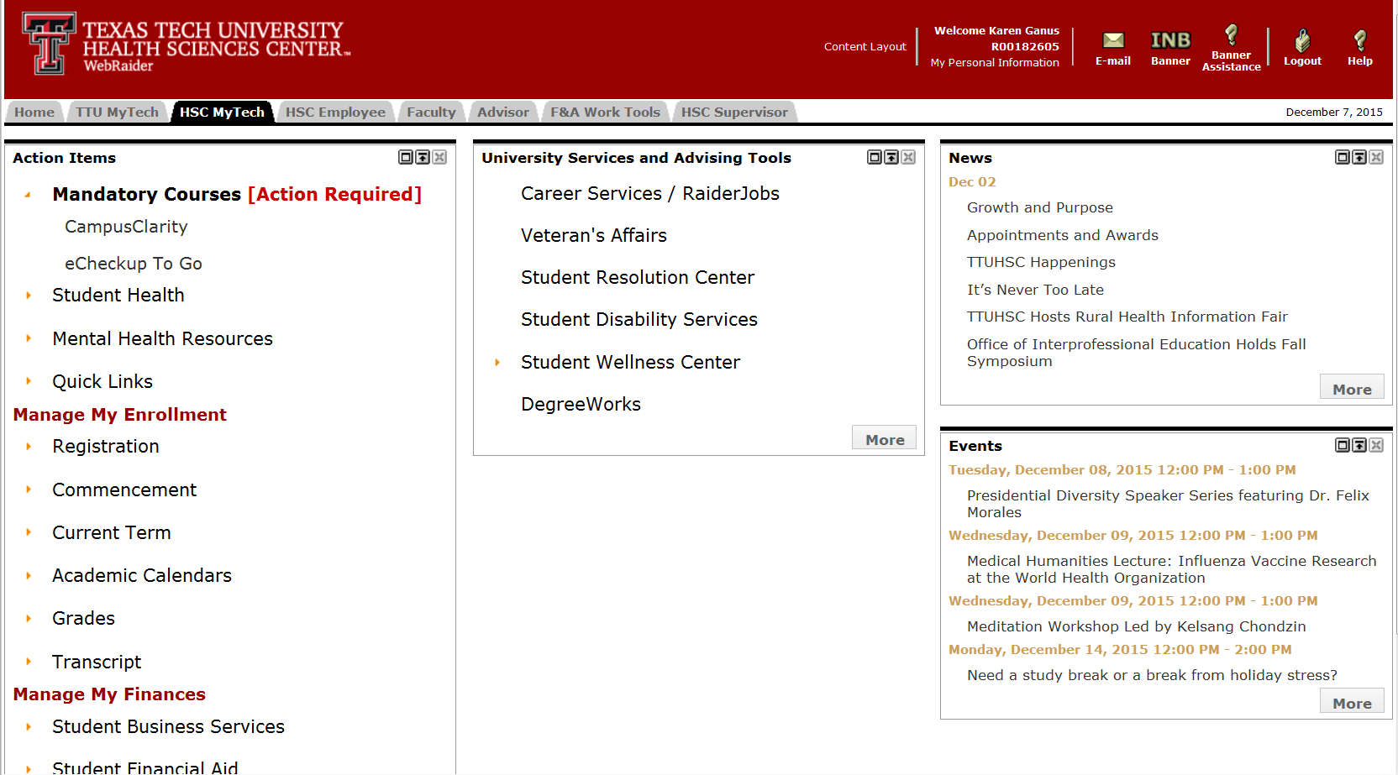
Under Action Items: Click on Mandatory Courses Click on each course: -eCHECKUP TO GO *Be sure to fully complete the course in order to receive credit.

Slide 4
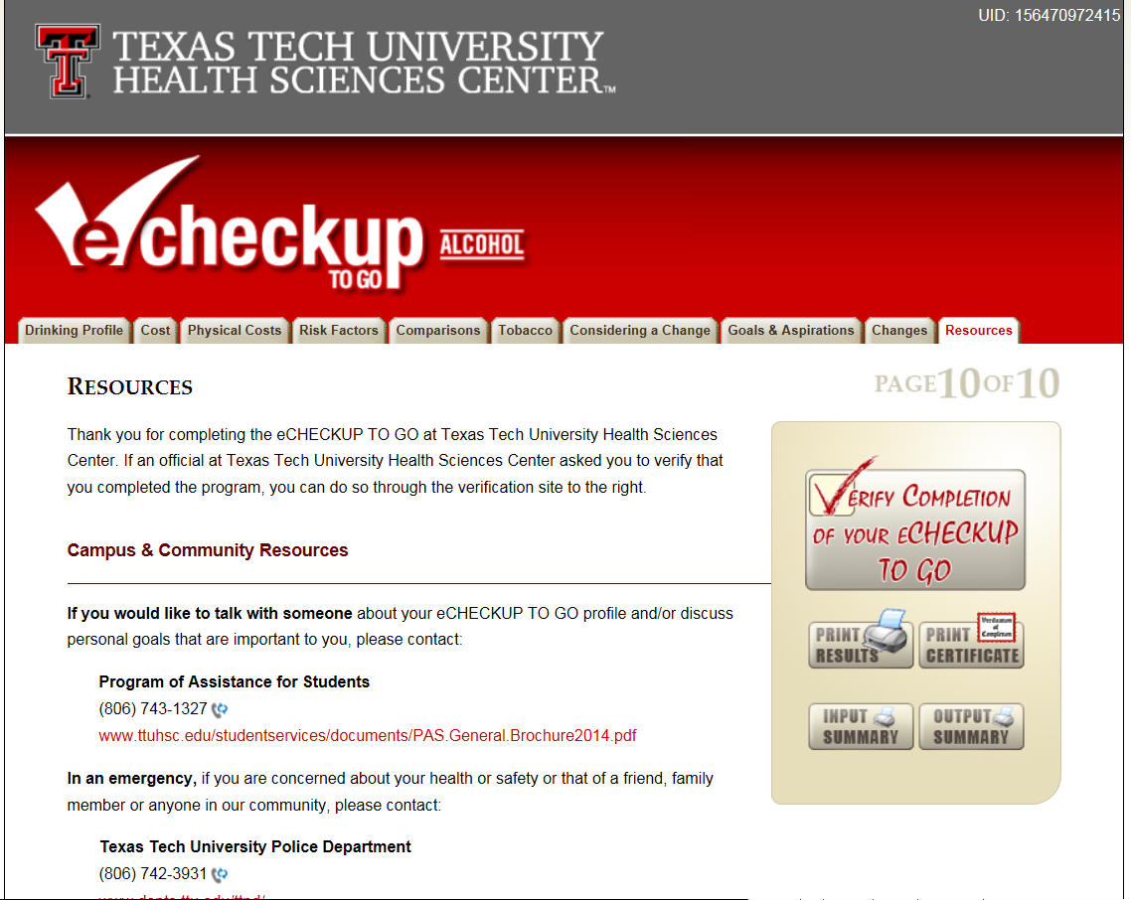
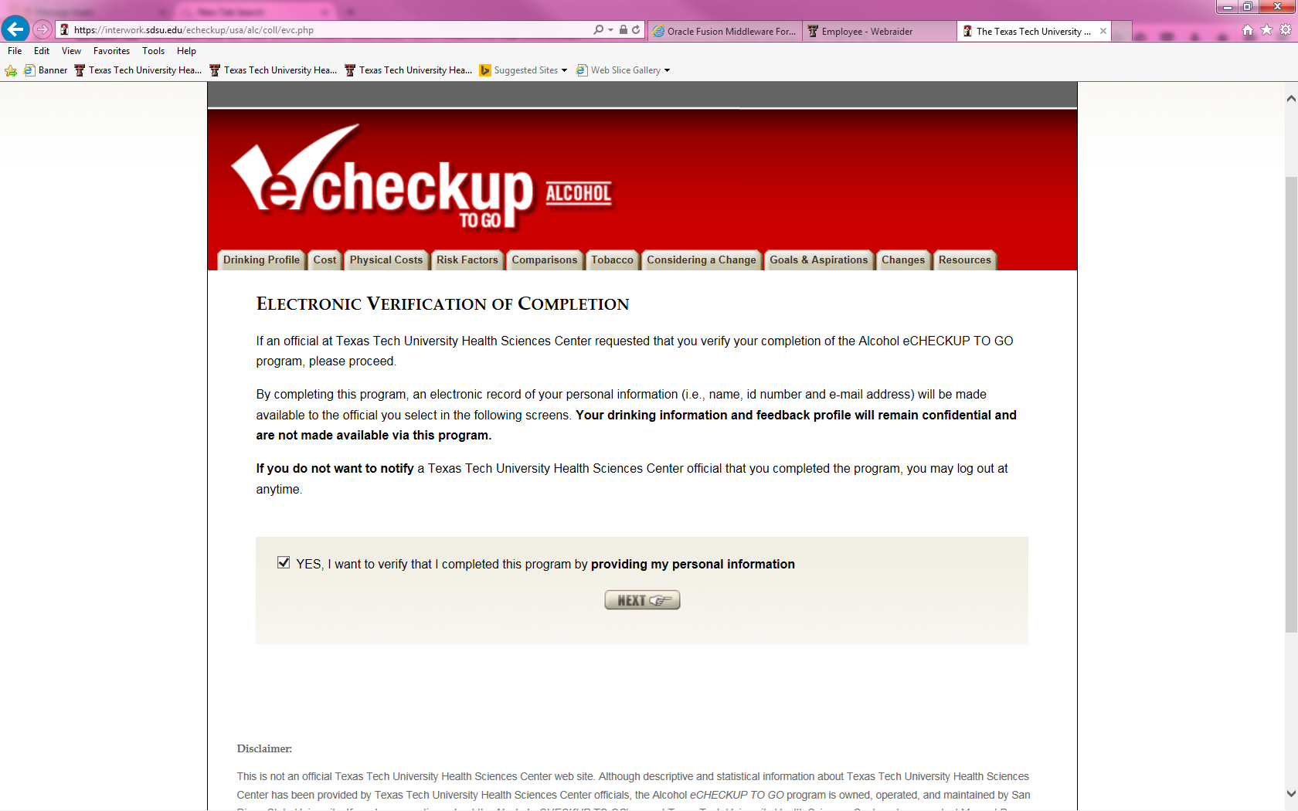
eCHECKUP TO GO Completion Confirmation: You will not received credit until you go through the Electronic Verification of Completion.
This is not your personal answers to the course. This is only your personal information for identification that you completed the course. Without this you will not receive credit and will receive a hold.

Slide 5
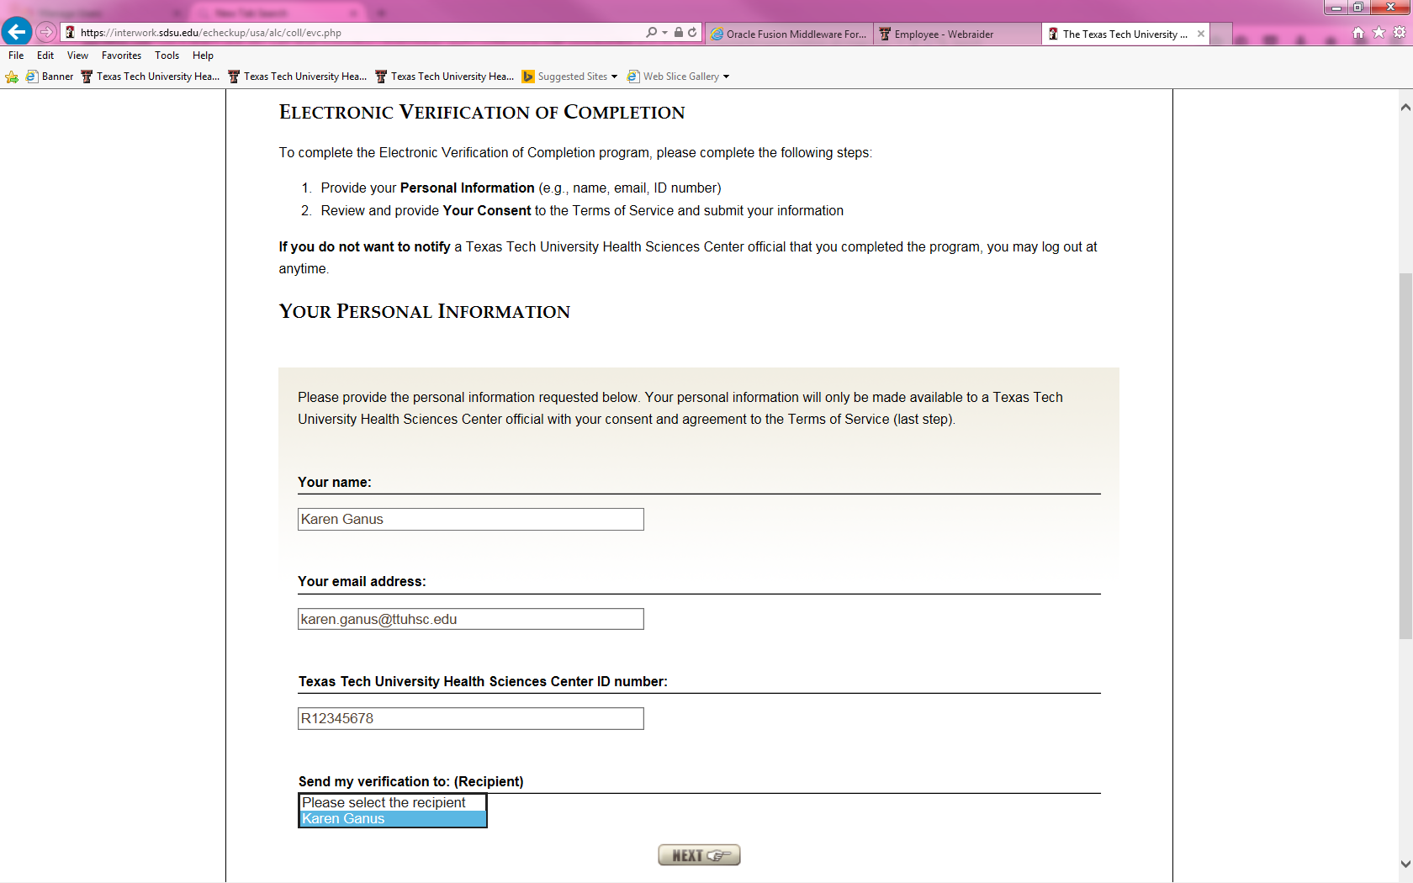
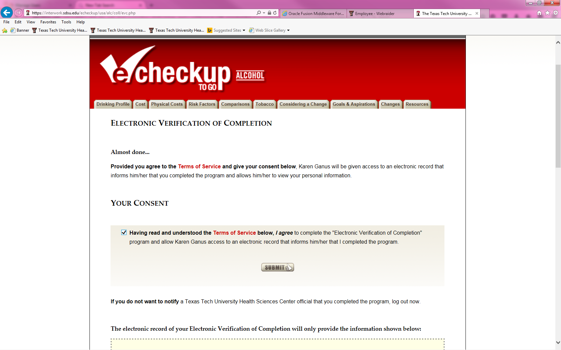
Completely fill out the Personal Information. You must enter your R# as your ID and your TTUHSC email in order to receive credit.
You must only use your TTUHSC Email.
No, this does not mean Karen Ganus or anyone else will see your answers to your questions. Only you will see how you answered or your results
You must enter your R# Here

Slide 6
Questions or Problems with Access Karen Ganus Associate Director Student Services karen.ganus@ttuhsc.edu

