Slide 1
Student Health Insurance 2016–2017
Underwritten by Blue Cross and Blue Shield of Texas (BCBSTX)
Texas Tech University System
Presented by: Academic HealthPlans
AcademicBlueSM is offered by Blue Cross and Blue Shield of Texas, a Division of Health Care Service Corporation, a Mutual Legal Reserve Company, an Independent Licensee of the Blue Cross and Blue Shield Association.
Academic HealthPlans, Inc. (AHP) is a separate company that provides program management and administrative services for the student health insurance plans of Blue Cross and Blue Shield of Texas.

Slide 2
Who can enroll?
Texas Tech University
All registered domestic undergraduate students enrolled in six (6) or more credit hours, (three (3) or more credit hours during the summer) and all registered domestic graduate students enrolled in one (1) or more credit hours, interns, fellows and students working on their dissertation or thesis are eligible to enroll in this insurance plan on a voluntary basis.
All registered international students on non-immigrant visas enrolled in one (1) or more credit hours are required to purchase the Student Health insurance plan, and are automatically enrolled in the plan, unless evidence of coverage is provided that meets the Texas Tech University international student requirements. For international students only, athletes can add sports coverage for an additional premium.
Texas Tech University Health Sciences Center &
Texas Tech University Health Sciences Center El Paso
All Health Sciences Center students (including Amarillo, El Paso, Odessa, Midland, Dallas, Abilene and Lubbock) enrolled in one (1) or more credit hours must be enrolled in the plan unless proof of comparable coverage is furnished.
Medical Students on Internships or Rotations are considered full-time Students and are eligible to enroll. Students may enroll online or download a form to print and mail at ttusystem.myahpcare.com by clicking on your campus link.
Notes:
Show and speak to current sites, applications, utilization, look and feel, etc.

Slide 3
Medical Coverage Periods and
Premium Cost
 | Annual | Fall | Spring/Summer | Spring/Summer
 | 08/01/2016 through 07/31/2017 | 08/01/2016 through 12/31/2016 | 01/01/2017 through 07/31/2017 | 06/01/2017 through 07/31/2017
Student | $2,180 | $911 | $1,269 | $364
Spouse | $2,180 | $911 | $1,269 | $364
Child | $2,180 | $911 | $1,269 | $364

Slide 4
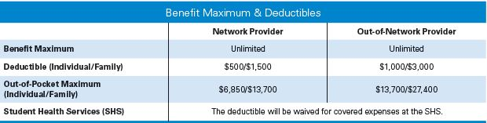
Benefits
ttusystem.myahpcare.com

Slide 5
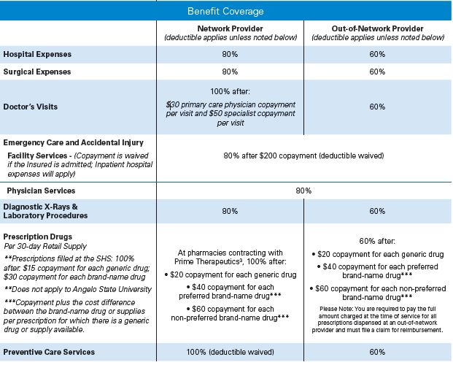
Benefits
ttusystem.myahpcare.com

Slide 6

ttusystem.myahpcare.com

Slide 7
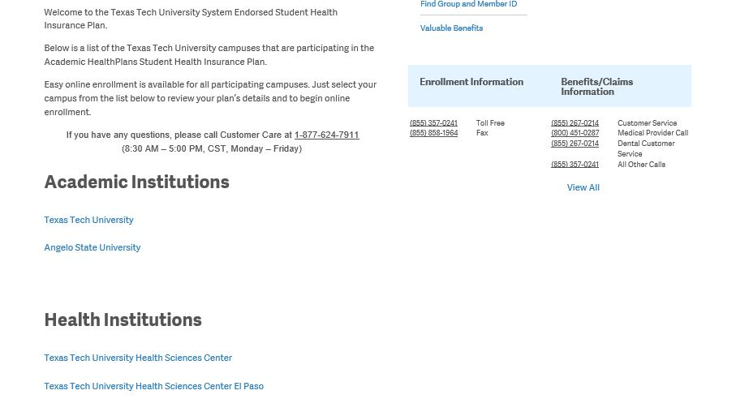
Once you are on the ttusystem.myahpcare.com page, you may click on the institution you attend to view all plan, premium and coverage periods.

Slide 8

Additional Benefits
Access to 24-hour nurse line
Coverage when traveling or studying abroad
Academic Emergency Services (AES)
Mobile Apps – ID card on your phone
Online Access
Online access to: ttusystem.myahpcare.com
View and download complete plan description
Download eligibility & enrollment information
View claim status and benefit questions
Find a BCBS network provider
Find network pharmacy, Prime Therapeutics

Slide 9


Slide 10
Wise choices = lower costs
For International students, the U.S. healthcare system may be different from your home country.
Chose your primary care doctor soon before a sudden illness or an emergency situation occurs.
The cost of treatment in a doctor office or urgent care clinic is much less than a visit to the hospital emergency room.
If you are unsure, call the 24-hour Nurse line for advice.
Making wise health care choices is key to saving yourself from unnecessary, high medical expenses.

Slide 11

Blue Cross and Blue Shield of Texas Preferred Provider Organization (PPO)
Certain doctors, hospitals, and other treatment providers contract with BCBSTX’s PPO network, agreeing to provide services at a lower cost
Doctors are screened for quality
There is less out-of-pocket for you when you receive care from a contracted BCBSTX PPO healthcare provider
BlueChoice® PPO Network
Find a Doctor or Hospital at ttusystem.myahpcare.com,
then click on “Benefits” tab.

Slide 12

Types of Treatment Facilities
Doctor’s office or Clinic
Minor Emergency or Urgent Care
Emergency Room
Hospital Inpatient

Slide 13

General Doctor or Clinic
For most routine visits related to health issues, preventive and ongoing care.
In network: 100% of covered expenses after a $30 primary care physician copayment per visit and $50 specialist copayment per visit
Out-of-network: 60% of covered expenses
Examples:
Primary care physician
Family practice
OB/GYN

Slide 14

Minor Emergency or Urgent Care Clinic
If you have a non life-threatening health problem that cannot wait, and your physician is unavailable (such as in the evening), these clinics can handle most minor medical situations.
In-network: 100% of covered expenses after a $50 copayment (Deductible waived)
Out-of-network: 60% of covered expenses

Slide 15

Hospital
Typical Inpatient or outpatient hospital care as ordered by your doctor.
Hospitals are not for routine office visits or after hours care.
In-network: 80% of covered expenses
Out-of-network: 60% of covered expenses

Slide 16

Emergency Room
In this type of situation, it is assumed that critical emergency care is needed at a hospital. You may need to call 911. This should only be used in life threatening situations.
80% of covered expenses after $200 copayment per visit (deductible waived, copayment waived if admitted)

Slide 17

Prescriptions
Prescriptions are classified as Generic, Preferred Brand-name or Non-Preferred Brand-name. Prescriptions are limited to a 30 day retail supply. See brochure for full details.
Prescriptions filled at the TTU Student Health Service Only: 100% after
$15 copayment per Generic drug
$30 copayment per Brand-name drug
At pharmacies contracting with Prime Therapeutics: 100% after
$20 copayment per Generic drug
$40 copayment per Preferred Brand-name drug
$60 copayment per Non-Preferred Brand-name drug
All other out-of-network pharmacies: 60% after
20 copayment per Generic drug
$40 copayment per Preferred Brand-name drug
$60 copayment per Non-Preferred Brand-name drug
The relationship between Blue Cross and Blue Shield of Texas (BCBSTX) and contracting pharmacies is that of independent contractors, contracted through a related company, Prime Therapeutics, LLC. Prime Therapeutics also administers the pharmacy benefit program. BCBSTX, as well as several other independent Blue Cross plans, has an ownership interest in Prime Therapeutics.

Slide 18

How Do I File a Claim?
In network providers will file claims for you. However, always keep your receipts when visiting a doctor’s office, hospital or pharmacy.
Claims and inquiries should be sent to:
Blue Cross and Blue Shield of Texas
PO Box 660044
Dallas, TX 75266-0044
(855) 267-0214 – Customer Service
(800) 451-0287 – Medical Providers

Slide 19

Questions?
Contact us
Enrollment Information:
Academic HealthPlans
(855) 357-0241
support@ahpcare.com
Claims & Benefit Information:
Blue Cross and Blue Shield of Texas (855) 267-0214

Slide 20

Q&A
Experience.
Service.
Care.
P.O. Box 1605
Colleyville, TX 76034-1605
1-855-AHP-CARE (247-2273)
www.ahpcare.com

