Slide 1
Safe Campus Mandatory Courses
Registered students will be assigned the Safe Campus Mandatory Courses through their Webraider portal. Newly admitted students will not be assigned these trainings until they have registered. Once registered the system will assign the courses and they can be accessed within a few days following registration.
CampusClarity “Think About It” Course: Title IX Awareness
eCHECKUP TO GO Course: Alcohol Awareness
All TTUHSC Students are required to complete both courses within one month from the first day of class. The system will update the completed courses and the trainings will disappear from the portal within one week of completion.
*These courses are completely confidential. NO ONE will see your results but you.

Slide 2
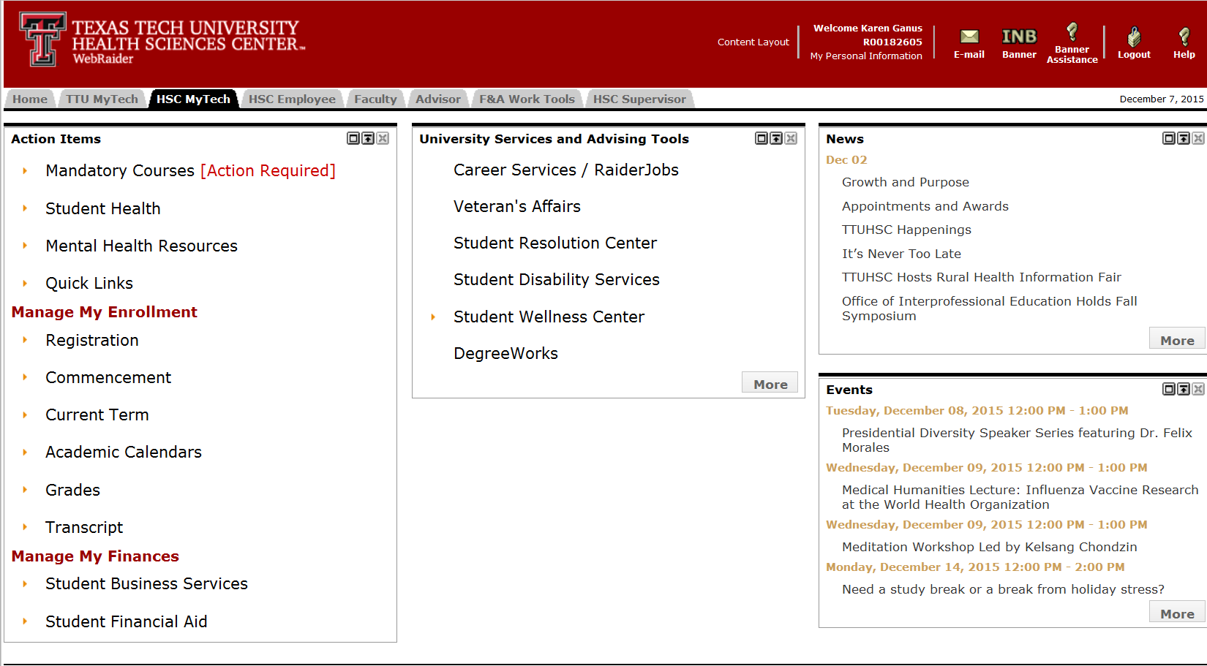
To Access the mandatory courses: Use FireFox or Chrome
Log into Webraider Portal
Click on HSC MyTech Tab

Slide 3
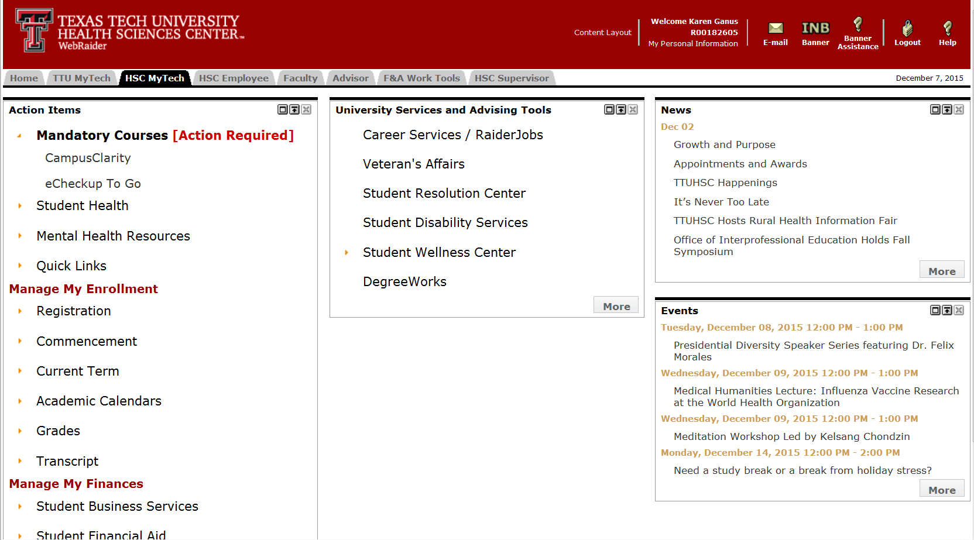
Under Action Items:
Click on Mandatory Courses
Click on each course:
-CampusClarity
-eCHECKUP TO GO
*Be sure to fully complete each course in order to receive credit for the course.

Slide 4
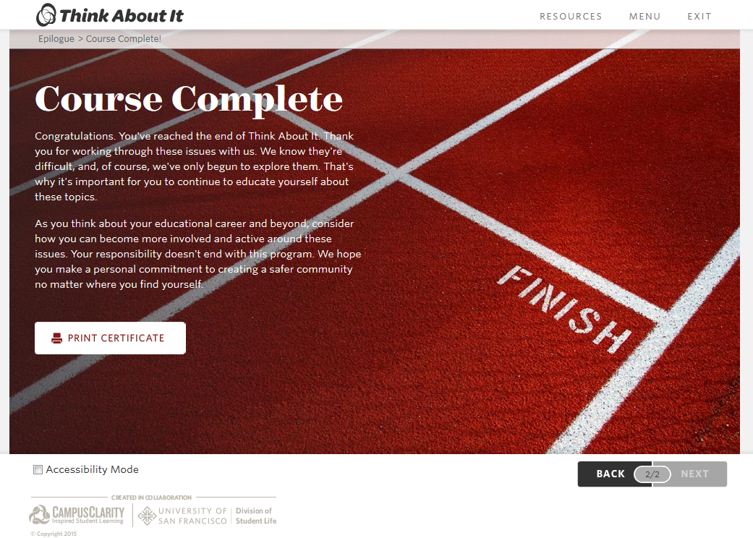
CampusClarity Completion Confirmation: You will not receive credit until you see this screen.

Slide 5
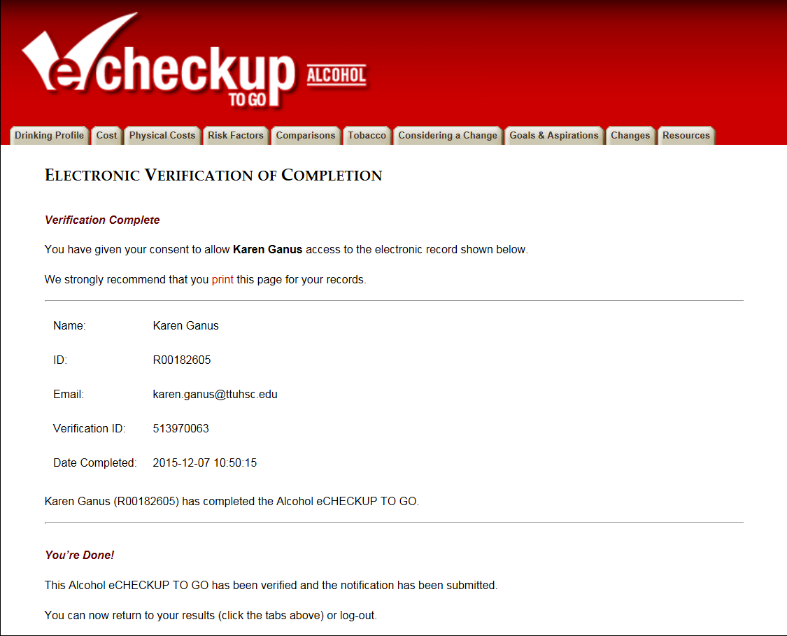
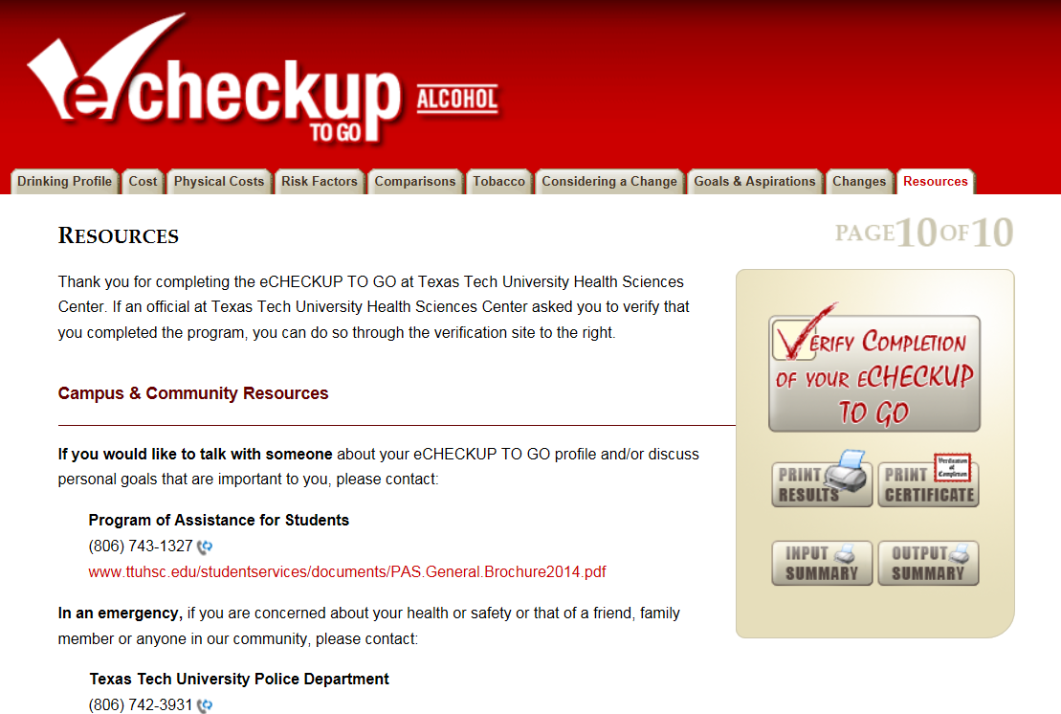

eCHECKUP TO GO Completion Confirmation: You will not received credit until you go through the Electronic Verification of Completion. You must enter your R# as your ID and your TTUHSC email in order to receive credit.

Slide 6
Questions or Problems with Access
Karen Ganus
Associate Director
Student Services karen.ganus@ttuhsc.edu
806-743-7412

