Slide 1
Student organization re-registration & budget Request training
Office of student life | spring 2024

Slide 2
agenda
Spending and Deadline Reminders
Organization Constitutions
Re-Registration Process
Budget Request Process

Slide 3
Spending & deadline reminders
Purchase Request in HSC Net
  2 Week Deadline
Senate Funds for FY24
  Deadline for Major Expenditures – June 2, 2024
  Deadline for Remaining Expenditures – August 2, 2024
No spending between August 17 and September 8th (Fiscal Year End)

Slide 4
Organization constitutions
Review & Update with any necessary changes
  Make sure file is in Documents section of HSC Net
  Save file with “Update” and the year in the name
Must Contain:
  Name, Purpose, National or Affiliate Organization, Membership Requirements, Officer List and Duties (President & Treasurer required), Officer Election & Removal Process, Faculty/Staff Advisor Responsibilities, Financial Procedures, and Annual Programs.

Slide 5
Required elements
Name & Purpose
National & Affiliate Organizations
Membership Requirements
Officer List & Duties (President and Treasurer Required)
Officer Election & Removal Process
Financial Procedures
Faculty/Staff Advisor Responsibilities
Annual Programs

Slide 6
Name & purpose
Article I - Name
Section 1. The name of the organization shall be the Bubble Blowing Society a student organization at Texas Tech University Health Sciences Center.
Article II - Purpose
Section 1. The purpose of our organization is to bring together TTUHSC students that enjoy blowing bubbles or are interested in participating in bubble blowing competitions.

Slide 7
National & Affiliate organizations
Article III – National & Affiliate Organizations
Section 1. National Relationship:
a. The Bubble Blowing Society has a relationship with the National Bubble Blowing Federation. The relationship includes an annual membership that enters the organization in regional and national competitions. They also provide standardized rules and instructions on how to hold competitions.
Section 2. Affiliate Relationship:
a. The Bubble Blowing Society has a relationship with the Panhandle South Plains Fair at which they sponsor a community Bubble Blowing Competition.

Slide 8
Membership requirements
Article IV - Membership
Section 1. Requirements
a. Members must be interested in the art of blowing bubbles.
b. Members must represent the organization and Texas Tech University Health Sciences Center in a positive light at all times.
c. Membership is open to all students and from any school.
d. Members are not allowed to participate in any activities or events hosted by the organization while intoxicated or under the influence of drugs.
e. Members must always treat their fellow members or officers with respect.
f. Members must uphold the Values-Based Culture of one team, kindhearted, integrity, visionary, and beyond service.

Slide 9
Officer list & duties
Article V - Officers
Section 1. List
The officers of the organization will be made up of: President, Vice- President Internal, Vice-President External, Treasurer, and Secretary.
Section 2. Duties
a. President duties include:
                Overseeing and running regular, executive, and special meetings.
                Serve as the liaison to the advisor and the university administration.
                Attend bi-monthly meetings with the organization advisor.
                Manage member violation report process.

Slide 10
Officer election
Article VI – Officer Election & Removal Process
Section 1. Officer Election Process
a. Nominations for officers will start in March of the spring semester by the person himself/herself or can be nominated by a regular member.
b. Nominees can either accept or decline the nomination at the time the nomination is given or wait to the end of the 2- week period.
c. Nominations will then be open for 2 weeks.
d. During the 2-week period nominees can either drop or be added to the candidacy list.
e. On the day of elections, which should be in April, nominees will give a 4 min speech on why they are fit for the position, what they can contribute to the organization to make the organization better, and any ideas for the organization or the position.
f. Voting will then only commence if quorum of majority is met. If quorum is not met before the meeting presides, then voting will commence at the next earliest meeting time.
g. Voting will require a two-thirds vote of all eligible voters to elect a member to a position. The vote will be done using a secret ballot to be tallied by the advisor.

Slide 11
Officer removal
Section 2. Officer Removal Process:
a. Any member or officer can submit an officer in violation of the organization purpose, their position responsibilities, or constitution to the president.
b. It the officer in violation is the president then it should be submitted to the organization advisor.
c. Once the president or advisor receives the violation it will be reviewed, and a special meeting will be schedule with the other officers to review the violation.
d. If the remaining executive board finds the violation creditable then they will schedule a time for the officer to come speak to the executive board about the violation.
e. After the meeting with the officer in question the executive board will take a vote on whether to move forward with the removal process or not. A two-thirds vote of the remaining officers is required to move the process forward.
f. If the vote passes to move the process forward a vote will be brought to the entire membership for a vote to remove or not. A two-thirds vote is required to remove an officer from their position with an additional vote to determine removal from the organization.
g. If the officer is not present at the meeting where the vote took place, they should be notified of the vote within 24 hours.

Slide 12
Financial procedures
Article VII – Finances
Section 1. Collection of Funds:
a. Membership dues shall be collected at the first meeting in September and January.
b. The Treasurer shall be responsible for applying for and documenting funds from the SGA and the School of Health Professions.
Section 2. Management of Funds:
a. Any costs occurred by the organization may be paid by the President or Treasurer.
b. All expenditures must be documented with an itemized receipt by the Treasurer.
c. All income must be deposited within 24 hours of receiving it. No cash is accepted only check or money orders unless it comes from a fundraiser. Venmo can only be used if linked to the organization checking account.
d. All income must be documented by a deposit slip and listed items from deposit.
e. Any funds donated to the organization shall be deposited into the Bubble Blowing Society bank account within 24 hours of receiving it.
Section 3. Documentation:
a. Documentation of any funds spent/gained must be added to the Financial Binder and available to all members with reasonable notice.
Section 4. In the event that the organization ceases to exist, all assets shall be donated to the National Bubble Blowing Federation Foundation.

Slide 13
Faculty/staff advisor responsibilities
Article VIII – Faculty/Staff Advisor
Section 1. Responsibilities of the Advisor.
a. Provide Feedback by listening and giving perspective insight for the organization’s development.
b. Support the organization in crises.
c. Intervene when appropriate. Especially when conflicts arise between members or officers.
d. Be knowledgeable of university or national policies that may impact the organization.
e. Co-sign Expenditures that are over $500.
f. Provide connections to the group such as campus resources etc.

Slide 14
Annual programs
Article IX – Annual Programs
Section 1. Panhandle South Plains Fair Bubble Blowing Competition
a. The organization hosts this competition every fall semester to bring joy and recognition to the art of bubble gum blowing.
Section 2. Holiday Bubble Blowing Invitational
b. The organization attends the state invitational that is annually hosted at the Dallas World Aquarium.
Section 3. National Bubble Blowing Championship
b. The organization attends the National Bubble Blowing Federation Championship if any members qualified to compete.

Slide 15
Amendment Approval
___________________________ __________________________
President – Print Advisor – Print
___________________________ __________________________
President – Signature Advisor – Signature
___________________________
Approval Date

Slide 16
Re-Registration & Budget Processes
Deadline: March 1st
Annual process for all student organizations/councils
Completed in HSC Net

Slide 17
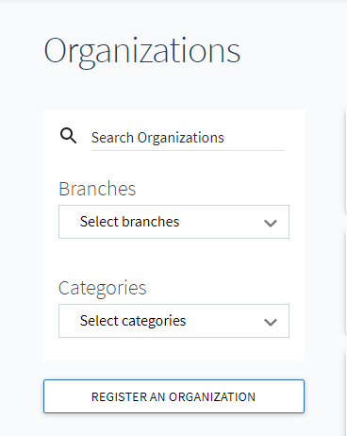
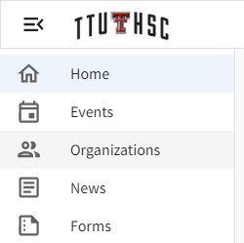
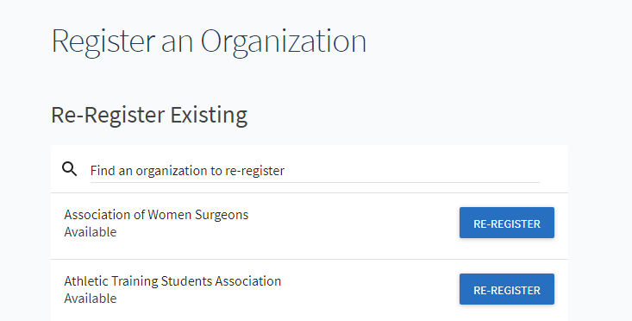
Re-registration process
To register your organization:

Slide 18
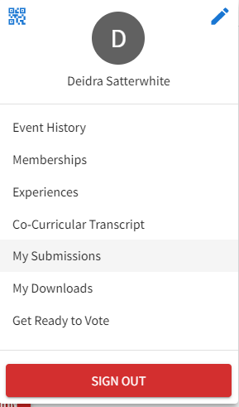
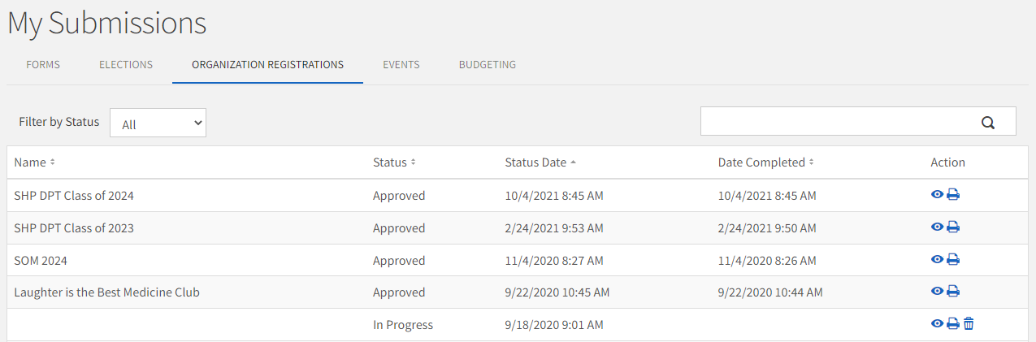
Re-registration process
To access your register on another day:

Slide 19
Re-registration process
SIX STEP PROCESS
Step 1: Instructions
Step 2: Organization Profile
Step 3: Organization Profile Picture
Step 4: Organization Categories
Step 5: Organization Roster
Step 6: Student Organization Registration Questions

Slide 20
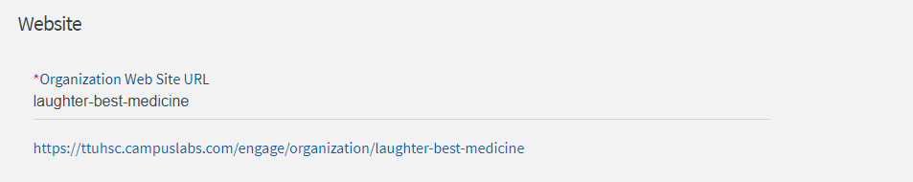
Organization profile - (step 2)
General Information
Website
Social Media
Contact Information

Slide 21
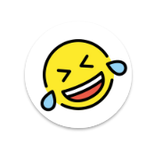
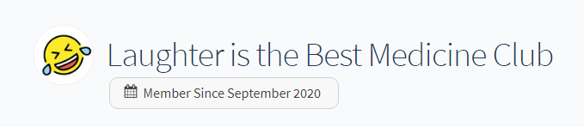
Profile picture - (step 3)
Not Required
More Attractive
Circular

Slide 22
categories- (step 4)
Advocacy / Activism
Campus
  Abilene
  Amarillo
  Dallas
  Lubbock
  Permian Basin
Cultural / International
Faith-Based / Spiritual
Health / Wellness
Honor
Recreational / Sports
Service / Philanthropy
Special Interest
Student Governance

Slide 23
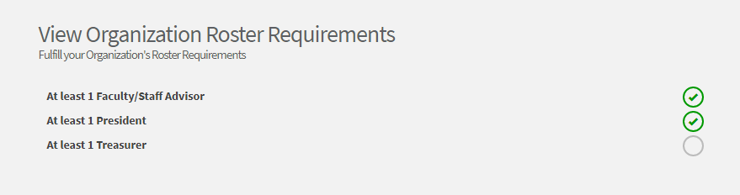
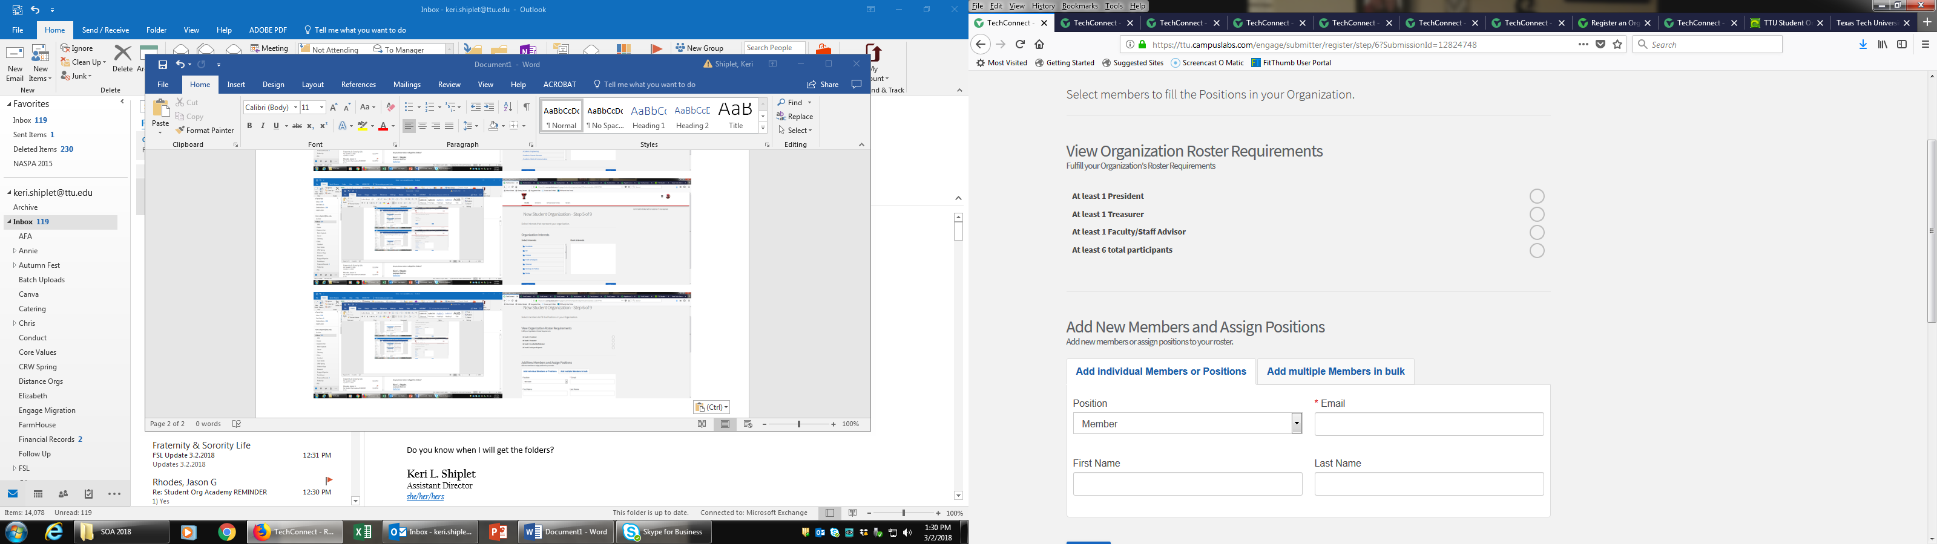
Roster- (step 5)

Slide 24
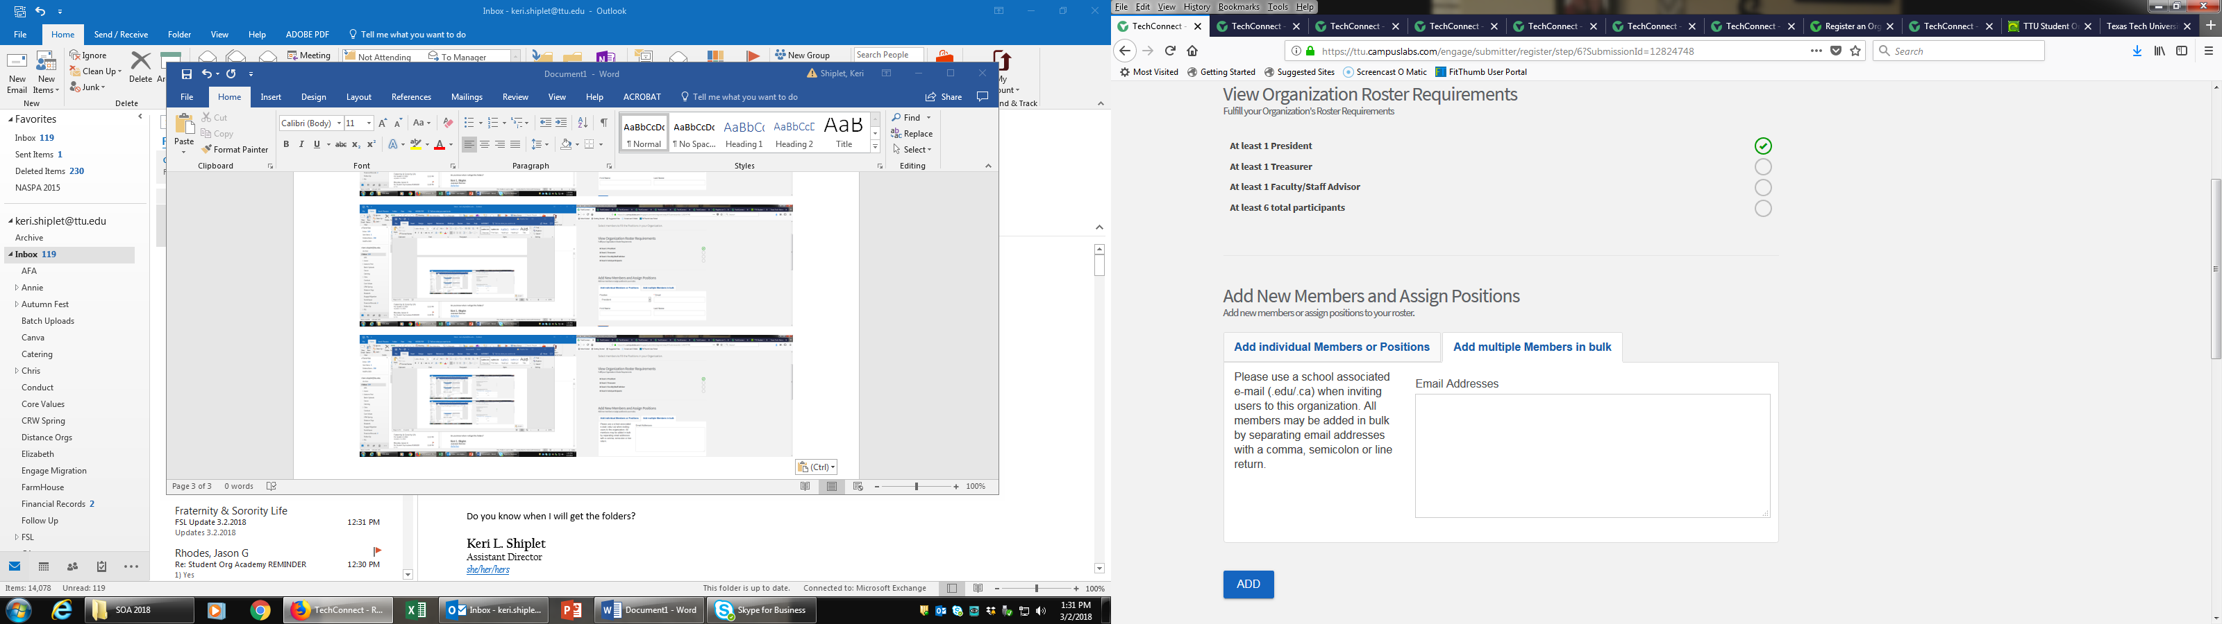
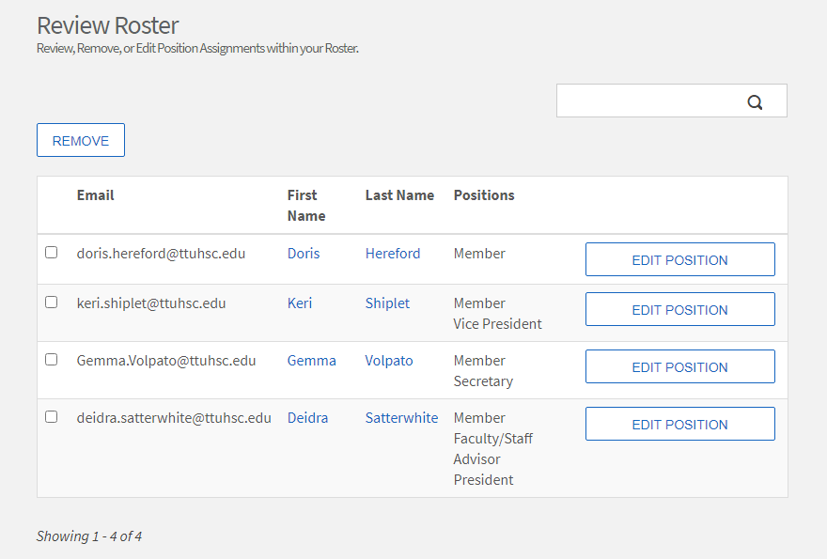
Roster- (step 5)

Slide 25
Registration Questions- (step 6)
General Org Information
  Constitution & Bylaws
Officer Contact Information
Faculty/Staff Advisor Contact Information
Additional Advisor Contact Information
National or Affiliate Organization
Verification of Information & University Policy Agreement

Slide 26
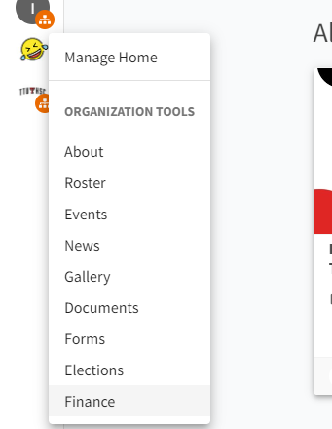
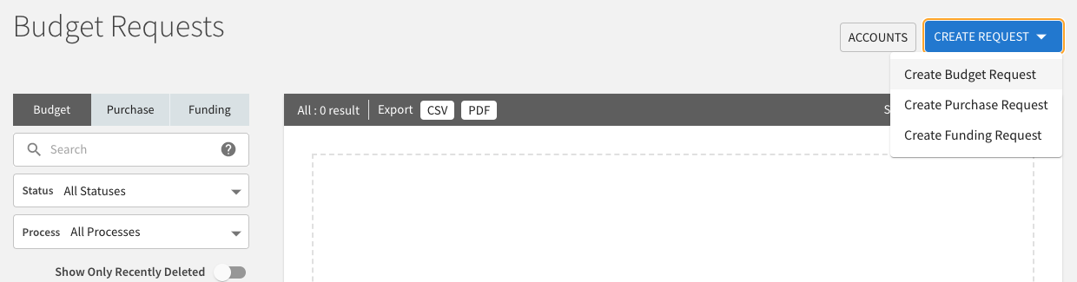
Budget request process

Slide 27
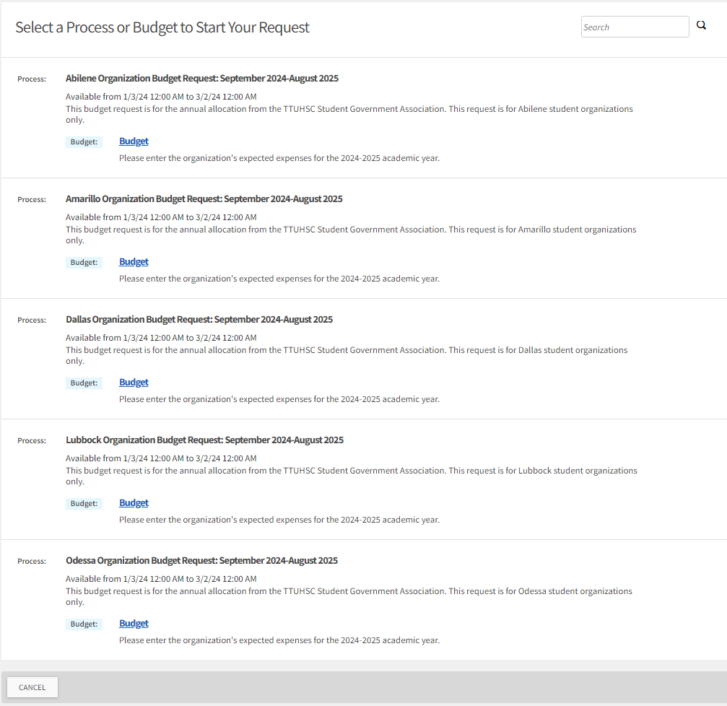
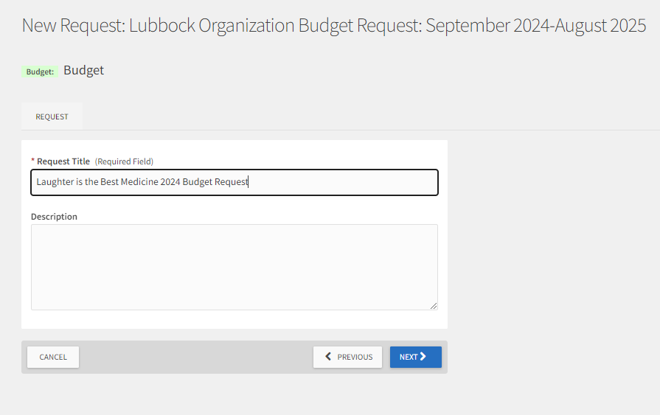
Budget request process

Slide 28
Budget request process
FOUR STEP PROCESS
Step 1: Organization Information
Step 2: Income
Step 3: Values Based Culture Questions
Step 4: Expenditures & Request Amount

Slide 29
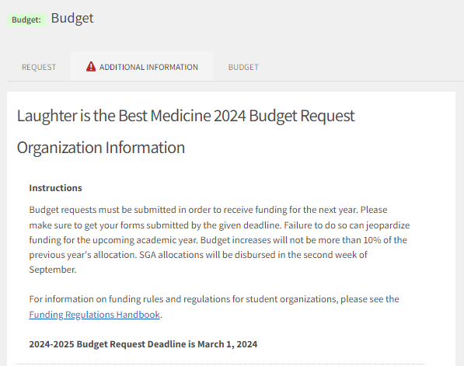
Organization Information – (Step 1)
Name of Student Organization
Current Account Totals (Senate & Agency/Off-Campus)
Any planned spending past March 1, 2024?
Roster Update
Number of Members in Organization
Current President & Treasurer’s Names
Incoming President & Treasurer’s Names (If elected)
Why your organization needs this funding?

Slide 30
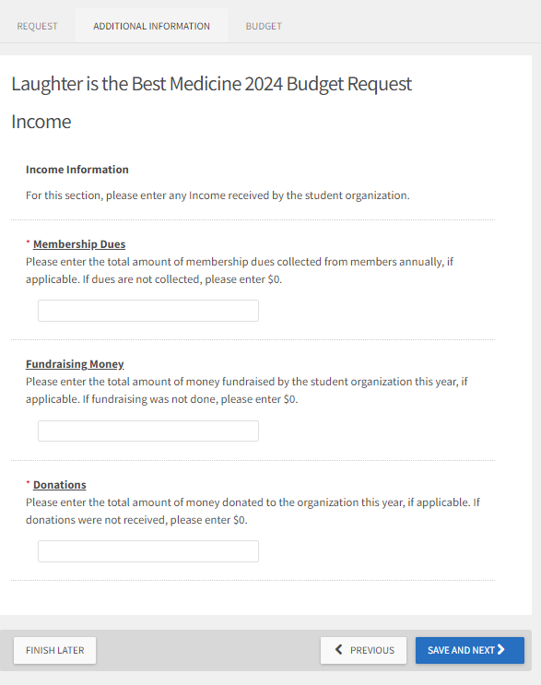
income– (Step 2)
Membership Dues
Fundraising
Donations to the Organization

Slide 31
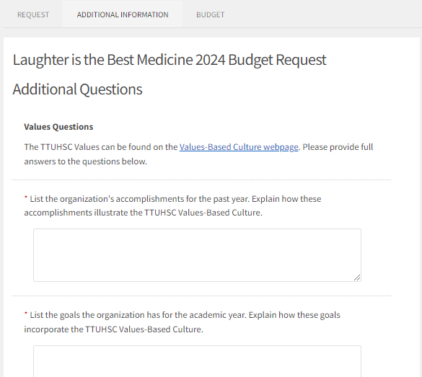
Values based culture questions– (Step 3)
Organization’s Accomplishments
Organization Goals for Year
Community Service
How Organization enhances the image of TTUHSC
Value the Organization Excels In
Value the Organization could Improve

Slide 32
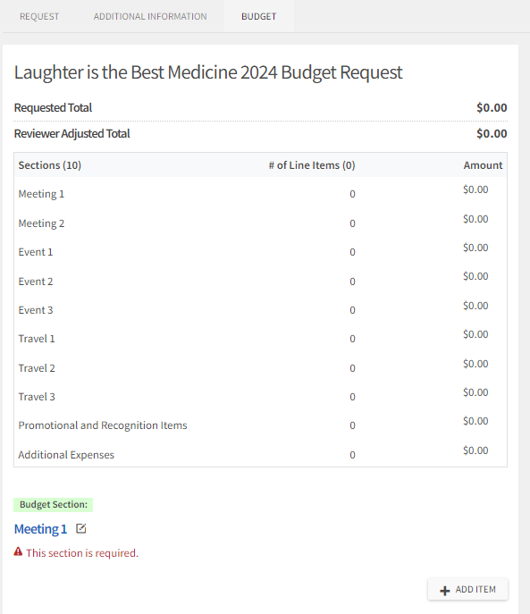
Expenses & Request Amount– (Step 4)
Cost of Meetings
Cost of Events
Cost of Travel
Cost of Promotional and/or Recognition Items
Cost of Additional Expenses

Slide 33
Request approval
Must Submit Re-Registration to be eligible
  March 1st Deadline for both Budget & Re-Registration (no exceptions)
Reviewed by the TTUHSC SGA Finance Committee
  Student Organization Funding Bill is voted on by the full TTUHSC SGA
  Final approval is based on budget availability
Notifications on Allocation Amount will go out in new fiscal year (September)
  Make sure HSC Net is updated with the correct officers
  Mandatory Fall Training on spending processes
  Fully signed SGA Funding Contract submitted to Student Life

Slide 34
Budget Resources
Funding Regulations Handbook
Budget Development Resources
  Budget Preparation document
  Budget Request Support Document (spreadsheet)

Slide 35
Questions?

