Slide 1
Student Organization Orientation
Office of Student Life | Fall 2023

Slide 2
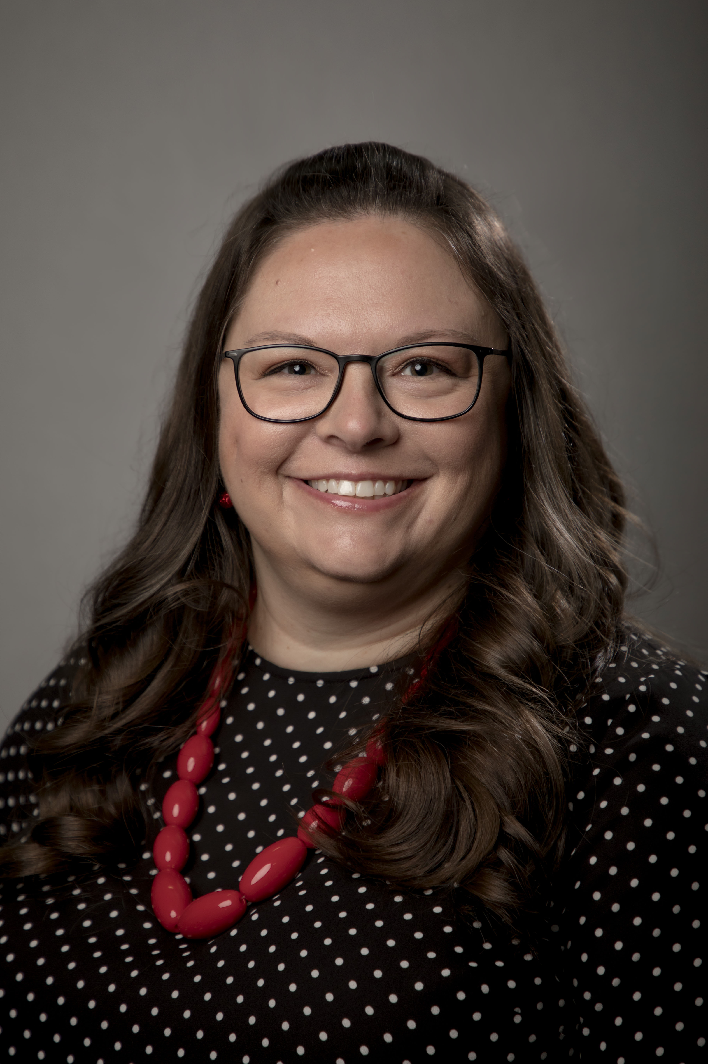
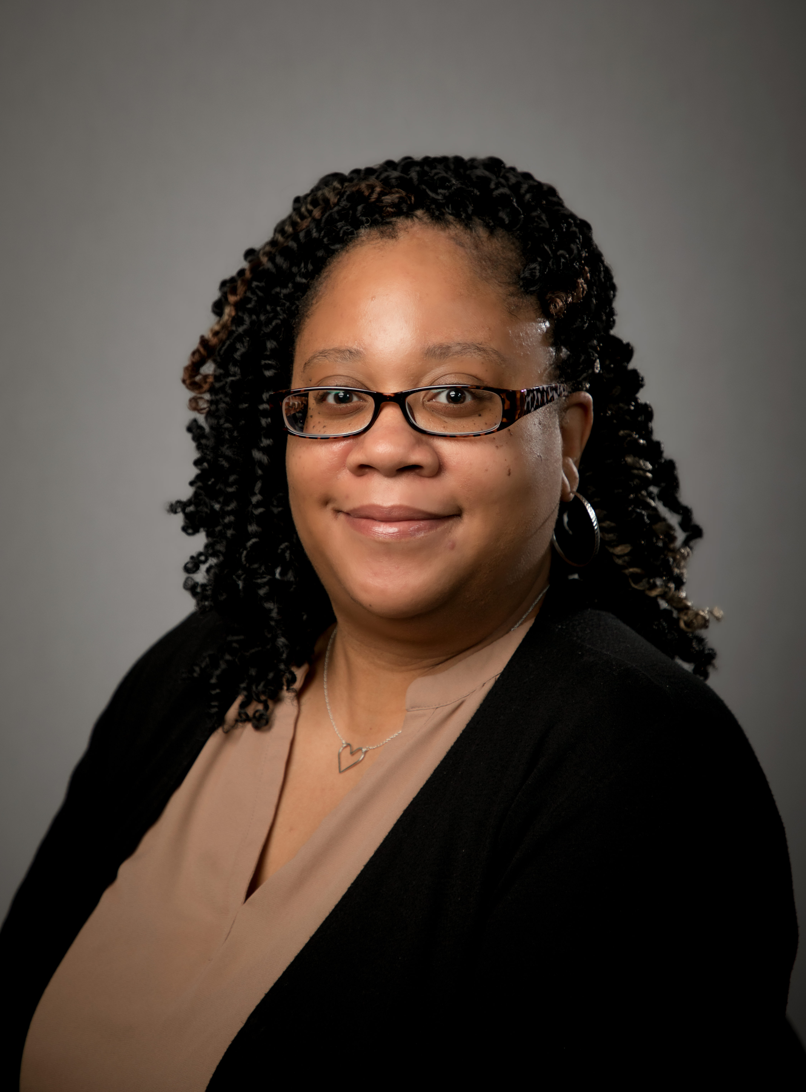
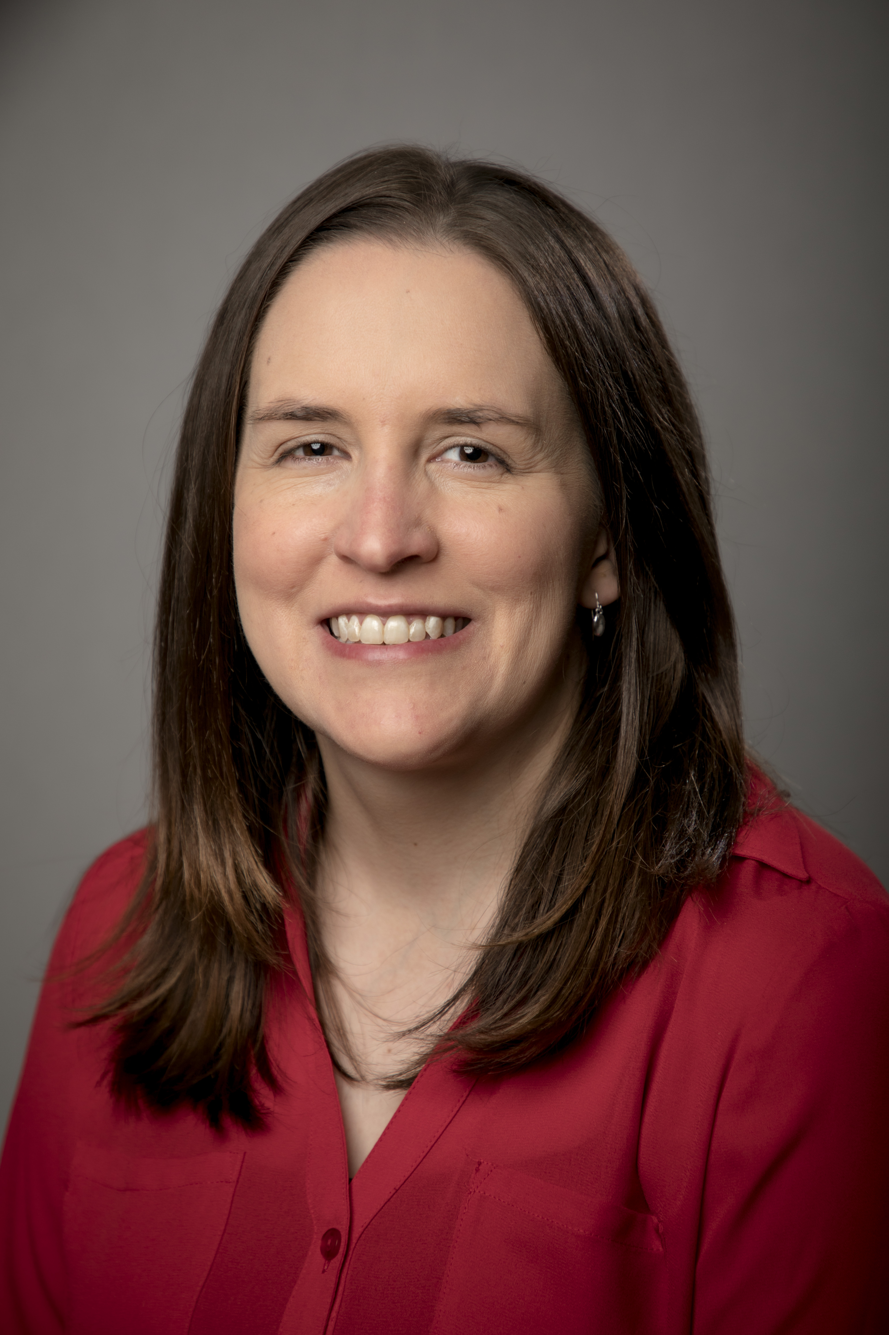
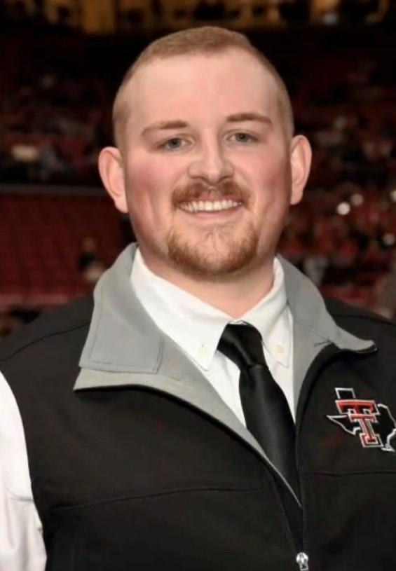
Student Life Overview & Introductions
Office Overview
Staff

Slide 3
Institutional sga
Represents all schools and campuses
Amarillo & Abilene have campus specific Senate/SGA

Slide 4
2023-2024 Funding Rules & Regulations
Funding Regulations Handbook
  Senate Funding Cannot Pay For
  Speaker Payment Procedures
  Food Expenditures

Slide 5
2023-2024 Funding Rules & Regulations
Travel
  Organization Related/Sponsored
  10 or More Students – Travel Card
  Less than 10 – Reimbursement Process
  Travel Process Documents

Slide 6
Sga special projects fund
Funds student organizations that are brand new or that have run out of funds.
For a one-time or unforeseen need
Form can be located in HSC Net under the Forms tab – SGA Special Projects Fund Request
Medicine organizations must first request from the Dean’s Contingency Fund (through MSG & SOM Dean’s Office)

Slide 7
Promotional Item purchase process
Approved Vendors
  TTUHSC Printing Center
  Advanced Graphix
  Scarborough Specialties
Design must be approved by Marketing
Payment is completed through a Purchase Order (check or direct deposit)

Slide 8
Reminder on purchases
Our office must handle all purchases on your Senate account
DO NOT make a purchase yourself
Personal Reimbursements are Not Allowed
If purchase is using on-campus Agency Funds (SOM groups), please use the Spending Request Form – Medicine Organization Agency Funds Only in HSC Net

Slide 9
Senate spending requests
Purchase Request System in HSC Net
Must submit at least 2 weeks prior to event/meeting
  If for a Speaker or large event, please submit at least 30 days prior.
Our office will contact you with any questions for any further information we need

Slide 10
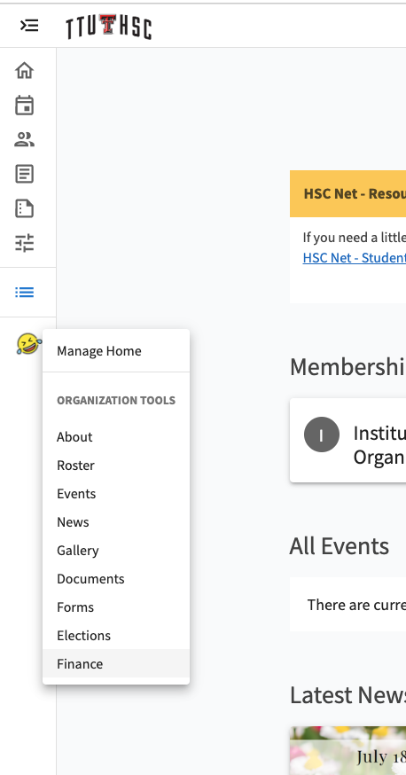
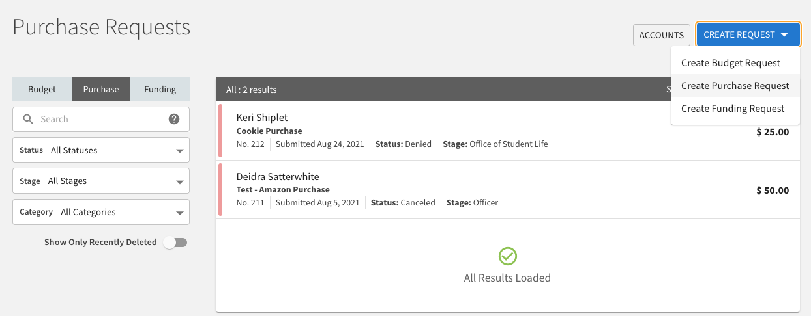
Purchase request process
Go to the Finance Tab
Click “Create Request”
  Select “Create Purchase Request”

Slide 11
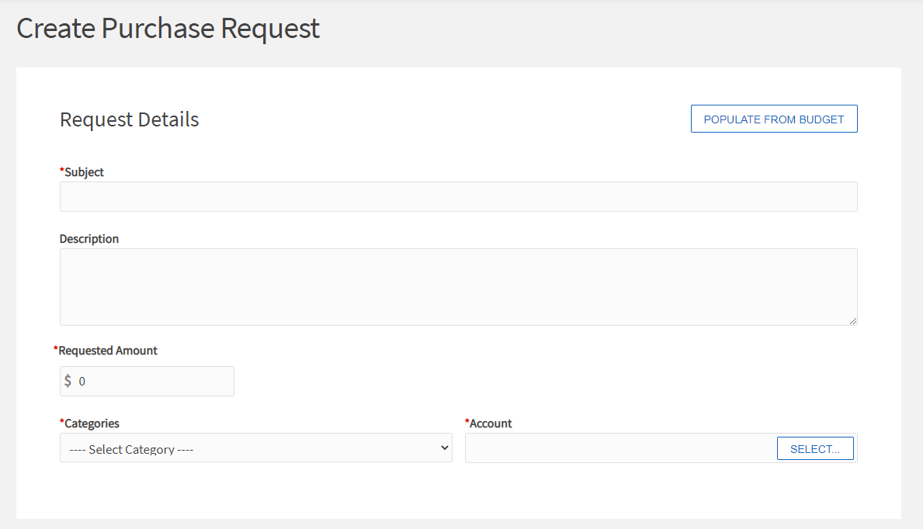
Purchase request process
Enter Request Information
Select your Senate Account
  If a Multi-Campus org, please select the correct Campus’ Senate Account

Slide 12
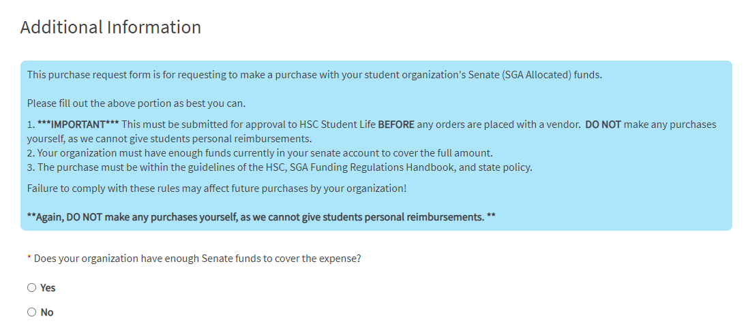
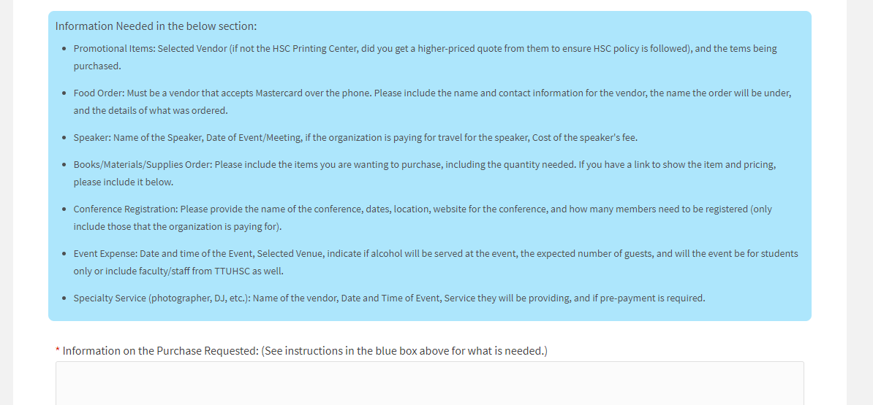
Purchase request process
Additional Information section
  Follow instructions for the type of purchase you are requesting.
Once finished, click “Submit Request”

Slide 13
HSC Net - ttuhsc.campuslabs.com/engage/
Roster
Events
Finance
Elections

Slide 14
Funding contract
Sign and Email to Student Life (student.life@ttuhsc.edu)
  President, Treasurer and Advisor
Must be returned to Student Life for Senate spending to begin

Slide 15
Key Reminders
2-Week Deadline for Purchase Requests
Items purchased with Senate funds cannot be sold.
Rosters
Travel Forms
Officer Transition

Slide 16
Reminders
Use of TTUHSC name
Contacting Media

Slide 17
Important dates
March 1, 2024 – Deadline
  2024-2025 SGA Budget Request Form
  Re-Registration
June 7, 2024 – Deadline
  Major Senate Expenditures
August 2, 2024 – Purchase Request Deadline
  Final 23-24 Year Senate Expenditures

Slide 18
Questions?

